Slide 1
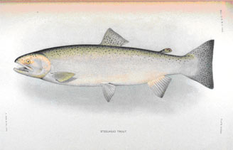


WELCOME
Eighteenth Pacific Coast Steelhead Management Meeting
(1991-2023)

Slide 2
Scope of Steelhead Meeting
Limit the size of in-person meeting to around 100 people to encourage personal interactions and sharing of information.
Include researchers and managers involved with the management of steelhead work throughout their native range.
Encourage participation from wide variety of state, provincial and federal agencies, tribal governments, environmental representatives and students.

Slide 3
Meeting Format
Limit the size of in-person meeting to around 100 people to encourage personal interactions and sharing of information.
Agenda topics for the meeting are established by the steering committee.
Session chairs are selected and they solicit presentations to develop and fill their session based on guidance from steering committee.
    There is no open call for presentations as in AFS meetings
    Meeting locations are rotated among States

Slide 4
Recognition and Thanks to PSMFC
STEERING COMMITEE
Chair: Roger Harding (ADFG, retired)
California (CDFW): Robyn Bilski and Jonathan Nelson
Washington (WDFW ): Thomas Buehrens, Neala Kendall, Bethany Craig, and Dan Rawding
Alaska (ADFG): Patrick Fowler, Troy Tydingco, and Brian Marston (ADFG retired)
Oregon (ODFW): Jamie Anthony, ODFW; Kevin Goodson (ODFW, retired)
British Columbia: Kenji Miyazaki and Robert Bison
Idaho (IDFG): Alan Byrne
PSMFC: Stephen Phillips, Amy Stark

Slide 5
Where are Meeting Attendees from?
(103 in person, 32 virtually)
Washington: 43 in person (13 virtually)
Oregon: 28 in person (8 virtually)
Idaho: 7 in person (2 virtually)
Federal: 7 in person (2 virtually)
California: 6 in person (1 virtually)
Alaska: 5 in person (3 virtually)
British Columbia: 4 in person (2 virtually)
Hoh Tribe: 2 in person
Quinault Tribe (1 virtually)
Columbia River Inter-Tribal Fish Commission: 1 in person
Utah: 1 virtually

Slide 6
HOUSEKEEPING
Meeting abstracts and presentations will be posted at:
  http://www.psmfc.org/steelhead/

