Slide 1
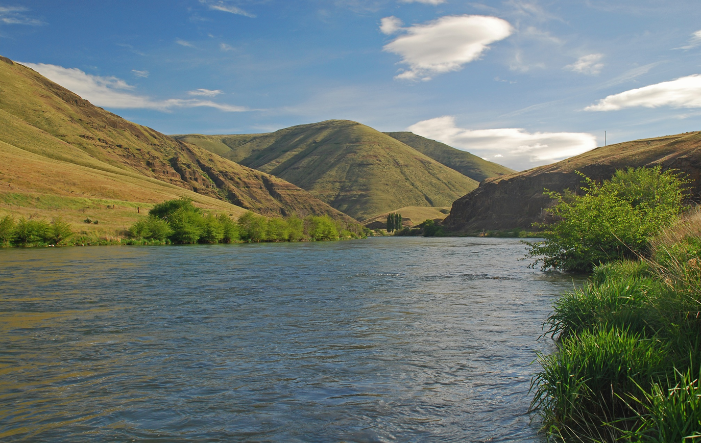

Unchartered Waters
Closing the Deschutes River to Steelhead Fishing: Hard Decisions, Developing a Fishery Management Framework, and Lessons Learned
Jason Seals
Mid-Columbia Fish District
Oregon Department of Fish and Wildlife

Slide 2
Deschutes River Steelhead Fishery Management
Background of Fishery and Abundance
Public Input
Development of Fishery Framework
Moving Forward

Slide 3
Does your agency have a statutory obligation to conserve native steelhead and to provide angling opportunities?
If both, does your agency have any guidance on which takes priority?
Our mission is to protect and enhance Oregon's fish and wildlife and their habitats for use and enjoyment by present and future generations

Slide 4
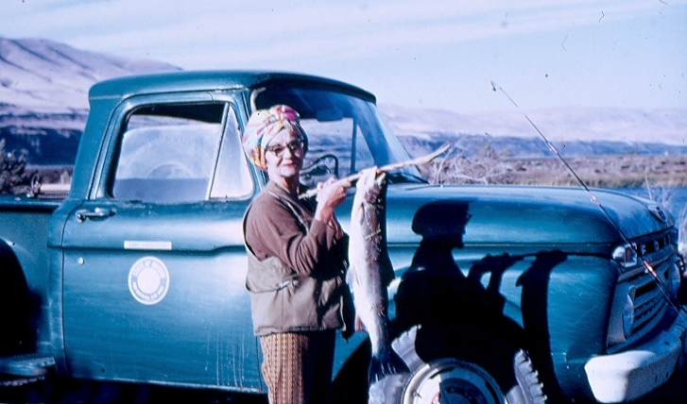
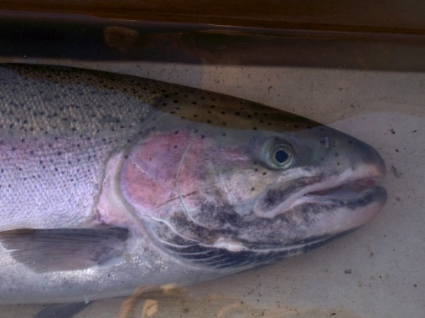
Steelhead Fishery
Mid-July to December
Desert Oasis
No Boat Fishing
Flies and Lures
Mandatory Release of Wild
Wide Demographics
Emotions
ESA Listed
Notes:
Some important notes about the fishery for context:

Slide 5
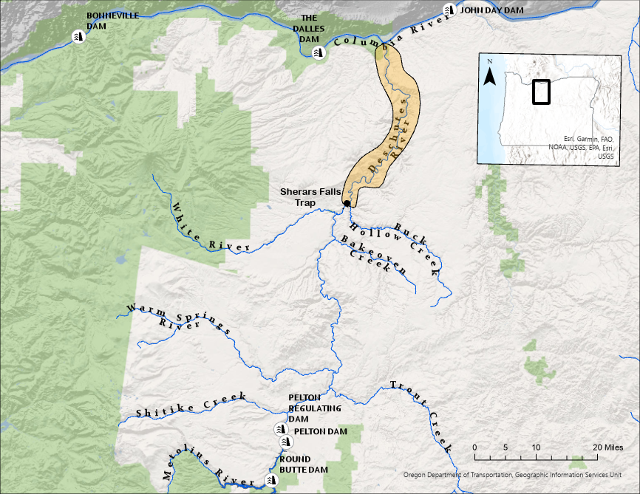
Map
Notes:
Watershed location and description
One of the most stable rivers in the world
How and when steelhead moving into the fishery
The fishery

Slide 6
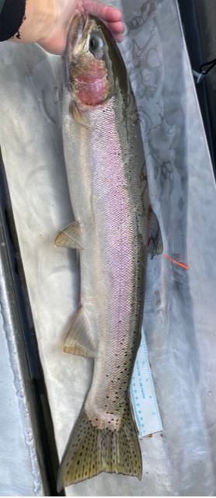
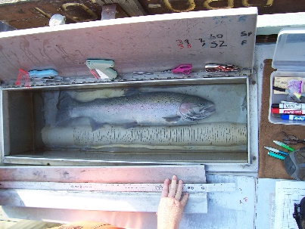
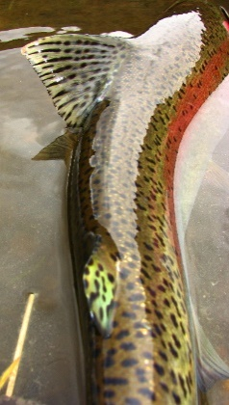
Population and Fishery Monitoring
Annual M-R Estimates above Sherars Falls
Annual Creel below Sherars Falls
Since 1977
Notes:
Lucky to have robust data sets

Slide 7
WILD STEELHEAD ABOVE SHERARS
Notes:
Bars are the escapement estimates above Sherars
Describe the lines
We’ve had some dramatic cycles, lows in the mid-1990’s and recent years
Lows have been around 500 and highs have been up around 9,000
Been below CAT twice and above MAT majority of years

Slide 8
HATCHERY STEELHEAD ABOVE SHERARS
Notes:
Talk about the bar was high for anglers
Large volume of hatchery fish, primarily strays
These numbers are above Sherars, more fish in the primary fishing zone
Since 2010, reduction in barging has greatly reduced straying
Good for wild fish (pHOS), bad for anglers
Our creel data shows that out of basin strays have traditionally accounted for about 70% of the hatchery fish harvested on average in the lower 43 miles of the Deschutes fishery.

Slide 9
Wild Escapement and Catch
Notes:
Bars are the escapement estimates
Line is angler catch and release of unmarked fish
Fishery is mixed stock with stray wilds
Escapement estimates don’t represent all fish in the fishery

Slide 10
HISTORY OF FISHERY RESTRICTIONS (Closures)
Not much to mention (1950’s to 2020)
1978 Closure
Mid-1990’s low returns led to ESA listing
Going into 2021, Fishery Closures were not on the radar…..

Slide 11

2021
Business as Usual
Bonneville Forecast ~101,000

Slide 12

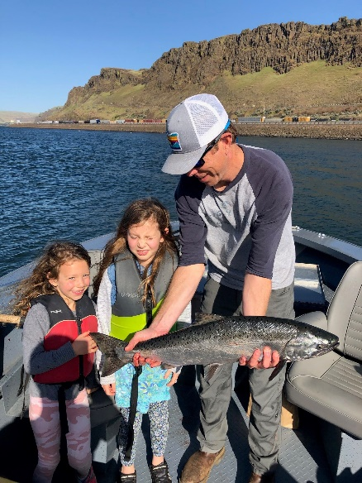
May 2021
How’s the Spring Chinook Fishing?

Slide 13

July 2021
HMMM…..
Have you seen those Bonneville Counts?

Slide 14
By August
They’re Not Late!
This is Serious!

Slide 15
Internal Discussions
1997 Deschutes Fish Management Plan
Deschutes River FMEP
Middle Columbia ESA Recovery Plan
Oregon Native Fish Policy
What are our fishery impact rates on Deschutes fish?
What are Deschutes catch and release mortality rates?
How much will the wild population be impacted if we continue to fish?
How much economic impact will a closure produce?
What are the Critical and Minimum Abundance Thresholds?
What is our primary guiding document for fishery management?

Slide 16
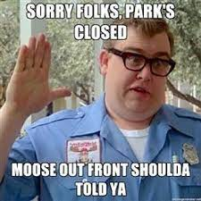
Closed to Steelhead Angling
Due to Wild Steelhead Conservation Concern
Mouth to Sherars (September 1)
Entire River (October 1)

Slide 17
Closure Led to More Public Questions
Who made these decisions?
Why did we close with mandatory release of wild in effect?
Did Anglers and the public understand and support the closure?
How Do We Move Forward?
Notes:
The decision was made by a team of staff
Anglers didn’t think catch and release impacts were real
Mixed bag of public response, lots of finger pointing, not much on accountability
Need to come up with a plan

Slide 18
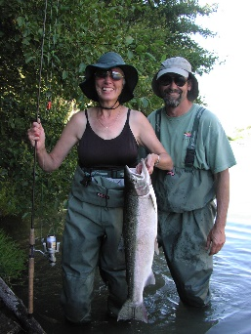
Fishery Framework
Develop for Public Transparency and Guidance
Based on High Quality Data
Use Real-Time by Managers with Public Knowledge to not repeat 2021

Slide 19
Data Used
M-R Estimates above Sherars Falls
  1978 to 2021
Observed Counts at Bonneville Dam as a real-time forecast
Creel Data
Evaluate these relationships and determine thresholds on behalf of conservation necessity (fishery restrictions)

Slide 20
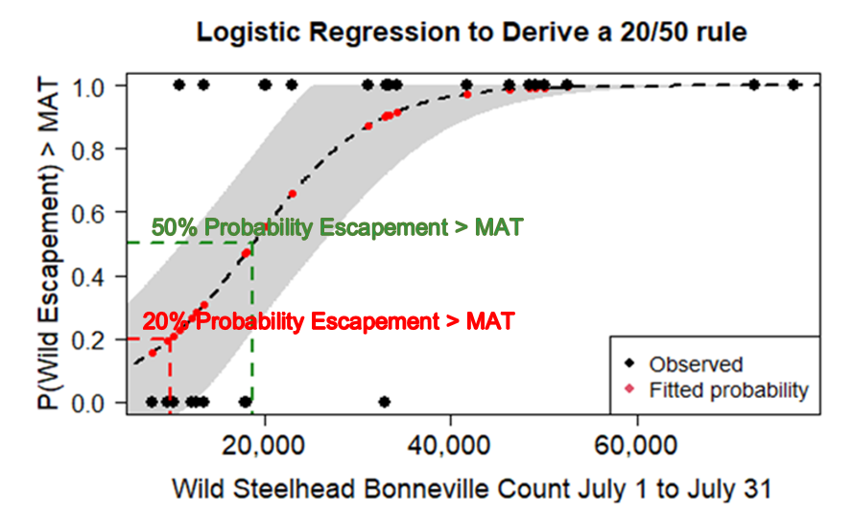
Use Bonneville Dam Counts
9,900
Notes:
X axis is the number of unmarked steelhead passing Bonneville Dam
Y axis is the probability that our mark recapture escapement estimate will be greater than MAT
20% (9,900) was more likely than not meet MAT, that conservation and restrictions were necessary
We decided that a greater than 20% probability to meet MAT was sufficient to allow a fishery
50% (18,700) probability of MAT more likely than not conservation restrictions would be needed

Slide 21
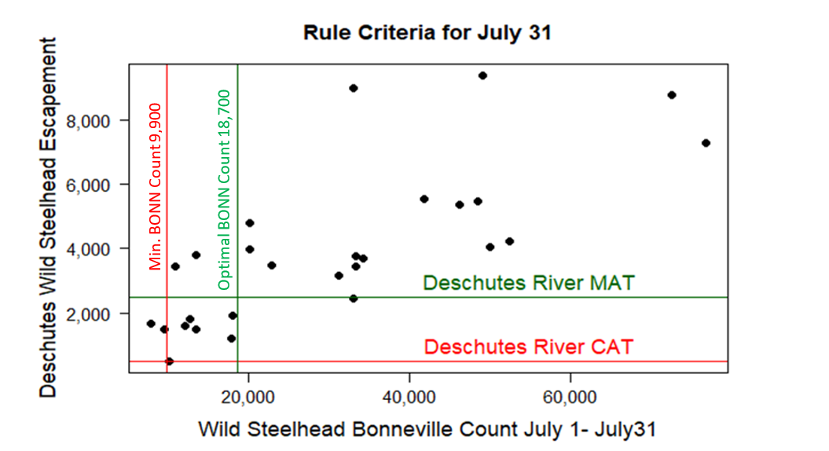
Use Bonneville Dam Counts
Notes:
Another way to observe the Bonneville Relationship

Slide 22
Proportion of Catch (2011-2020)
Heritage Landing
Unmarked Released
July 1-15 | 0.01 | 0.01
July 16-31 | 0.09 | 0.08
August 1-15 | 0.24 | 0.15
August 16-31 | 0.43 | 0.19
September 1-15 | 0.64 | 0.21
September 16-30 | 0.83 | 0.18
October 1-15 | 0.96 | 0.13
October 16-31 | 1.00 | 0.04

Slide 23
Public Input Prior to Final Draft
Public Survey Form
  Framework was posted online
  Feel out the public sentiment
  Which rivers they were most interested in
  Did they support conservation measures etc
Hosted Webinar
  Multiple Fisheries
  Deschutes Framework was presented
  Questions were submitted during presentations
  Individual follow-up were made later
.

Slide 25
7/1 to 7/31: Less than 9,900 wild steelhead over Bonneville
If fishery starts closed, stay closed; continue in-season evaluation
If fishery starts open, close 8/15; continue in-season evaluation
7/1 to 8/31: Wild steelhead passage under 23,100
Fishery closed
7/1 to 8/31: Wild steelhead passage over 23,100
Open 9/15
If previous run year is greater than the CAT (625):

Slide 26
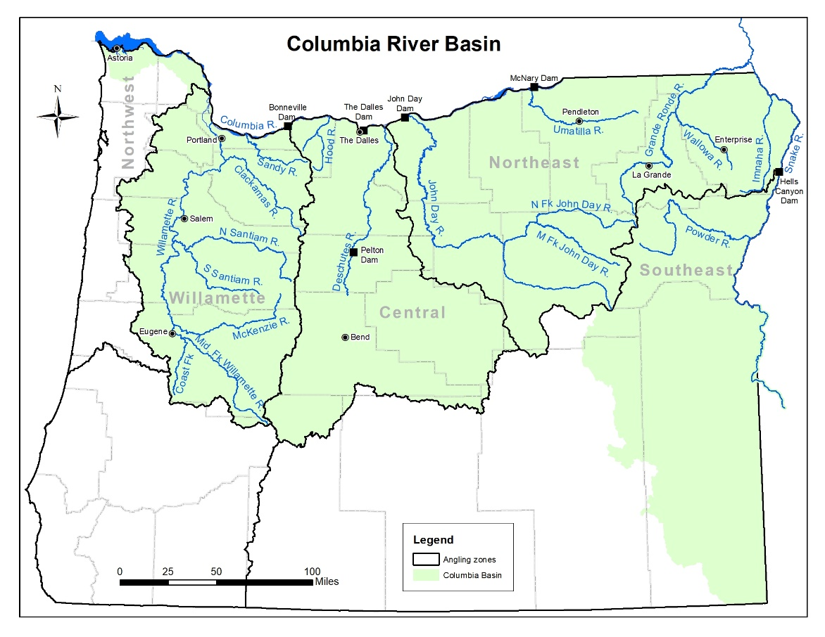
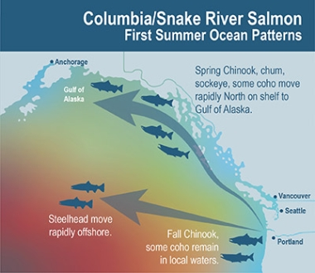
Columbia River Management and Tributary Frameworks
https://myodfw.com/articles/steelhead-management-columbia-snake-river-basins
Links to Deschutes and other tributary frameworks

Slide 27
Moving Forward
Address Information Gaps
  Spawner Distribution (MAT refinement)
  Wild Stock Composition in the Fishery
  Evaluate Additional Predictor Options
Continue to Improve the Framework
Continue to monitor Population and Fishery

Slide 28
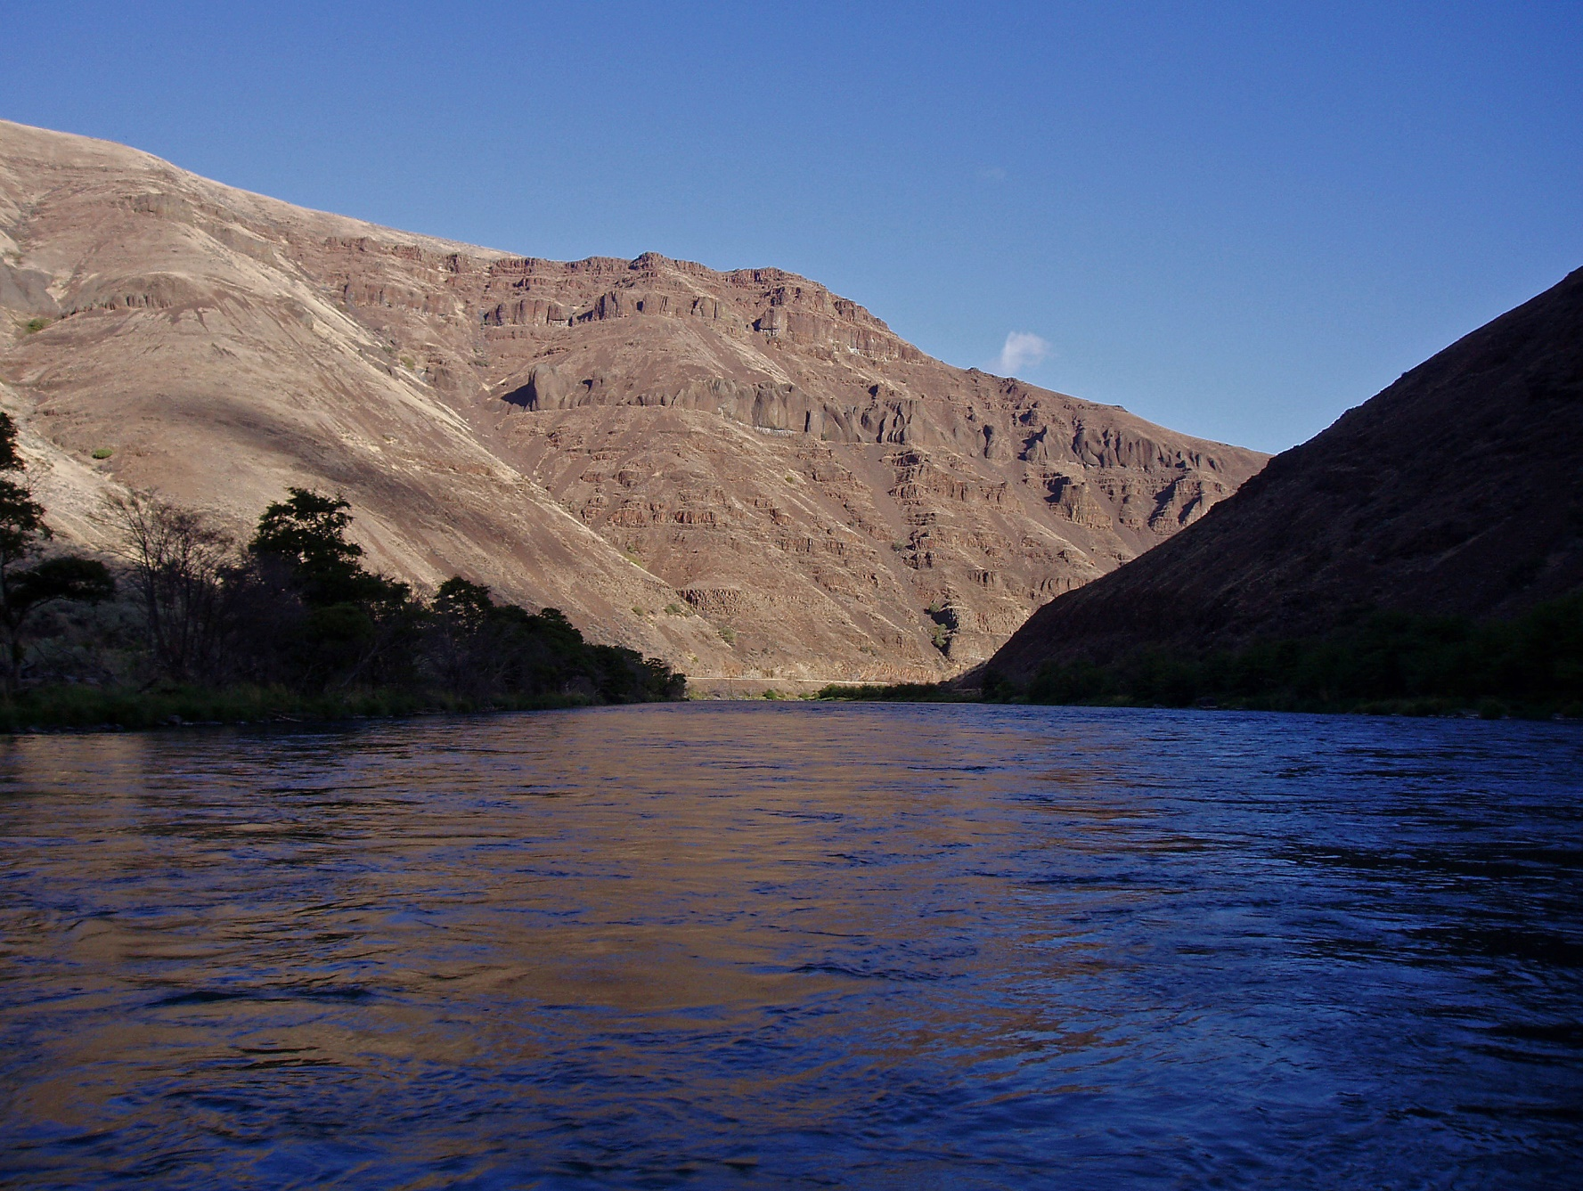
Thanks For Listening
Special thanks to Lindsay Powell, Corey Heath, Shaun Clements, Michelle Jones, Ian Tattum, Mike Gauvin, Nick Myatt, Michelle Dennehy, Mike Harrington, and Peter Stevens.

