Slide 1
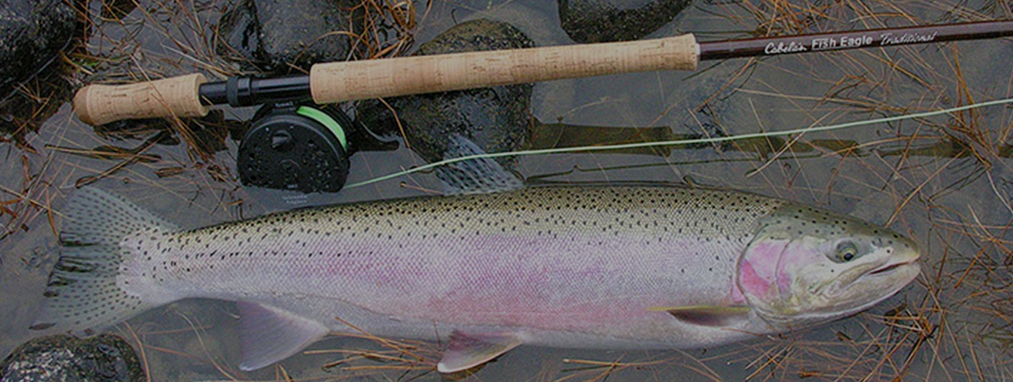
Development of e-Creel for Steelhead: Monitoring Harvest and Release of Steelhead in Oregon’s Recreational Fisheries.

Slide 2




Introduction
Paradigm Shift: Applying Capture-Recapture Techniques to Electronic Licensing System Data to Estimate Chinook Salmon Harvest
Brian Riggers
Oregon Department of Fish & Wildlife
Coastal Chinook Research & Monitoring Program
Corvallis, Oregon
541-757-5132
Brian.Riggers@odfw.Oregon.gov
Brian L. Riggers, Michelle L. Jones
https://doi.org/10.1002/nafm.10778

Slide 3
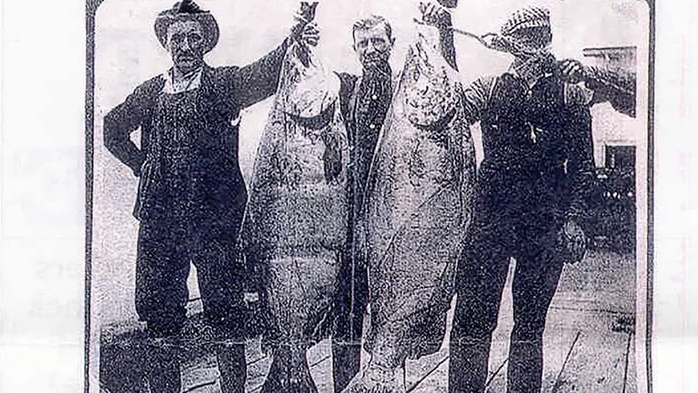
Presentation Outline
ELS and e-Creel Defined
e-Creel PST Implementation Chinook
  Hybrid Design
  Assumptions
  Bias
  Capture-Recapture Techniques
Paradigm Shift
  Standardized Methods
  Steelhead Challenges
Coming Attractions
Discussion

Slide 4
Definitions
ELS: Electronic Licensing System, Implemented December 2018 –Enhanced Efficiencies
ELS Database: Containing e-tagged fish and other harvest and angler information
e-Creel: Hybrid approach using in-person creel interviews and ELS data
Traditional Creel: HPUE * Effort, conceptually simple, statistically complicated
E-tag Sample Ratio: e-Creel (in-person interviews), e-tag validated harvest/all harvest
ELS Sales Ratio: e-tags / all tags purchased (e-tags+paper punchcards)
Harvest Estimates
Harvest vs Catch
e-Creel Harvest Estimate: derived from e-Creel using the capture-recapture model
Paper, “Punchcard” Harvest Estimates: non-compliance expansion
ELS Harvest Estimate
  ELS data expanded by sales ratio (statewide)
  ODFW Estimates found on public website – estimates reported after 2019 are ELS Harvest
https://www.dfw.state.or.us/resources/fishing/sportcatch.asp
Notes:
ODFW implemented the ELS in 2019. The objectives were to effectively administer licenses and harvest tags, reduce operating cost through increased efficiencies and enhance regulatory enforcement. The option to select electronic license & tags or the paper combination remains, however selection of the e-license effectively creates compulsory tag returns which is necessary to meet key assumptions inherent the e-creel estimation process. Electronic Licensing System-not intended for harvest estimation. Creates compulsory returns 0f e-harvest validation.

Slide 5
ODFW Electronic Licensing System - ELS
Not designed for harvest estimation.
Administer license and tags, reduce operating costs, enhance enforcement.
Choose either electronic or paper at the time of purchase, printed from home.
Allow customers to store their licenses, harvest tags and validations on their smart phone or tablet.
Allows for electronic tagging of fish harvest a smart phone app even offline.
  Regulations require immediate harvest validation
  Compulsory electronic reporting (paper reporting voluntary)

Slide 6
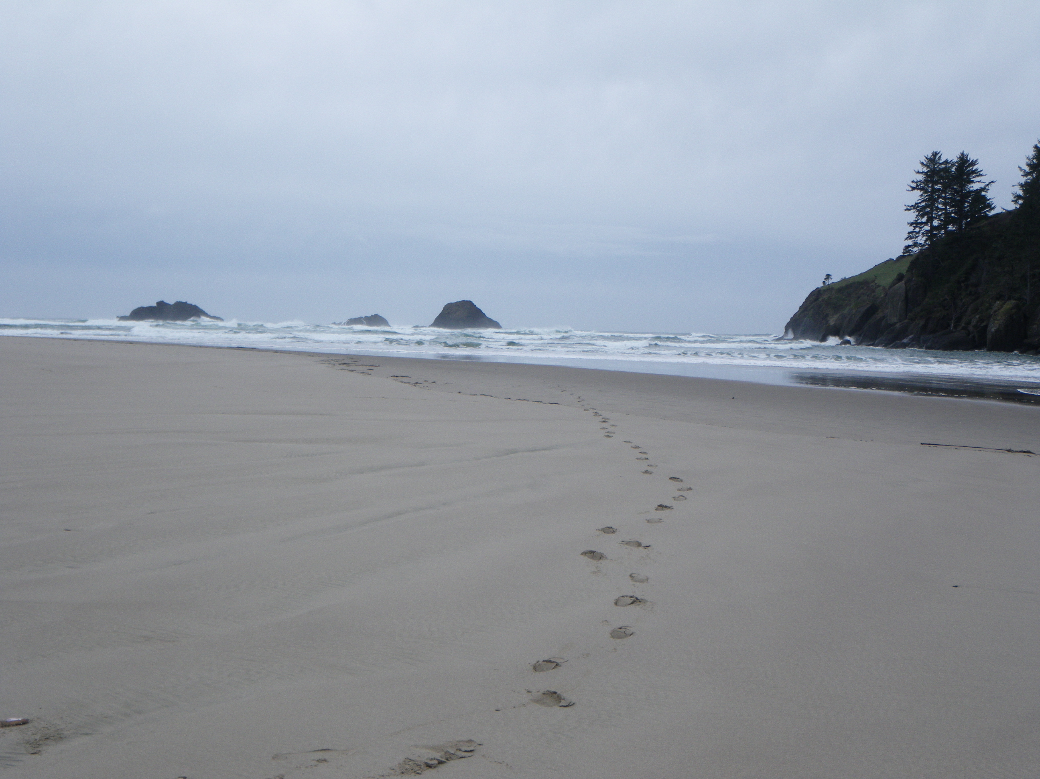

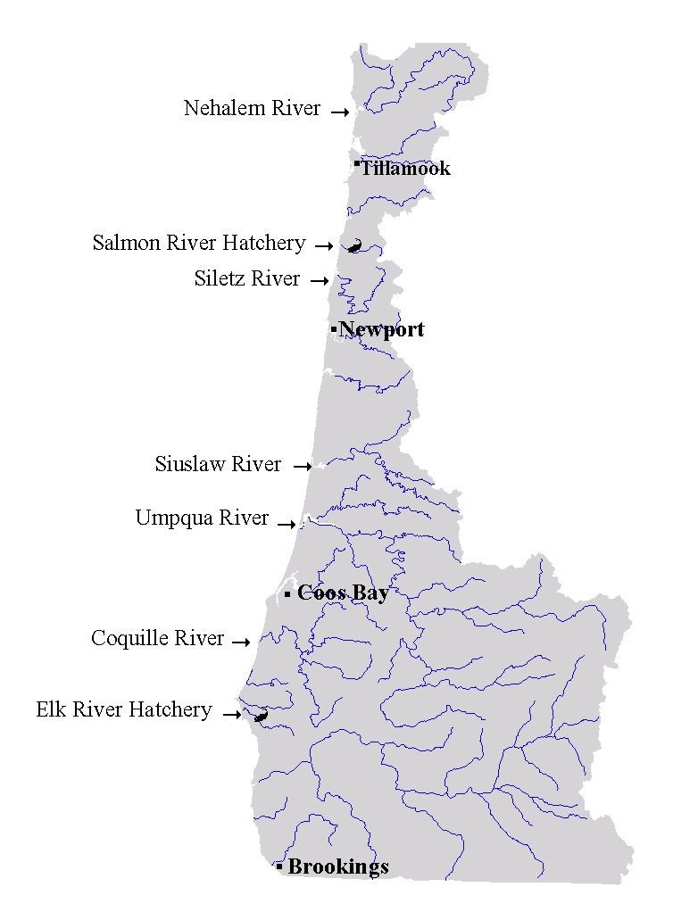



Pacific Salmon Treaty
Chapter 3
Nacanicum River
Creel in ALL Indicator Basins
ERIS Salmon River Hatchery
ERIS Elk River Hatchery
NOC
MOC
Nestucca River
Yaquina River
Alsea River
International agreement (U.S. and Canada) to conserve and manage Pacific salmon stocks, production, and harvest (1985) implemented by the Pacific Salmon Commission.
  Many Oregon stocks of salmon migrate north to Alaska and Canada and are subject to commercial and sport fishing while there.
Treaty sets limits on harvest (commercial and sport) and triggers for conservation-based restrictions.
  Implemented by the Pacific Salmon Commission (PSC)
  Our work is primarily funded through the PSC
  Treaty 2019 revision emphasizes CYER metric
Yachats River
Coos River
Sixes River
Notes:
Traditional creel-The primary goal of the coastal creel surveys is to generate unbiased estimates of total end-of-season recreational steelhead catch, where catch is a combination of harvest and catch
and release (C&R).
A secondary goal of the coastal creel surveys is to produce catch estimates with a
precision of ± 20% at the 95% confidence level, which corresponds to a coefficient of variation
(CV) of 10%. A method for calculating precision is provided based on previously derived
equations outlined in Pollock et al. (1994) and Hahn et al. (2000).
Angler surveys are an established method used to estimate catch and fishing pressure in
recreational fisheries (Malvestuto et al. 1978, Pollock et al. 1994, Jones and Pollock 2012n the mid-1970s, WDFW (formally Washington State Game Department) began implementing on-site steelhead creels in Western Washington rivers following the 1974 Federal District Court Order (United States vs. Washington, Civil Case No. 9213), referred to as the Boldt Decision.

Slide 7

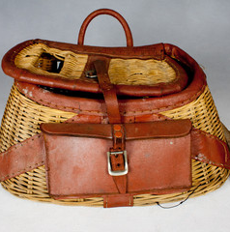
e-Creel
ELS Database not intended for harvest estimation
ELS
Creel
Notes:
ELS Database not intended for harvest estimation
-administer licenses and harvest tags
-Reduce operating costs
-Enhance regulatory enforcement

Slide 8
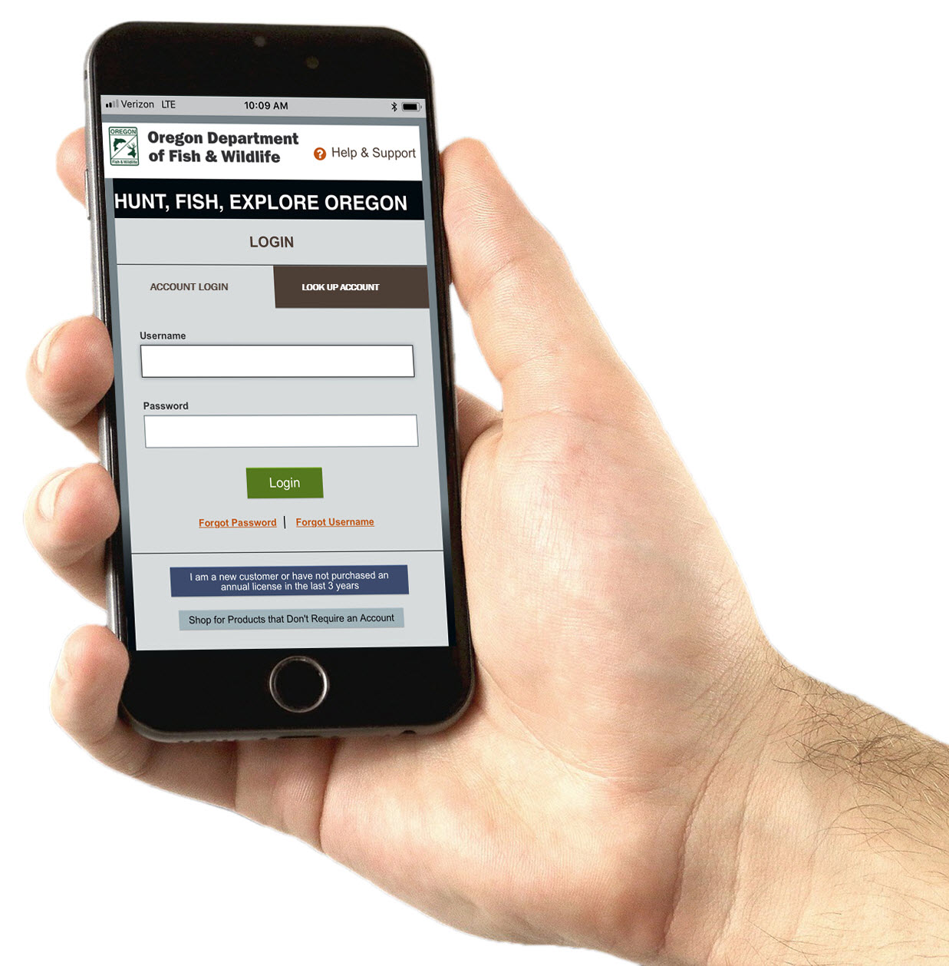
Introduction to e-Creel
Integrated approach simultaneous e-tagging & interviews
Capture & Recapture Techniques to Estimate Harvest
  H=(m*c)/r
  Electronically marked from ELS database (m)
  Total fish sampled in creel (c)
  Electronic marks recovered from creel (r)
Assumptions
Closed population
  All anglers using mobile license validate harvest (e-tagged)
  Appropriate location assigned to e-tags
Eliminates effort counts
Compulsory reporting (mitigates public relations issues)
Post temporal stratification if necessary
Cost effective
Expandable (Steelhead)
Notes:
N_{i}= the estimated harvest of fall Chinook salmon in fishery i.
M = Total reported harvest to the ELS database corresponding to the time period of the fishery.
C = Total number of biologically sampled fish.
R = Total number of biologically sampled fish that were electronically tagged
Capture – Recapture Techniques
Petersen estimator is a well-known capture-recapture method to estimate animal abundance
Immediate validation compliance on MyODFW smart phone application.
Anglers correctly assign the fishery from which the fish was harvested.
Improper nomenclature defining harvest location was identified.
Some of the freshwater recreational harvest was mistakenly reported as marine harvest
Significant bias identified – can be corrected Chapman version for small sample sizes

Slide 9
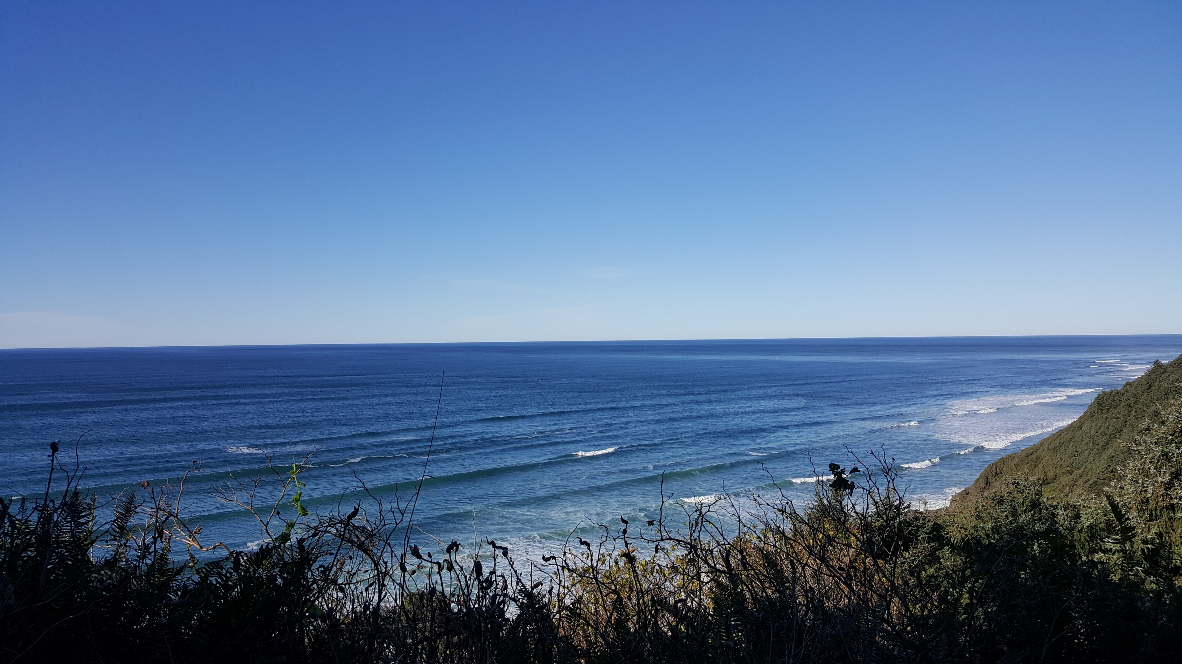
Comparison of e-creel to ELS Harvest Estimates
2019
Location Description | e-Creel Estimate | Standard Deviation | Creel Estimate | Standard Deviation | ELS Estimate | Marine Adjusted ELS Estimate
Elk R Basin | 565 | 67 | 506 | 196 | 553 | 553
Nehalem R Basin | 1,527 | 133 | 1,512 | 466 | 767 | 1,639
Salmon R Basin | 1,001 | 144 | 1,003 | 275 | 468 | 868
Siletz R Basin | 1,776 | 176 | 1,730 | 322 | 1,817 | 2,263
  Mann-Whitney U test estimates are not significant
3.4% Difference
  Identifies location codes in ELS and marine harvest error

Slide 10
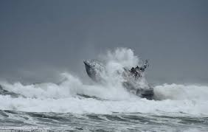

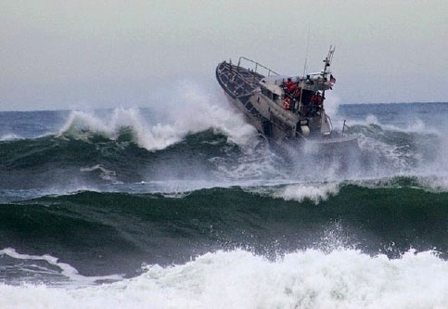
e-Creel-Identifying ERROR 2022
 | Salmon River | Siletz River | Nehalem River
Interview error | 0.100 | 0.010 | 0.076
Marine ELS | 65 | 149 | 324
River ELS | 284 | 1,055 | 829
Adjusted Marine | 33 | 139 | 257
Adjusted River | 317 | 1,065 | 896
Expected error | 0.180 | 0.120 | 0.150
Expected Marine | 3 | 5 | 179
Expected River | 346 | 1,200 | 974
Table adjusting estimate concluding documentation necessary for Siletz harvest
Notes:
2022 preliminary interview adjustments
Question: What harvest code did you use? Was this an ocean harvested fish?
Non-jetties at river mouth unlikely access during fishing season
Can corrected in ELS through nomenclature change
Salmon River ELS represents 90% of true value

Slide 11
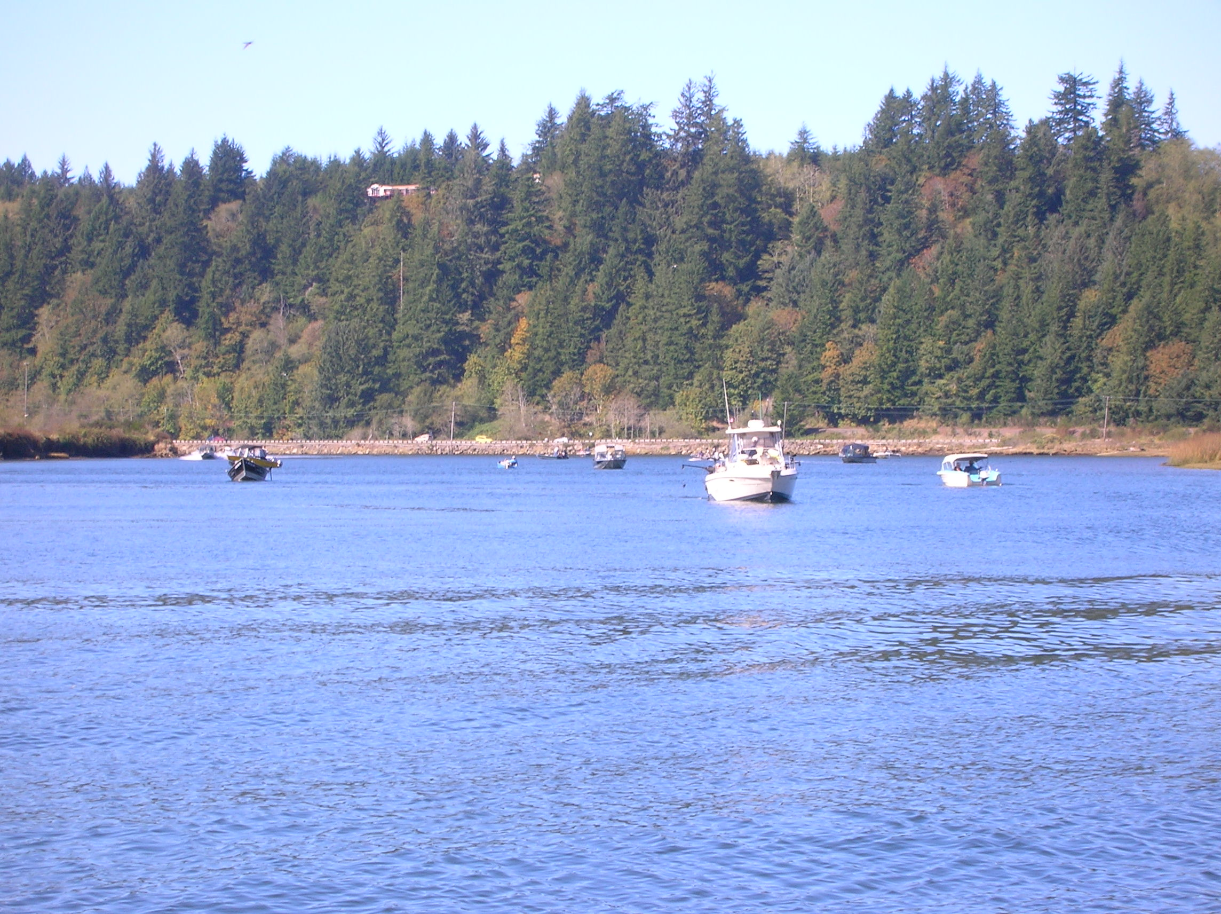
Results
  Cost reduction can be achieved through transition to e-Creel
    Reduced personnel cost
    Reduced travel cost due to no effort component
  Eliminates some safety concerns
  Potential for wide-spread use
Basin | 2019 e-tag Sample Ratio | Average | C.V. | Statewide e-tag Sales Ratio
Elk River | 0.303
Nehalem River | 0.309
Salmon River | 0.282
Siletz River | 0.335
 |  | 0.307 | 7.1% | 0.289
Notes:
A Mann-Whitney U test determined that the estimates produced by the two methods were not significantly different.
We also estimated about a 33% reduction in the creel budgets could be realized through the transition from traditional creels to an e creel design. This is primarily due to the elimination of effort counts and subsequent reduced personnel and transportation cost. The reduction in travel requirements naturally alleviates some safety concerns. Note the e tag/paper tag ratios are very similar with a coefficient of variation of 7.1%, and similar to the coast wide ratio (in red) provided by ELS administrators. This supports the potential for confidently estimating coast wide harvest without the need for in the field interviews. However revised analytics would need to be developed and there would be no means to determine age structure.

Slide 12
Cost Comparison of e-Creel to Traditional Creel
2023 Cost Estimates | e-Creel (1 BSA) | Trad Creel (3 BSA) | Difference
Labor | $ 20,736 | $ 48,384 | $ 27,648
Equipment (Vehicle Leases) | $ 2,600 | $ 7,150 | $ 4,550
Total Direct Costs | $ 23,336 | $ 55,534 | $ 32,198
District staff should consult with the ELS coordinator (Michelle Jones, biometrician) prior to doing their own research so that all research is comparable and can be combined with larger statewide efforts. Brian Riggers may also be consulted for development of an e-Creel.
Notes:
eCreel: 1 BSA 90 days, 1 vehicle (4 months)
Trad Creel: 3 BSA 2 BSA 90 days, 1 BSA 80 days; 3 vehicles
Post hoc assessment of spending associated $24,842 in cost saving estimated per basin in 2019. Contributed to not taking effort counts.

Slide 13
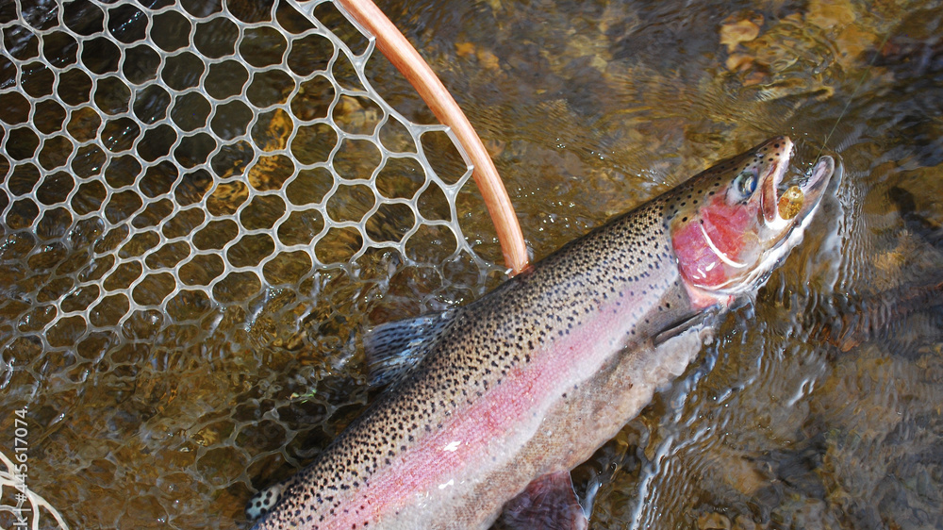
Paradigm Shift
an important change that happens when the usual way of thinking about or doing something is replaced by a new and different way

Slide 14
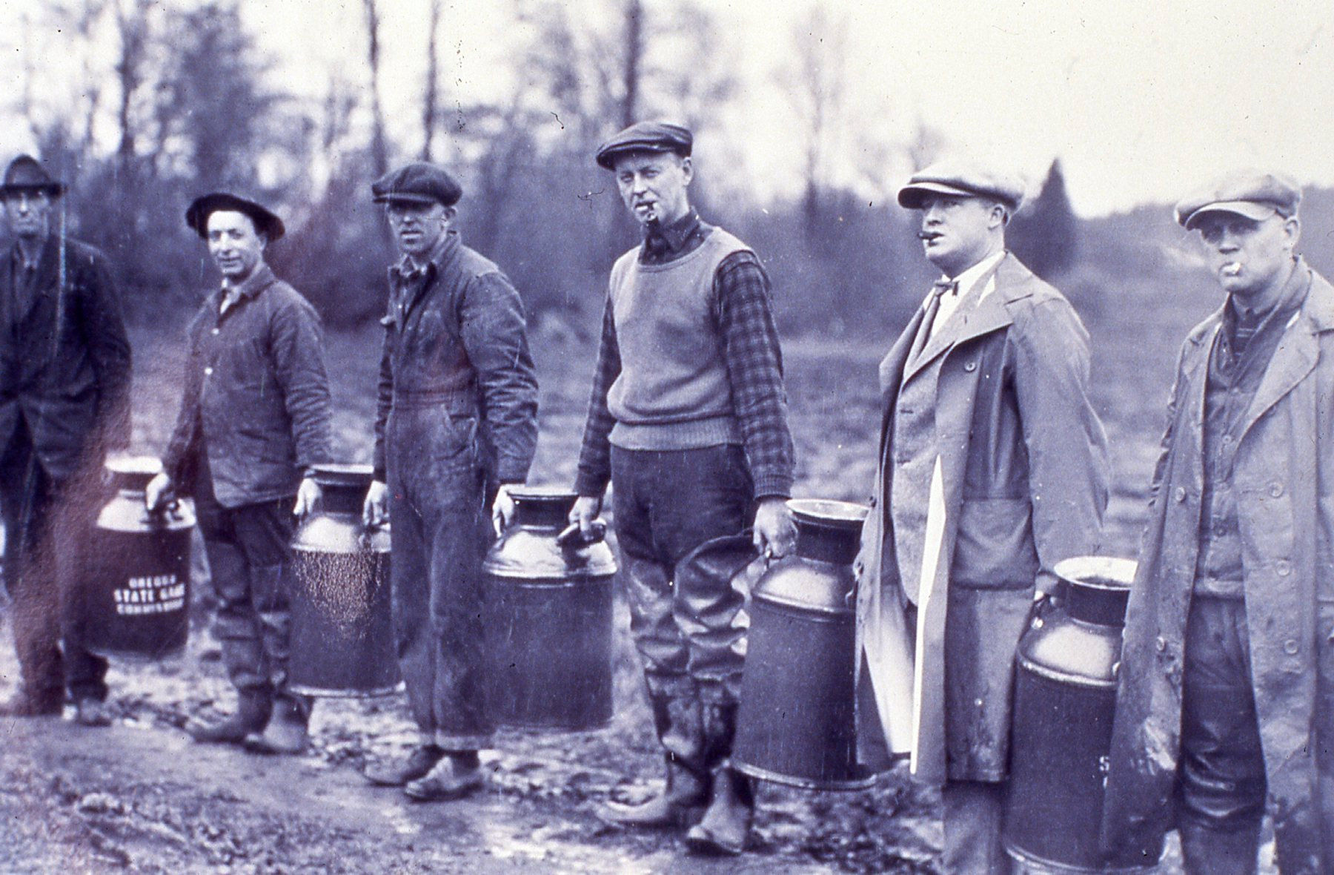
What makes a Paradigm Shift?
 | PROS | CONS
Traditional Creel | Precise harvest estimates | $$ Expensive $$
 | Demographic data collection | Invasive
 | Sample Visibility | Enforcement
 | Effort count trends | Difficult mitigating for effort bias
e-Creel | Estimates with increased precision | Location error
 | Estimates with reduced bias | Non-compliance error
 | Cost reduction-personnel, travel & safety | Lacks access infrastructure
 | Increased biological sampling (age)
 | User friendly-technological advanced
 | Compulsory reporting
 | Gold Standard-validation
 | Expeditious harvest monitoring
 | Excludes Effort | Excludes Effort
Notes:
Infrastructure should not be an obstacle.
Oregon State Fish Commission. Historic estimates of Oregon’s Chinook harvest were derived through a voluntary “Harvest Card” system reliant on paper tagging,
where anglers were asked to submit their salmon harvest information back to the agency at the end of the season. Theoretically, this would result in a total estimate of harvest given all anglers that purchased harvest cards returned them properly filled out at seasons end. However, Oregon’s system was, and still is a voluntary one, where compliance rates were insufficient to derive confident, estimates of harvest. Current ODFW estimates from harvest card returns do not provide acceptable estimates of harvest for treaty management purposes and are considered inferior to traditional creels (Williams 2004). Although cost effective, the system was wrought with bias, did not meet PSC guidelines for precision, accuracy and timeliness, thus rendering it unfit for PST management purposes.
ODFW implemented the ELS in 2019. The objectives were to effectively administer licenses and harvest tags, reduce operating cost through increased efficiencies and enhance regulatory enforcement. The option to select electronic license & tags or the paper combination remains, however selection of the e-license effectively creates compulsory tag returns which is necessary to meet key assumptions inherent the e-creel estimation process. Electronic Licensing System-not intended for harvest estimation. Creates compulsory returns of e-harvest validation.

Slide 15
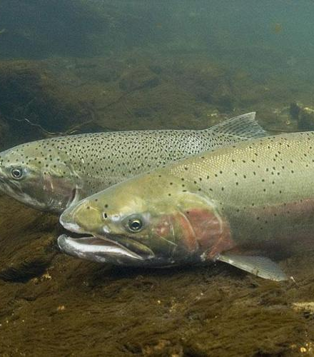
Steelhead e-Creel Challenges
e-Creel Starter
    Transition
      1. How did you tag your fish?
      2. What location code did you use?
      3. Other basin/study specific questions
    ELS-Data Development Plan
    Integration with ELS
    Location codes
    Enforcement
    Compliance
    Catch and release fisheries
    Dispersed fishery
    Need to assess stratification (sales ratio)
Male and female steelhead trout. Credit: NOAA Fisheries

Slide 16
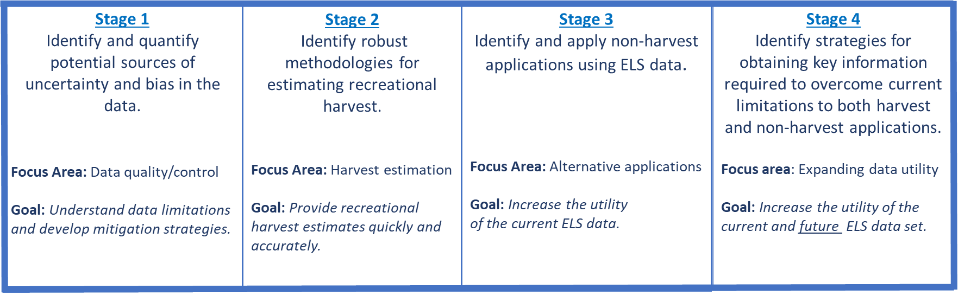
ELS Data Development Plan Framework
e-Creel Integration Challenge
ELS bias identified through e-Creel
Instantaneous population estimates with measure precision
Validation & Improved Forecasting
e-Creel next step: calibrated expansions expanding estimates
e-Creel
Location Error
e-Creel
In-Season
Harvest Estimates
e-Creel
Scales & Forecasting
Regulation Shifts
e-Creel Expansion
Michelle Jones
ELS Database Coordinator
Recreational Fisheries, HQ
(503) 947-6252
Notes:
OVERVIEW
The Fish Division ELS Data Development Plan provides a framework to ensure information provided by the agency derived from ELS data meets statistical standards. The plan itself is broken into a four-stage process that prioritizes focus areas for research and data collection. Stages transition from focusing on data quality/control to harvest estimation, followed by finding alternative applications for ELS data and expanding it’s capabilities through additional features. Although displayed as a linear process, all four stages are interconnected and should occur in tandem. All four stages are detailed within this document.
COORDINATION AND DATA AVAILABILITY
It is ODFW’s intent to take a coordinated and thoughtful approach to the incorporation of ELS data into our monitoring plans and management decisions. By doing this we hope to: 1) reduce costs, 2) leverage additional value from individual efforts, 3) ensure complimentary (not duplicate) efforts, and 4) avoid inappropriate inference where it affects management actions.
To make sure the agency bases decisions using statistically defensible methods, ODFW staff should:
1). Streamline ELS data requests to a single staff member to ensure the data is being used appropriately and to prevent duplicate efforts at addressing the research needs prioritized within the developmental framework.
2). Coordinate questions on creel surveys to obtain useful supplemental data sets
3). Submit any data quality concerns to the ELS coordinator
4). Submit any additional ideas regarding potential applications for ELS data to the ELS coordinator
5). Document and share supplemental data regarding angler harvest to the ELS coordinator.
6). Provide the ELS coordinator with any additional management questions that may relate to ELS data

Slide 17


Validation-The New Gold Standard
e-Creel
e-Creel
e-Creel
e-Creel
Validation/Correction marine vs freshwater
ELS Harvest Estimate Sales Ratio
Validation and/or integration of Steelhead Management
Validation of assumptions and inferences
e-Creel
Notes:
Problems with sales ratio method which is not applicable to e-Creel
e-Creel address release estimates
Validation tool

Slide 18

Expansion Techniques
 | Nehalem | Siletz | Umpqua | Salmon | Elk | Sixes
e-Creel Est | 1,987 | 2,406 | 2,392 | 796 | 632 | 215
CV e-Creel | 6.0% | 5.5% | 4.2% | 8.7% | 8.4% | 8.6%
Expansion | 2.15 | 2.19 | 2.19 | 2.13 | 2.05 | 2.25
ELS e-tag | 901 | 1,199 | 1,179 | 348 | 235 | 127
Exp Estimate | 1,937 | 2,625 | 2,577 | 741 | 482 | 286
CV Expansion | 18.7% | 18.1% | 17.2% | 19.2% | 12.6% | 12.7%
Leave one out Expansion 2022
Expansion | CV
2. 16 | 16.4%
= 14.7% Mean Absolute Percentage Error
Notes:
CV Includes both CR variance term and expansion variance.
stdev/Est
stdev=Sqrt[(Index^2)*(var avg ratio)]
Simple expansion method applied to basins where interviews are not feasible
Applies to all species requiring harvest validation
Applies to all water bodies with managed fisheries
Instantaneous, precise and cost-effective forecast of harvest
Demonstrates utility of ratio methodology
Has not been peer reviewed

Slide 19
Coast-Wide Estimates Steelhead Applicable
Expansion Techniques
Estimates of adult ChF Harvest using average expansion (2.16) from six Oregon coastal basins (var=0.114) where e-Creel was conducted 2022*.
 | ELS Index | Exp Est | Stdev | Stdev
Necanicum R | 23 | 47 | 5 | 5
Tillamook Basin | 746 | 1,526 | 156 | 156
Nestucca R | 1,094 | 2,237 | 229 | 229
Three Rivers (Nestucca) | 518 | 1,059 | 109 | 109
Yaquina R | 226 | 462 | 47 | 47
Alsea R | 1,434 | 2,933 | 300 | 300
Coos R | 1,340 | 2,740 | 281 | 281
Yachats R | 25 | 51 | 5 | 5
Coefficient of Variation |  |  |  |  | 10.2% | 16.7%
*2022 e-creels: Nehalem, Siletz, Salmon, Umpqua, Sixes, and Elk
Notes:
CV
stdev/Est
stdev=Sqrt[(Index^2)*(var avg exp)]
Perhaps use sales ratio or ChF e-Creel
Simple expansion method applied to basins where interviews are not feasible
Applies to all species requiring harvest validation
Applies to all water bodies with managed fisheries
Instantaneous, precise and cost-effective forecast of harvest

Slide 20
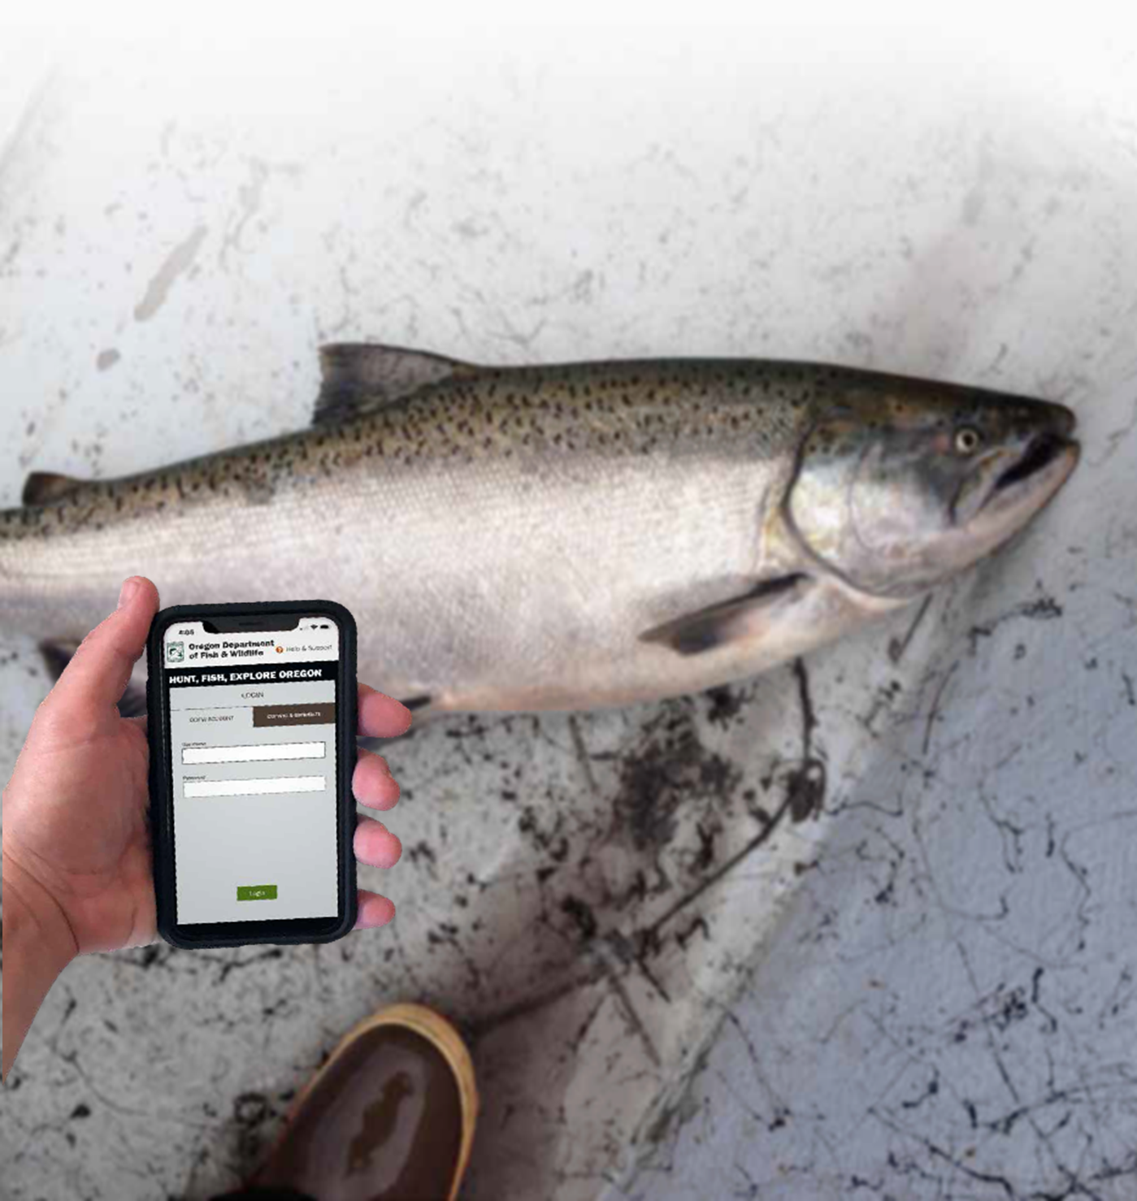
Steelhead Advantages/Objectives
ELS Steelhead Data – e-Creel
  Eliminates effort counts and associated error (bias)
  Reduced bias-LOS
  Increased efficiency (more with less)
  Increased sample rate
  Increased certainty with age structure
  Eliminates complicated design & analysis
  Integrate e-Creel expansions
  Expandable (species, basin, strata)
  Annual population-based estimates (entire basin)
  Immediate implementation

Slide 21
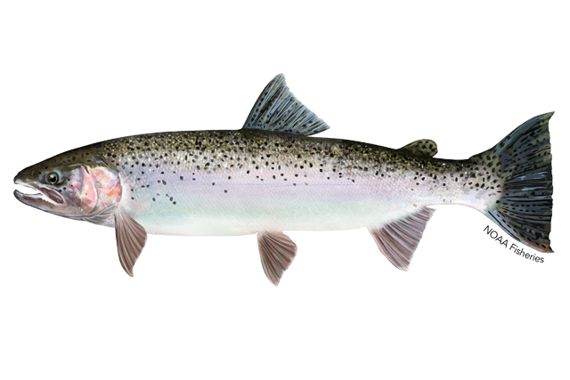
Coordinated Integration of e-Creel for Steelhead
Glaring weakness is ELS data access and process infrastructure
Leverage e-Creel to support Steelhead harvest management
Validation of ELS Data and Harvest Estimation Methods
Evaluate cost efficiencies
Improvements to/or Development of ELS
  Incorporate e-Creel
  Incorporate e-Creel expansion
  Automated Ocean or River harvest
  Phase out traditional creel (assess risk)
  Integrate OSP to develop compliance rates
Notes:
Information needed from managers and district staff:
ELS-independent estimates of salmonid harvest.
ELS-independent estimates will allow us to do quality/control on the current expansion methodology and explore alternative stratifications of the data. To streamline our efforts please follow the directions below:
If you have implemented a traditional creel survey since 2019, report your salmonid harvest estimates on the spreadsheet TraditionalCreelHarvestEstimates.xlsx located in the creel folder labeled “Harvest Estimates - Traditional Creel”. If available, deposit a draft of any creel reports associated with the estimate as reference material in the same folder and/or any raw creel data files. Creel estimates are most helpful at the scale of waterbody codes, so there is no need to provide detailed harvest estimates from particular access sites. If you have weekly or bi-weekly estimates they can be scaled up to facilitate faster data entry to monthly or seasonal totals. If you have separate estimates for boat and bank anglers, they can be combined to a single total harvest.
Note that the proportion of anglers using ELS, if available from your creel, will be most helpful if entered into the spreadsheet ObservedAnglerSummaryStatistics.xlsx, which is a stand alone spreadsheet in the main “ELS Project Information” folder.
If you have an e-Creel estimate of harvest, please provide this estimate and some associated information in the spreadsheet labeled eCreelDerivedHarvestEstimates.xlsx which is located in the folder “e-Creel Resources.”
If you have a non-creel independent estimate of harvest, please provide this estimate in the spreadsheet labeled “NonCreelHarvestEstimate.xlsx” which is a stand-alone spreadsheet in the main “ELS Project Information” folder.
As you input date into any of these spreadsheets, please feel free to suggest additional columns that may be missing. For help finding or filling out these forms, please email the ELS Fish Division coordinator.
Geographic-specific estimates of the proportion of people using ELS and other data-quality metrics.
Report any informal spot checks of the total number of people who are using the ELS application in the spreadsheet labeled ObservedAnglerSummaryStatistics.xlsx.
Report data quality concerns, such as suspected misreporting of harvest codes by emailing the ELS data coordinator or directly contributing to the Known Sources of Bias and Uncertainty.docx worksheet in the ELS project information folder (e.g., misreporting of freshwater catch as marine harvest). These reports will be used to quantify bias and uncertainty.
Report fish in the data in areas where they shouldn’t exist (either because the fishery is closed or because they are reported in a system where there is no run). Make sure you also include the full fishing regulation and/or expected species so we know why the fish being reported are unexpected (e.g., fall chinook caught in month W at location X when the fishing regulations only allow catch across months Y and Z). Note that rule compliance, misidentification of species, and technology errors are confounding factors when trying to draw conclusions from these unexpected reports.
District analyses using ELS data (i.e., bag limit analysis, compliance checks with fish reported in closed areas, etc.)
Anytime you go one step beyond reviewing the data as it was sent to you, place a copy of your results or analysis in the ELS Project Information Folder
This doesn’t need to be a finalized report – for example, if you were checking rules compliance rates you could just send a table with total anglers you viewed, total non-compliant, a date range and location code.
This request includes districts that have independent estimates of harvest from self-generated proportions of anglers using ELS, ecreel estimates, etc.. In general, estimates generated from self-calculated proportions of ELS anglers should only be used internally until a better policy on official ODFW ELS harvest estimates is developed.
ELS-related presentations should also be provided in the “presentations” folder.
Additional management applications/questions/needs/concerns
If you have specific management questions outside of harvest estimation that you think the ELS data can address, please email the ELS coordinator or contribute directly to the document: Non-harvest applications for ELS data.docx, which is located in the folder “Non harvest applications.” This will keep your need on the radar and provide a source for developing potential projects that can be pursued either internally through small-scale grants, or with help from our partners at academic institutions (i.e., graduate students).
Creel-specific questions to help inform ELS data development
Ask each party how many anglers using the ELS smartphone application and how many are using a paper tag. Note that some people may be tagging in the ELS application in parallel to recording harvest on a paper harvest tag, in which case their legal requirement would still be the paper harvest tag.
Ask about which angling product(s) the angler is using (e.g., one day license, 3-day, annual angling, combo license, pioneer license, etc. – a full list of products is available here: https://myodfw.com/fishing/licensing-info)
Ask what location code the angler is using to tag fish and record whether they were accurate (i.e., get misreporting rate)
Opportunistically, if you have time to interview anglers for a day here or there, you can always report the total number of anglers and proportion of anglers using ELS (preferably by license type) on to the “angler summary statistics” spreadsheet in the shared folder.
Thank you for supporting the data development plan so we can leverage this new information to help inform future management decisions.

Slide 22
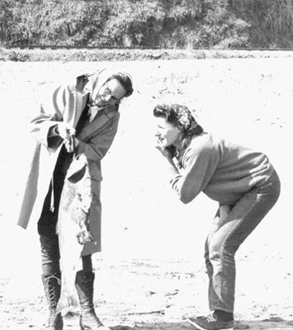
Discussion
Paradigm Shift- an important change that happens when the usual way of thinking about or doing something is replaced by a new and different way
Don’t be afraid of change
Advancement of knowledge to action
Embrace, adapt and lead
  Improve ELS to minimize e-Creel bias
  Design future ELS to leverage e-Creel design
  Maximize benefits and minimize extirpation risk
Notes:
Better, faster, safer, cheaper and reliable. Get on the same page, affordable with expanded methods can estimate harvest for the entire coast and the Columbia R.
Monitor economically and ecologically critical commercial, recreational, and cultural salmon stocks. Expand to both marine and freshwater components and other species that require harvest validation.

Slide 23
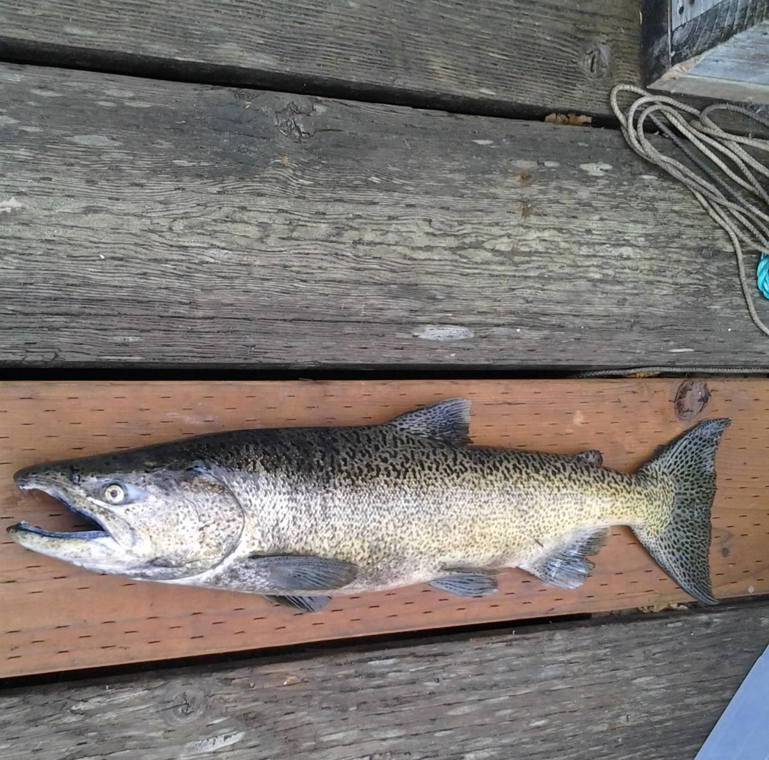

End of e-Creel Presentation
Thank you for listening
Brian Riggers
Oregon Department of Fish & Wildlife
Coastal Chinook Research & Monitoring Program
Corvallis, Oregon
541-757-5132
Brian.Riggers@odfw.Oregon.gov

Slide 24
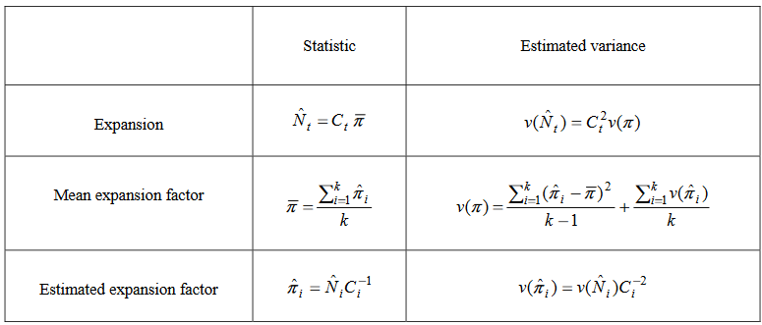
Derivation of Expansion & Variance
Notes:
From McPherson et al 2000 capture – recapture calibration methods.
Suggesting estimating population and species-specific harvest abundance for entire state. Will require additional coordination with ELS administrators to develop functioning program for all to access.

Slide 25
Location Specific adoption of ELS
Location | Year | Species | %ELS (Creel) | %ELS (License Sales)
Lower Rogue | 2021 | Steelhead | 15% | 46%
Wallowa | 20221 | Steelhead | 73% | 46%*
Imnaha | 2021 | Steelhead | 50% | 46%*
LGR | 2020/21 | Steelhead | 59% | 46% **
Siletz River | 2020 | Chinook | 51% | 35%
Siuslaw | 2020 | Chinook | 40% | 35%
Sixes | 2020 | Chinook | 37% | 35%
Elk | 2020 | Chinook | 37% | 35%
Siletz River | 2019 | Chinook | 33% | 30%
Salmon River | 2019 | Chinook | 28% | 30%
Elk River | 2019 | Chinook | 30% | 30%
Nehalem | 2019 | Chinook | 30% | 30%
If adoption of ELS is less than the sales ratio we will underestimate the catch using sales data
If adoption of ELS is greater than the sales ratio we will overestimate the catch using sales data
*As of 3/4/2021
ELS data overview
Notes:
ELS estimates

Slide 26
Current ELS data accessibility
Data sent to Fish Division monthly
Requests for angler harvest forwarded to Recreational Fish c/o Michelle
Data sent to requesting staff for internal use only (all estimates are preliminary)
Expanded data will be posted annually on the ODFW sport catch page:
https://www.dfw.state.or.us/resources/fishing/sportcatch.asp
ELS data overview
Notes:
ELS accessibility

Slide 27
Identified data quality concerns
Sales ratios change monthly, but ELS isn’t built to easily extract the proportion of ELS anglers retrospectively
Unclear which license types are appropriate to include with expansions
The statewide sales ratio doesn’t reflect the actual location-specific ratios. These ratios which have an unknown distribution
Misreporting has occurred chronically across coastal areas with no means of retrospective correction
Misreporting of species is present
  May be able to evaluate looking at locations with reported catch while they were closed
ELS data overview
Notes:
ELS Data Concerns.

