Slide 1
Using a newly developed integrated population model to evaluate alternative management strategies for WA coastal steelhead
Jan Ohlberger¹, Eric Buhle², Thomas Buehrens¹, Neala Kendall¹
¹ Washington Department of Fish and Wildlife
² Mount Hood Environmental
Notes:
30 min talk plus 10 min Q&A (40 min time slot)

Slide 2


Acknowledgements
We thank all agency staff and tribal co-managers past and present for collecting, procuring, and sharing data
Special thanks for providing data and feedback:
Quinault Indian Nation Department of Fisheries
Jim Jorgensen, Tyler Jurasin
Washington Department of Fish and Wildlife
Toby Harbison, James Losee, Mike Scharpf, Jody Pope, Jenni Whitney, Andrew Claiborne, Curt Holt, Kevin See, Michaela Lowe
Photo: John McMillan
2
Department of Fish and Wildlife

Slide 3
Motivation and goal

Slide 4
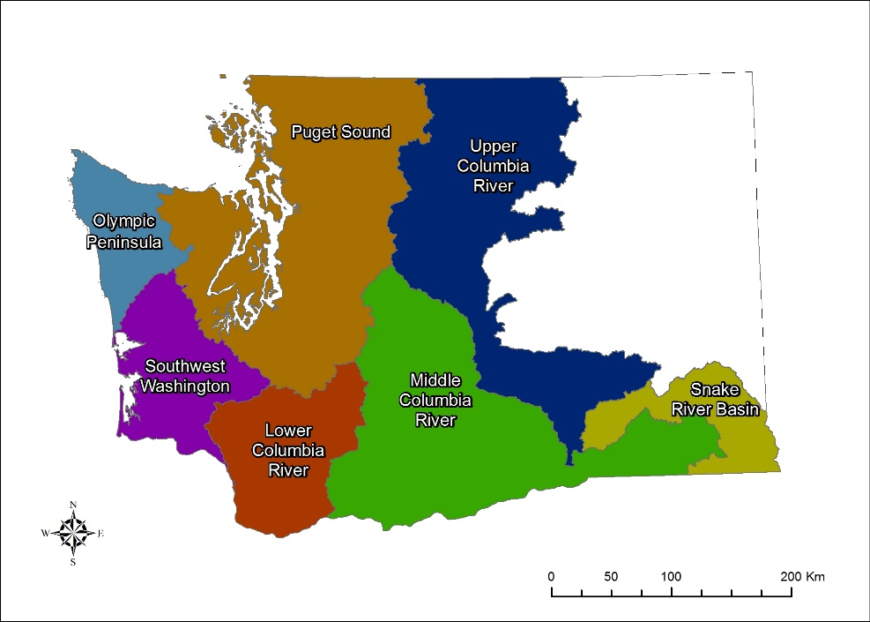
Motivation and goal
Why these steelhead populations?
Concerns over population status (declining trends) has led to recent fishery closures along the coast
Olympic Peninsula and SW Washington DPSs are currently not listed under the ESA (but a petition to list OP steelhead submitted to NOAA in Aug 2022)
Management goals were established in the 1980s using limited data and assessments of conservation risks are not available
WA steelhead DPSs (Distinct Population Segments)
ESA-listed
Assess risks and benefits of harvest strategies using management strategy evaluation (MSE)
4
Department of Fish and Wildlife

Slide 5
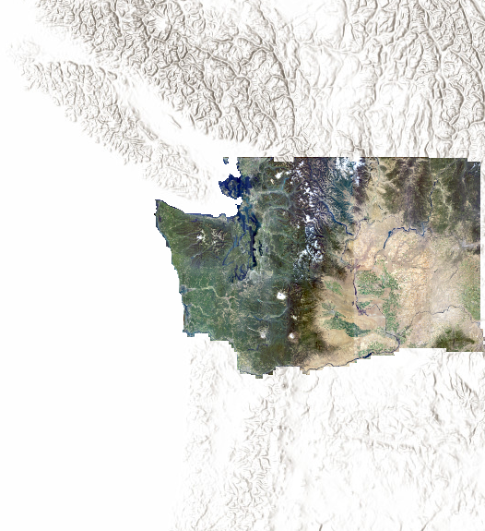
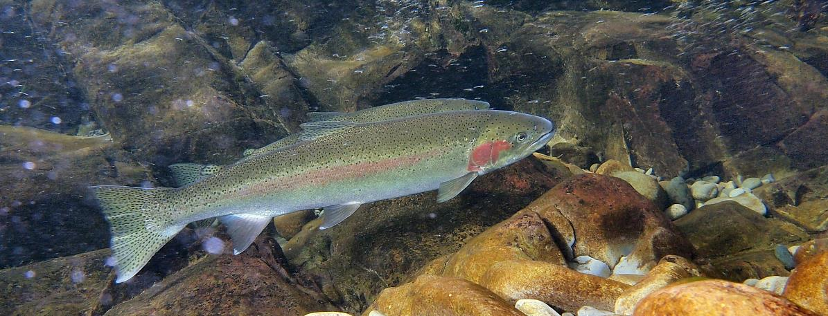

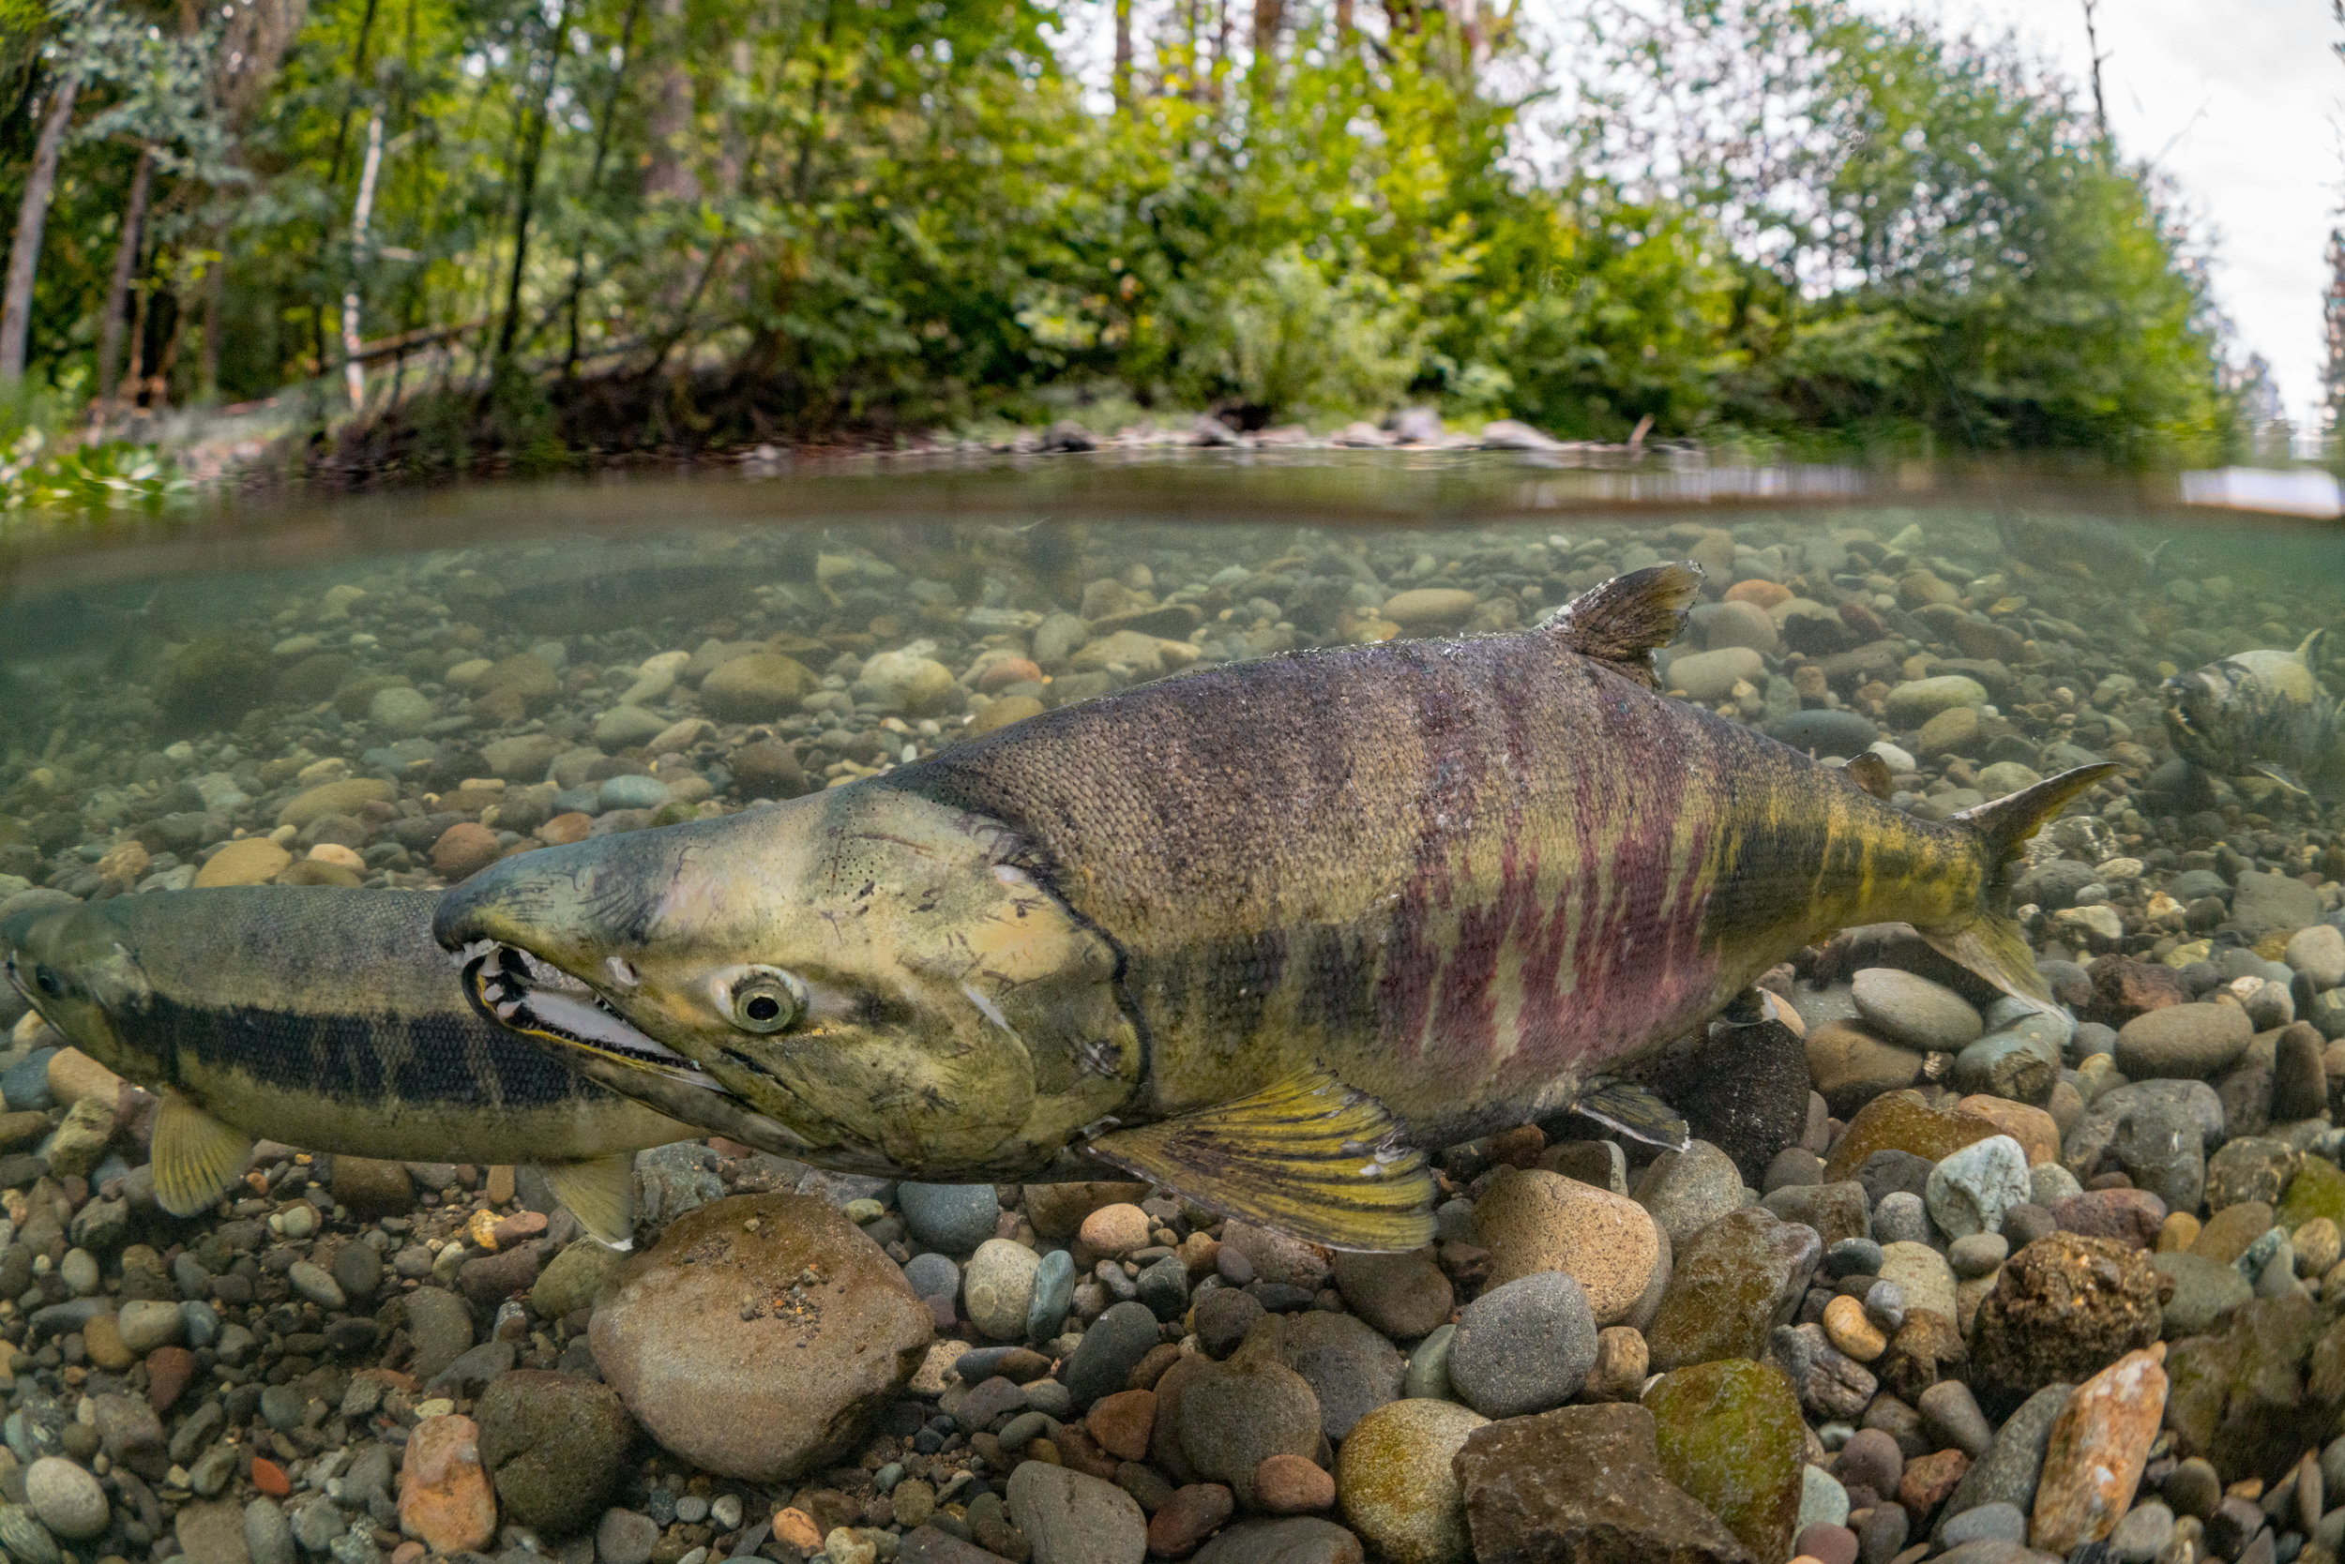



Motivation and goal
Potential advantages of MSE framework
Can be applied to salmon and steelhead populations statewide
Evaluate current practices relative to alternative approaches
Standardize fishery management across regions and species
Photo: John McMillan
Photo: Morgan Bond
Photo: Jason Ching
Photo: Jason Ching
Photo: Jason Ching
Photo: Jason Ching
5
Department of Fish and Wildlife

Slide 6
What is Management Strategy Evaluation?

Slide 7
What is Management Strategy Evaluation (MSE)?
MSE is used to identify the best management strategy among a set of candidate strategies by quantifying trade-offs among multiple management objectives
Simulation approach to evaluate the relative performance of management strategies
Accounts for various sources of uncertainty (observation, estimation, implementation)
Uses forward projections to model effects of alternative Harvest Control Rules (HCRs)
Given what we know about a population
from past observations
How might the future look like if we manage using strategy x, y, z
What does that mean for fishing opportunities and conservation risks?
Department of Fish and Wildlife

Slide 8

Harvest Control Rules
HCRs are used in fishery management plans to determine the allowable fishing mortality
(fishery regulations such as the time and location of fishing are used to achieve a specific HCR)
Examples of HCRs:
Harvest all surplus above escapement goal
Fixed harvest rate (e.g., harvest 50% of total run)
Abundance-based harvest tiers
Diversity of methods:
Simple stock-recruit analysis to estimate reference points
Based on habitat capacity estimates
Professional opinion
Common deficiencies:
Often no assessment of alternatives
No complete accounting of uncertainty
Not typically updated as data become available
nwtreatytribes.org
Can be addressed using an MSE
Department of Fish and Wildlife

Slide 9
Conceptual illustration of the MSE process
1. Collect available population data
2. Build statistical model given observed data
3. Design management strategies and project population forward
4. Quantify performance trade-offs and select alternative strategy
Abundance
Recruitment
Abundance
Year
Spawners
Year
Population data
Integrated Population Model
Management Strategy Evaluation
Fishery Management Plan
Data input:
Escapement
Age structure
Catch/mortality
Parameters:
Productivity
Capacity
Population state
Performance:
Mean catch
Catch variability
Conservation risks
Science
Policy
Department of Fish and Wildlife

Slide 10
MSE for steelhead populations in coastal WA

Slide 11
Part I – Population Data
Abundance
Recruitment
Abundance
Year
Spawners
Year
Population data
Integrated Population Model
Management Strategy Evaluation
Fishery Management Plan
Data input:
Escapement
Age structure
Catch/mortality
Parameters:
Productivity
Capacity
Population state
Performance:
Mean catch
Catch variability
Conservation risks
Department of Fish and Wildlife

Slide 12
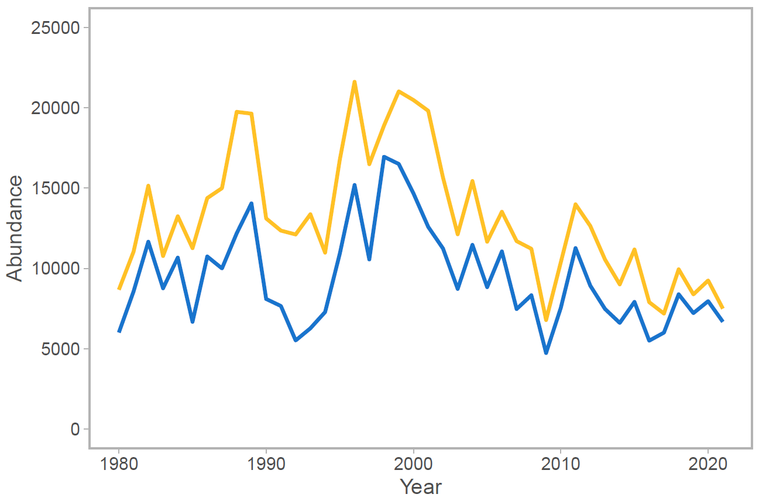

Part I – Population Data
Observational data input to population model
Estimates of escapement (redd surveys, mark-recapture, etc.)
Catch statistics and estimates of non-retention mortality
Age structure information from scale samples (mostly tribal fishery)
Quillayute River winter steelhead
Total run size (harvest + escapement)
Spawner escapement
Photo : John McMillan
Steelhead redds - Photo: John MCMillan
Department of Fish and Wildlife

Slide 13
Part II – Integrated Population Model (IPM)
Abundance
Recruitment
Abundance
Year
Spawners
Year
Population data
Integrated Population Model
Management Strategy Evaluation
Fishery Management Plan
Data input:
Escapement
Age structure
Catch/mortality
Parameters:
Productivity
Capacity
Population state
Performance:
Mean catch
Catch variability
Conservation risks
Department of Fish and Wildlife

Slide 14
What is an Integrated Population Model (IPM)?
IPMs are statistical population models that integrate multiple sources of information to estimate important population parameters (productivity, capacity, etc.)
Integrate information about population abundances and demography
Allow for sharing of information across populations when fit hierarchically
Can incorporate independent prior information using a Bayesian approach
Capture full uncertainty in the data by estimating a joint likelihood
Abundance data
Escapement estimates
Total catch/harvest
Non-retention mortality
Bayesian approach
Prior information
Population productivity
Mean age composition
Observation error variance
Integrated data
Demographic data
Spawner age composition
Spawner sizes & sex ratio
Size-selectivity of fishery
Joint
likelihood
Hierarchical structure
Joint posterior distribution of all parameters
Department of Fish and Wildlife

Slide 15
What is an Integrated Population Model (IPM)?
IPMs are statistical population models that integrate multiple sources of information to estimate important population parameters (productivity, capacity, etc.)
Provide estimates of biological reference points using spawner-recruit model (e.g., escapement at MSY)
Estimate time-varying recruitment residuals (i.e. changes in productivity/capacity over time)
Steelhead IPM explicitly models iteroparity (maiden/repeat spawner age structure and kelt survival rate)
α (maximum R/S)
Replacement
R_{max}
R_{MSY}
Recruits
R_{eq}
MSY
S_{MSY}
S_{max}
S_{eq}
Spawners
Department of Fish and Wildlife
Notes:
Emphasize that there's no need to focus on the details of the S-R curve illustration—the point is that S-R analysis is used to estimate the biological reference points

Slide 16
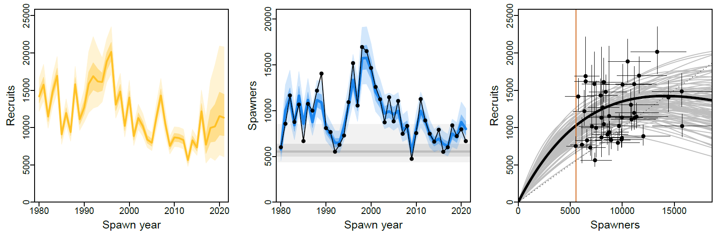
Single-population IPM: spawners and recruitment
Quillayute River winter steelhead
PRELIMINARY RESULTS
Department of Fish and Wildlife

Slide 17
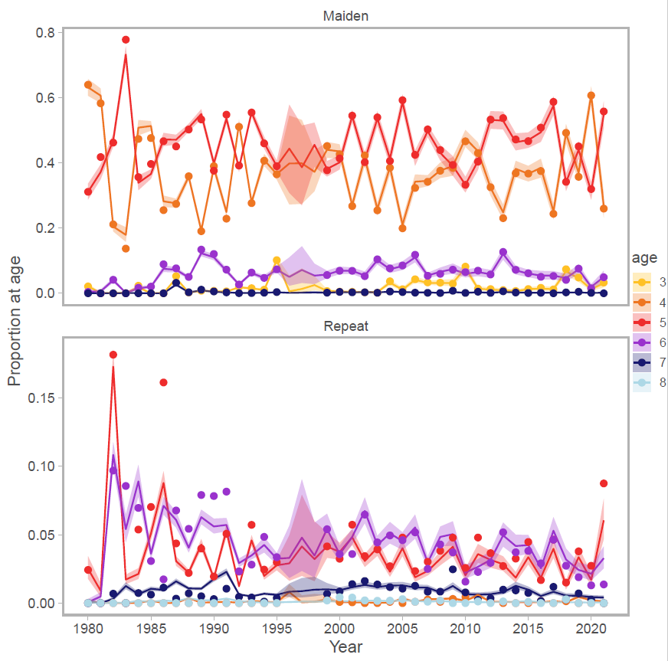
IPM-estimated age structure
Quillayute River winter steelhead
PRELIMINARY RESULTS
Changes in kelt survival rate over time
Department of Fish and Wildlife

Slide 18
Part III – Management Strategy Evaluation (MSE)
Abundance
Recruitment
Abundance
Year
Spawners
Year
Population data
Integrated Population Model
Management Strategy Evaluation
Fishery Management Plan
Data input:
Escapement
Age structure
Catch/mortality
Parameters:
Productivity
Capacity
Population state
Performance:
Mean catch
Catch variability
Conservation risks
Department of Fish and Wildlife

Slide 19
Part III – Management Strategy Evaluation (MSE)
Harvest Control Rules and quantifiable performance metrics
Harvest Control Rules
Performance metrics
Historical agreed escapement goal
Model-estimated escapement goal (S_{MSY})
Fixed harvest rate goals at varying levels
Hybrid of different state and tribal HCRs
Abundance-based harvest rate tiers
(tied to estimated biological reference points)
Projection given HCR
Opportunity metrics
Mean harvest
Stability in harvest
Probability of open fishery
Conservation metrics
Mean escapement
Probability above threshold
Probability of recovery or quasi-extinction?
Abundance
Year
Department of Fish and Wildlife

Slide 20
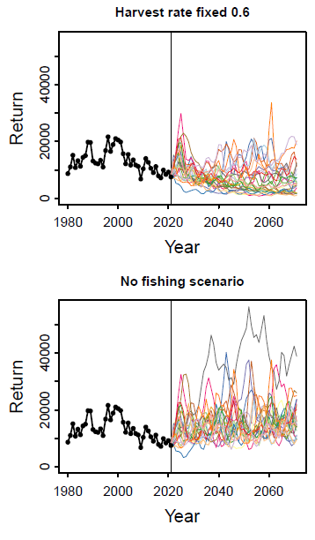
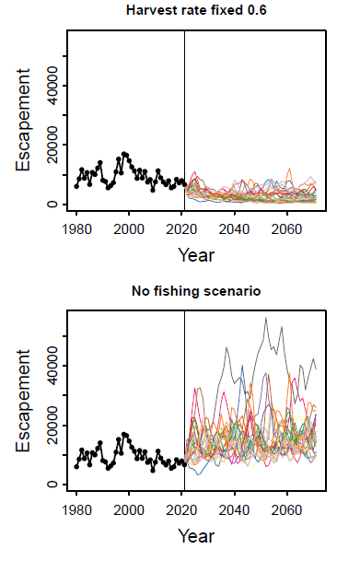
Population projections
Projections reflect full uncertainty
Parameter estimation uncertainty
Process uncertainty (e.g., recruitment)
Fishery implementation uncertainty
Management targets not achieved precisely:
Error in pre- or in-season run forecasts
Imperfect in-season monitoring
Unknown non-retention mortality
Mixed fisheries that include limiting stocks
Unreported discards and illegal catch
Changes in fishing and processing capacity
Department of Fish and Wildlife

Slide 21
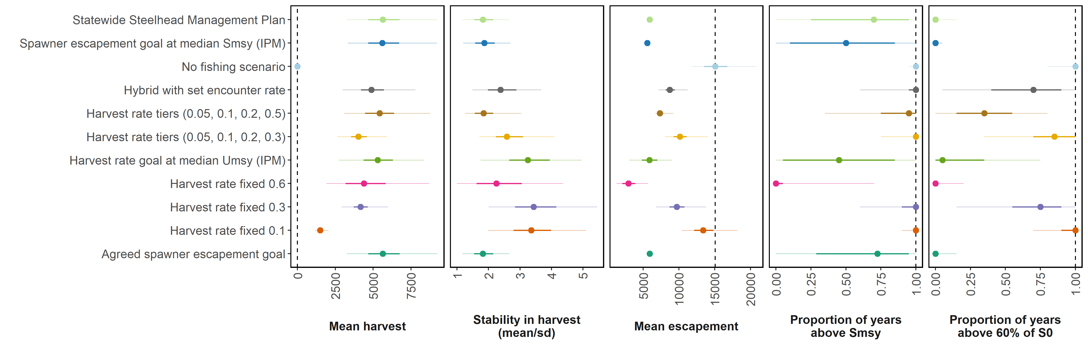
Performance metrics for each HCR
Multiple performance metrics compared among alternative management strategies
PRELIMINARY RESULTS
Harvest Control Rule (HCR)
Department of Fish and Wildlife

Slide 22
Performance metrics for each HCR
Multiple performance metrics compared among alternative management strategies
PRELIMINARY RESULTS
Medians with 50% and 95% ranges
No fishing scenario reference line
Harvest Control Rule (HCR)
Opportunity metrics
Conservation metrics
Department of Fish and Wildlife

Slide 23
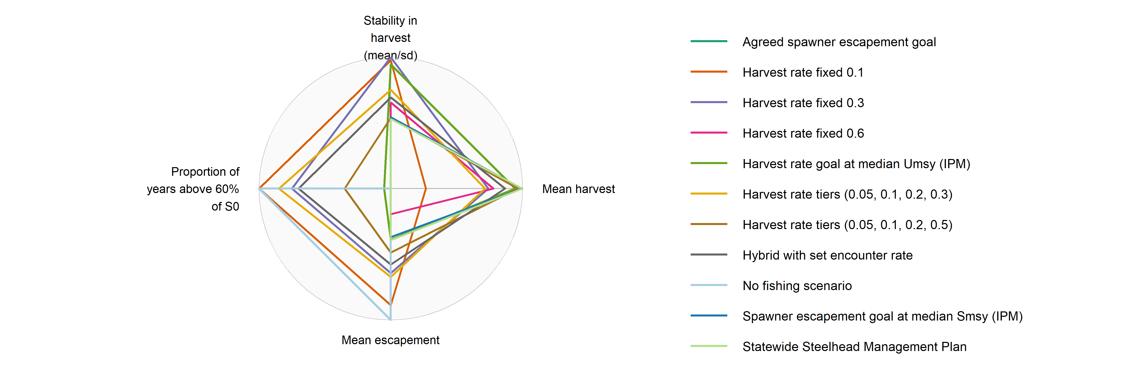
Trade-offs among multiple performance metrics
Fishing opportunity vs. conservation benefits
PRELIMINARY RESULTS
Figure: Radar plot of median values by HCR for each metric, axes are scaled from zero (center) to the highest value across all HCRs
Harvest Control Rule (HCR)
Department of Fish and Wildlife

Slide 24
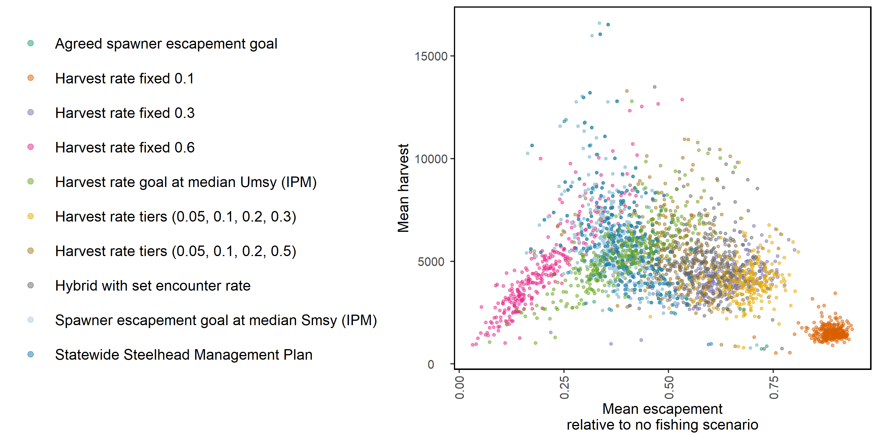
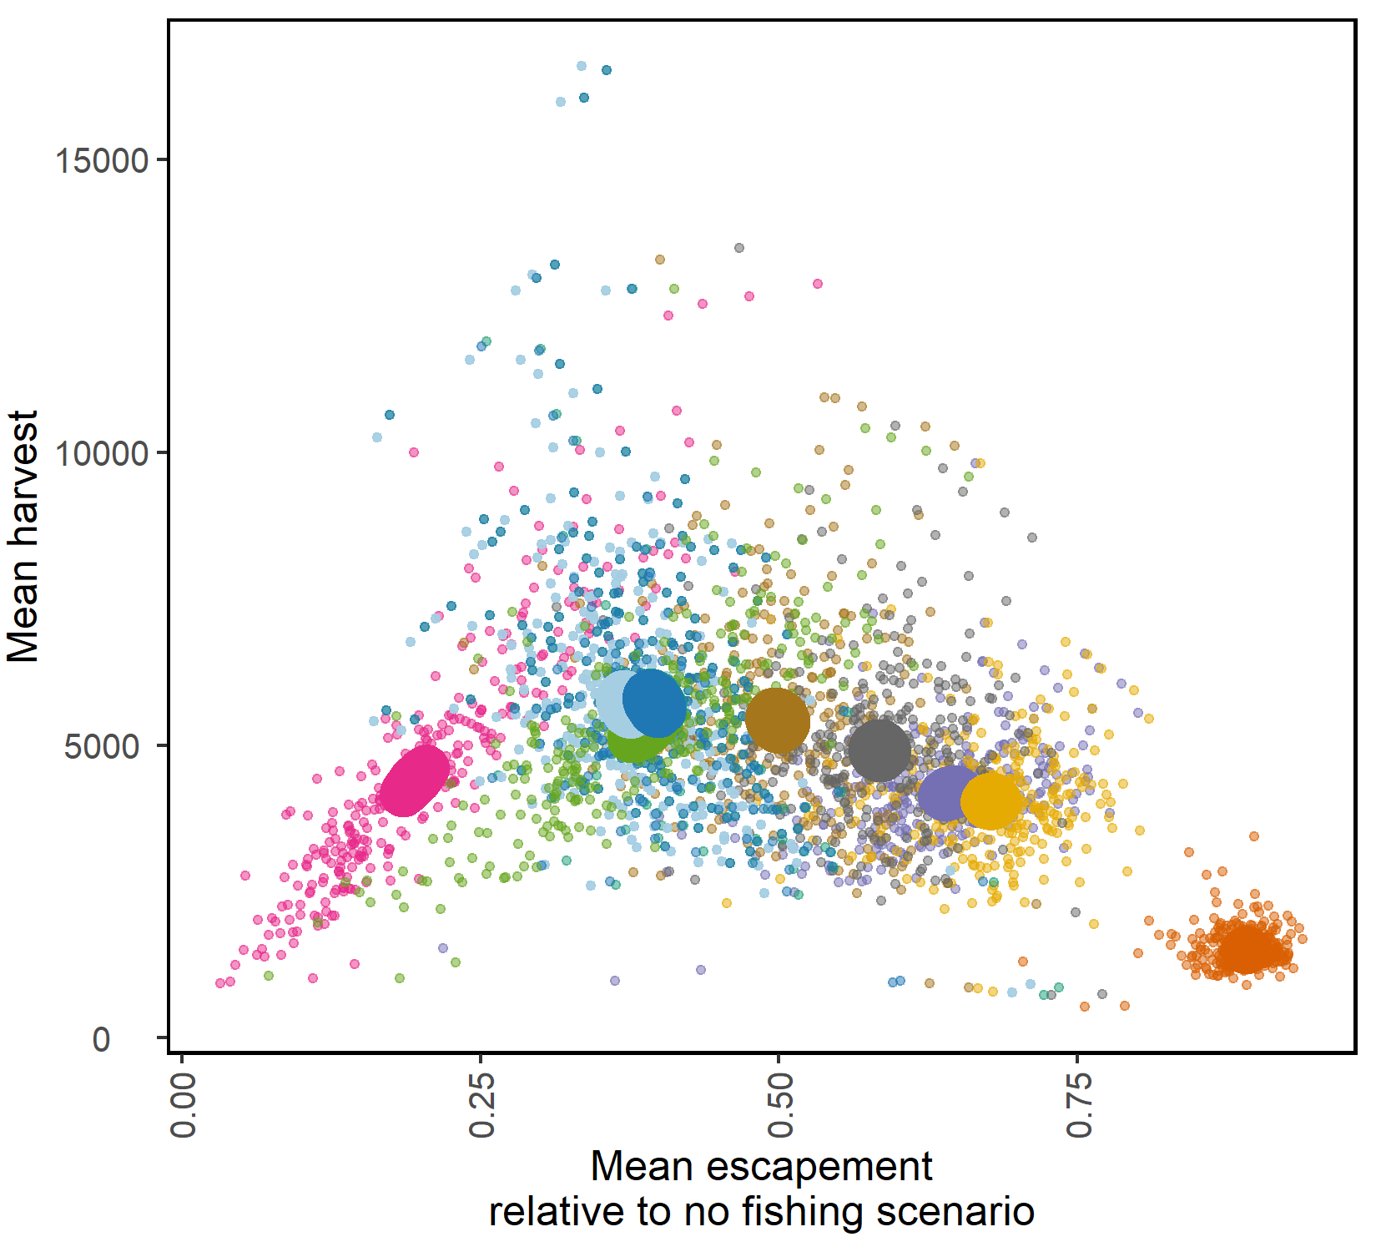
Trade-off between two performance metrics
Fishing opportunity vs. conservation benefits
PRELIMINARY RESULTS
Harvest Control Rule (HCR)
Fishing opportunity
Conservation benefits
Department of Fish and Wildlife

Slide 25
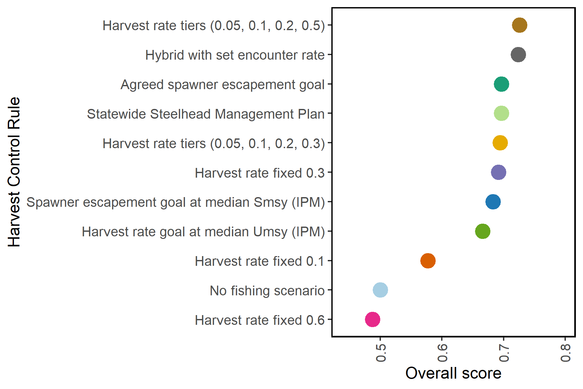
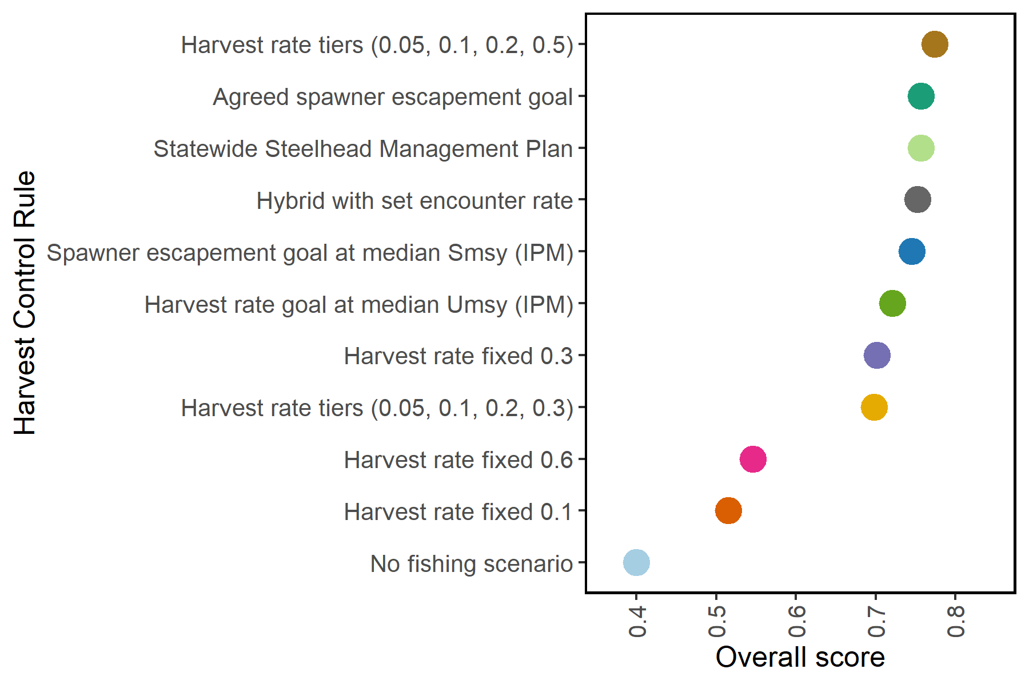
HCR overall scores
Based on two or more performance metrics and relative weights
PRELIMINARY RESULTS
Example:
Metrics: mean harvest and mean spawner escapement
Weights: equal for the two performance metrics (0.6/0.4)
Metric score: proportion of maximum value across HCRs
Overall score: sum(metric scores * relative weights)
Example:
Metrics: mean harvest and mean spawner escapement
Weights: equal for the two performance metrics (0.5/0.5)
Metric score: proportion of maximum value across HCRs
Overall score: sum(metric scores * relative weights)
Department of Fish and Wildlife

Slide 26
Part IV – Fishery Management Plan
Abundance
Recruitment
Abundance
Year
Spawners
Year
Population data
Integrated Population Model
Management Strategy Evaluation
Fishery Management Plan
Data input:
Escapement
Age structure
Catch/mortality
Parameters:
Productivity
Capacity
Population state
Performance:
Mean catch
Catch variability
Conservation risks
Department of Fish and Wildlife

Slide 27
Summary and conclusions

Slide 28
Summary and conclusions
MSE approach can be used to inform fishery management of steelhead
Based on a population model that explicitly accounts for iteroparity
Evaluates the relative performance of alternative management strategies
Can improve the balance between socio-economic and biological objectives
Fishing opportunity
(expected average catch)
Conservation benefits
(probability of recovery)
Department of Fish and Wildlife

Slide 29
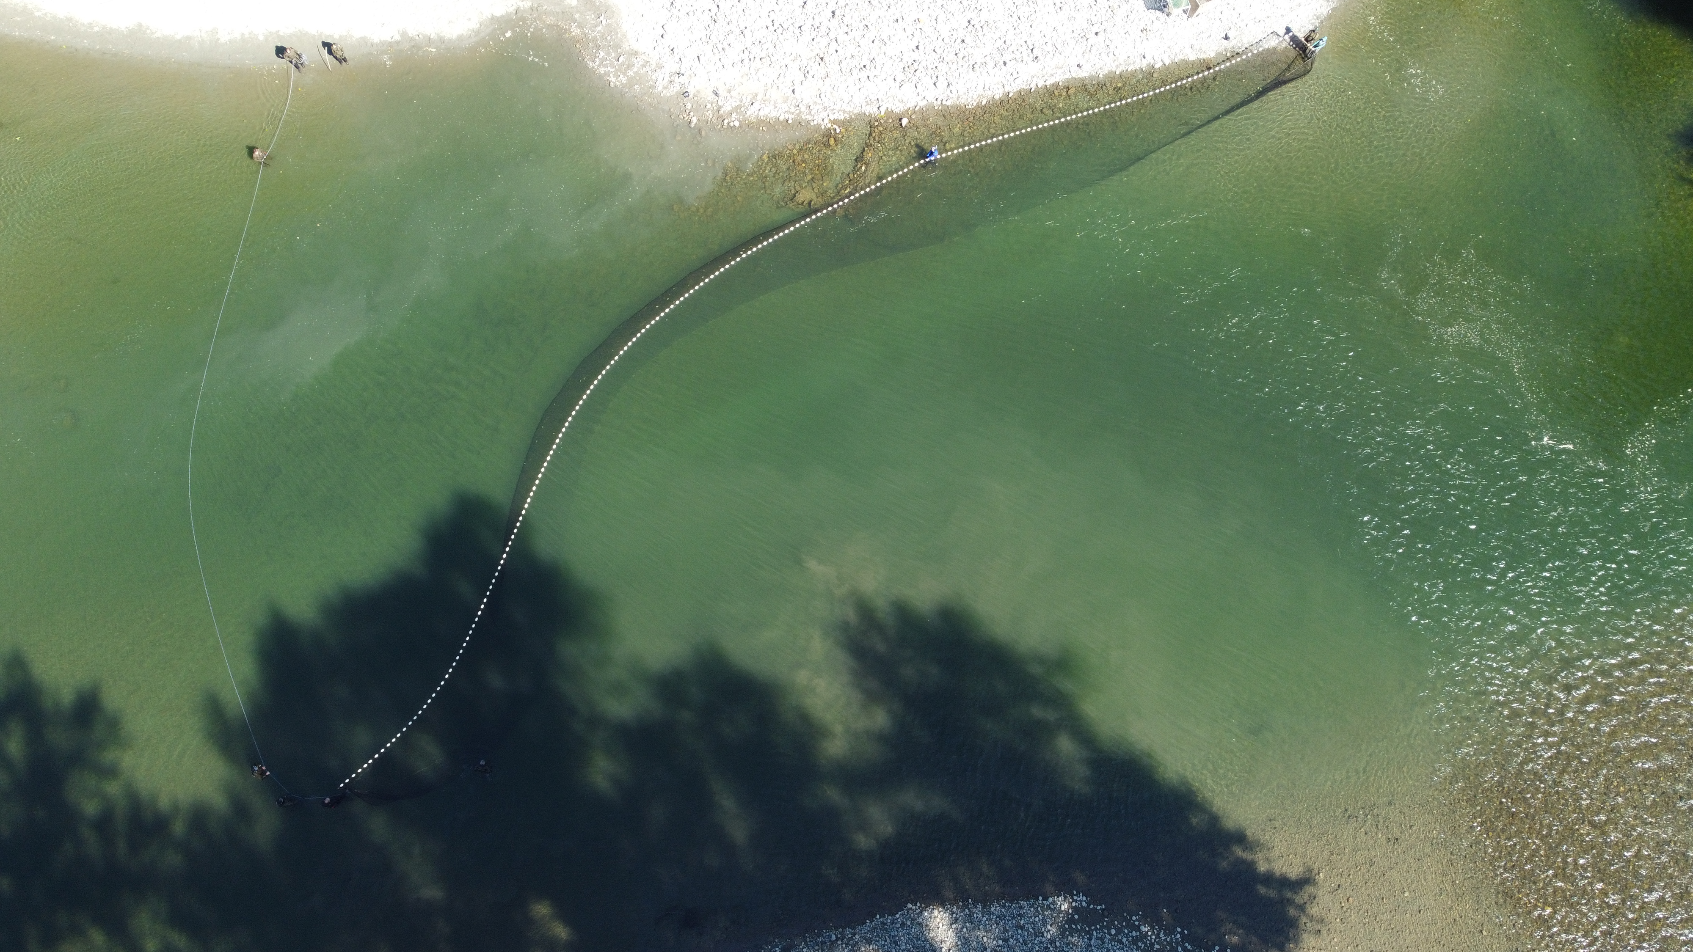
Thanks!
jan.ohlberger@dfw.wa.gov
Photo: Pete Verhey
29
Department of Fish and Wildlife

Slide 30
SUPPLEMENTARY INFORMATION

Slide 31
Implementation uncertainty
Why accounting for fishery implementation uncertainty is important
(from simple random error to modeling human behavior and fishery dynamics)
Management targets do not have to be achieved precisely, because implementation uncertainty is part of simulated HCR
In-season abundance updates are less critical to ensure compliance of fisheries with the HCR (management plan)
Reduced risk of unexpected ad-hoc fishery closures because years with harvest above surplus are ‘allowed’ by the HCR
Department of Fish and Wildlife

