Slide 1
Long-term changes in kelt survival of WA coastal steelhead
Jan Ohlberger¹, Eric Buhle², Thomas Buehrens¹, Neala Kendall¹
¹ Washington Department of Fish and Wildlife
² Mount Hood Environmental
Notes:
20 min talk plus 10 min Q&A (30 min time slot)

Slide 2
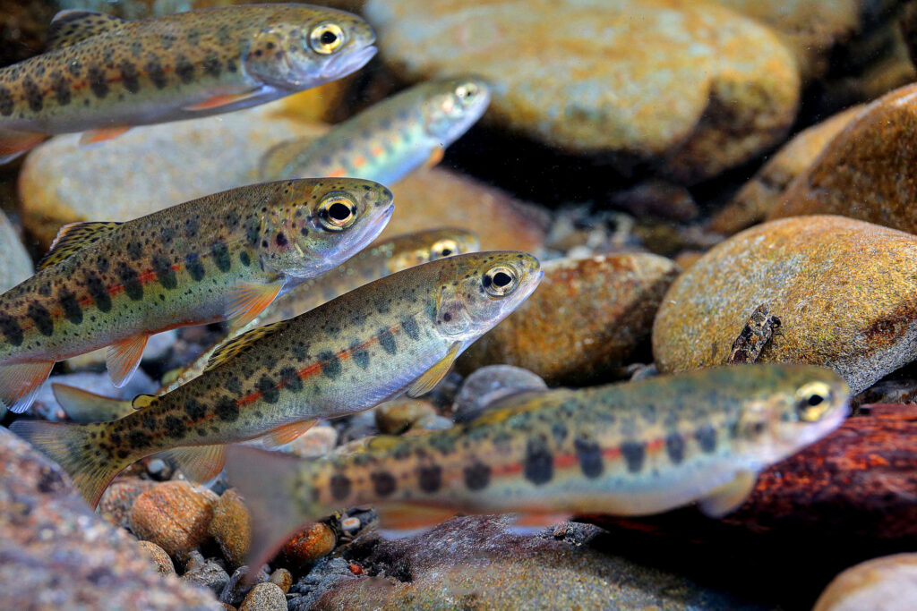

Acknowledgements
We thank all agency staff and tribal co-managers past and present for collecting, procuring, and sharing data
Special thanks for providing data and feedback:
Quinault Indian Nation Department of Fisheries
Jim Jorgensen, Tyler Jurasin
Washington Department of Fish and Wildlife
Toby Harbison, James Losee, Mike Scharpf, Jody Pope, Jenni Whitney, Andrew Claiborne, Curt Holt, Kevin See, Michaela Lowe
Photo: John McMillan
2
Department of Fish and Wildlife

Slide 3
Motivation and goal

Slide 4
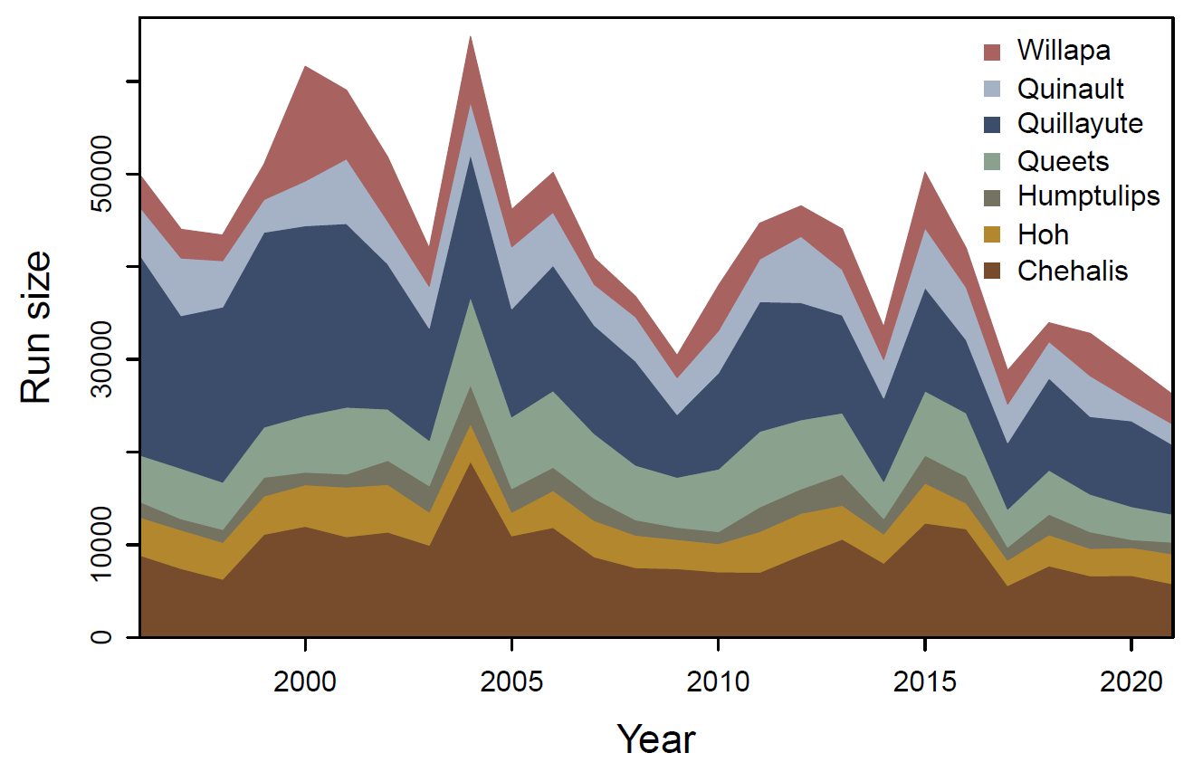
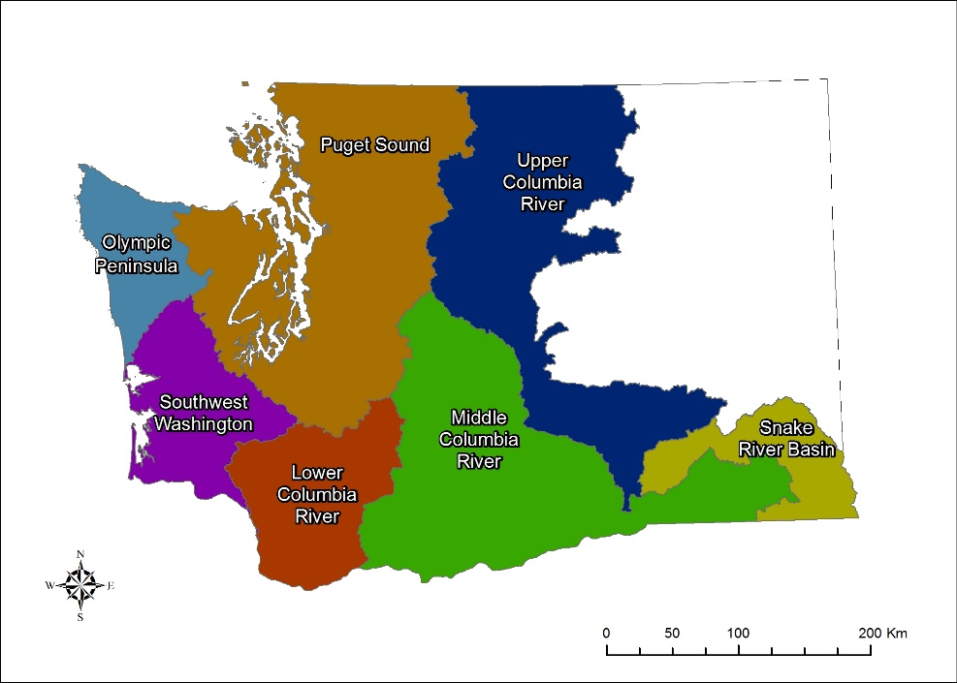
Motivation and goal
Many coastal steelhead populations show declining trends population abundance
Run sizes of WA coastal steelhead populations
DPSs (Distinct Population Segments) of Olympic Peninsula and SW Washington steelhead currently not ESA listed
ESA-listed
4
Department of Fish and Wildlife

Slide 5
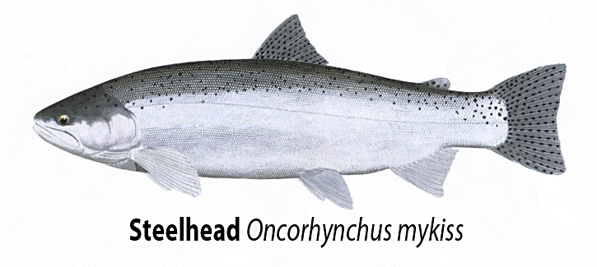
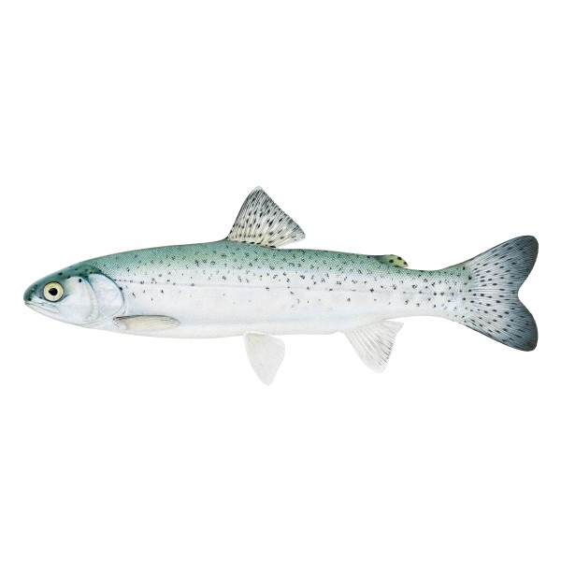
Motivation and goal
Better understand why steelhead population abundances have been declining
Understanding changes in marine survival, specifically kelt survival rates, over time
Steelhead life-cycle
Repeat spawners
ocean
freshwater
Maiden spawners
Smolts
Department of Fish and Wildlife
Notes:
Emphasize that there's no need to focus on the details of the S-R curve illustration—the point is that S-R analysis is used to estimate the biological reference points

Slide 6
Integrated Population Model for steelhead

Slide 7
What is an Integrated Population Model (IPM)?
IPMs are statistical population models that integrate multiple sources of information
Integrate information about population abundances and demography
Allow for sharing of information across populations when fit hierarchically
Can incorporate independent prior information using a Bayesian approach
Capture full uncertainty in the data due to estimation of joint likelihood
Abundance data
Escapement estimates
Total catch/harvest
Non-retention mortality
Bayesian approach
Prior information
Population productivity
Mean age composition
Observation error variance
Integrated data
Demographic data
Spawner age composition
Spawner sizes & sex ratio
Size-selectivity of fishery
Joint
likelihood
Hierarchical structure
Joint posterior distribution of all parameters
Department of Fish and Wildlife
Notes:
SAY (I removed the later part from the text): IPMs capture the full uncertainty in the data (joint likelihood / process model and observation model)
Emphasize that there's no need to focus on the details of the S-R curve illustration—the point is that S-R analysis is used to estimate the biological reference points

Slide 8
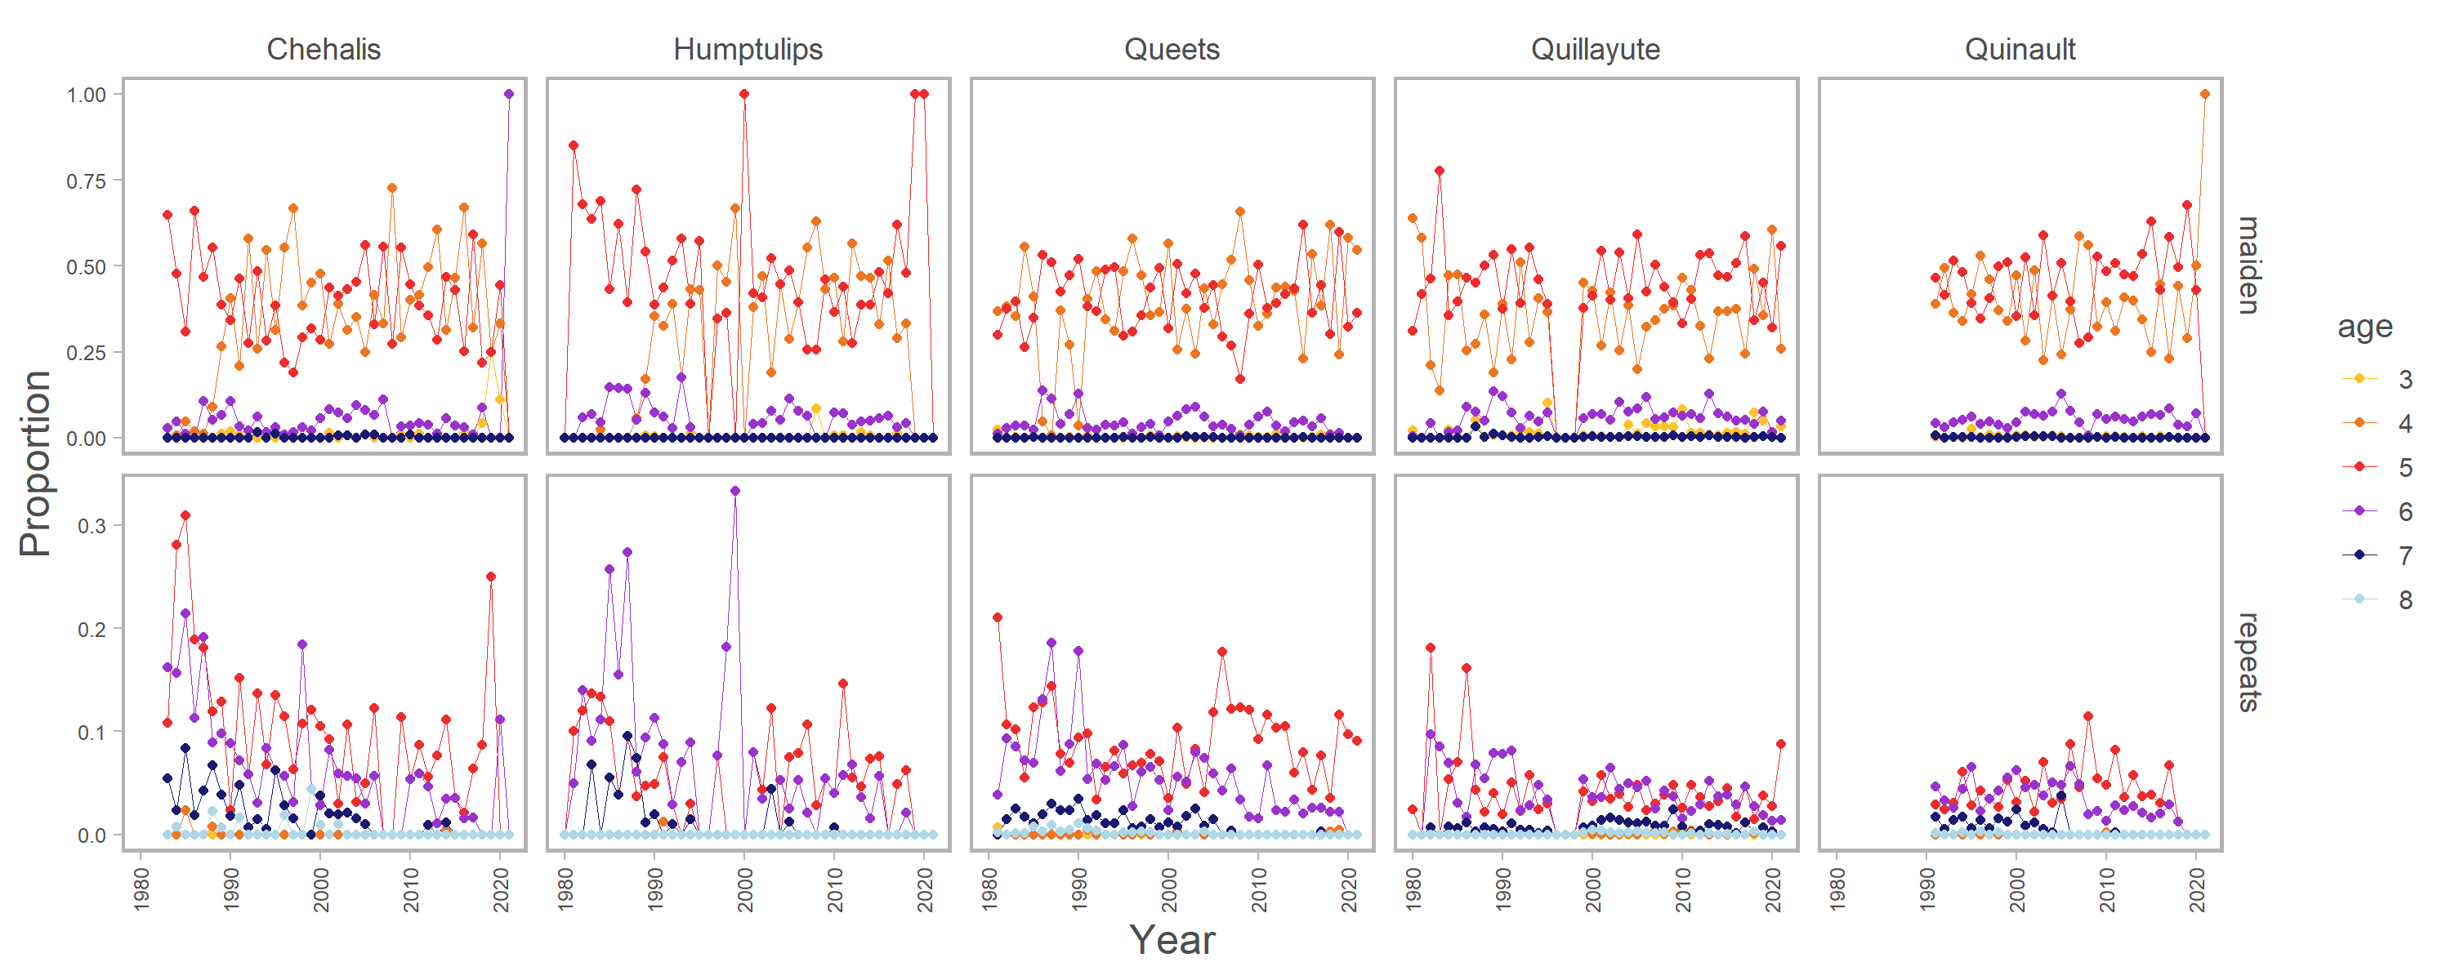
Steelhead IPM
IPM that explicitly models iteroparity
Incorporates age composition data for maiden and repeat spawners
Can estimate changes in kelt survival rate over time
Estimates time-varying recruitment residuals
Age notation example
2.2+S+
maiden
return
FW-2
SW-2+
total age at spawning
(maiden vs. repeats)
Year
S
1
2
3
4
5
6
7
1st
2nd
3rd
repeat
return
Department of Fish and Wildlife
Notes:
Emphasize that there's no need to focus on the details of the S-R curve illustration—the point is that S-R analysis is used to estimate the biological reference points

Slide 9
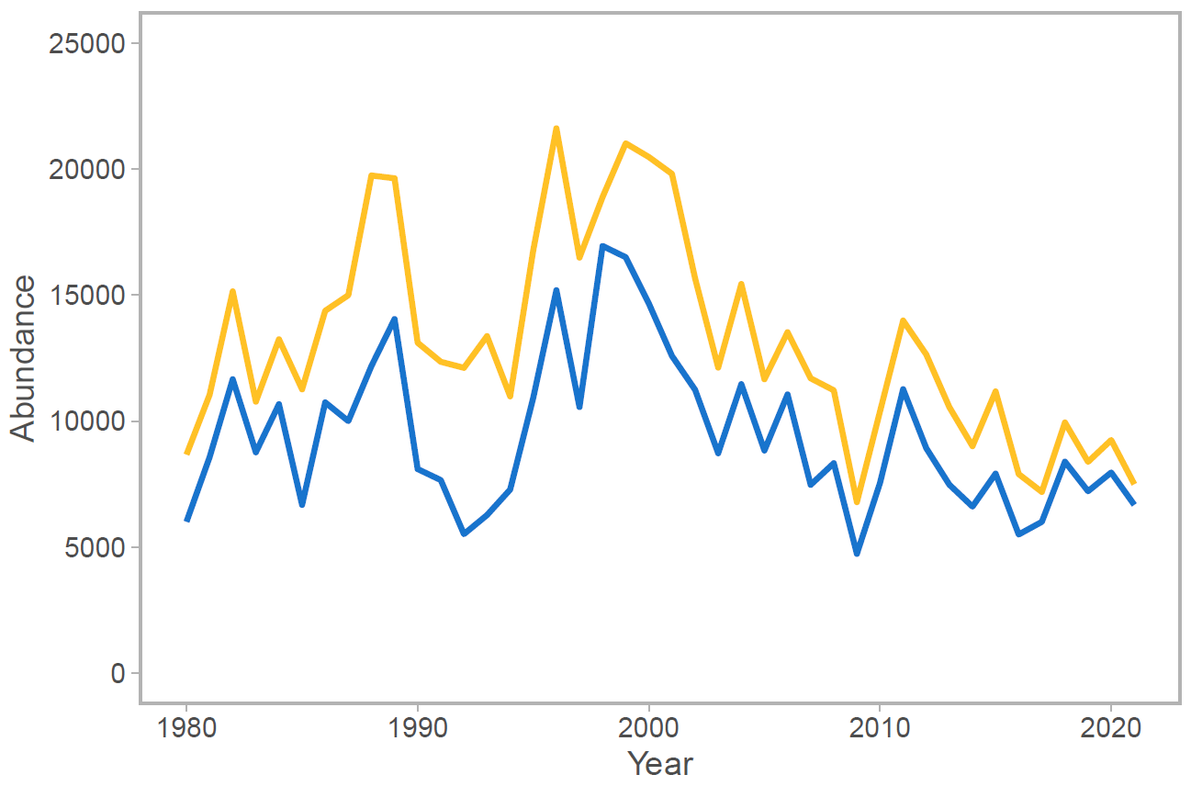
Steelhead IPM
Statistical population model relies on observational data
Estimates of escapement (spawner surveys, redd surveys, mark-recapture)
Estimates of total harvest and possibly non-retention mortality
Age structure information (e.g., scale samples)
Quillayute River winter steelhead
Total run size (harvest plus escapement)
Spawner escapement based on redd counts
Steelhead redds - Photo: John MCMillan
Department of Fish and Wildlife

Slide 10
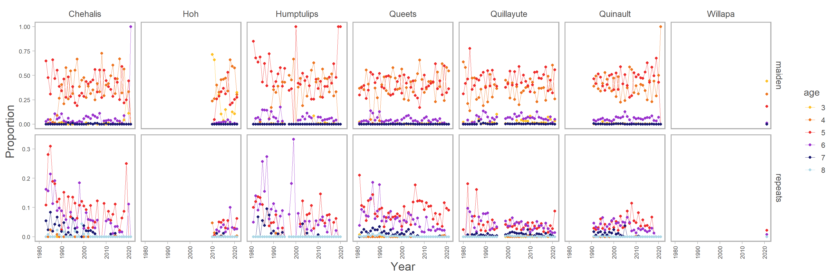
Hierarchical IPM: age data
Sampled age proportions for maiden and repeat spawners
Department of Fish and Wildlife

Slide 11
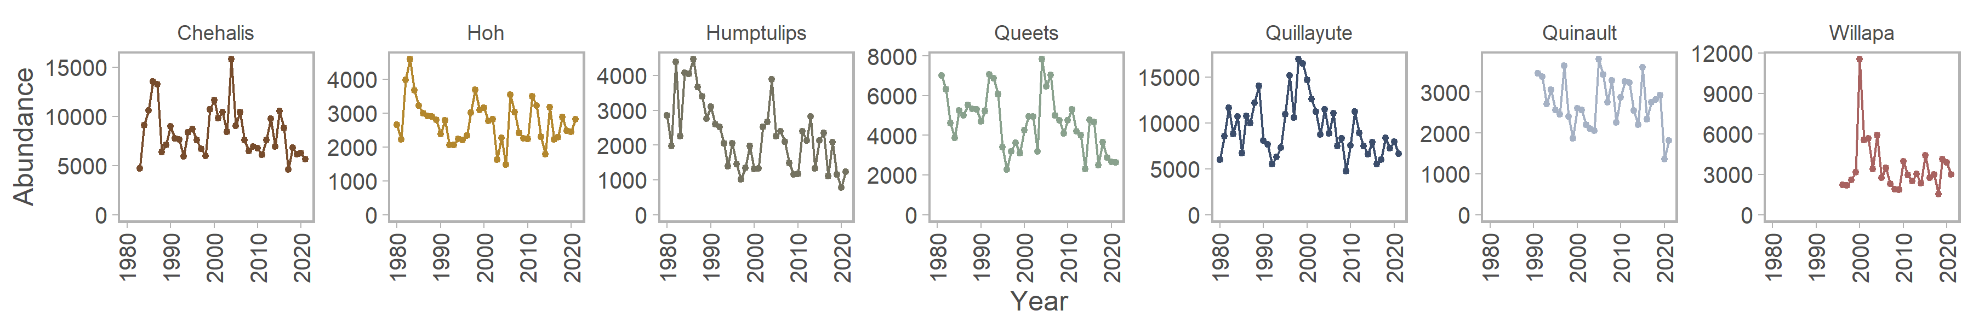
Hierarchical IPM: spawner abundances
Spawner abundance estimates
Department of Fish and Wildlife

Slide 12
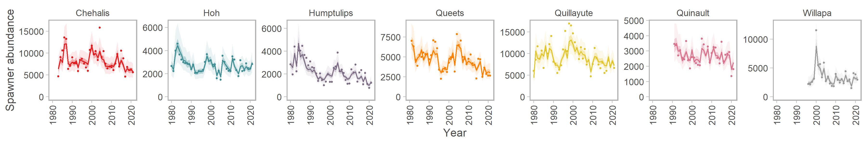
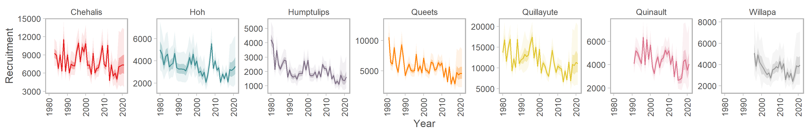
Hierarchical IPM: estimated spawners and recruitment
Multi-population model estimates of spawner abundance and recruitment (by spawn year)
PRELIMINARY RESULTS
Department of Fish and Wildlife

Slide 13
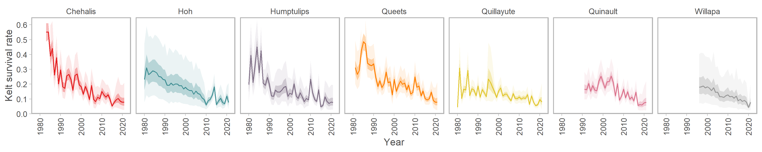
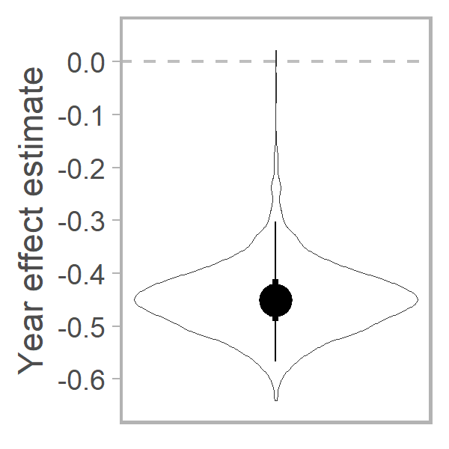
Hierarchical IPM: estimated kelt survival rate
Multi-population model estimates of natural kelt survival and year effect on survival rate
PRELIMINARY RESULTS
Year effect estimate
Circle: median (-0.444)
Bars: 50% and 95% CIs
Violin: full distribution

Slide 14
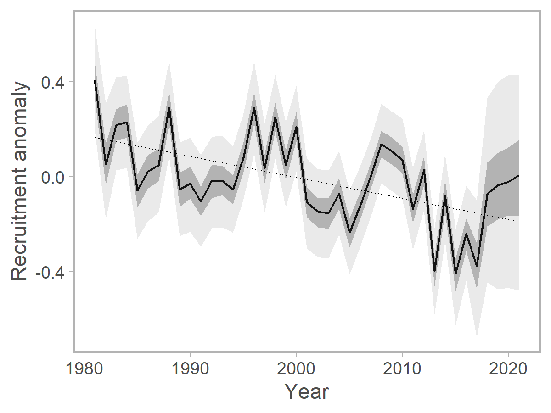
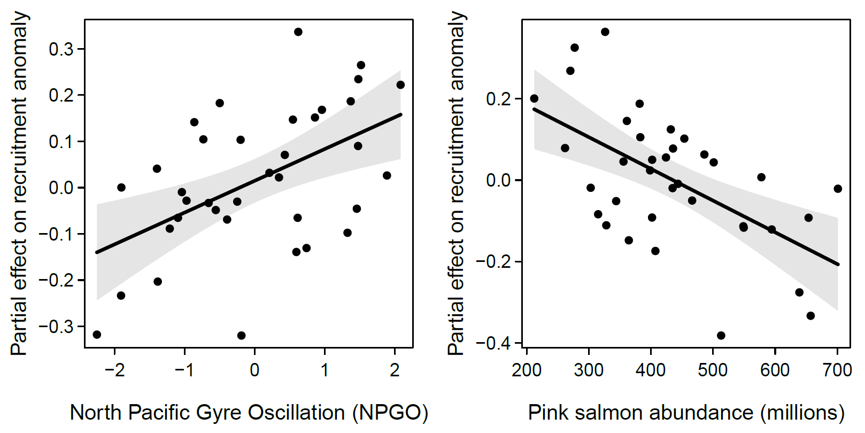
Hierarchical IPM: estimated recruitment anomaly
Multi-population model estimates of time-varying recruitment residuals (log-space)
PRELIMINARY RESULTS
Linear regression model of recruitment anomaly (medians):
About 46% of variance explained by NPGO (19%) and pink salmon abundance in the North Pacific (27%), 3 and 4 years after spawning
Negative trend in recruitment anomaly partially explained by lower marine survival to 1st maturation due to changing ocean conditions

Slide 15
Summary and conclusions

Slide 16
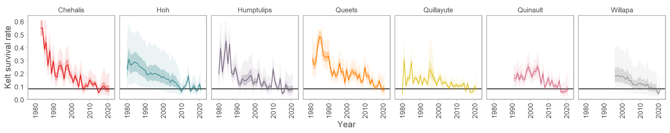
Summary
Changes in kelt survival:
Declines in kelt survival across multiple populations since at least the 1980s
Iteroparous life-history becoming less important in these steelhead populations
Declining marine survival to first maturation due to changing ocean conditions
Mean kelt survival of ~9% over the past five years
Department of Fish and Wildlife

Slide 17
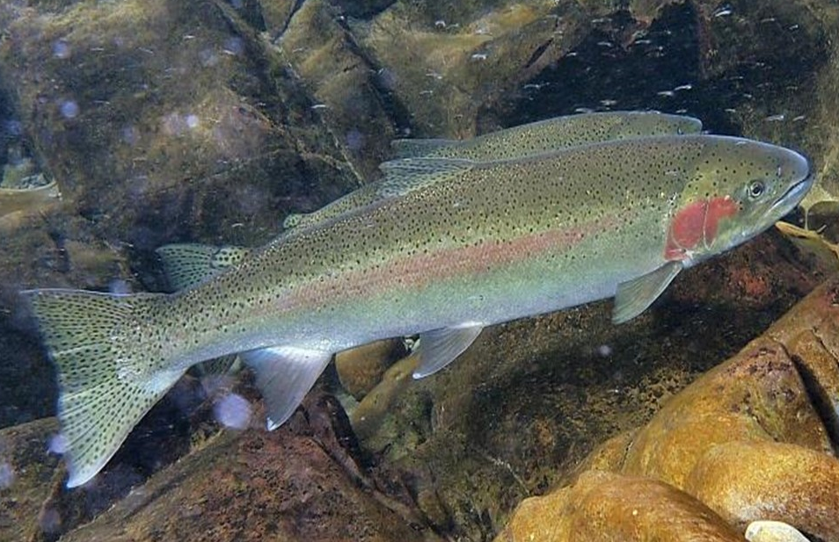
Conclusions
Management implications:
Reduced marine survival contributes to declines in population abundances
Loss of reproductive potential likely means lower population productivity
Need to quantify consequences for sustainable yield and conservation risks
Photo : John McMillan
Department of Fish and Wildlife

Slide 18
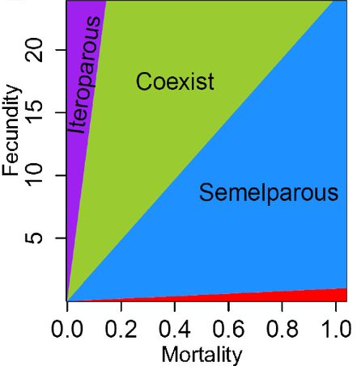
Food for thought
Potential consequences of declining survival rates:
Higher investment into early growth and reproduction
Evolutionary shift toward a semelparous life-history?
Evolutionarily Stable Strategy (ESS)
Maintenance of iteroparous life-history in steelhead depends on fecundity and especially ocean mortality
?
Christie et al 2018 PNAS
Department of Fish and Wildlife

Slide 19
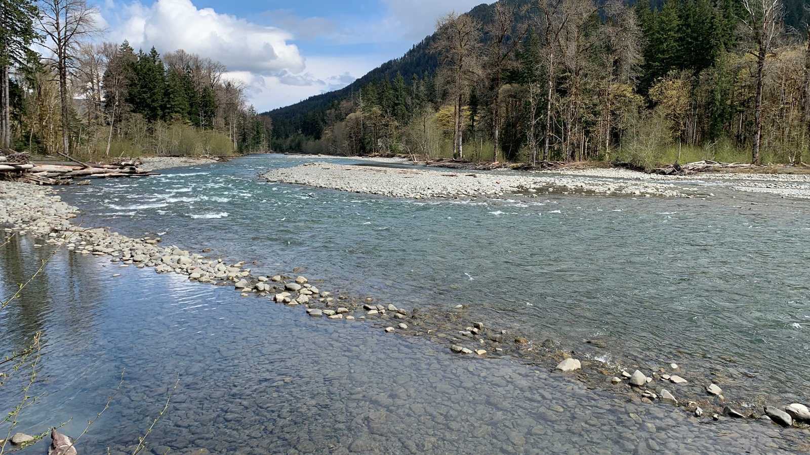
Thanks!
jan.ohlberger@dfw.wa.gov
Photo: Jan Ohlberger
19
Department of Fish and Wildlife

Slide 20
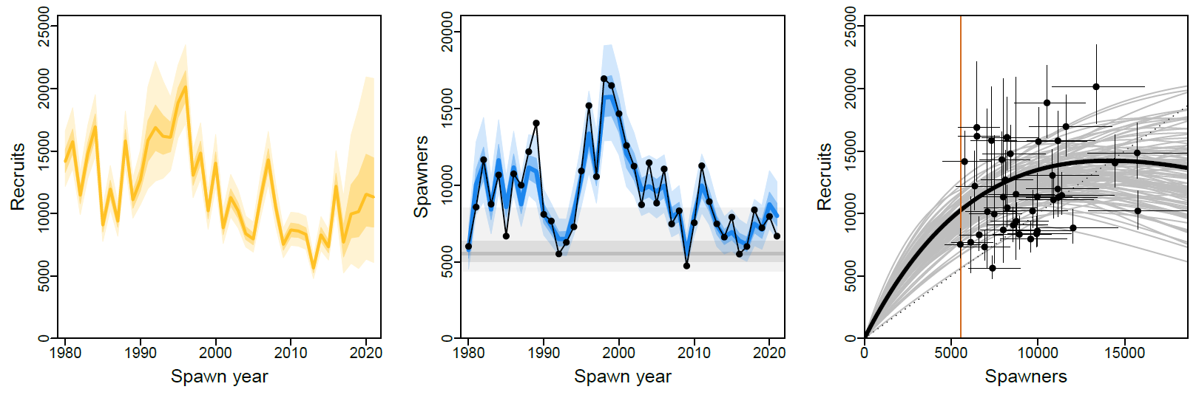
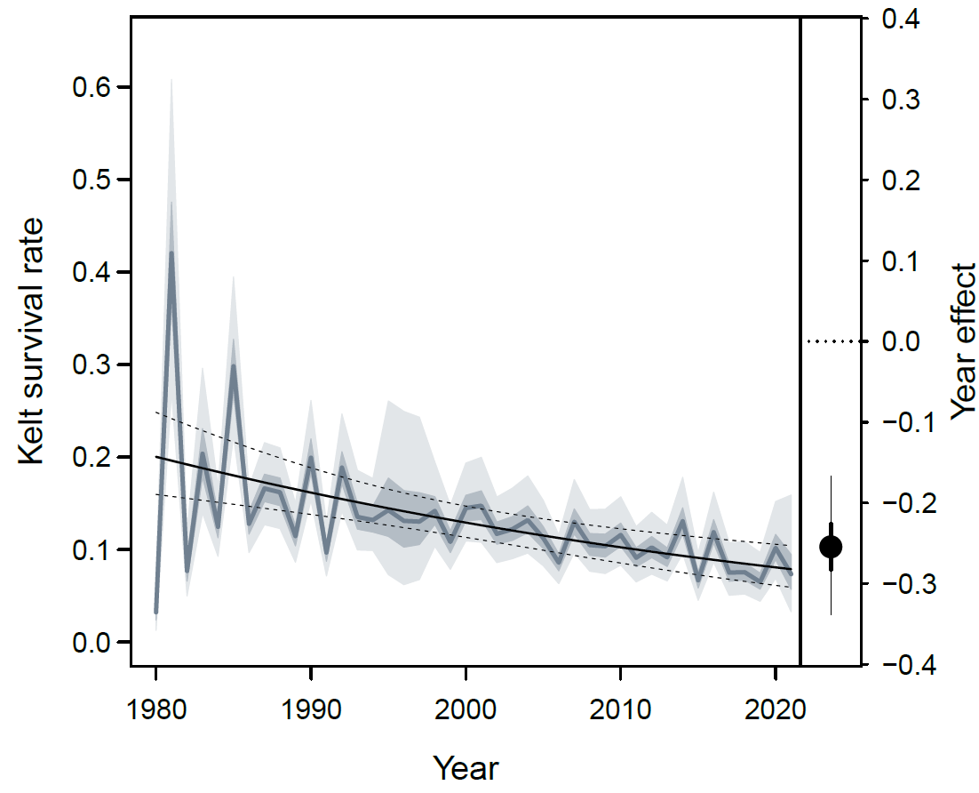
Single-population IPM: spawners, recruitment, kelt survival
Quillayute River winter steelhead
PRELIMINARY RESULTS
Department of Fish and Wildlife

