Slide 1
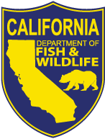
Statewide Drought Management and Monitoring Actions for Salmonids in California
Pacific Coast Steelhead Management Meeting
March 14-16, 2023
Jonathan Nelson, Program Manager
Anadromous Fishes Conservation and Management Program
California Department of Fish and Wildlife

Slide 2
Presentation Overview
  ESA Listed Anadromous Salmonids in California
  Status of Drought in California
  Drought Impacts to California Fisheries
  Drought Policy and Management Actions
  Drought Monitoring and Fish Rescue Actions
  Drought Focused Angling Actions
  Future Direction for Anadromous Salmonid Management

Slide 3
CA ESA Listed Steelhead DPSs
NC Steelhead
CV Steelhead
Threatened
Threatened
CCC Steelhead
SCCC Steelhead
SC Steelhead
Threatened
Threatened
Endangered

Slide 4
CA ESA Listed Chinook and Coho Salmon ESUs
CV Winter-run Chinook
CCC Coho
Endangered
Endangered
CV Spring-run Chinook
CC Chinook
SONCC Coho
Threatened
Threatened
Threatened

Slide 5
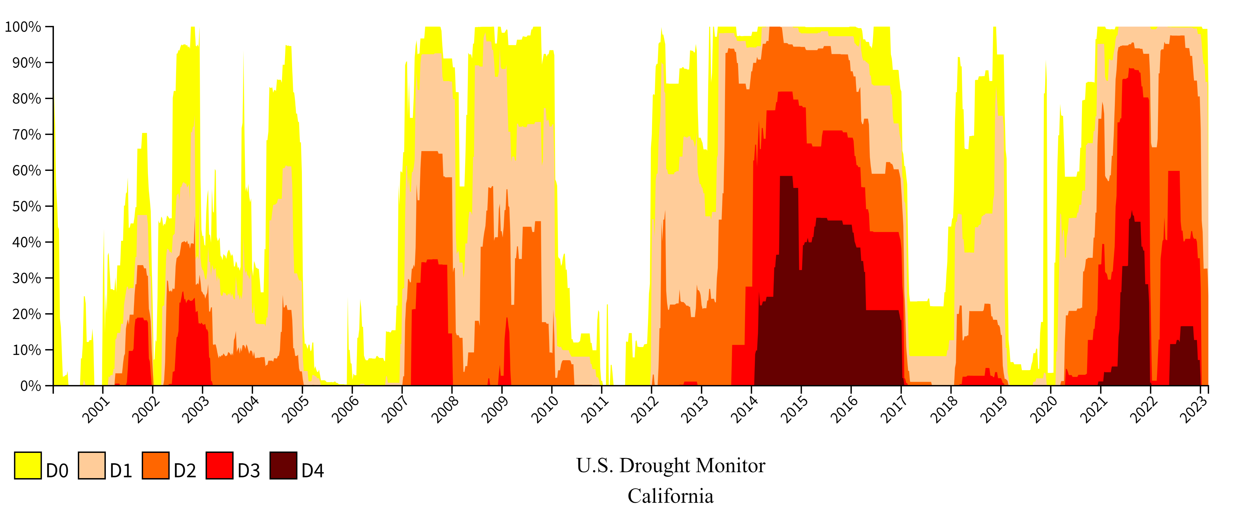
CA Drought Designations 2001-2023
Since 2000, the longest duration of drought (D1–D4) in California lasted 376 weeks beginning on December 27, 2011, and ending on March 5th, 2019. The most intense period of drought occurred the week of July 29, 2014, where D4 affected 58.41% of California land.

Slide 6
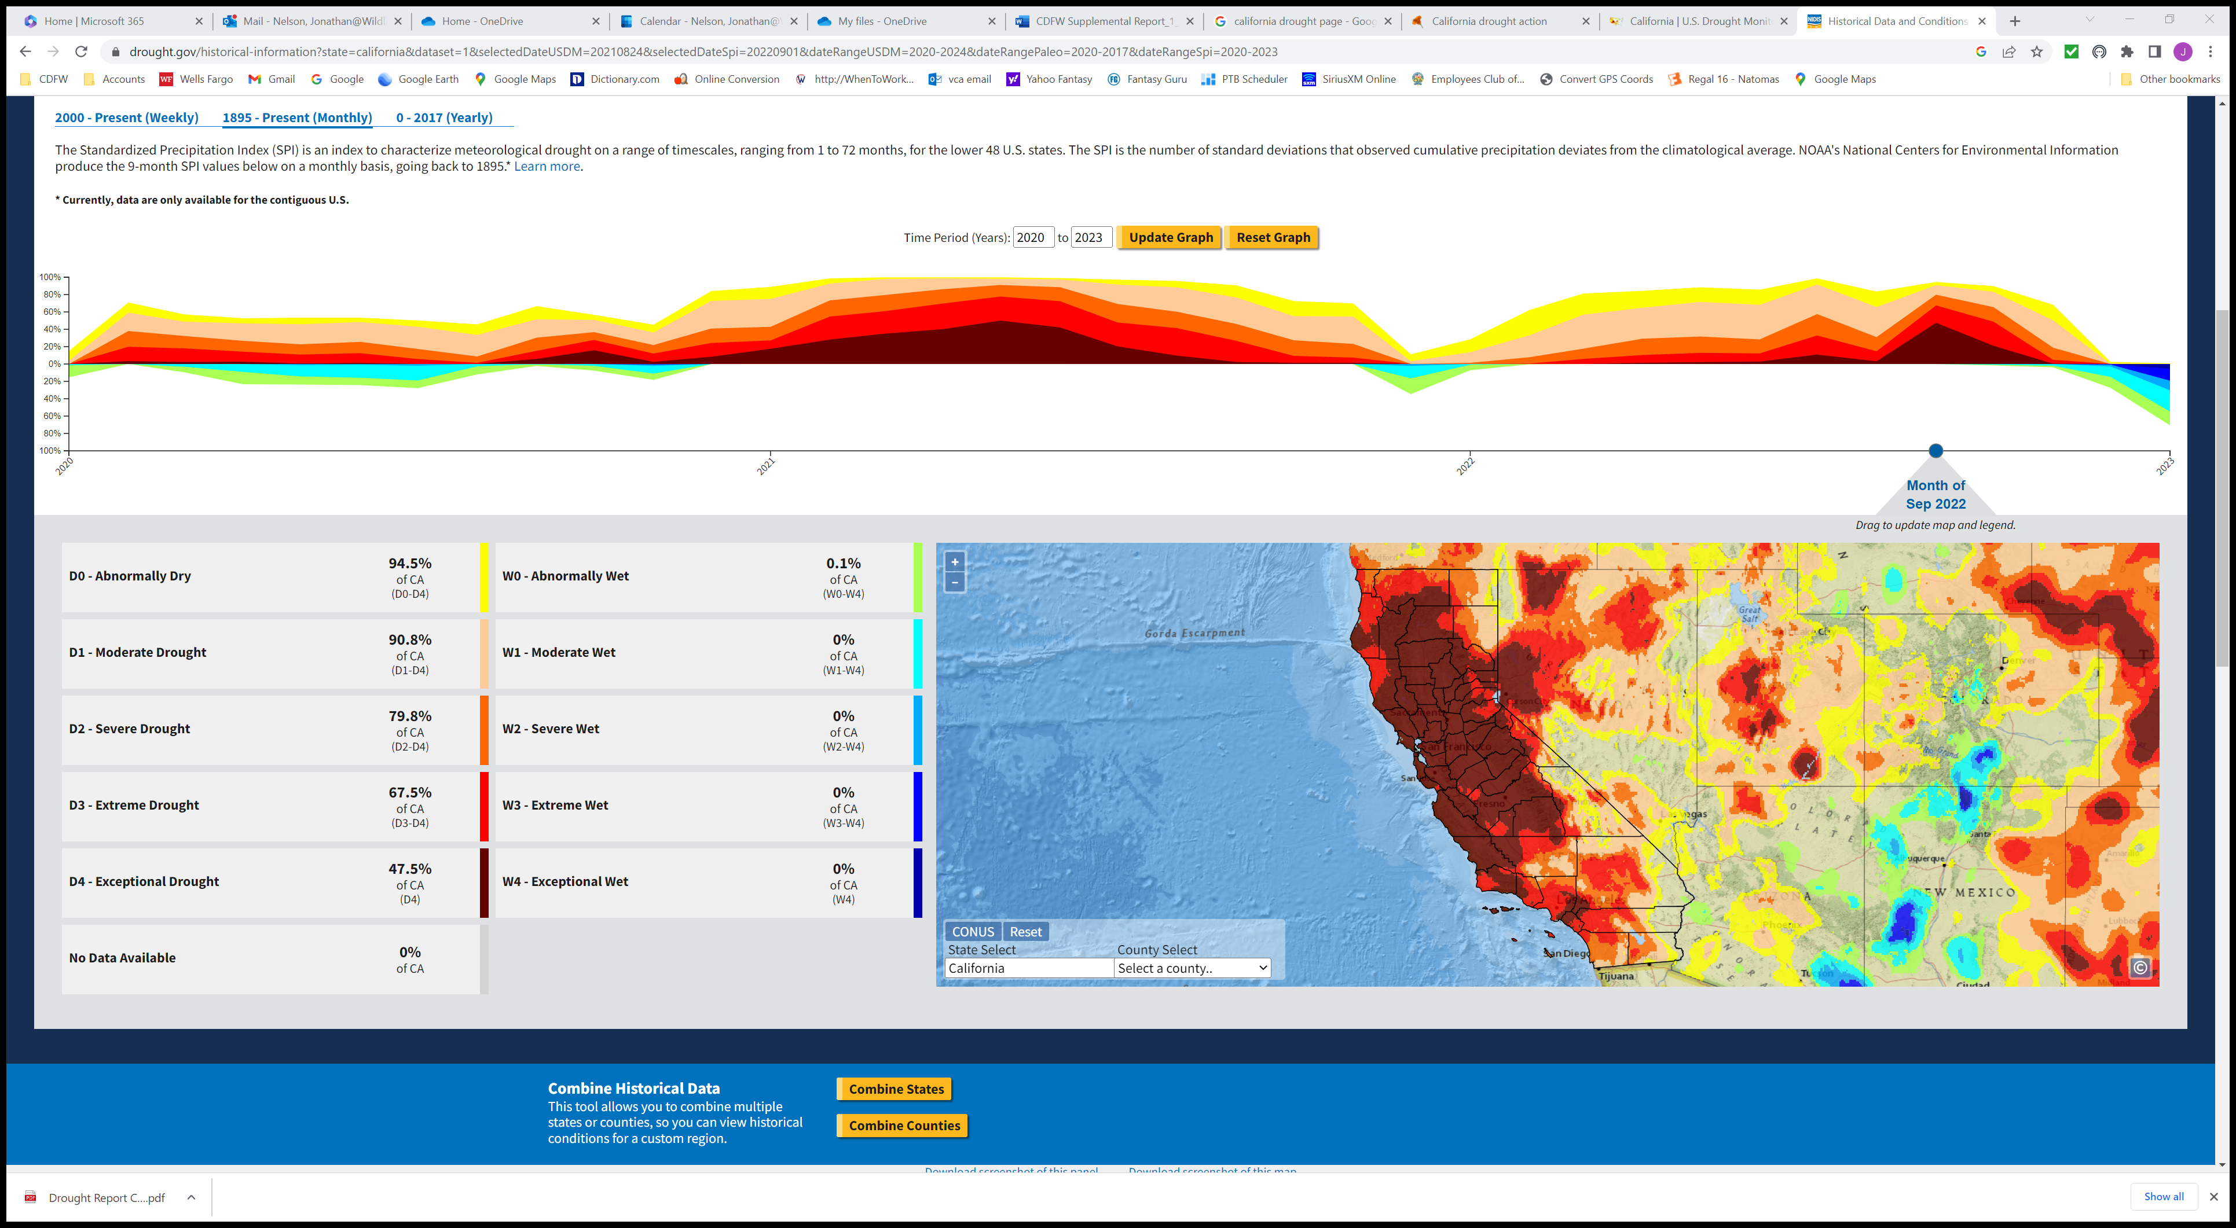
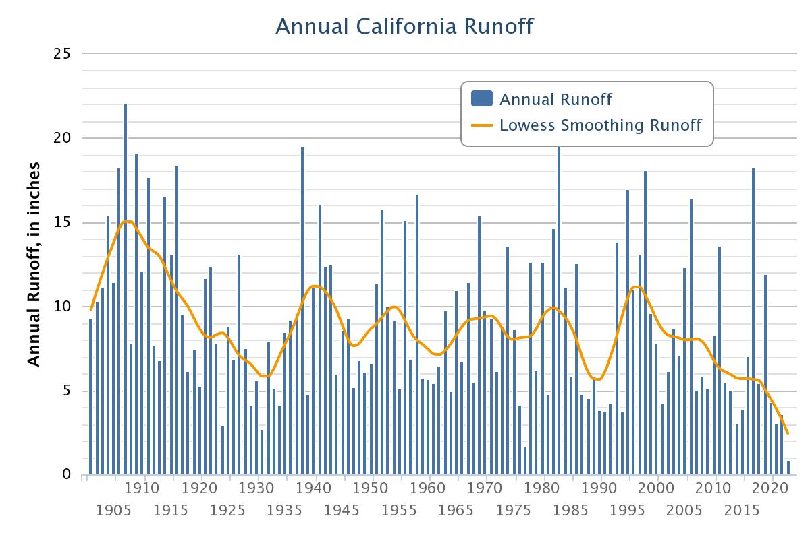
CA Fisheries Drought Impacts
  8 of the top 10 CA wildfires have occurred since 2017, of which 5 took place in 2020
    Major impacts to riparian and introduction of fine sediments
  Reduced snowpack and runoff resulting in limited cold-water storage
    Major impacts to water quality, spawning and rearing habitat, and connectivity
  Sustained elevated water temperatures
    Increased disease and fish kills
    Increased adult pre-spawn mortality and egg mortality
  Impacts during winter conditions
    Shallow streams form anchor ice and/or freeze solid
  Economic impacts
    Reduced Angling opportunity
      Lack of returning fish
      Season closures and harvest restrictions
US Drought Monitor
September 2022

Slide 7
CA Drought Policy and Management Actions
  Drought State of Emergency proclamation declared by the Governor in 2021 authorizing State Water Board to ban wasteful water uses and boosting conservation efforts
  Governor signed a package of climate action bills in 2021 that include $5.2 billion for drought response and long-term water resilience
    The measures will secure and expand water supplies, support drinking water and wastewater infrastructure with a focus on small and disadvantaged communities, improve water supply security and quality, and support wildlife and habitat restoration
  CDFW received ~ $200 M in funding funds for multi-benefit ecosystem restoration and protection projects under Drought, Climate, and Nature-Based Solutions Initiatives, of which $100 M is dedicated for salmon and steelhead restoration projects
  CDFW initiated a Cutting Green Tape program in 2020 focused on improving regulatory processes and policies for environmental restoration so work can occur more quickly, simply, and cost-effectively
    This program will lead efforts to develop and implement improvements to the way CDFW issues permit and administers its grant programs, to accelerate the pace and scale of restoration throughout the state

Slide 8
CA Drought Policy and Management Actions
  In collaboration with National Marine Fisheries Service, CDFW developed a community program called the Voluntary Drought Initiative
    This program recognizes the severe constraints drought conditions have on agriculture and fish in California and is targeted to work with small water users in high priority areas throughout the state
    The Initiative seeks to develop temporary, voluntary water conservation and in-stream flow agreements with water users in high-priority salmon and steelhead rivers and streams in exchange for short-term relief from enforcement standards of the Endangered Species Act
  CDFW received ~ $21 M drought funding for immediate hatchery infrastructure and equipment needs and $17 M for a feasibility study to identify future climate resilient infrastructure needs
  CDFW received ~ $10 M drought funds to support aquatic stressor monitoring and fish rescue needs
  CDFW developed recommendations and modified regulations to help mitigate impacts from angling during periods of poor water conditions

Slide 9
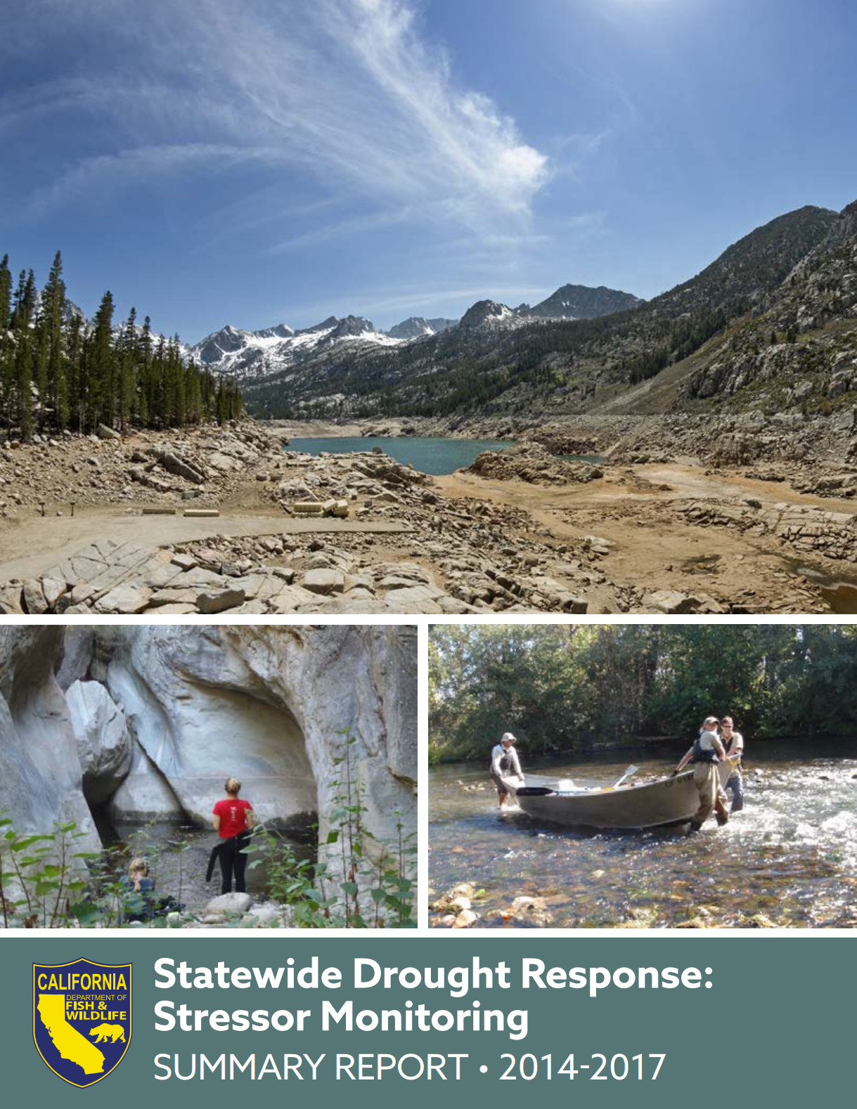
Aquatic Stressor Monitoring and Fish Rescue
  CDFW experienced a prolonged drought period from 2012-17
  In 2014, CDFW implemented the Drought Stressor Monitoring Program dedicated to collecting information on the status of habitat and water quality of fish populations and other aquatic species
  This program helped standardize monitoring protocols and data collection and provided a framework to evaluate environmental conditions for imminent or immediate response for fish rescue
  CDFW published a Statewide Stressor Monitoring Summary Report for 2014-17
    This report captures the knowledge and data gained through these monitoring efforts and can be used to guide future drought management needs and actions

Slide 10
Aquatic Stressor Monitoring and Fish Rescue
  With the onset of the 2020 drought period, CDFW was able to reference the 2014-17 Stressor Monitoring Report and confirm funding/staffing needs for increased aquatic stressor monitoring and fish rescue
    CDFW received ~$10 M from the State budget to hire an additional 20 biologist and 30 seasonal limited-term positions through June 2024
  In April 2021, CDFW began implementing stressor monitoring of aquatic habitats for drought impacts
    To date, a total of 110 staff have spent over 8570 hours monitoring 167 waterbodies in 36 counties across the state
  In 2021-22, a total of 69 fish rescues have occurred in 34 anadromous waterbodies across 12 counties, totaling 16,840 individual anadromous salmonid species, of which 4426 were steelhead
  The Department has developed an online interactive Dashboard that the public can use to visually display fish rescue data using various query options

Slide 11
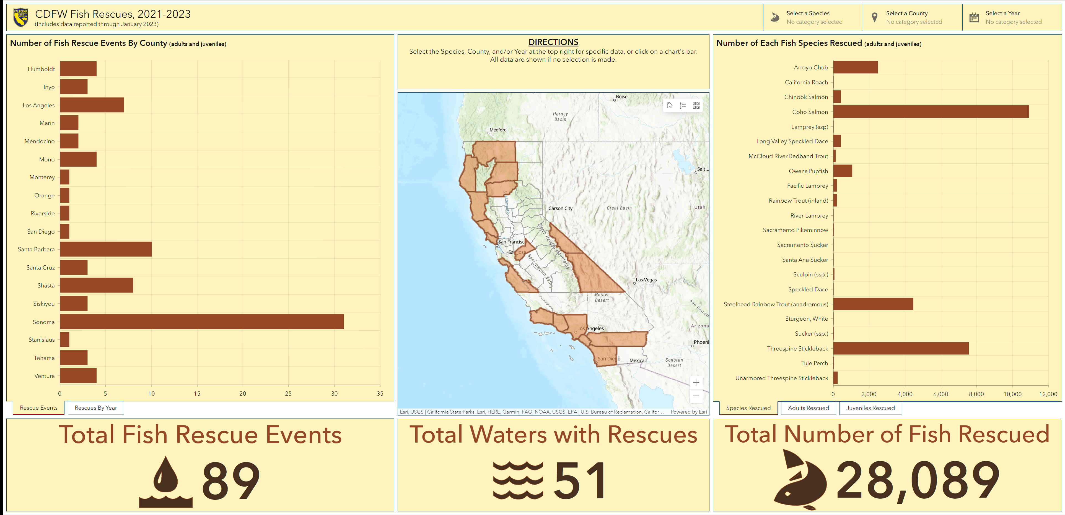
Fish Rescue Dashboard
Fish rescue data are entered monthly through an online data portal and provides CDFW the ability to provide near real-time updates to the public.
These data can be queried by species, county, year, and life stage.

Slide 12
Drought Focused Angling Actions
  CDFW established a “Hoot Owl” watch list to identify select waters throughout California that anglers should consider not fishing after 12 pm during periods of increased temperatures
    This approach directs anglers to focus their angling during the cooler “hoot owl” periods of the day when water temperatures are lowest
    When these select fisheries begin to achieve sustained afternoon water temperatures exceeding 67° Fahrenheit, CDFW will add the water(s) to a “Hoot Owl” watchlist
    Although these are not legal angling closures, CDFW strongly recommends adhering to the recommendations for the specific waters listed until removed when conditions for those waters improve
  CDFW implements low flow angling restrictions for many of the coastal streams which allow for discrete closures if flows drop below minimum flow criteria.
    In 2021 the angling regulations were updated to extend the dates for the low flow criteria to allow for added protection of salmonids as drought conditions expand into traditionally wet seasons
  In 2016, CDFW was granted delegated authority to temporarily close a fishery based on a minimum criteria for select conditions and subsequent monitoring to determine re-opening
    Conditions include: water temperature, dissolved oxygen, fish passage, water levels, and adult breeding population levels
    This authority provides CDFW the flexibility to take immediate actions to protect fisheries in adverse conditions

Slide 13
Future Management Actions
  At the end of 2022 and start of 2023, California endured three weeks of nine atmospheric rivers. The state just experienced a flood emergency while still in an active drought emergency, marking a new period of climate whiplash and underscoring California’s position on the front lines of climate change.
  It’s important to point out that while these storms have not ended the drought, they provide a cautiously optimistic outlook for relieving another potential year of drastic conditions and impacts to fisheries.
  California and CDFW will continue to take proactive measure to conserve water and protect and retore habitat for our fish and wildlife through opportunistic and dedicated funding and policy and management actions.
  CDFW will continue to use adaptative measures for our fisheries management, monitoring, and hatcheries to help mitigate impacts from extreme climate shifts.
  CDFW would like to thank their employees, partner agencies and tribes, NGO’s, universities, stakeholders, and public that are engaged in protecting our State’s natural resources to provide for future generations.

Slide 14
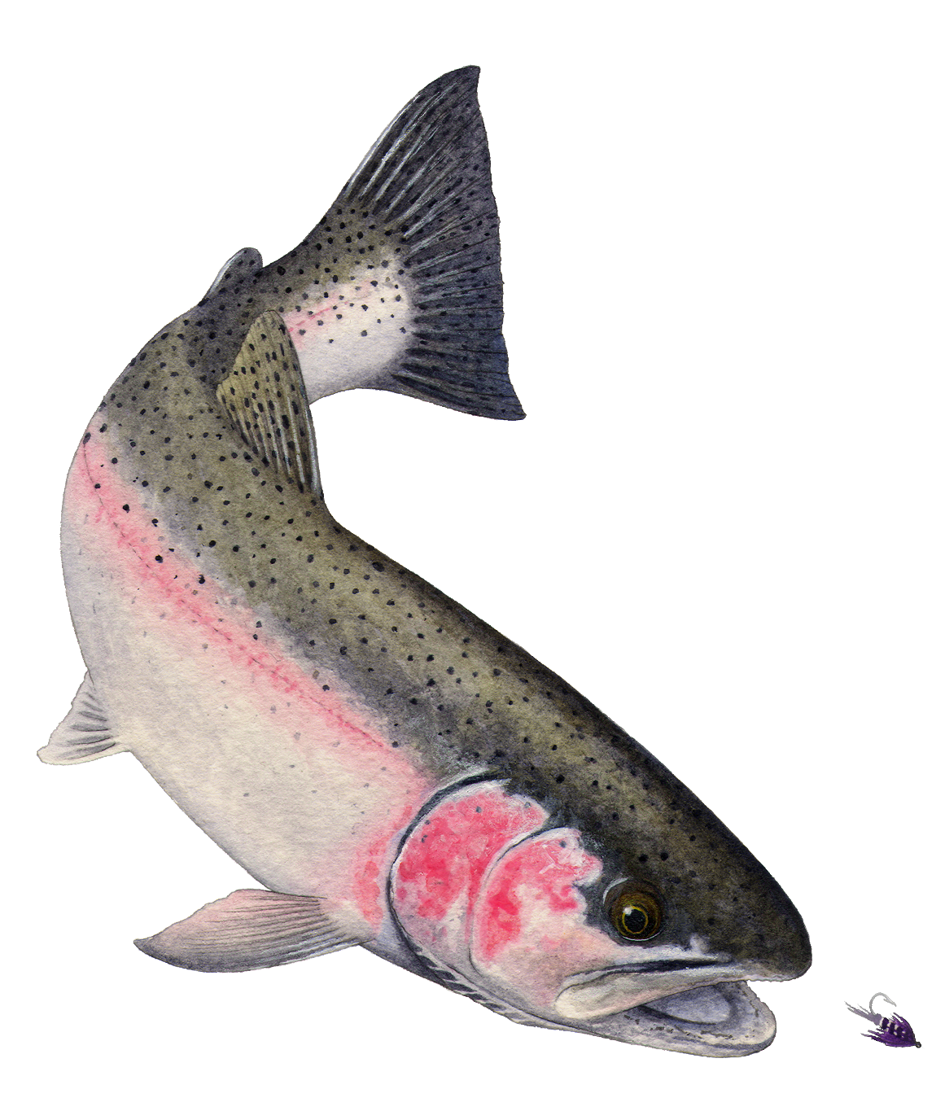
Questions
Jonathan Nelson
Jonathan.Nelson@wildlife.ca.gov
Environmental Program Manager
Anadromous Fishes Conservation and Management
Fisheries Branch
California Department of Fish and Wildlife
www.wildlife.ca.gov
Oncorhynchus mykiss irideus

