Slide 1
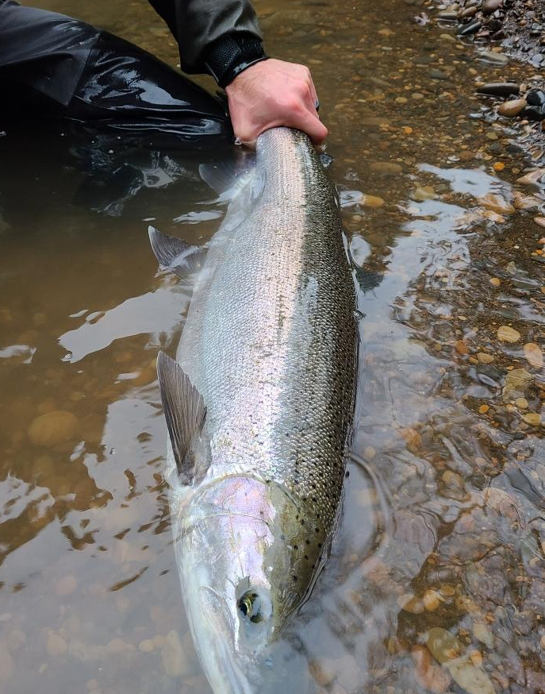
Utilizing Models for Hatchery Program Evaluation
Anja Huff and Gary Marston
Gary Marston

Slide 2
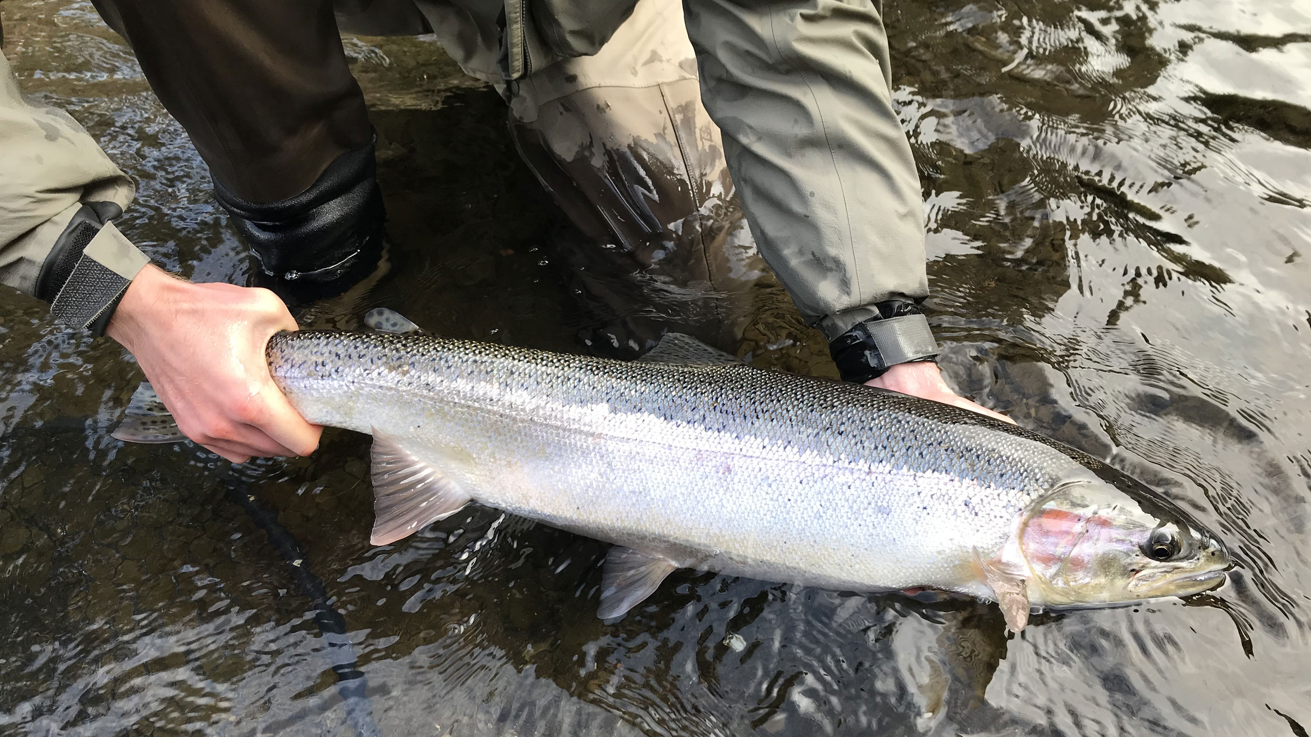
Introduction
Washington State utilizes guidelines set by the Statewide Steelhead Management Plan
  Indicates that hatchery impacts on wild populations should not exceed 2% geneflow, and/or 30% pHOS and 0.70 PNI
Current Models
  Segregated Programs modeled with the Demographic Geneflow Model (DGM)
  Integrated Programs modeled with the All-H-Analyzer (AHA)
Data Gaps and Shifting Thresholds of Redd Timing
Future Analysis and Evaluation
Gary Marston

Slide 3
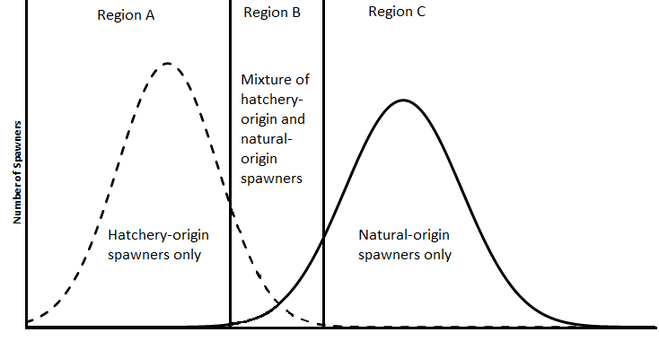
Demographic Geneflow Model
Bases geneflow on the overlap in the hatchery and wild spawning period
  Hatchery spawning from hatchery data.
  Wild spawning from redd data.
Uses hatchery releases and escapement along with an assumption of trapping efficiency to determine gene flow.
What it doesn’t include:
  Age structure (Assumes Age 1.2)
  Catch data
  Spatial overlap
G. Marston

Slide 4
Geneflow Model Assumptions
The model relies heavily on the March 15 cut off date for Hatchery v Wild Spawners.
  Standard deviation of redd timing from March 15 to last redd count date calculates % of wild redds prior to cut-off day
  Hatchery spawning and trap dates to determine mean spawn date and cutoff’s
Model results have a high-level of sensitivity to trapping efficiency.
  Lacking data on actual trapping efficiency
Uses six-year average for hatchery and wild escapement

Slide 5
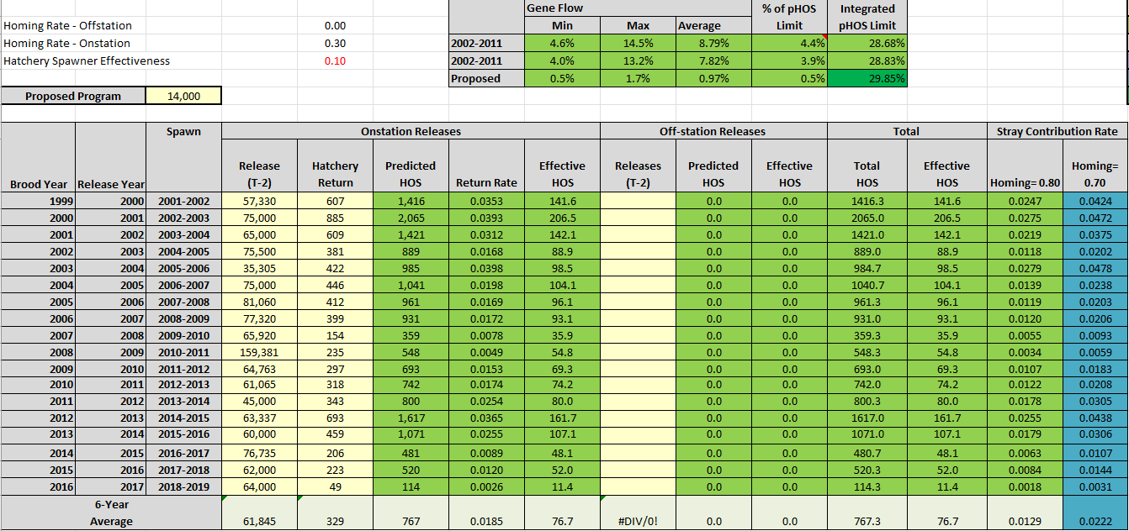

Slide 8
AHA Model
Uses hatchery and natural population data to provide estimates of pHOS and PNI.
SSMP set standard of pHOS <30% and PNI >0.70
Productivity data used to model natural-origin abundance:
    SAR%
    Recruits per spawner
    Harvest Rate
Hatchery Performance Data for Steelhead used to verify model inputs:
    SAR%
    Harvest Rate
    Trapping Efficiency
HSRG Tools - StreamNet

Slide 9
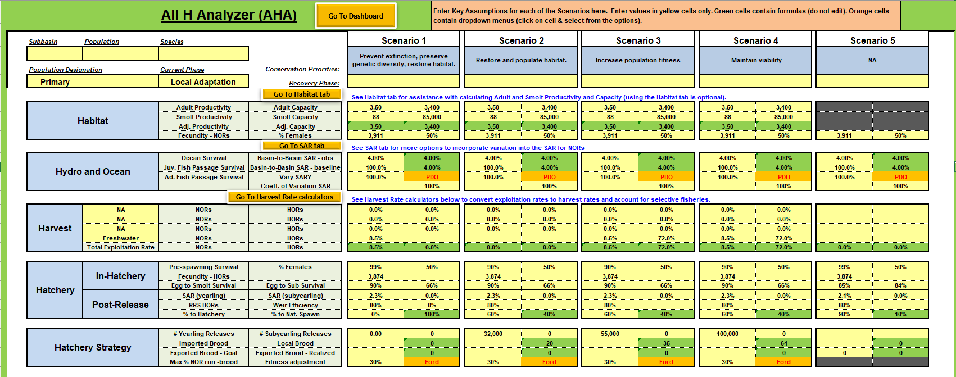

Slide 10
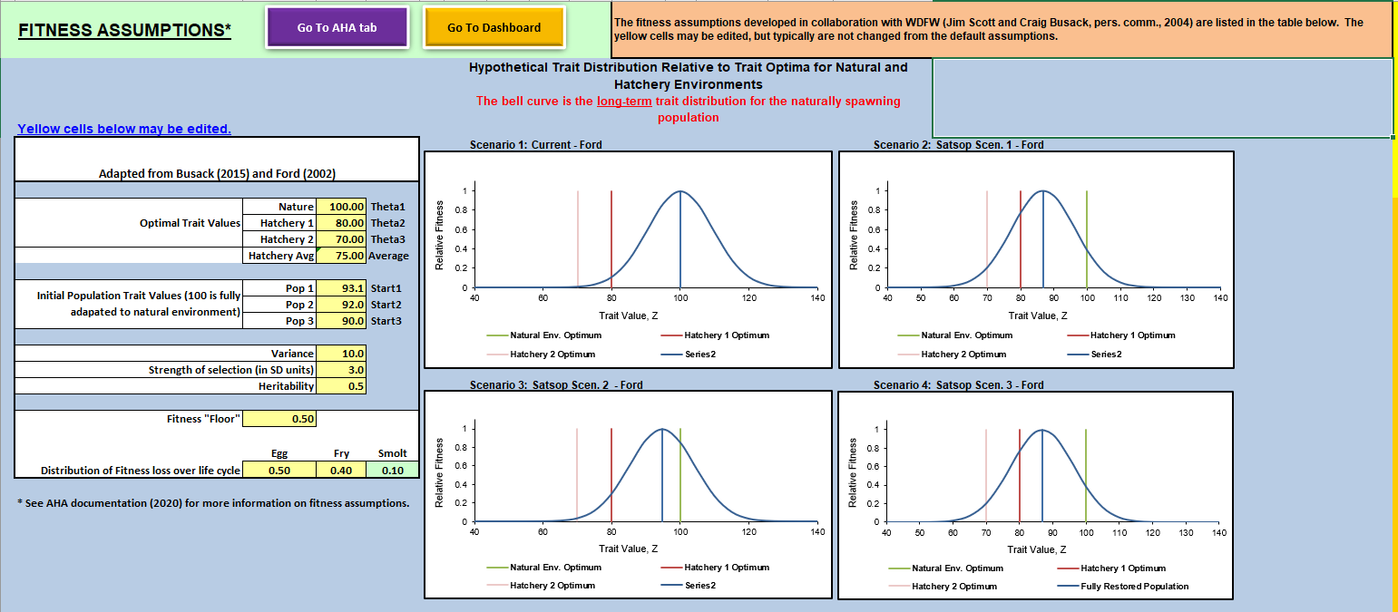

Slide 11
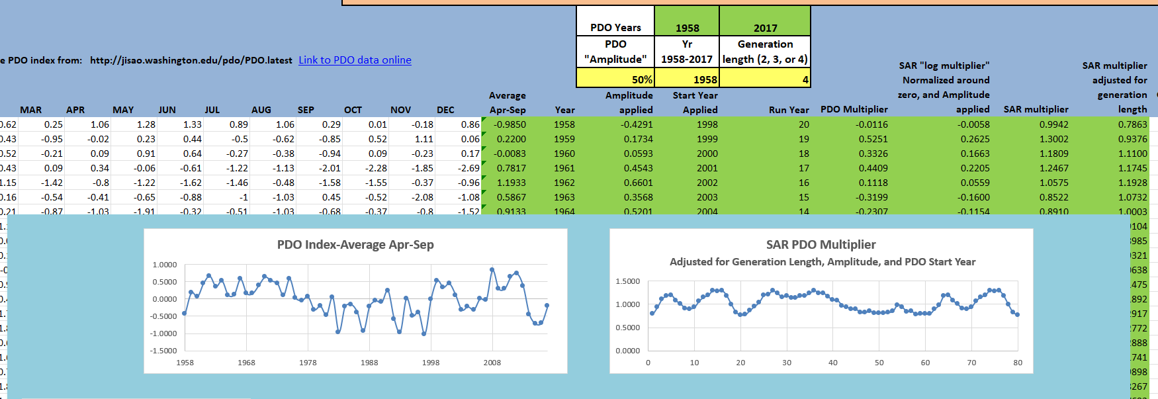

Slide 12
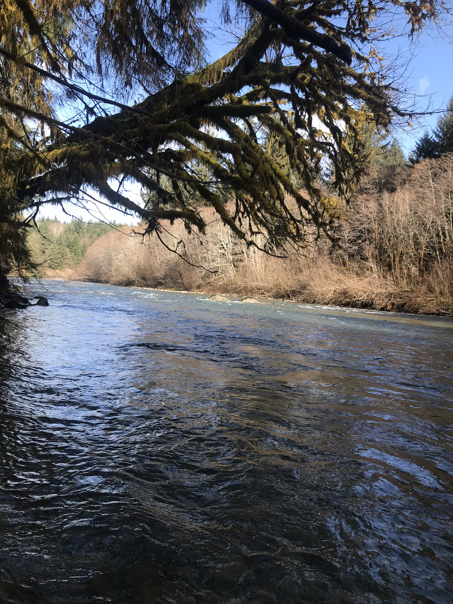
Data Gaps
Assess the status, spawn timing, and spatial distribution of natural origin summer run steelhead populations
River and Watershed specific Smolt Productivity and Capacity
River and Watershed specific Adult Capacity
Natural Origin Steelhead Survival
  Currently an average based on two indicator stocks (Snow and Bingham Creek)
Data on Iteroparity
Spatial overlap of Natural and Hatchery Spawners
Empirical data on trapping efficiencies and homing rates
Impacts of straying between watersheds
Gary Marston

Slide 13
Shifting Thresholds
Watershed/River | Population | Mean Spawning Date | Mean Spawning Day Number(day) | Standard Deviation(day) | Natural-Hatchery Cutoff Date
Bogachiel/ Calawah River | Natural Winter | April 22 | 143 | 27.6 | January 29
Bogachiel | EWS | January 2 | 33 | 17.2 | February 23
Bogachiel | ESS | November 16 | -15 | 18.2 | January 9
Humptulips River | Natural Winter | April 28 | 149 | 15.9 | March 11
Wynoochee River | Natural Winter | April 20 | 141 | 23.6 | February 12
Humptulips | EWS | January 5 | 36 | 15.4 | February 20
Humptulips | ESS | December 26 | 26 | 7.3 | January 17
Lake Aberdeen | ESS | December 11 | 11 | 6.2 | January 1
North River | Natural Winter | April 2 | 123 | 15.7 | February 18
Willapa River | Natural Winter | April 7 | 128 | 19.0 | February 9
Naselle River | Natural Winter | April 1 | 122 | 18.0 | February 6
Forks Creek | EWS | January 19 | 50 | 15.7 | March 7
Naselle | EWS | January 21 | 52 | 18.0 | March 7

Slide 14
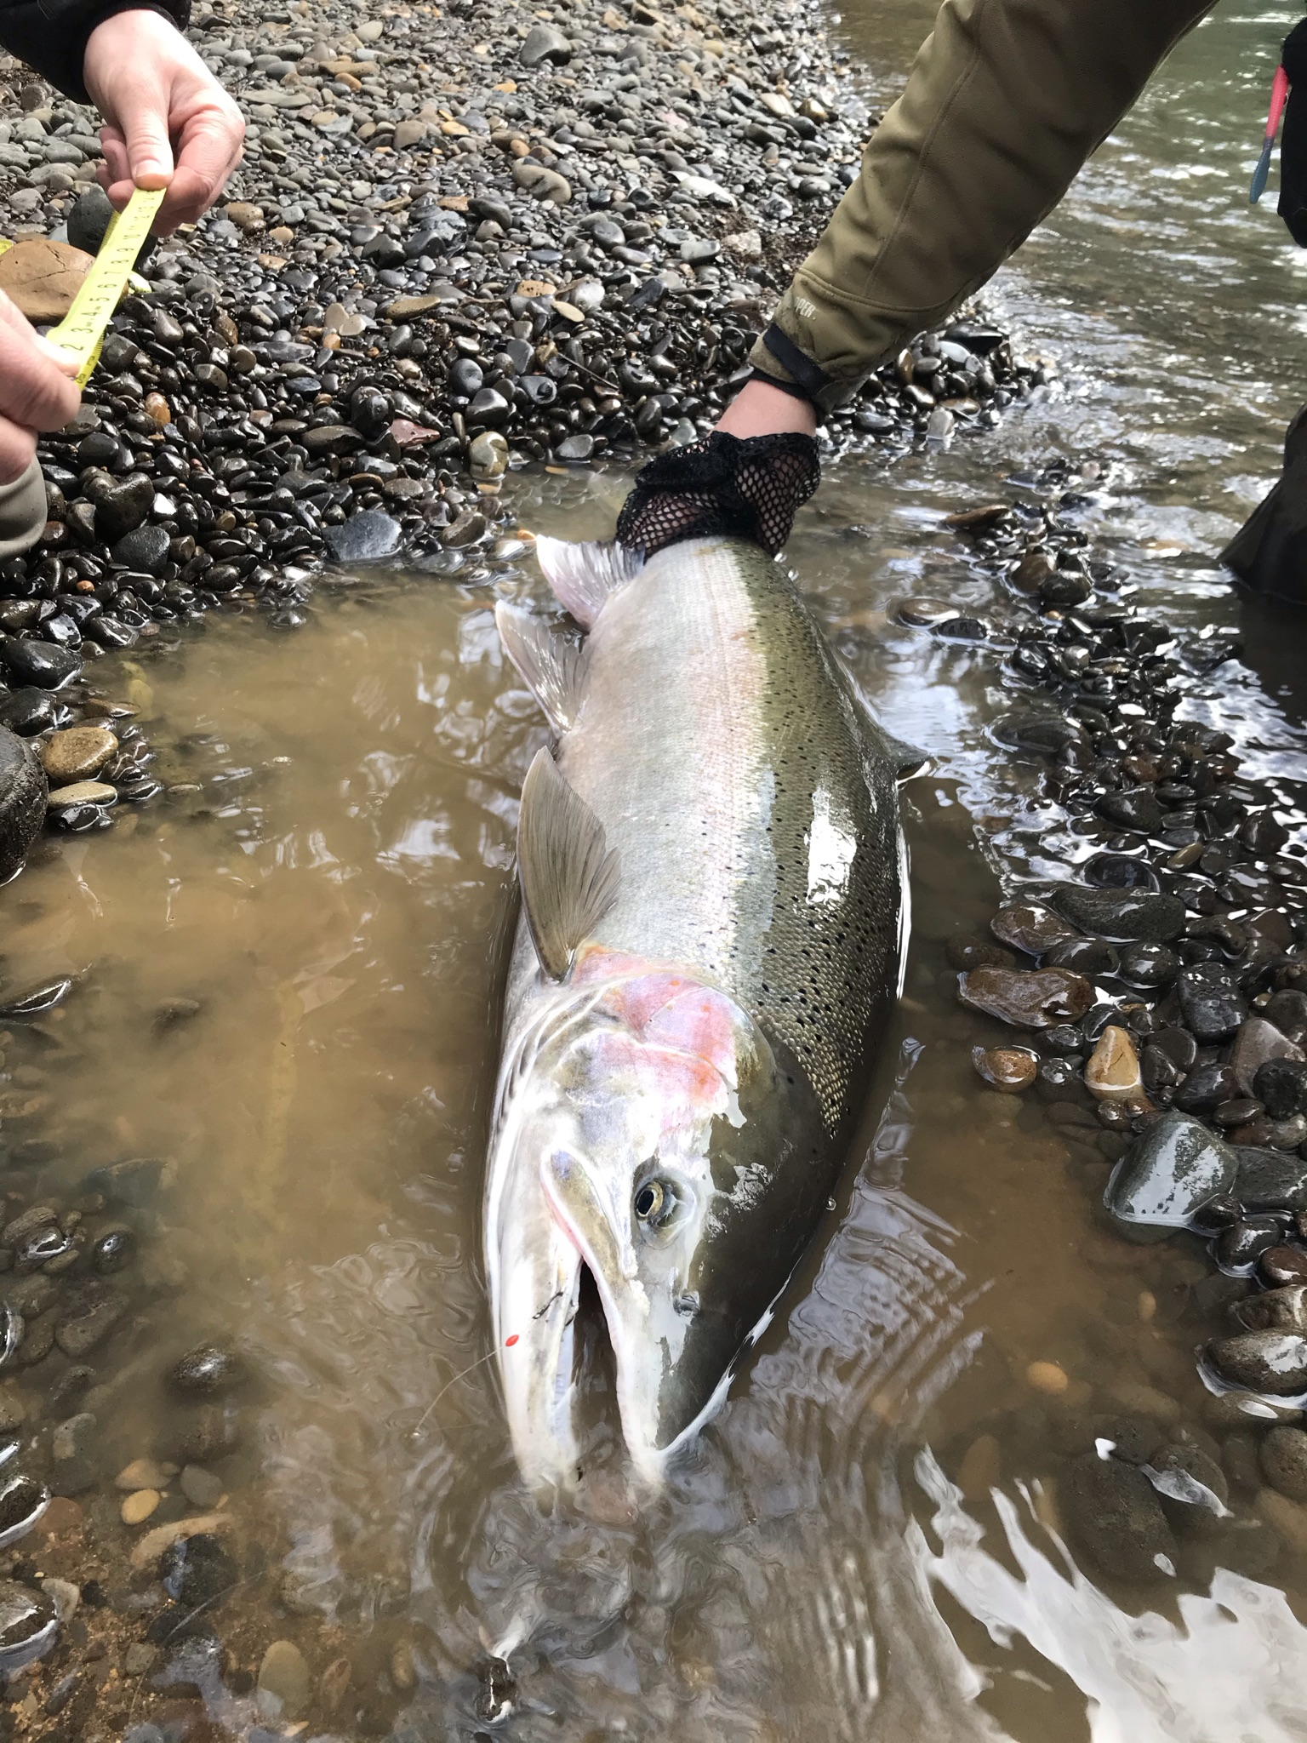
Future Program Analysis and Evaluation
Demographic Replacement
  Integrated program effects on natural populations
Compare Segregated and Integrated Programs
  Program impacts: Negative, Positive, Neutral?
  Benefits?
Run program analysis for all Steelhead programs
  Determine current geneflow/pHOS
  Create Scenarios of Success
Gary Marston
Gary Marston

Slide 15
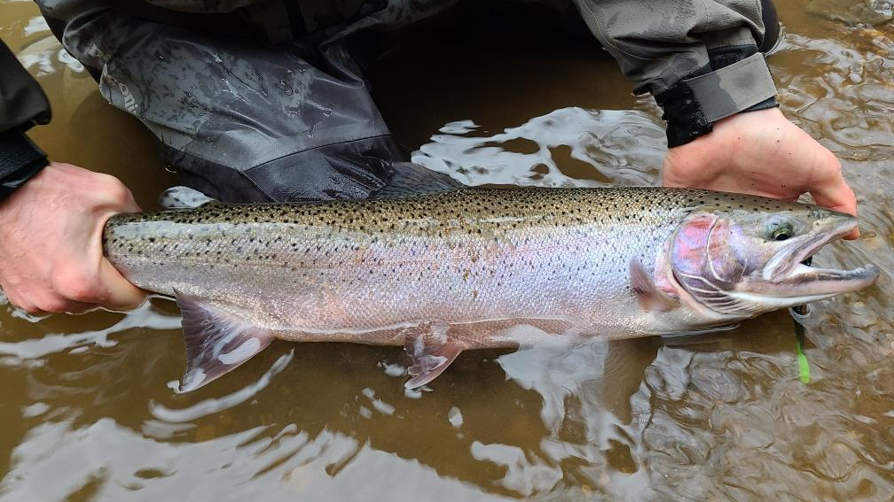
Questions?
Gary Marston

