Slide 1
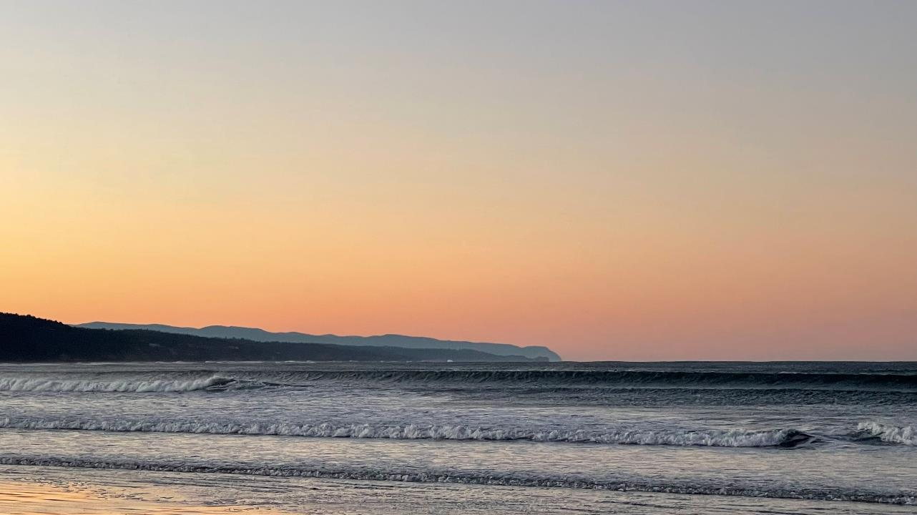



Marine heatwaves in the northern California current: Impacts on early marine steelhead diet composition, morphology and potential survival
Elizabeth A. Daly, Hillary L. Thalmann, Richard D. Brodeur, and Brian J. Burke

Slide 2
Low numbers of adult salmon have been returning to the Columbia River that out-migrated into the ocean 2014-2019; and 2014-20 for steelhead
Values above zero are higher adult returns than average, and below zero lower than average
Counts at Bonneville Dam of adults are lagged 1 ocean year for coho, and 2 years for all other salmon

Slide 3
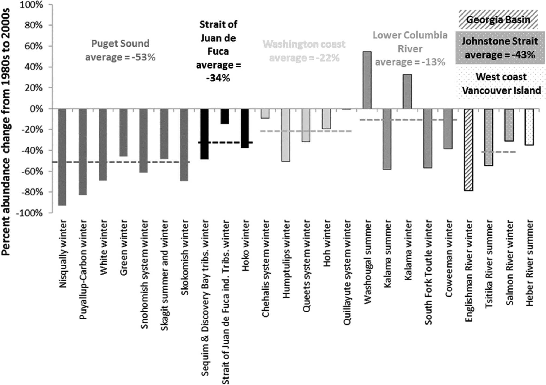
Using a marine smolt-to-adult survival rate time series Kendall et al. 2017 found that “Over 80% of [Steelhead] populations have declined in abundance…” over the past three decades
The time series went through 2012

Slide 4
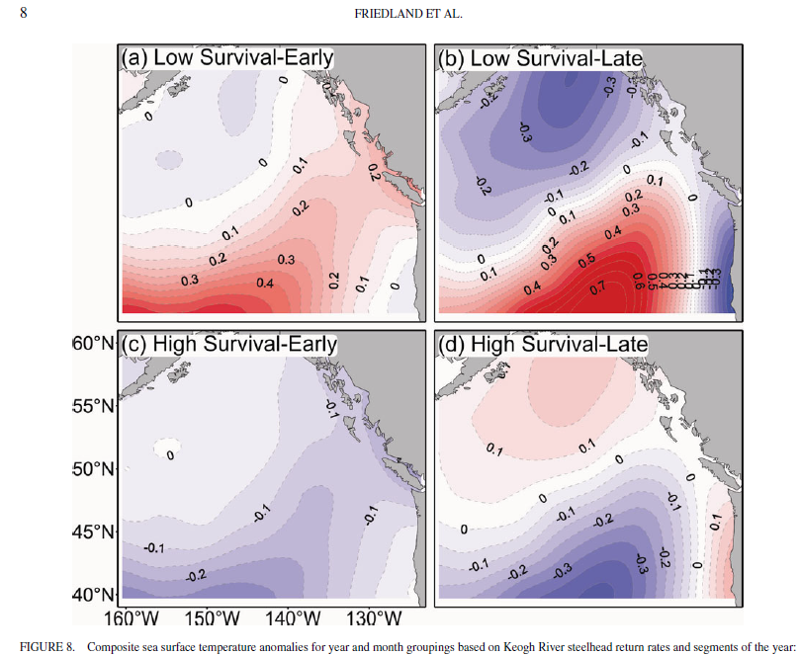
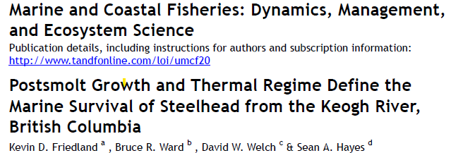
Friedland et al. 2014 “The return rate of steelhead was negatively correlated with sea surface temperature in the ocean… suggesting that growth is directly affected by warming conditions or that ocean warming affects the food web upon which steelhead depend”.

Slide 5
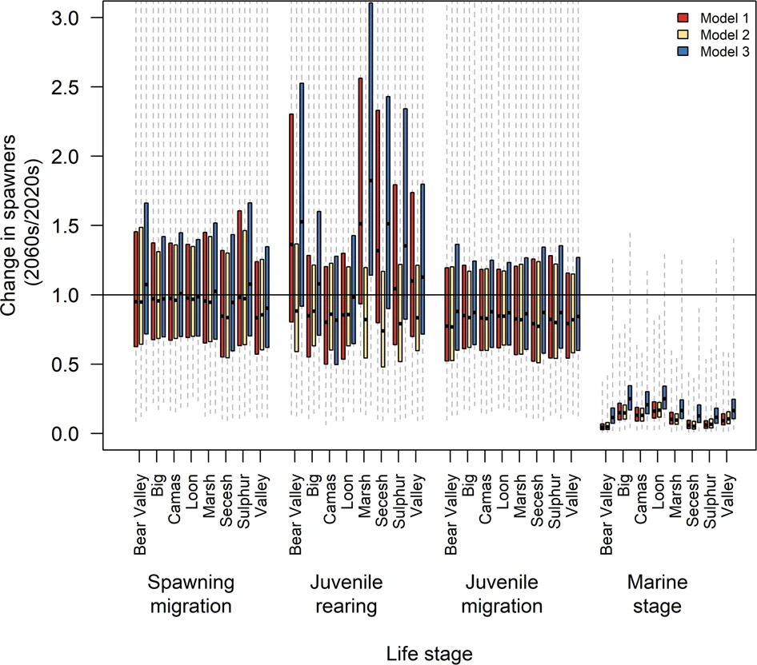
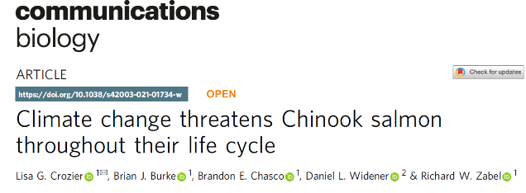
Predicted future scenario for Columbia River Chinook salmon using a life cycle model
“Climate impacts were most dramatic in the marine stage, where survival was reduced by 83-90%”
Crozier et al. 2021

Slide 6
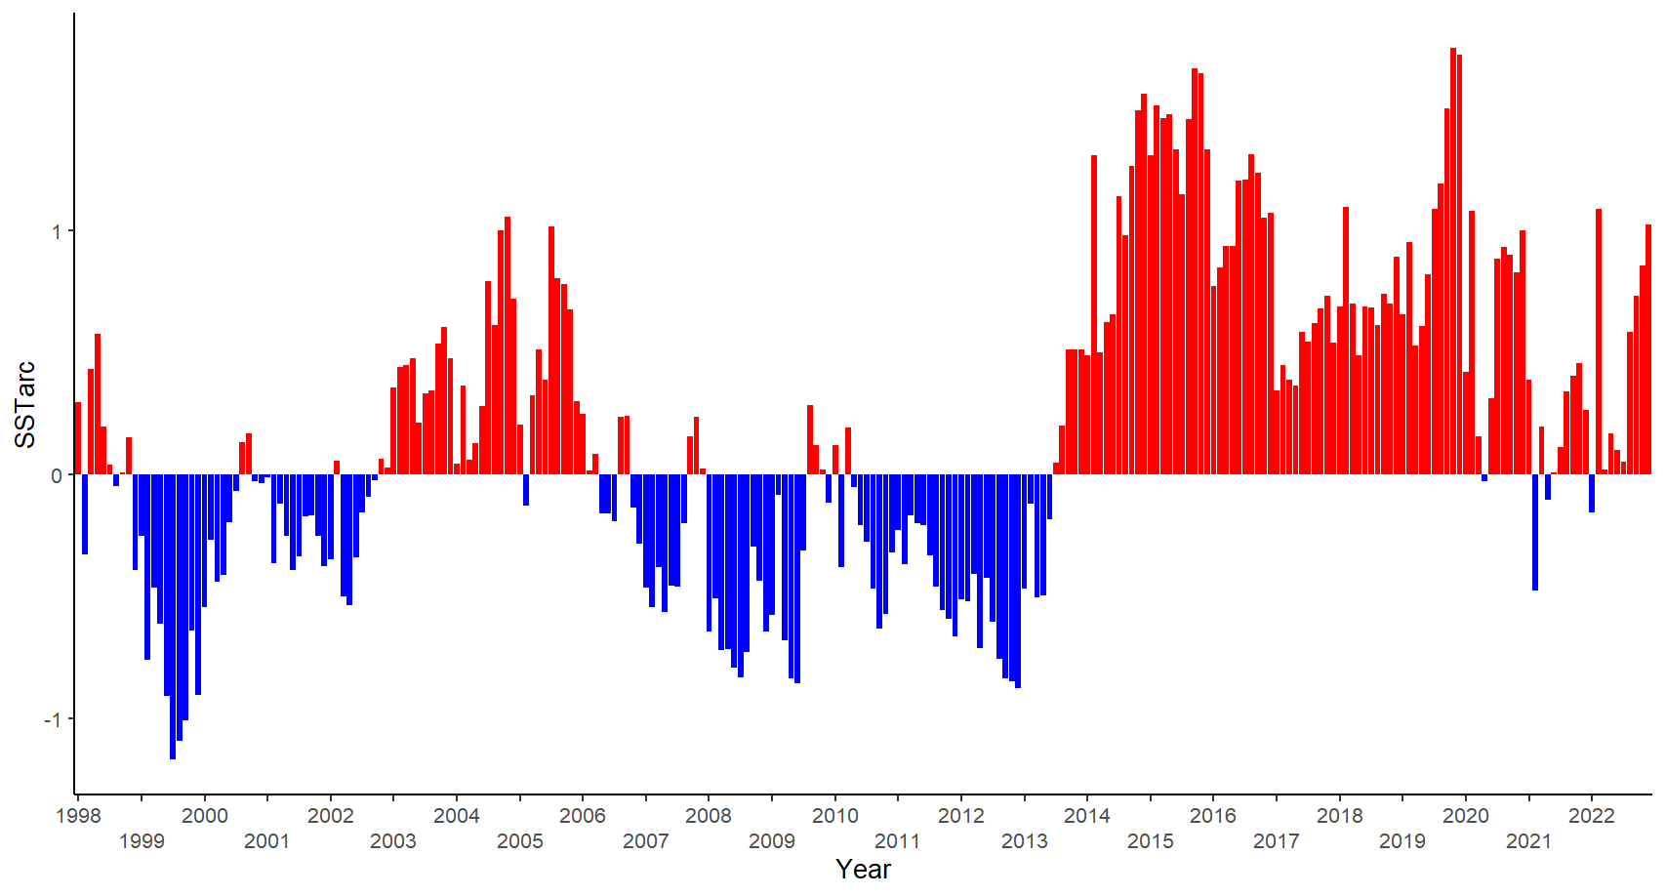
Starting in late 2013, the NE Pacific sea surface temperature (SSTarc) has almost continually been above average and is predicted to increase further
SSTarc

Slide 7
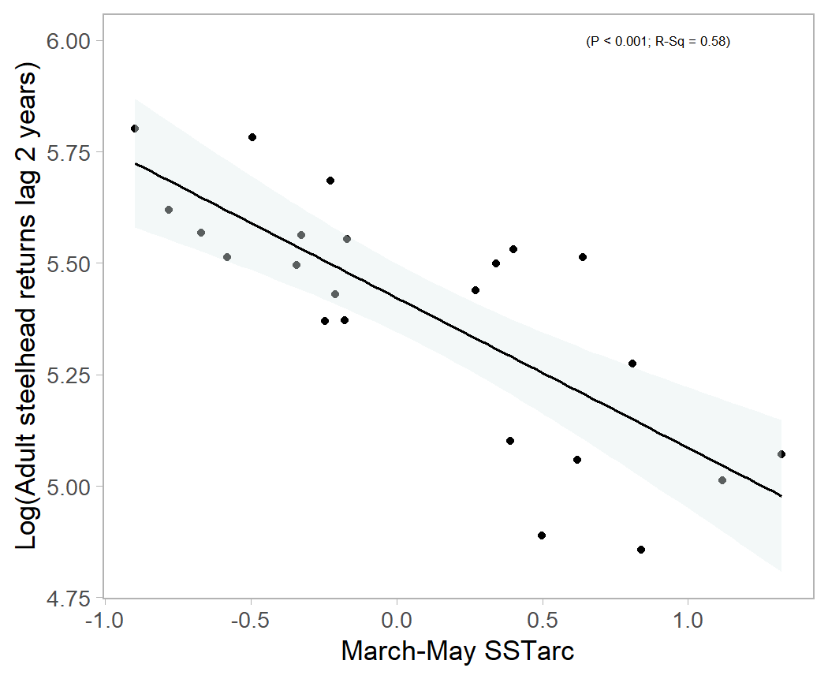
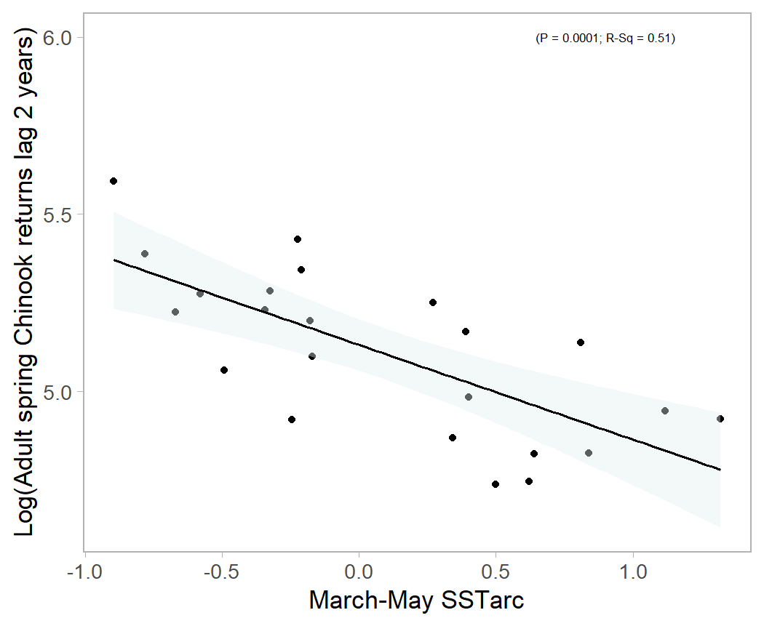
Steelhead adult counts (left) and spring Chinook adult counts (right) are negatively correlated with the SSTarc during the spring of their outmigration as juveniles (1998-2020)

Slide 8
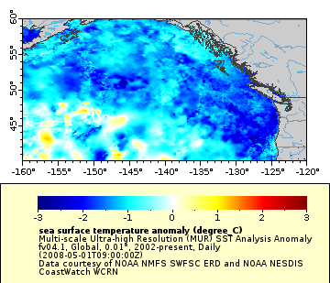
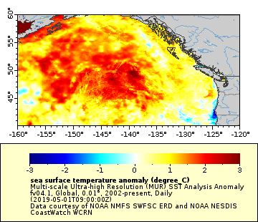
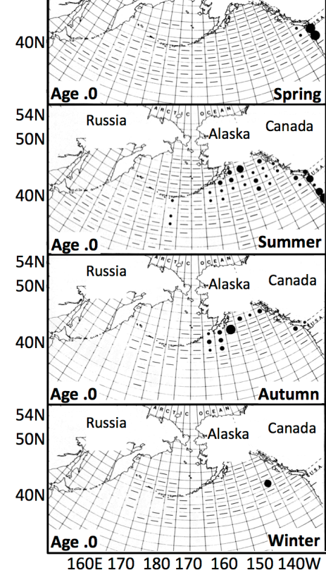
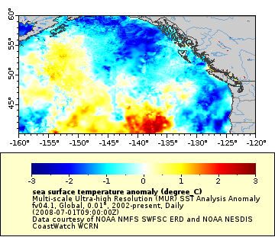
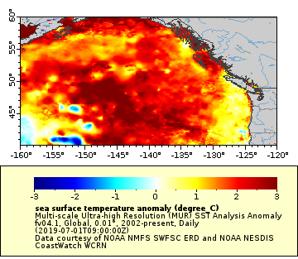
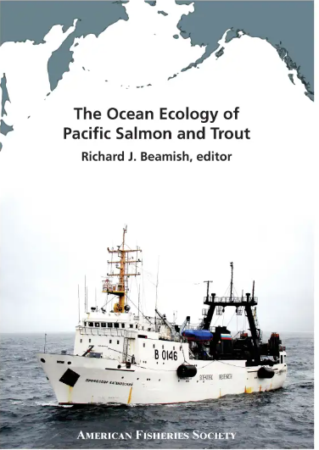
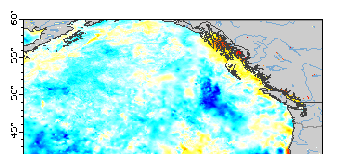
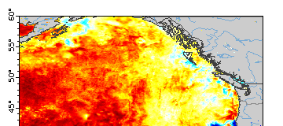
Where are juvenile steelhead in the ocean?
2008
2019
May
May
Myers et al. 2018
Chapter 7
July
July
Oct
Oct

Slide 9

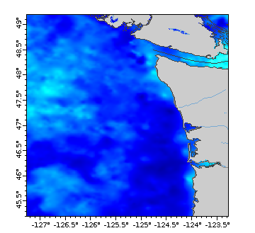
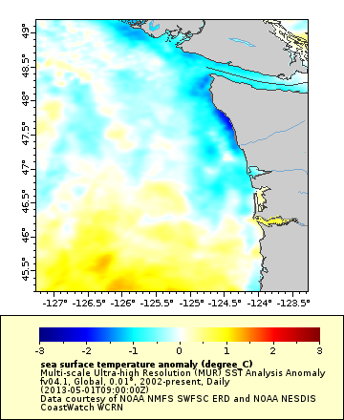
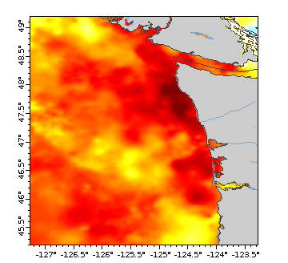
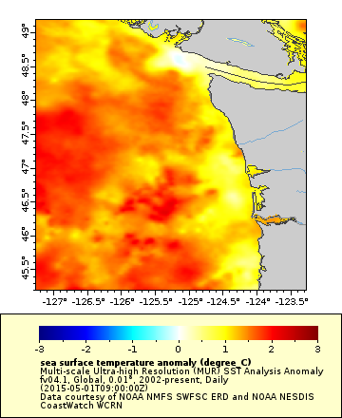
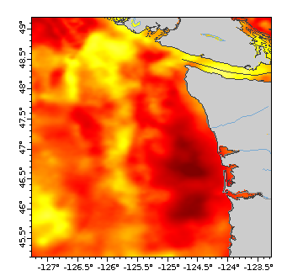
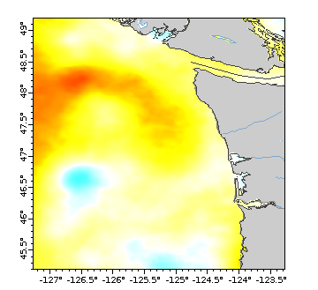
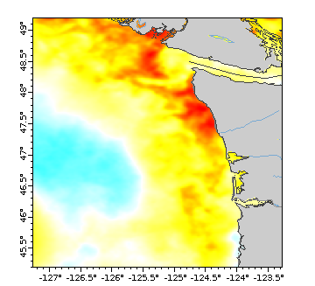
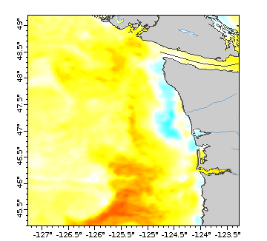
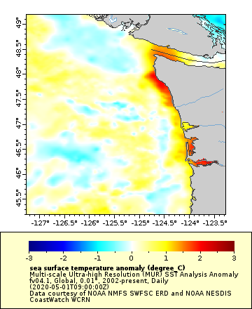
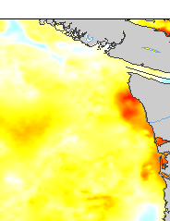
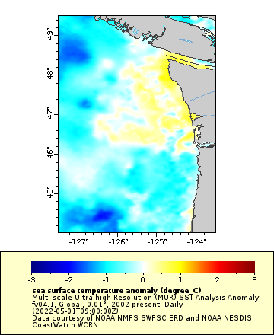
California Current Marine Heat Waves (MHW): are defined by differences in expected temperatures for the location and time of year https://www.integratedecosystemassessment.noaa.gov/regions/california-current/california-current-marine-heatwave-tracker-blobtracker maps made at https://coastwatch.pfeg.noaa.gov/erddap/griddap
MAY 1st SST as juvenile steelhead first enter ocean
2008
2013
2014
2015
2016
2017
2018
2019
2020
2021
2022

Slide 10
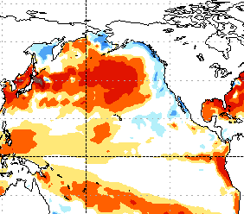
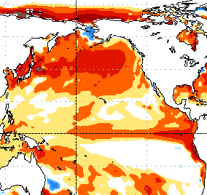
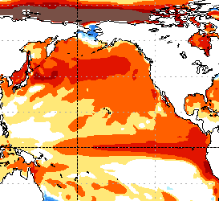
Above average SST are forecast to continue in 2023
Mar-Apr-May
May June July
July Aug Sept
https://www.cpc.ncep.noaa.gov/products/people/wwang/cfsv2fcst/htmls/glbSSTe2Sea.html

Slide 11
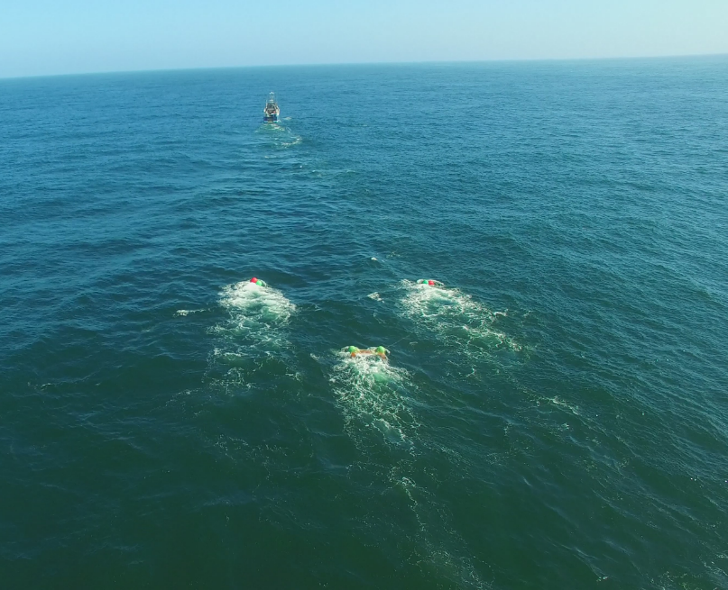
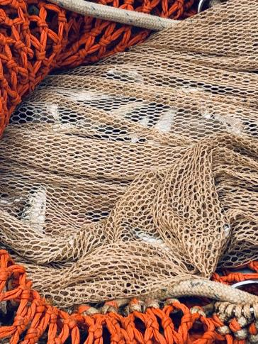
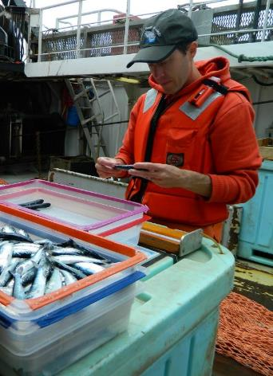
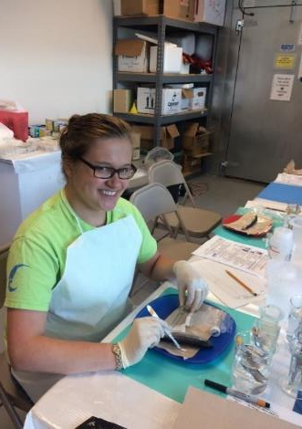
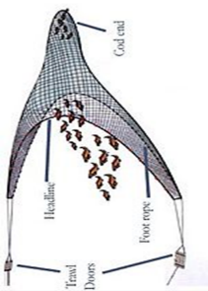
Juvenile salmon ocean ecosystem survey (JSOES) NOAA/OSU 1998-ongoing
May, June, September marine survey with a surface trawl net
20 m X 30 m towed for several km to capture nekton
May survey 1999-2012; modified 2015-19; 2021-current
June 1998-current
September 1998-2012
30 m

Slide 12
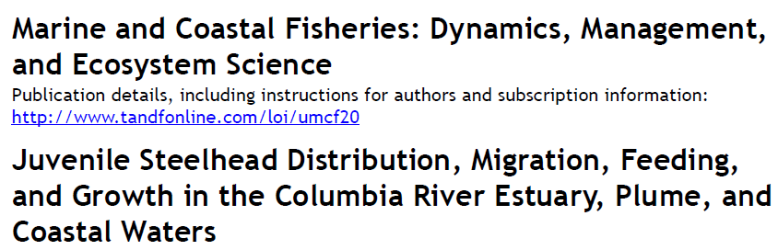
Juvenile steelhead salmon are caught off coastal OR/WA in May and are offshore by June (1999-2011 time series)
Juvenile steelhead salmon spend less than 10 days in our ocean sampling area- based on otoliths and are longer, fatter, have higher growth hormone, and stomach fullness as they move offshore
Daly et al. 2014
Unmarked
Hatchery

Slide 13
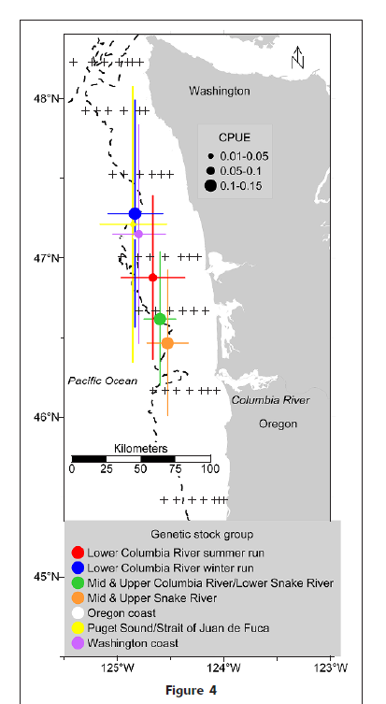
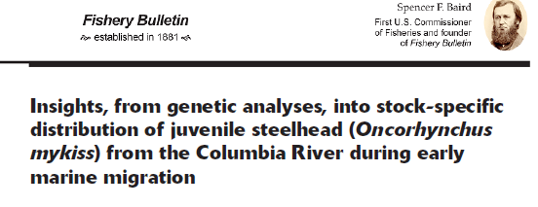
JSOES May steelhead catches by genetically identifies stock groups
May 2006-2012
78% of ocean caught juvenile steelhead were genetically identified as Columbia River stocks
Caught near the Columbia River
along the 180 m isobath
Van Doornick et al. 2019

Slide 14
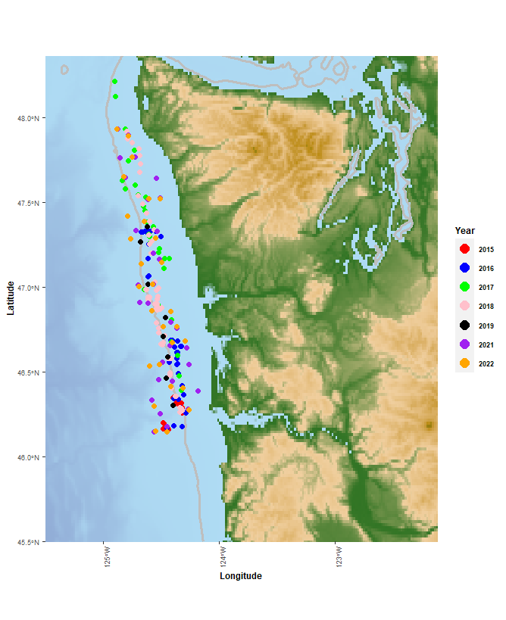
May JSOES survey was redesigned in 2015
Sampling is now along the 100 m isobath
The change occurred to increase catches of yearling Chinook salmon
Also added fine mesh liner to capture prey of the salmon
< 2.5% of stations were > 180m bottom depth
There were no 2013-14 and 2020 surveys
All stations sampled 2015-2022

Slide 15
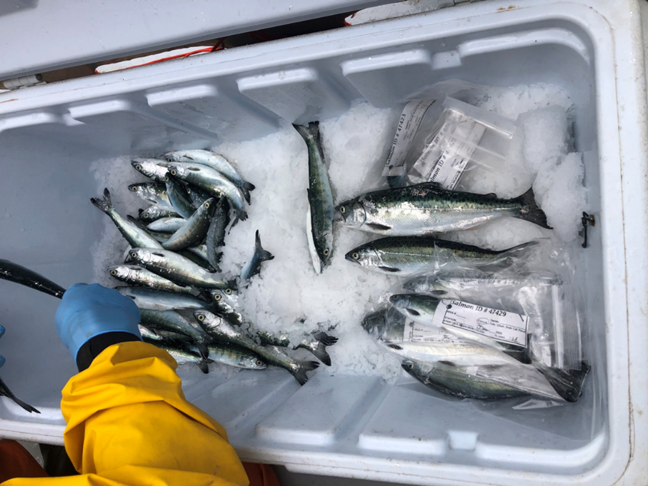
Can we use juvenile yearling Chinook salmon characteristics during their early marine residence to understand what is going on with juvenile steelhead?

Slide 16
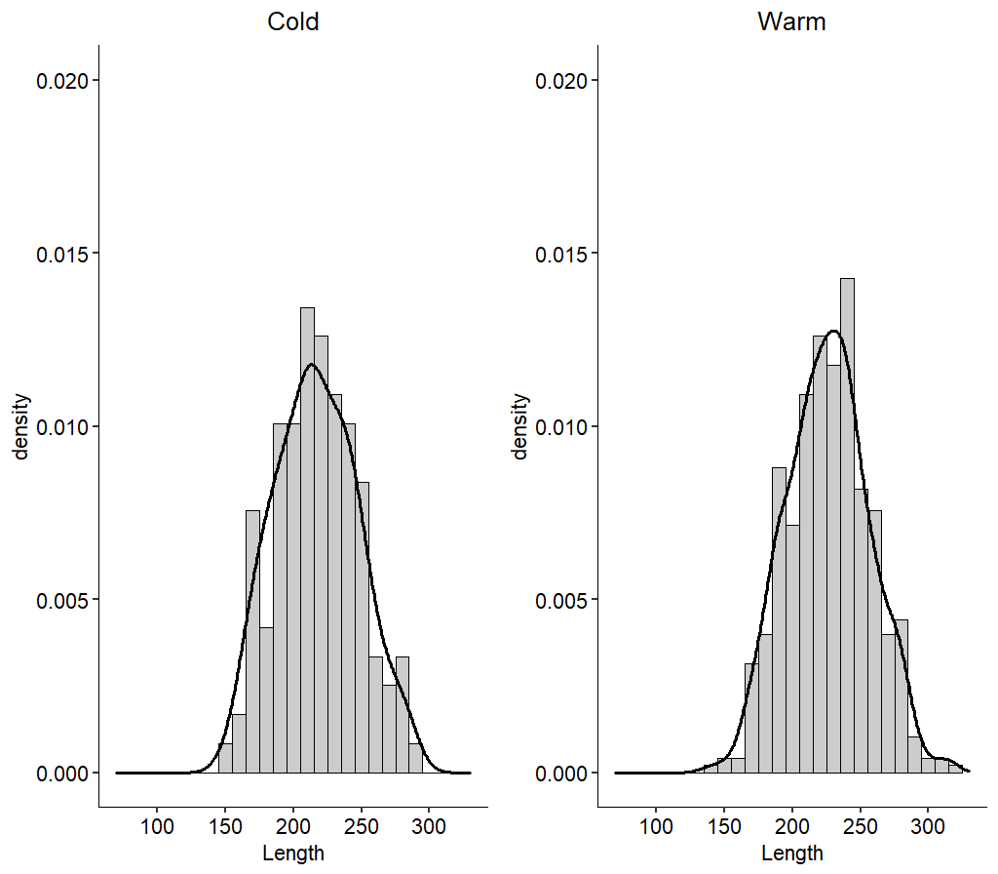
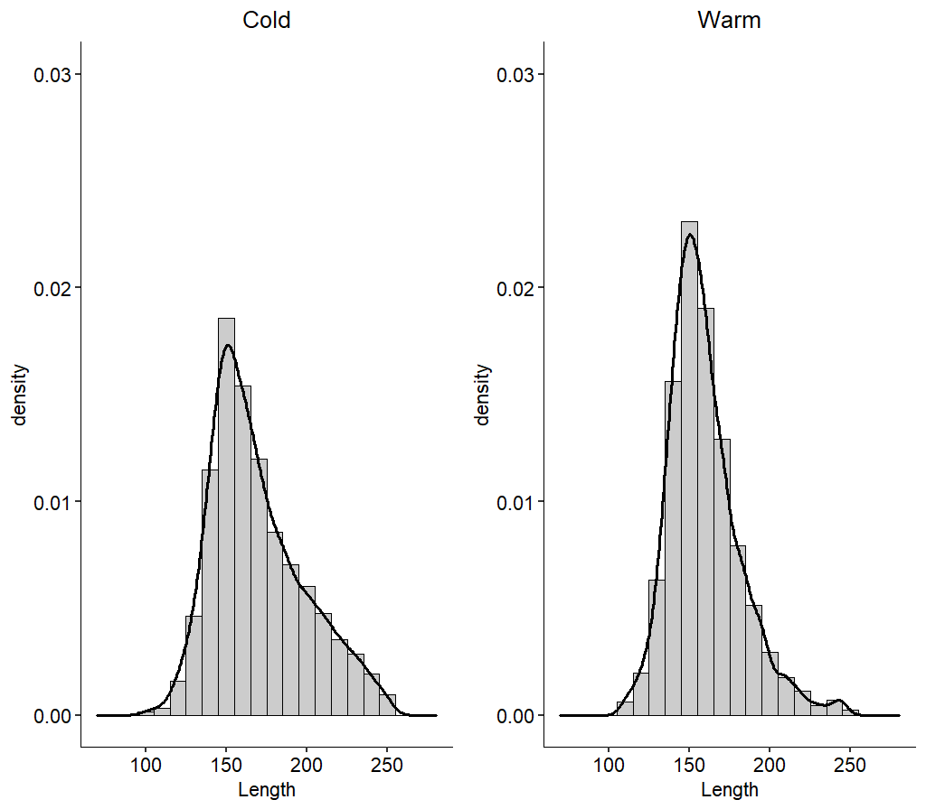
Fork length: Juvenile Columbia River Steelhead were the same size between cold and warm ocean conditions and all stocks of Chinook salmon were significantly longer during colder ocean conditions
Juvenile yearling Chinook salmon
5 Columbia River stocks:
Mid & UCR_Spring (p< 0.001)
Snake_Spring. (p=0.01)
UCR_Summer/fall (p< 0.001)
Kolmogorov-Smirnov test
WC_Spring (p= 0.001)
WR_Spring. (p= 0.015)
Juvenile Steelhead
3 Columbia River stocks:
Lower CR (n.s)
Salmon R. (n.s)
Mid& UCR/Snake R. (n.s)
Warm
Cold
Cold
Warm

Slide 17
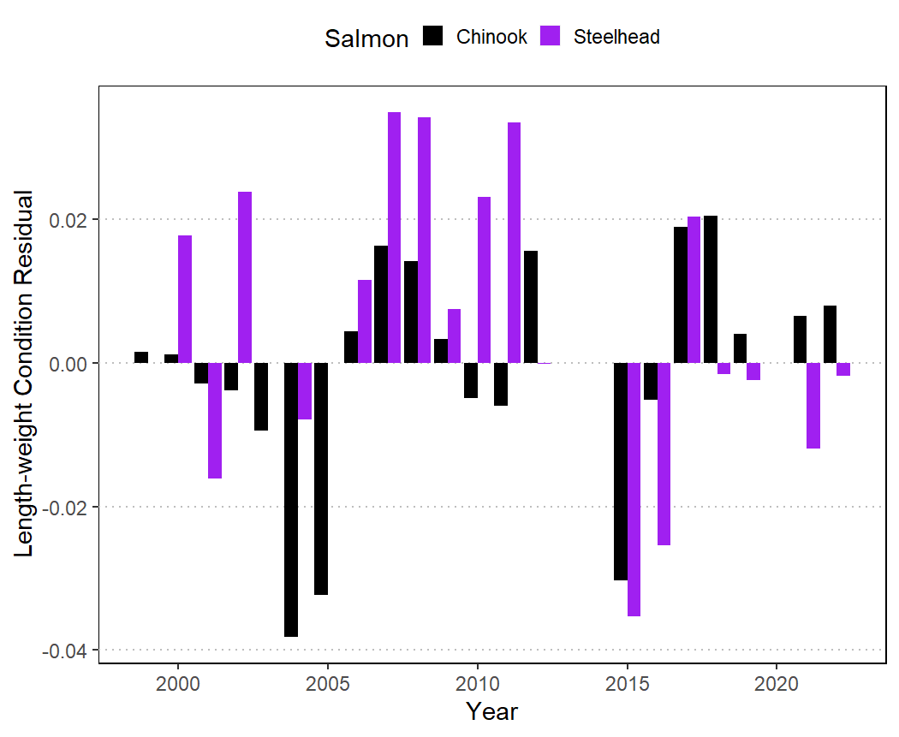
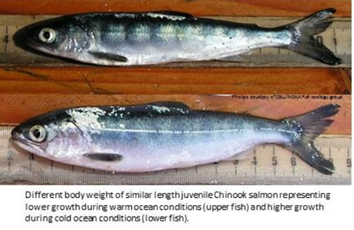
Juvenile steelhead and yearling Chinook salmon condition residual follow similar interannual patterns in the ocean
Fatter
Thinner

Slide 18
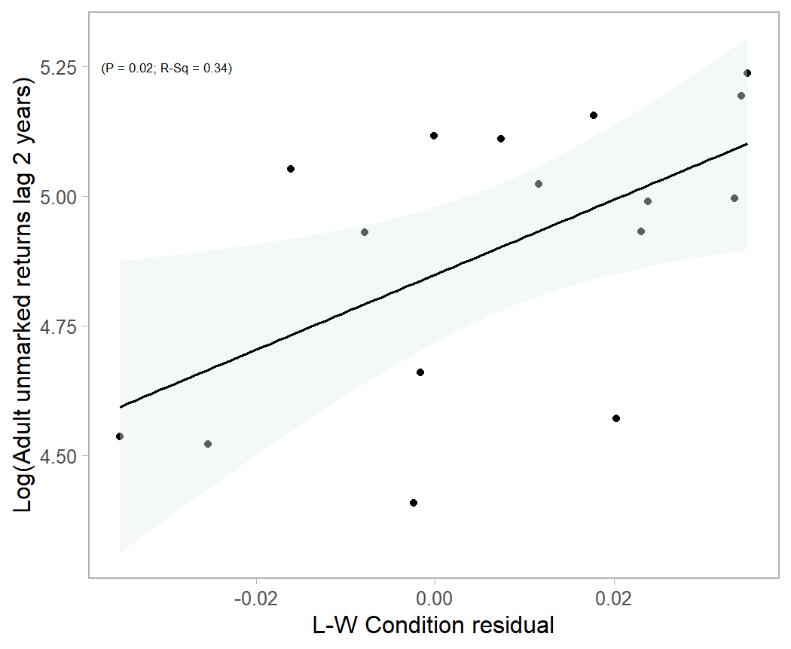
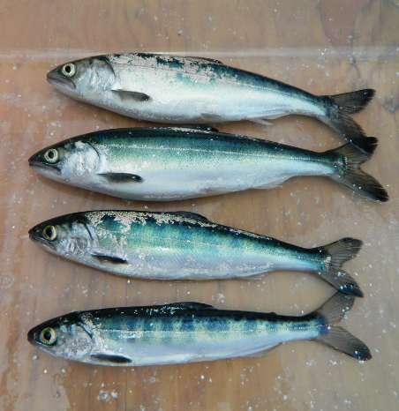
More unmarked steelhead return as adults when juveniles sampled in May are fatter (heavier for their length).
No significant relationship for yearling Chinook salmon

Slide 19
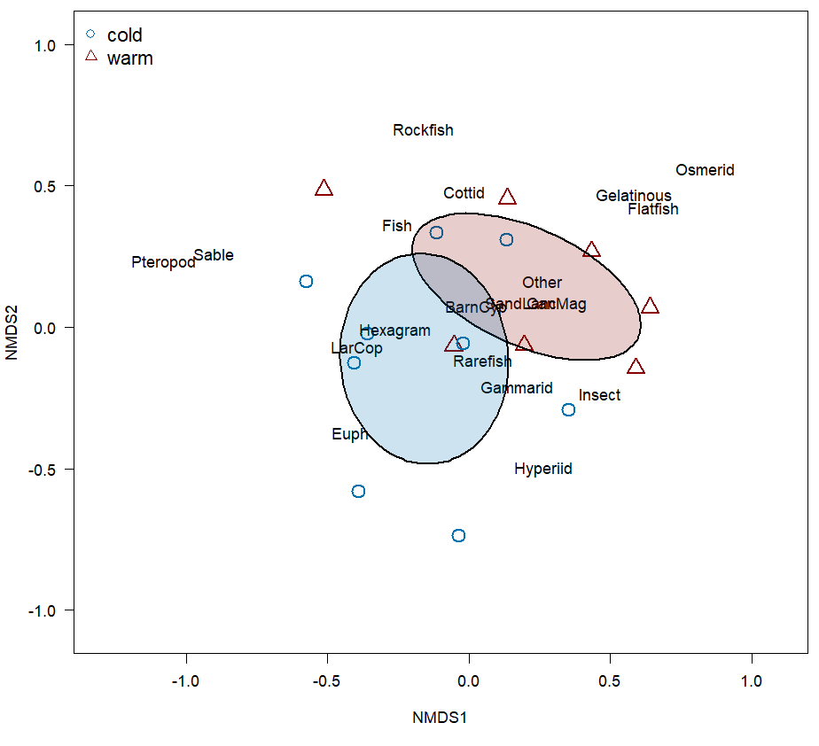
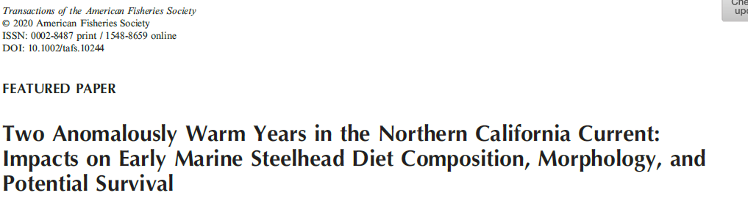
Diets of juvenile steelhead continue to change between cold and warm ocean conditions (16-yrs)
Thalmann et al. 2021
*additional 3-yrs to Thalmann et al. 2014

Slide 20
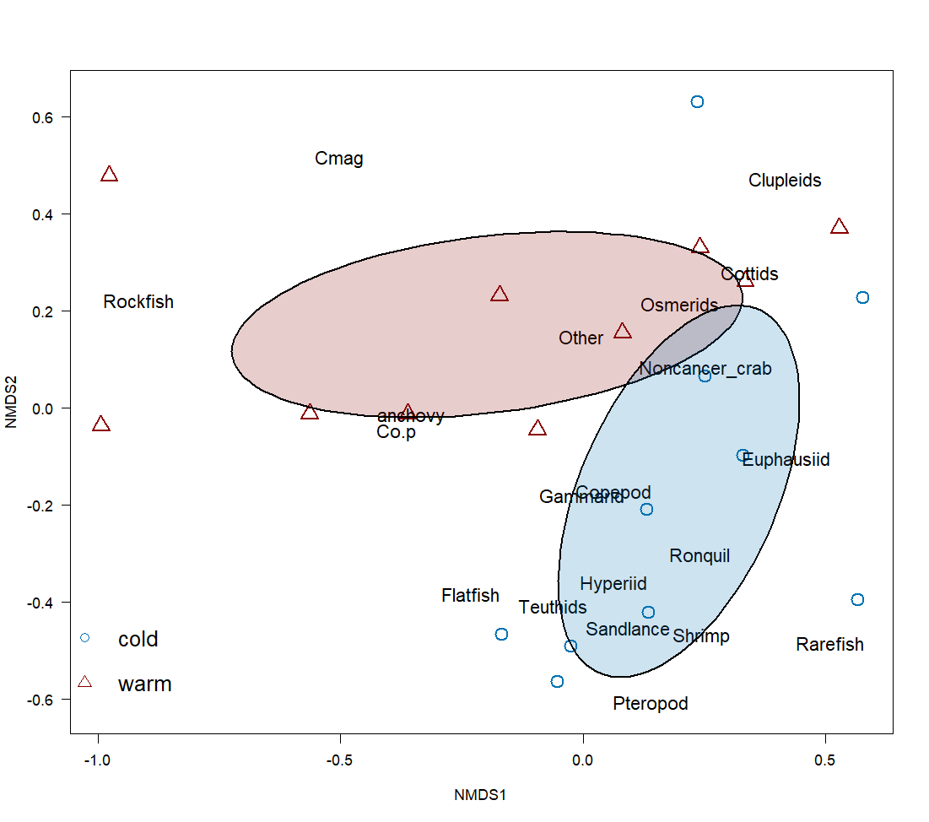
Diet composition of juvenile yearling Chinook salmon also significantly change with cold and warm ocean conditions

Slide 21

Juvenile steelhead and yearling Chinook salmon diets in May are significantly different in composition
Notes:
Just 2015, station diets as they were in spatial overalap. Same as other years 2016, 2018, 2019, 2021. diets not done CK 2022

Slide 22


Steelhead (left) and Spring Chinook salmon (right) adult returns to Bonneville Dam are correlated with what type of fish prey community develops the winter prior to their ocean entry
Notes:
And biomass for Chinook salmon, not steelead. Community is all fish, biomass is limited

Slide 23

Conclusions
Ocean conditions during the time of juvenile salmon outmigration have been warm since late 2013 and are predicted to be warm this year
Large marine heatwaves have covered that majority of where juvenile steelhead are distributed during their first summer and fall for the last 9-yrs
Juvenile steelhead condition, and diet composition shows significant changes between cold and warm ocean conditions
Juvenile steelhead and yearling Chinook salmon sampled during our May survey display some similarities in condition, and correlations with prey community but differences in diet composition and size

Slide 24





Thanks to all supporters of and participants in the juvenile salmon ocean ecosystem surveys and those that helped process samples in laboratory

