Slide 1
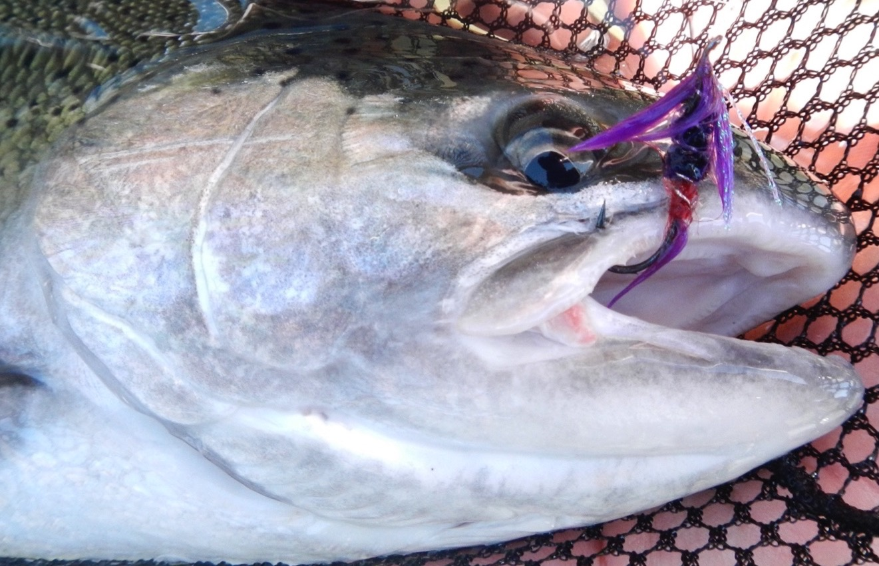
The Quest for Fisheries-Specific Steelhead Hooking Mortality Estimates
Ian Courter, Thomas Buehrens, Mark Roes, Tara Blackman, Ben Briscoe, and Sean Gibbs

Slide 2
Notes:
Recreational angling regulations are complex for the following reasons:
-Protections for specific stocks
-Harvest allocation, or allocation of angling opportunity
-Local managing biologist scientific perspective/interpretation
-Local advocacy

Slide 3
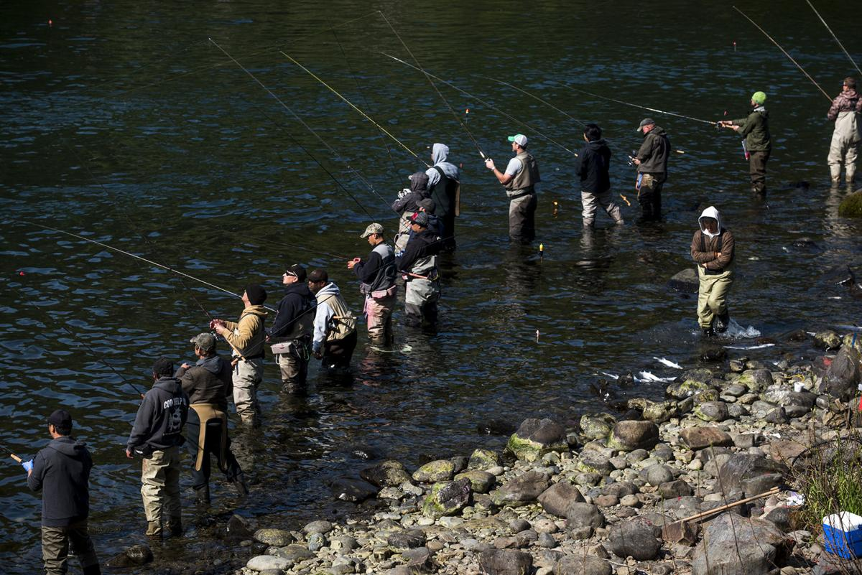
Daily Chronicle
Notes:
Anglers at the Barrier Dam pool on the Cowlitz River

Slide 4
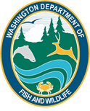
Notes:
Cowlitz enters Columbia near town of Longview WA
Study reach 30 river km Barrier Dam to Toledo
Barrier Dam to Blue Creek roughly 13 km

Slide 5
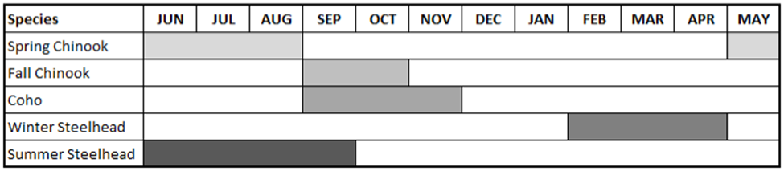
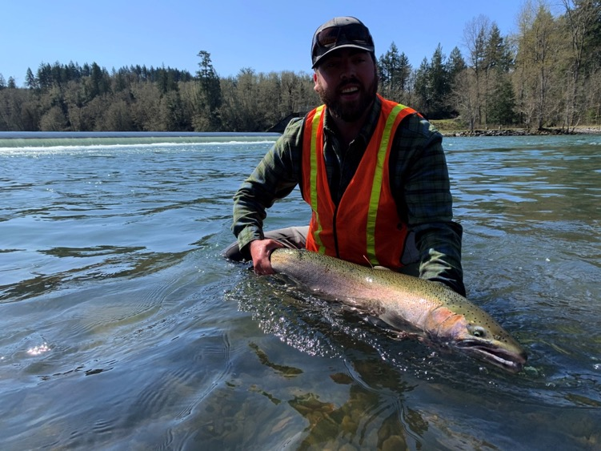
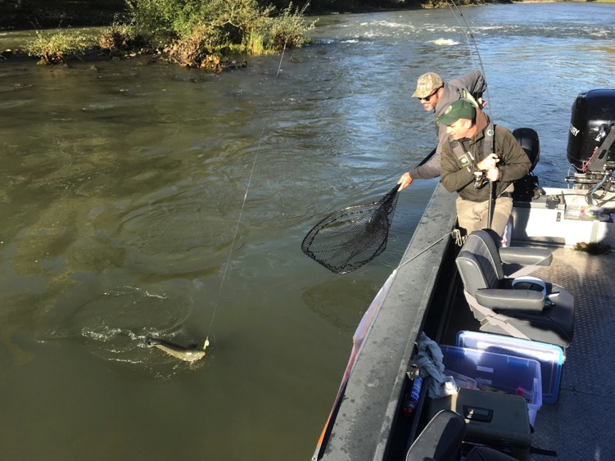

Slide 6
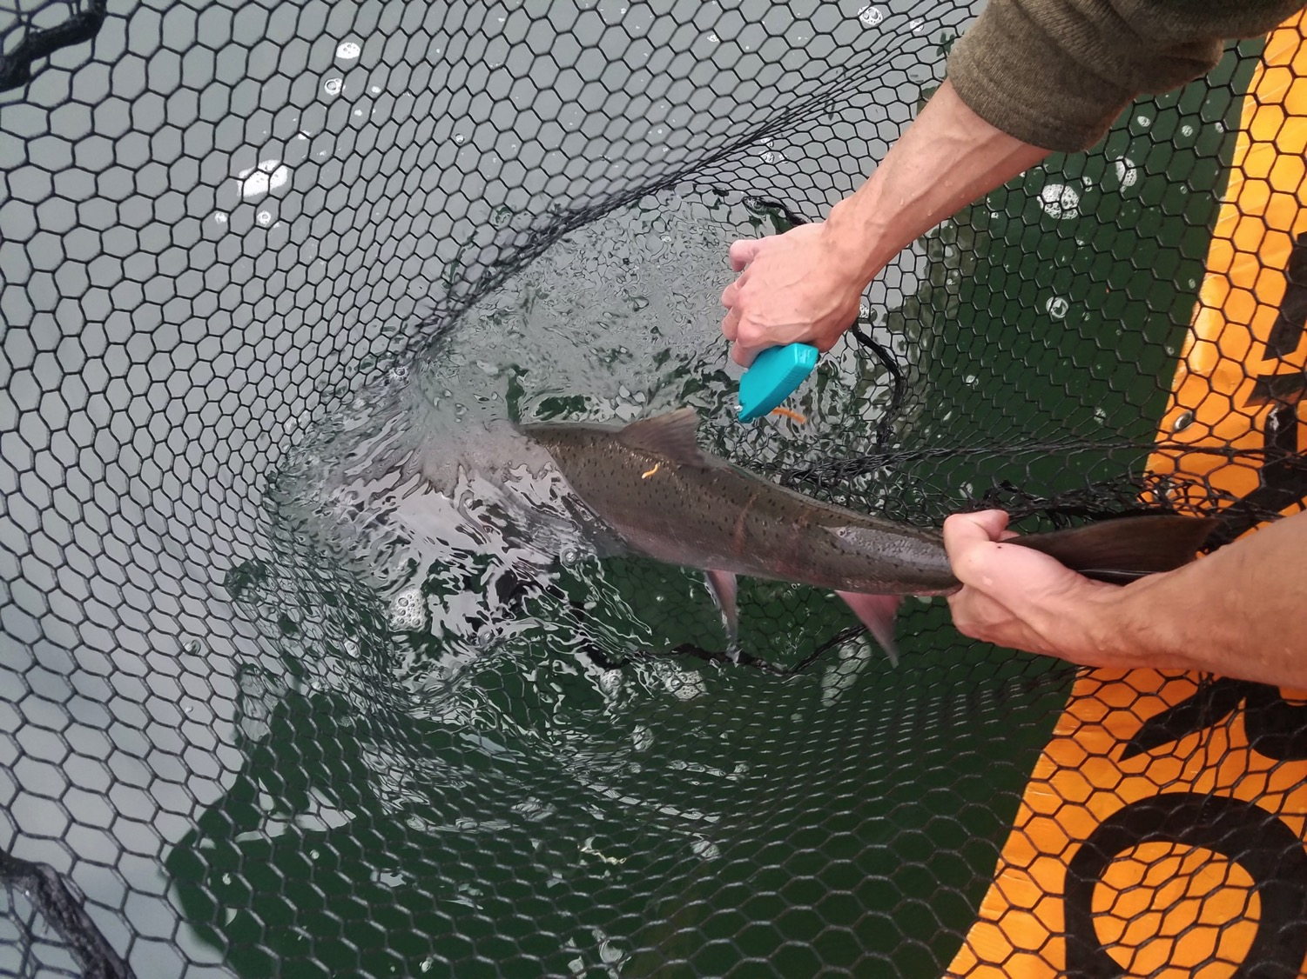

Slide 7
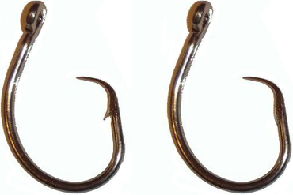
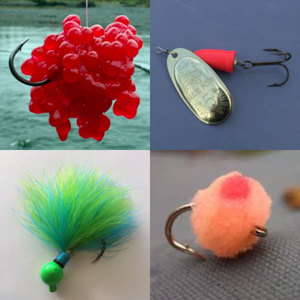
Method & Gear Type
Hook location
Hook Size/Type/Barb
Fight Time
Handling Time
Species
Sex
Fork-length
Angler Exp.
Fish Condition
Knotted vs. Knotless nets
Water temp

Slide 8
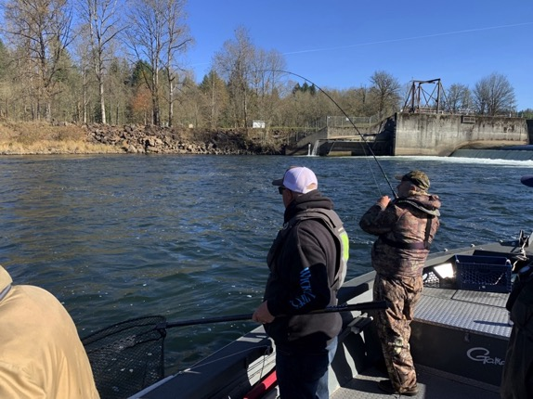
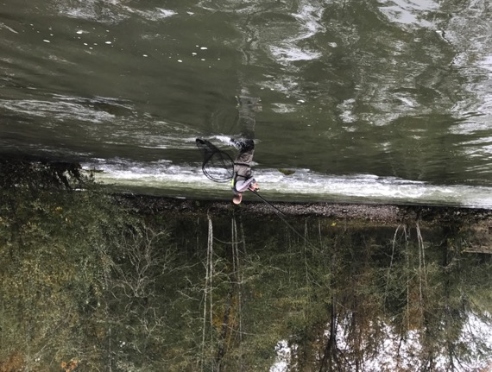
Boat Angling
Bank Angling

Slide 9
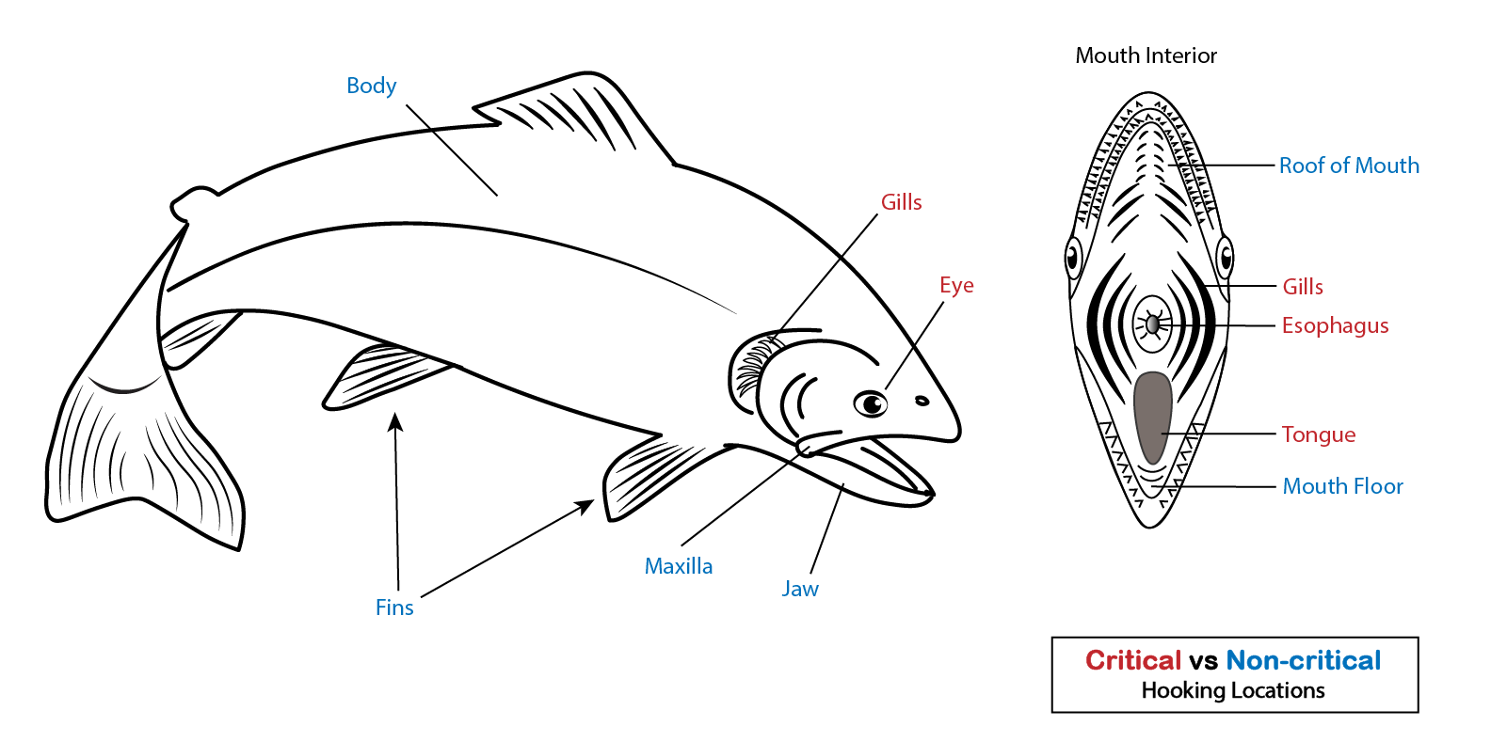

Slide 10
Environmental Conditions

Slide 11
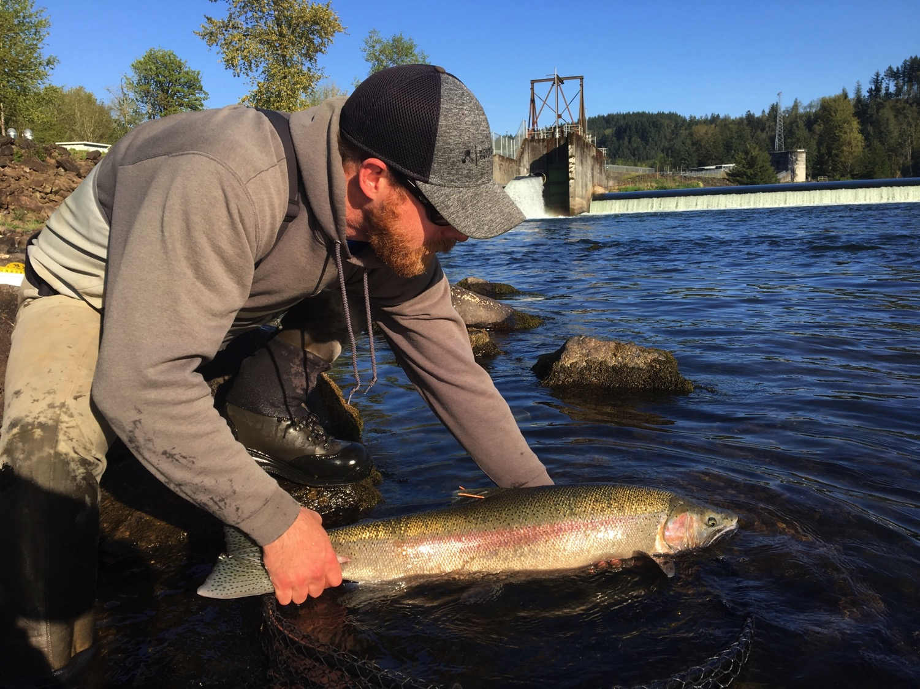

Slide 16
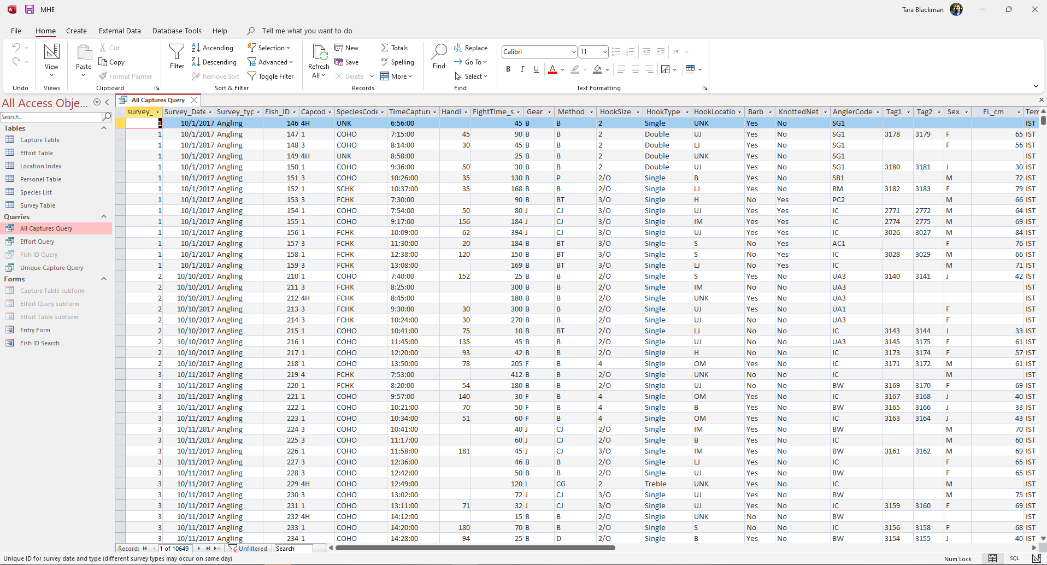
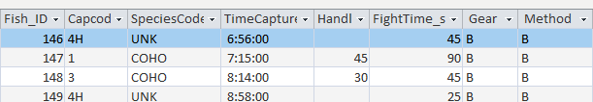
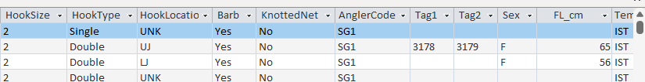
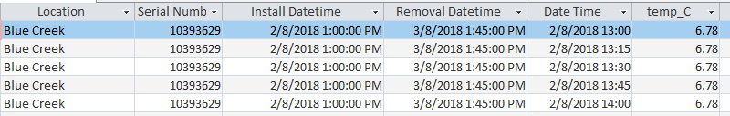

Slide 17
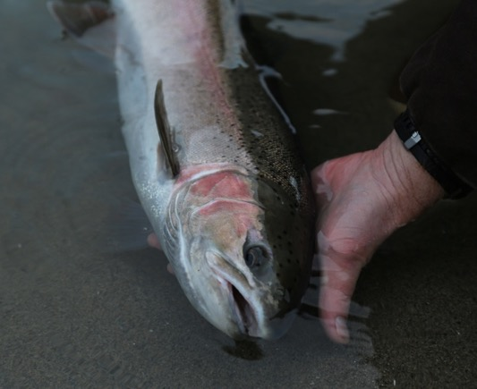
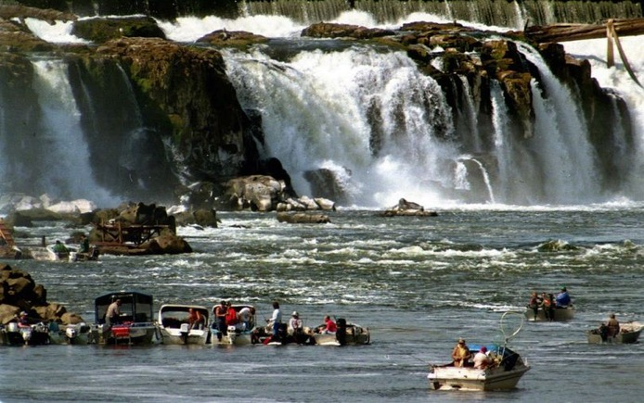
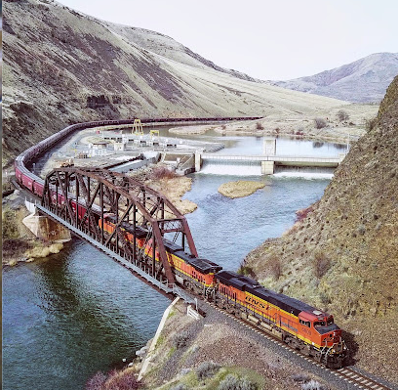
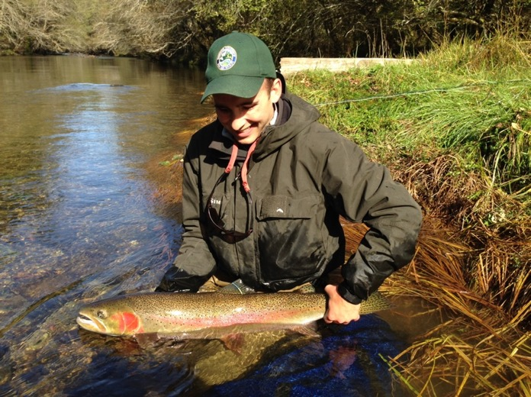
Will Lubenau
Don Ryan
Notes:
Proposal to combine datasets from the Yakima, Wind, Willamette, Snake Rivers, and others with our Cowlitz database
Purpose of database is to make empirical information more accessible. The push-pull between conservation and angling opportunity will necessitate a certain level of variation in angling regulations throughout the region, and we’re not expecting, nor should there be a one-size fits all approach to angling regulations. What we’re hoping to do is to create some consistency in the science/data used as the basis for establishing angling regulations.

Slide 18
