Slide 1
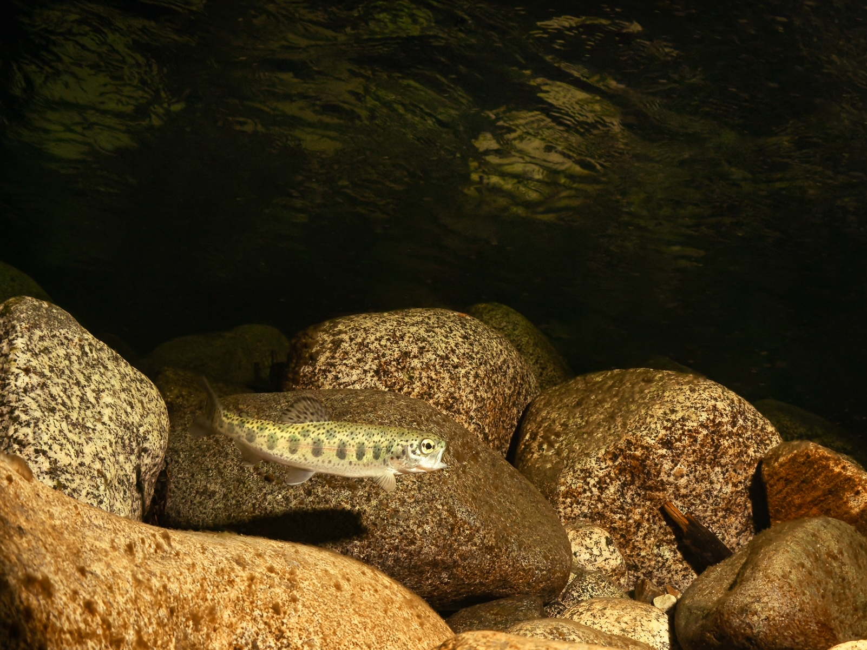




Early Life Dispersal of Steelhead
Nick Chambers
March 16th, 2023

Slide 2
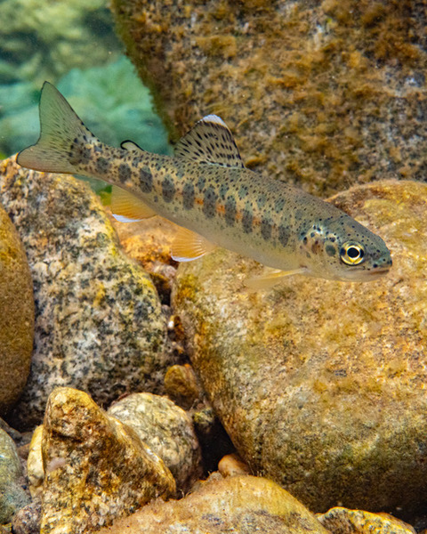
Juvenile Dispersal
Highly mobile life stage
Able to seek out high quality habitat and undertake seasonal movements
Influences competitive interactions among juveniles
Mechanism that allows for compensation - higher productivity at low run sizes

Slide 3
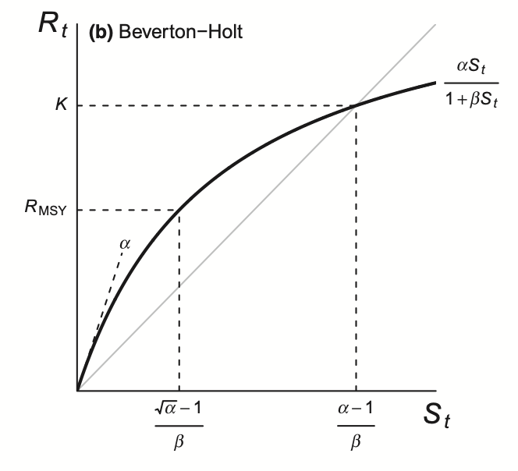
Often only have adult to adult data
Density dependence can manifest differently at successive life stages

Slide 4
Salmonids with long freshwater residence characterized by sessile early life stage and mobile parr
The greatest period of mortality in life is at the fry stage

Slide 5
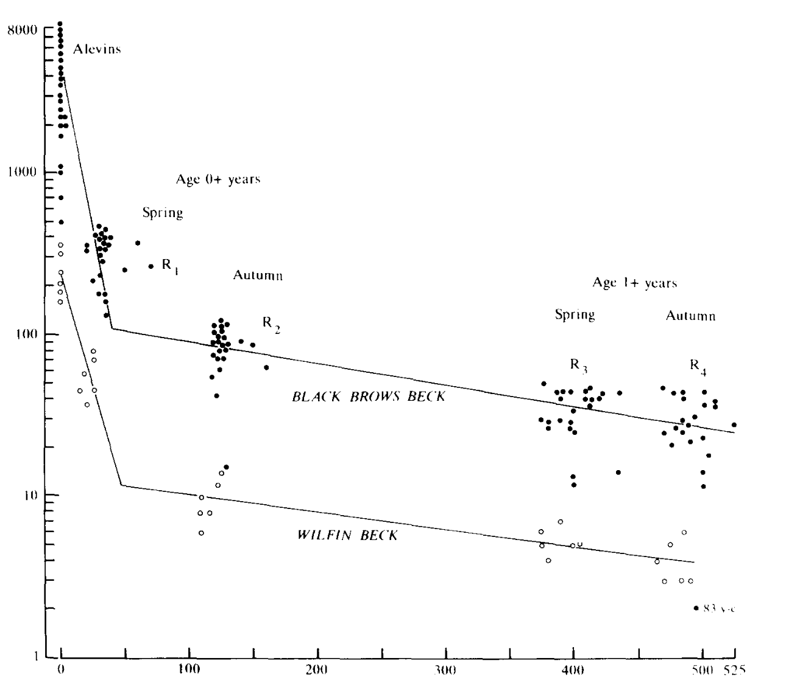
Limited capacity for dispersal leads to density dependent mortality among fry
Density primarily influences growth among parr
Elliott 1993
Survivor Density
Time (days post emergence)

Slide 6
Limited capacity for dispersal leads to density dependent mortality among fry (Elliott 1993, Einum 2008)
Density primarily influences growth among parr
Fry dispersal has never been quantified for steelhead
Elliott 1993
Survivor Density
Time (days post emergence)

Slide 7
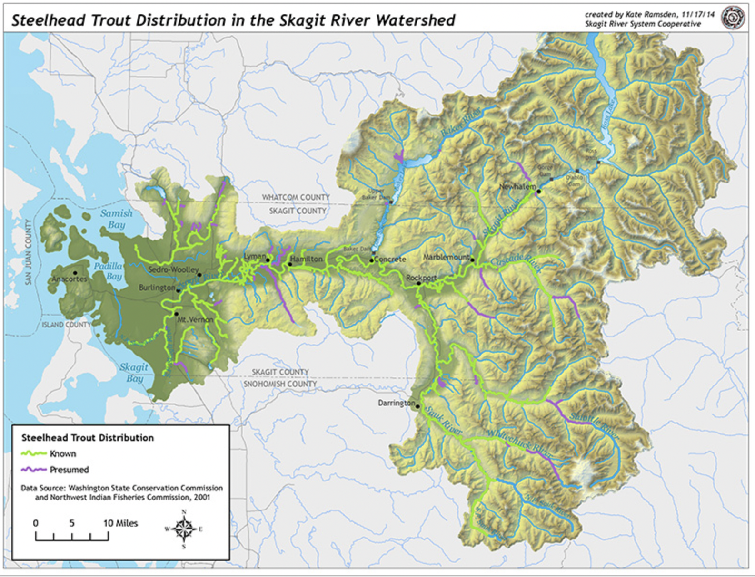

Slide 8
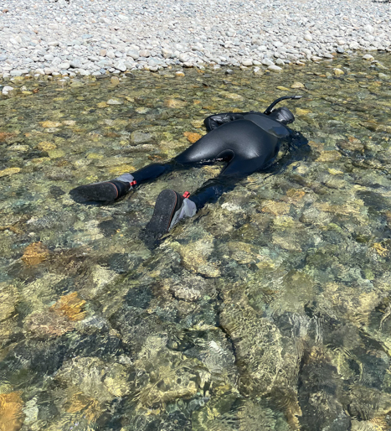
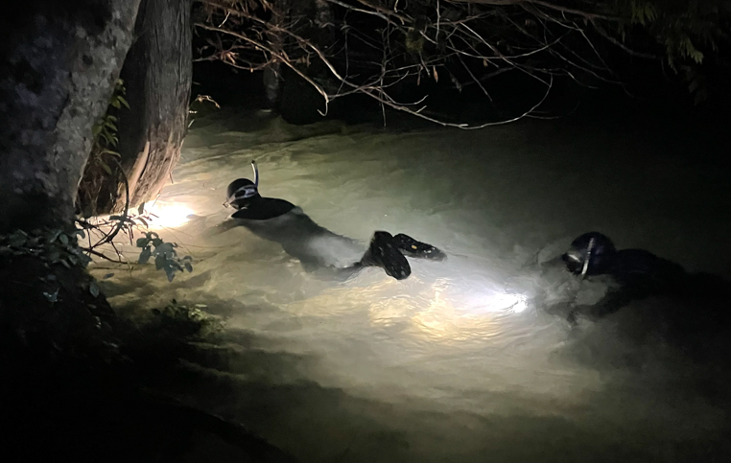
Methods
Redd counts 2021 and 2022
Selected isolated single and clustered redds
Snorkel counts along 10m transects up and down from redds in July and August

Slide 9
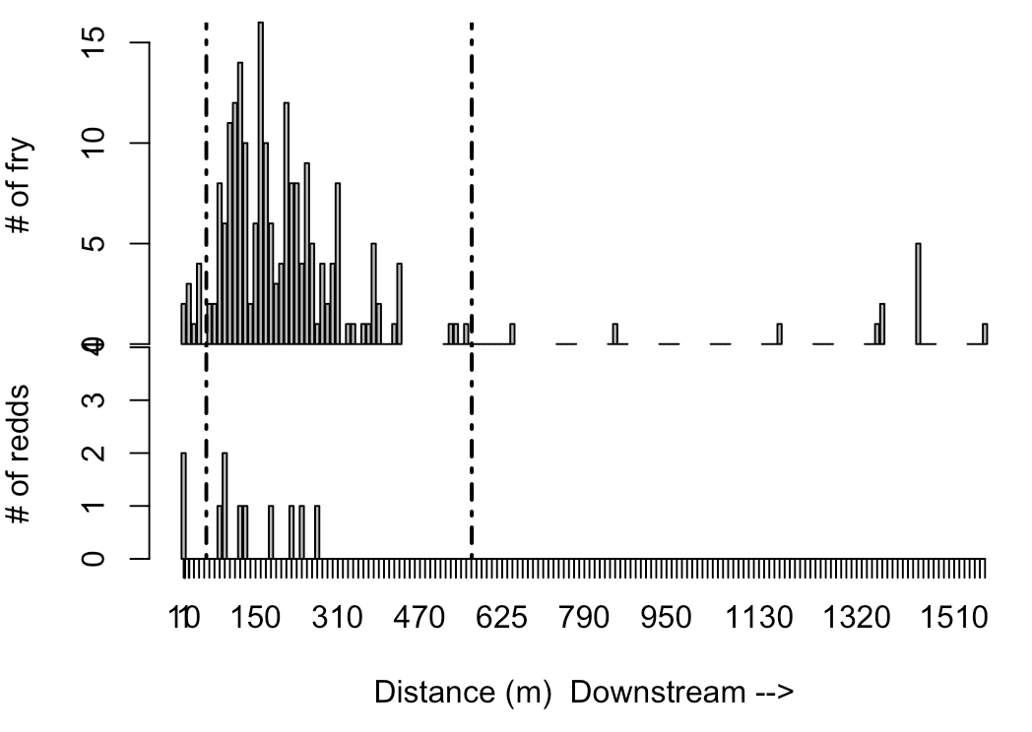
0
0

Slide 10
 | Median Distance | Maximum Distance | Chi-squared
Single | 178 m | 270 m | p < .005
Cluster | 450 m | 750 m
Values are for middle 90% of total count. n=12
Redd counts range from 1-27 per site
Dispersal kernels range from 102m – 750m

Slide 11
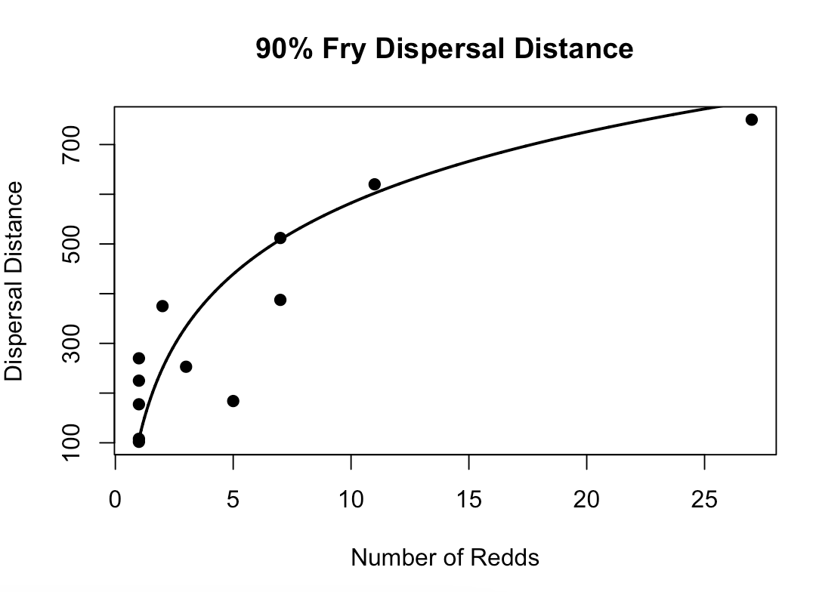
Points represent inner-quantile distance where 90% of fry were observed
Asymptote corresponds with habitat unit length

Slide 12
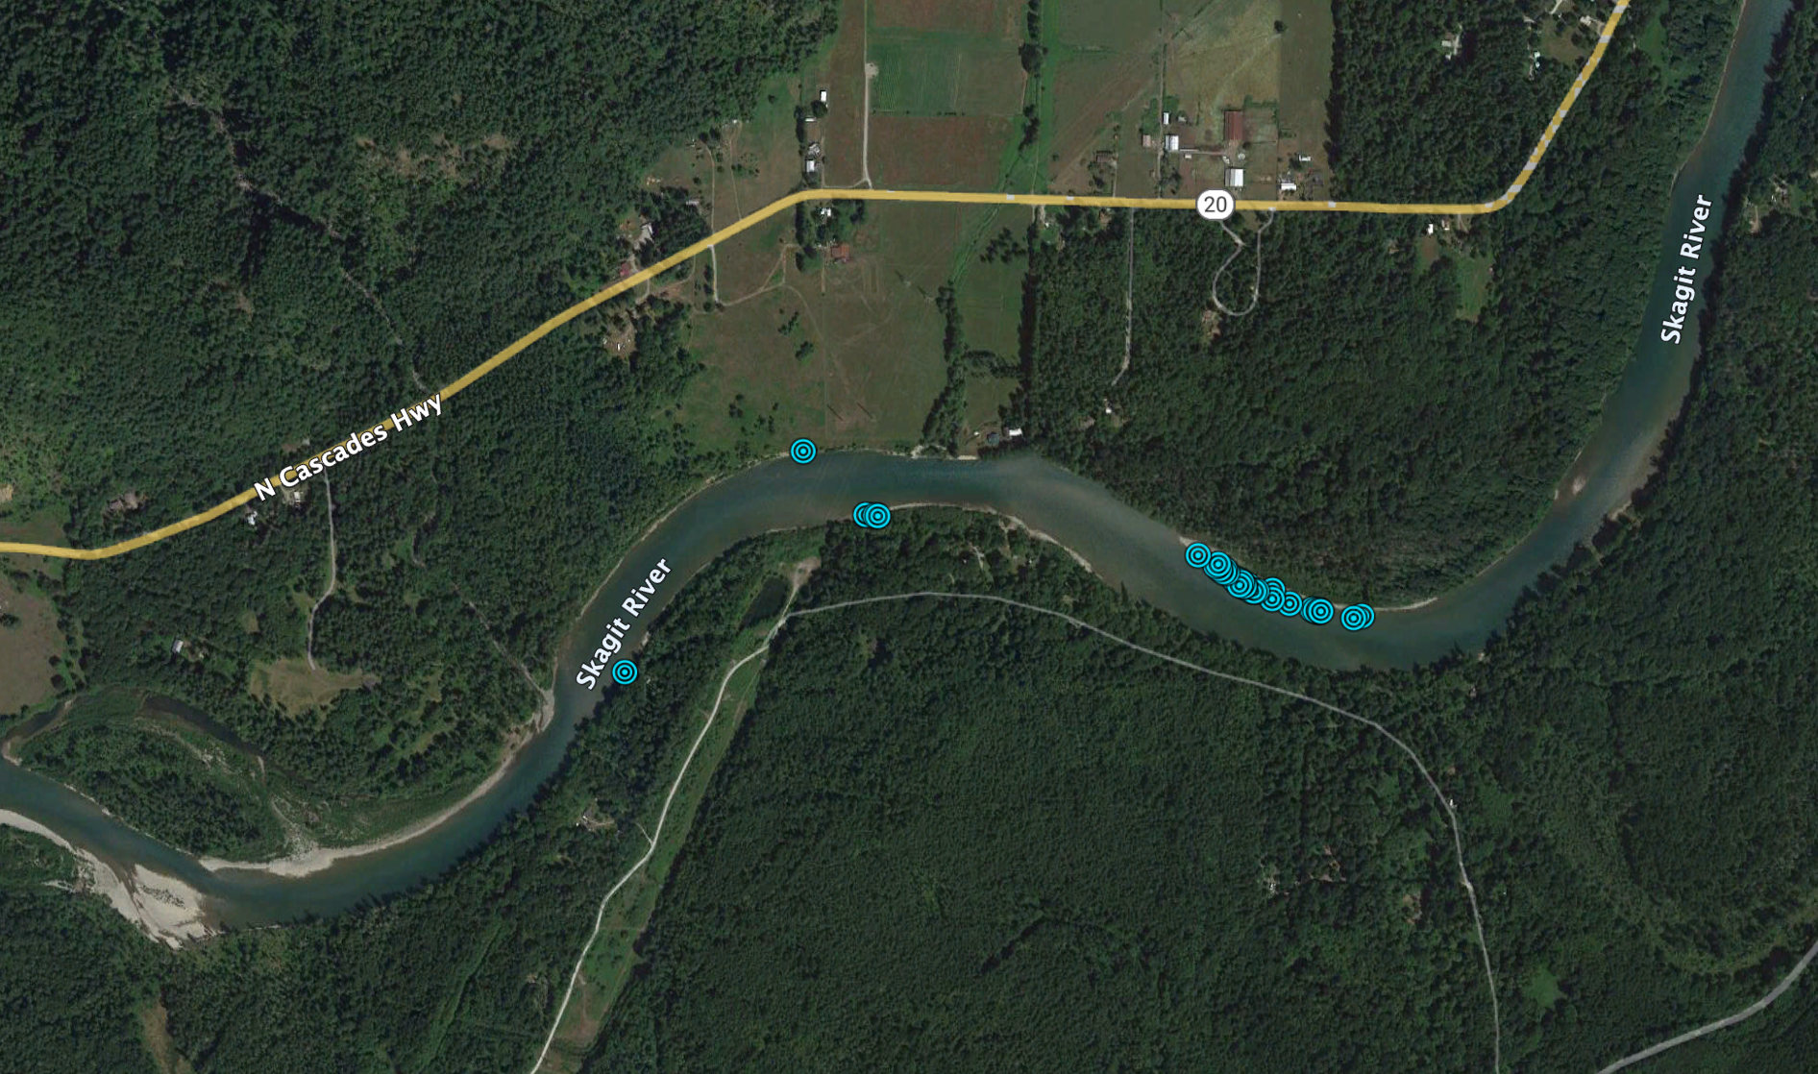
250 meters

Slide 13
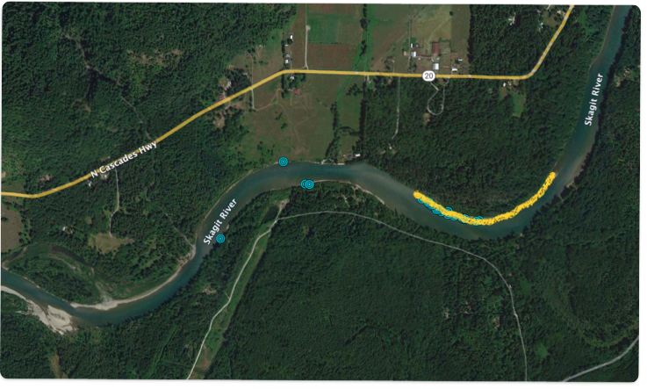
250 meters

Slide 14
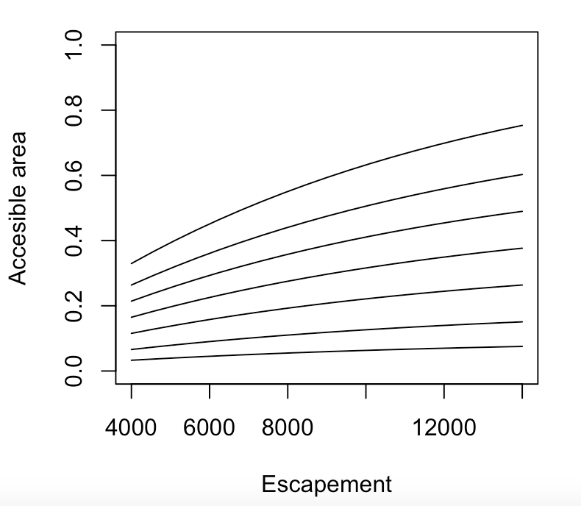
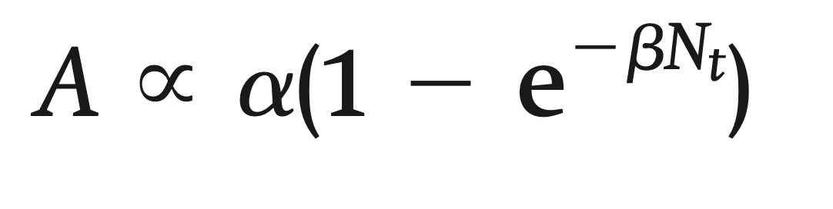
Adult Clustering
⍺
A = total area accessible to juveniles
⍺ = maximum area accessible
𝛽 = rate at which asymptote is reached
From Finstad et al. 2013

Slide 15
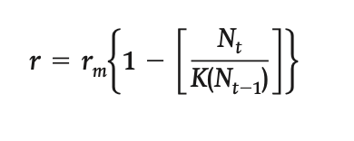
Parameter Estimation
⍺
r = realized per capita growth
r_{m} = maximum growth rate
K(N_{t-1}) = asymptotically increasing function
From Finstad et al. 2013

Slide 16
Parameter Estimation
Abundant fry habitat and low adult dispersal can reduce the estimated rate of population increase
The rate of recovery may be slower than otherwise expected
Traditional assumptions may overestimate the amount of accessible habitat
⍺

Slide 17
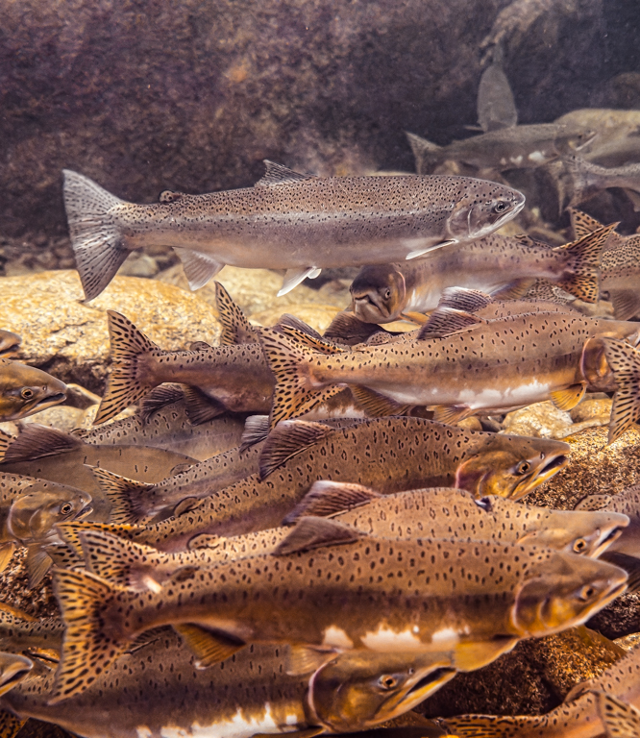
Modeling Dispersal
Patterns of redd dispersal correlated with adult abundance
Low abundance can lead to increased synchrony in space and time
Incorporate redd dispersal into steelhead specific population dynamics models
Use DIP specific information

Slide 18
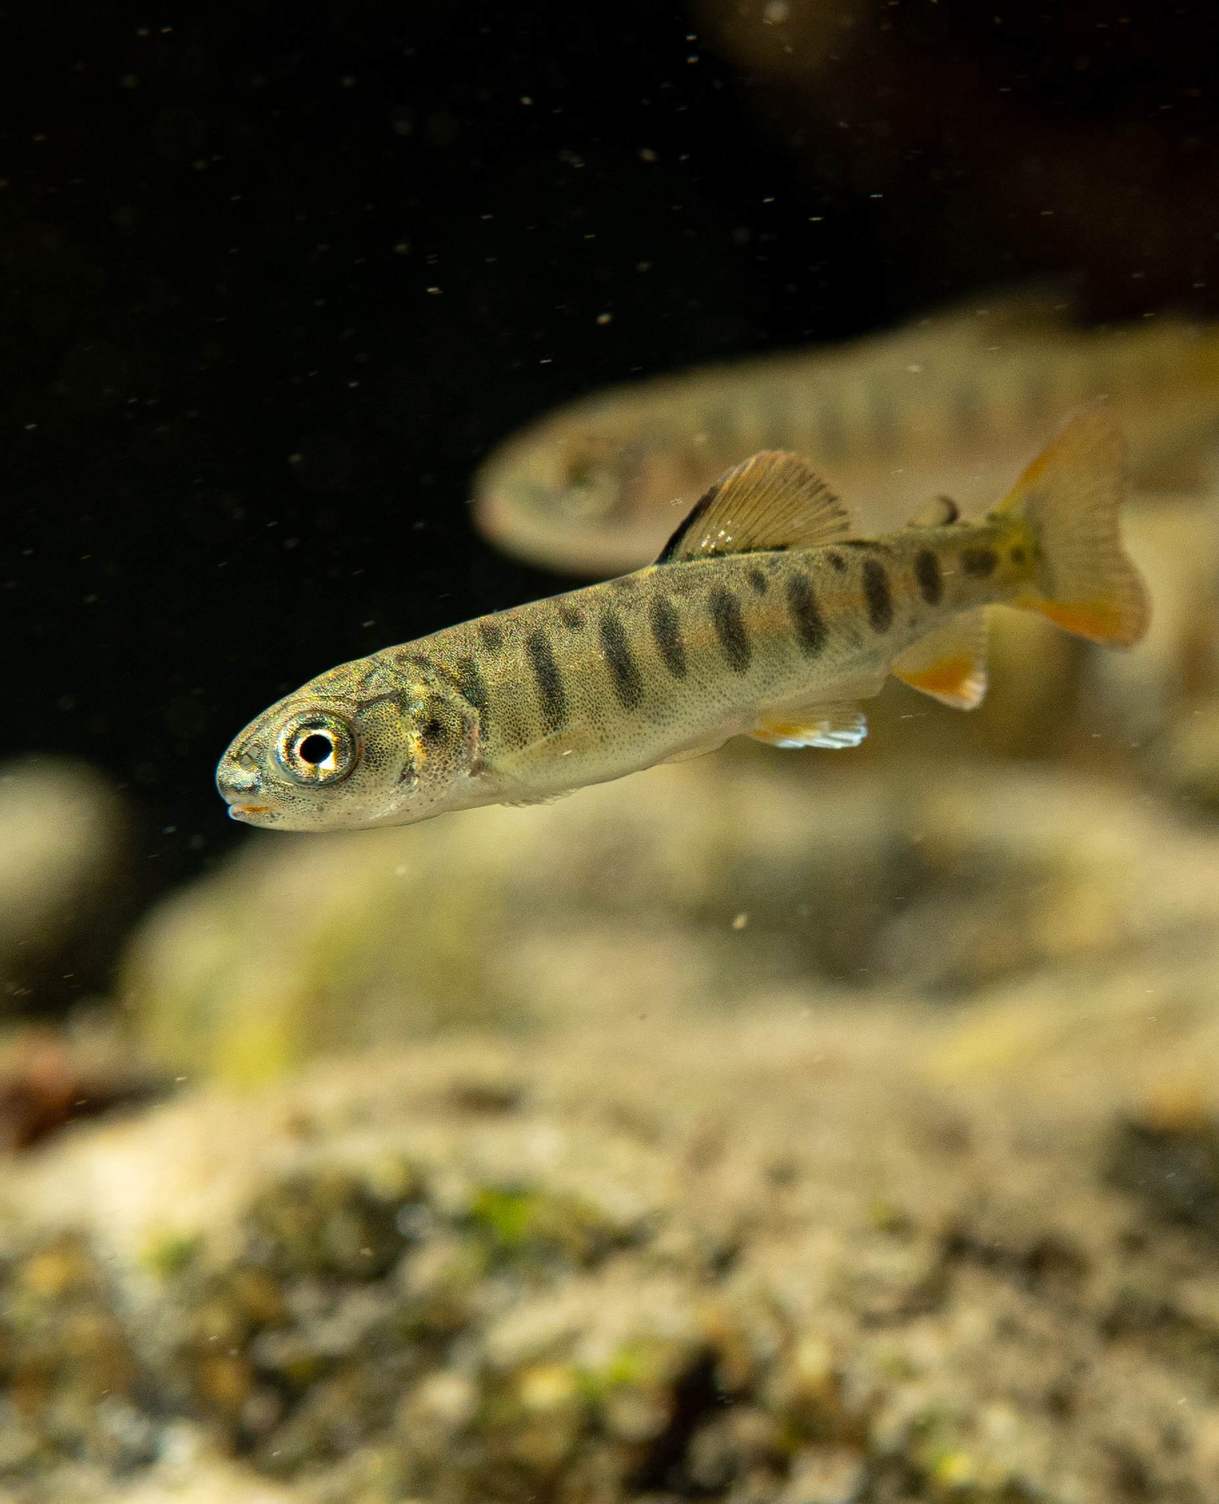
Conclusions
Limited dispersal capacity can reduce compensatory capacity
Recovery may be slower than anticipated due limited access to under-utilized habitat
High escapements are needed to test habitat capacity

Slide 19
