Slide 1
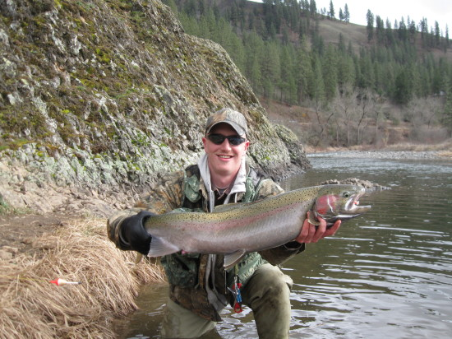
Steelhead Status in Idaho
Idaho Department of Fish and Game - 2023 Update
Presented by:
Alan Byrne
Boise, Idaho
Notes:
Dworshak hatchery steelhead caught in SF Clearwater River

Slide 2
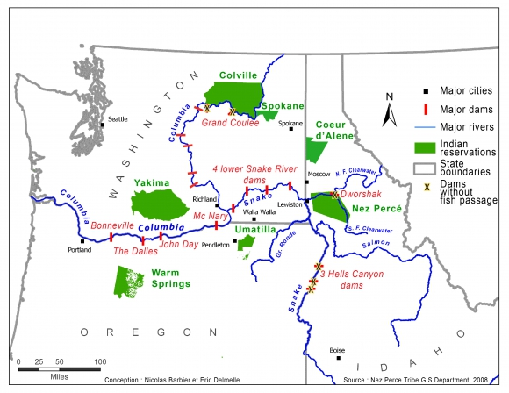
Columbia and Snake River Basins with Mainstem Dams
Notes:
Lewiston is 746 km from mouth of Columbia River. Hells Canyon Dam is 173 km upst of Lewiston. Lower Granite Dam is 695 km from mouth of Columbia River

Slide 3
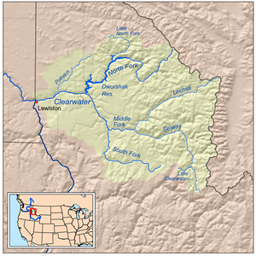
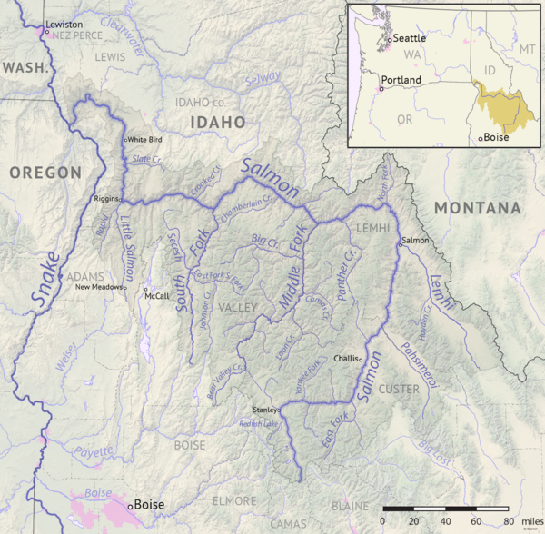
Clearwater River Basin
Salmon and Snake River Basins
Dworshak Dam (no fish passage)
Hells Canyon Dam (no fish passage)
Notes:
Dams completed in: Dworshak 1973, Hells Canyon 1967, Oxbow 1961, Brownlee 1959

Slide 4
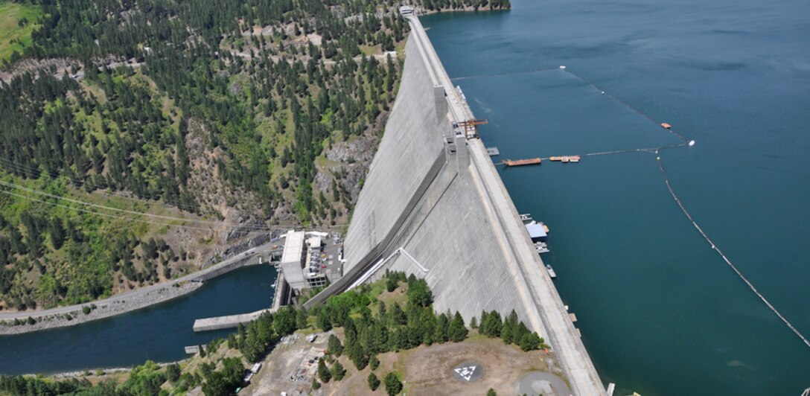
Dworshak Dam is the third tallest dam (717 feet) in the U.S. and the tallest straight-axis concrete dam in the Western Hemisphere. Completed 1973.
Notes:
Oroville Dam (Feather River, CA) = 770’; Hoover Dam = 726’

Slide 5
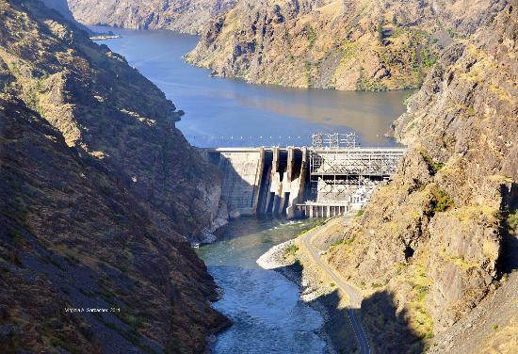
Hells Canyon Dam - Height 330 feet. Completed 1967.
Notes:
1 of 3 Idaho Power dams in Hells Canyon (others upstream are Oxbow and Brownlee)

Slide 6
Steelhead Return at Bonneville Dam, July 1 to October 31
nearly all Snake Basin Steelhead pass during this time frame
2023 BON return
Total: 116,969 Rank 62 of 85 years (begin 1938)
Clip: 82,033 Rank 24 of 29 years (begin 1994)
Unclip: 34,936 Rank 20 of 29 years (begin 1994)
Notes:
Data and chart for this slide from: C:\Users\abyrne\Documents\Excel_Files\Dam Counts\[BON steelhead 1938 - 2022 totals and LGR counts.xlsx]BON Chart
Summer steelhead passing BON in Year x == Spawn Year x+1 (or Run Year x to x+1). BON is 234 km from the ocean.

Slide 7
IDFG Adult Steelhead Sampling at Lower Granite Dam
Snake basin steelhead that pass Bonneville Dam in year X can pass Lower Granite Dam in year X and X+1
Began in 2008 (prior to 2008 there was sampling by NMFS)
Fish are randomly and systematically sampled throughout the run when adult ladder is open
--The adult ladder is de-watered in January and February for maintenance, hence no fish passage
All sampled fish are:
Identified to species and the date the fish was sampled is recorded
Scanned for PIT tag and CWT
The presence/absence of the adipose (AD) fin, other fin marks and condition, and injuries are recorded
Fork length is measured
In-season run size estimates are based on visual data
A sub-sample of the fish since 2008 are:
A tissue sample is obtained for genetic analysis (PBT and GSI)
PIT tagged (if not a recapture)
Scales are collected from AD-unclipped fish to age wild fish.
Final post-season run size estimates incorporate genetic data
Notes:
LGR = 695 km from mouth of Columbia River

Slide 8
Genetic Sampling Allows Fish to be Assigned to Hatchery and Wild Stocks
All Idaho hatchery broodstock have been genotyped since BY2008 (all Snake basin stocks since BY2009)
able to identify all hatchery offspring using non-lethal sampling and PBT techniques
using PBT we can assign fish to the hatchery stock, brood year, and release site (in recent years)
fish that do not assign to a PBT release group can be assigned to a GSI group
AD-unclip fish with no external marks, CWT, or hatchery origin PIT-tag are assumed to be wild fish
10 Snake River Basin GSI groups used for Wild fish assignments
2 Oregon GSI groups (Grand Ronde and Imnaha)
1 Snake River drainage GSI group
3 Clearwater River drainage GSI groups
4 Salmon River drainage GSI groups

Slide 9
Steelhead Return to Lower Granite Dam by Run Year
July 1 to June 30
Notes:
Hatchery includes unclipped and clipped hatchery origin fish
Data and chart from: C:\Users\abyrne\Documents\Excel_Files\Dam Counts\[BON steelhead 1938 - 2022 totals and LGR counts.xlsx]Charts for Andro meeting

Slide 10
Abundance of AD-clip Idaho Hatchery Stocks at Lower Granite Dam
by Run Year (July 1 to June 30)
Notes:
Data and chart from: C:\Users\abyrne\Documents\LGR estimates\[Clipped hatchery abundance at LGR_2-10-23.xlsx]Sheet1
Run year 2015-16: 2015 is the year of passage at BON, 2016 is the Spawn Year. Fish pass LGR 7/1/2015 to 6/30/2016

Slide 11
Statewide Effort (days fished) for Steelhead by Run Year and Season
Notes:
Data and chart from: C:\Users\abyrne\Documents\Steelhead Workshop\2023 meeting\[Steelhead harvest summary_SY2012 to 2022.xlsx]Pivot summary
July/August – not all areas open to harvest. Currently some sections of the Snake and Clearwater are open for catch and release fishing. In the past there was harvest allowed in the lower 2 km of the Clearwater and in the Snake River before September 1 (however not much was caught).

Slide 12
Statewide Harvest of AD-Clip Steelhead by Season and Run Year
Only AD-clipped fish may be kept since the 1987 Fall Season
Notes:
Data and chart from: C:\Users\abyrne\Documents\Steelhead Workshop\2023 meeting\[Steelhead harvest summary_SY2012 to 2022.xlsx]Pivot summary
Fishing allowed in parts of Clearwater and Snake in July and August for catch and release only. Harvest was allowed in August in the lower 2km of the Clearwater and the Snake prior to 2022.

Slide 13
Sport Harvest of AD-Clip Steelhead by Drainage and Run Year
Notes:
Data and chart from: C:\Users\abyrne\Documents\Steelhead Workshop\2023 meeting\[Steelhead harvest summary_SY2012 to 2022.xlsx]Pivot summary
AD-clip harvest only since Fall 1987.

Slide 14
Wild Steelhead Estimates at Lower Granite Dam by Run Year
and River Drainage
Notes:
Data and chart for this slide from; C:\Users\abyrne\Documents\LGR estimates\[Wild adult and smolt steelhead estimates at LGR since 2008_2-10-23.xlsx]adult data

Slide 15
Clearwater River Drainage Wild Steelhead GSI Group Estimates at Lower Granite Dam by Run Year
Notes:
Data and chart for this slide from; C:\Users\abyrne\Documents\LGR estimates\[Wild adult and smolt steelhead estimates at LGR since 2008_2-10-23.xlsx]adult data

Slide 16
Average Decadal Spawn Year Return at Lower Granite Dam
Notes:
Data and chart from: C:\Users\abyrne\Documents\Excel_Files\Dam Counts\[BON steelhead 1938 - 2022 totals and LGR counts.xlsx]LGR decade chart
Wild estimates begin with Run Year 1986-87 (wild avg for SY 1987-1989 == 23,634)
Decade 2020 Avg is return for SY2020+SY2021+SY2022 and SY2023 using Fall2022 prelim return estimate plus estimated spring 2023 passage.

Slide 17
Both wild and hatchery steelhead have been in decline since Spawn Year (SY) 2010 in the Columbia and Snake basins
The average return at Lower Granite Dam since SY2020 has been less than the 1990’s when steelhead were listed as “ Threatened” under ESA
Fishing effort and harvest in Idaho has decreased in recent years
The total and unclipped steelhead return at Bonneville Dam in 2023 (SY2024), if the forecast is accurate, will be the lowest total return since the dam was constructed in 1938 and the unclipped return will be the lowest since clip/unclip counting began in 1995.
The SY2024 return at Lower Granite Dam, if the forecast is accurate, will be the 5th lowest total return since SY1976 (first complete SY count). The SY2024 wild return, if the forecast is accurate, would rank 30th of the 39 years with wild return estimates. Both the total and wild SY2024 forecasts are less than the 2020 decadal averages.
Notes:
Fish counting began at LGR on 3/19/1975.

