Slide 1
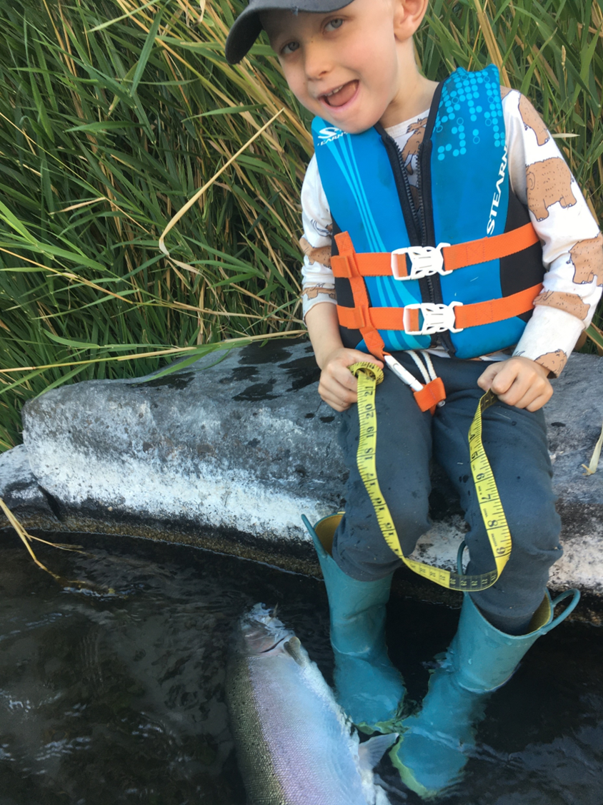



Evaluation of Deschutes Thermal Sanctuary Use – Steelhead and Steelhead Anglers
Logan Breshears, Jeremy Henderson, Ian Tattam, Jason Seals
Notes:
Hello everyone! My name is Logan Breshears, and I am a masters student at Oregon State University working with the Oregon Department of Fish and Wildlife out of the John Day fish research office. I know the program says my talk is focused on Drano Lake usage, however, my talk today is going to be about the evaluation of the Deschutes River thermal sanctuary use, examining steelhead and steelhead anglers by using acoustic telemetry and angler creel data. For those who are unfamiliar with the Deschutes River Thermal Sanctuary, this angling sanctuary was established at the mouth of the Deschutes river in 2020 to help reduce angler pressure in areas being heavily utilized by migrating steelhead escaping the excessively warm temperatures in the mainstem Columbia River. Additional sanctuaries were established at the mouth of Eagle Creek and Herman Creek on the Oregon shore. Our goal with this talk is to begin the conversation around the evaluation of these areas, specifically the Deschutes River, so we can improve the outlook of Steelhead populations going forward, ensuring angler success for future generations, like this young man in the photo.

Slide 2
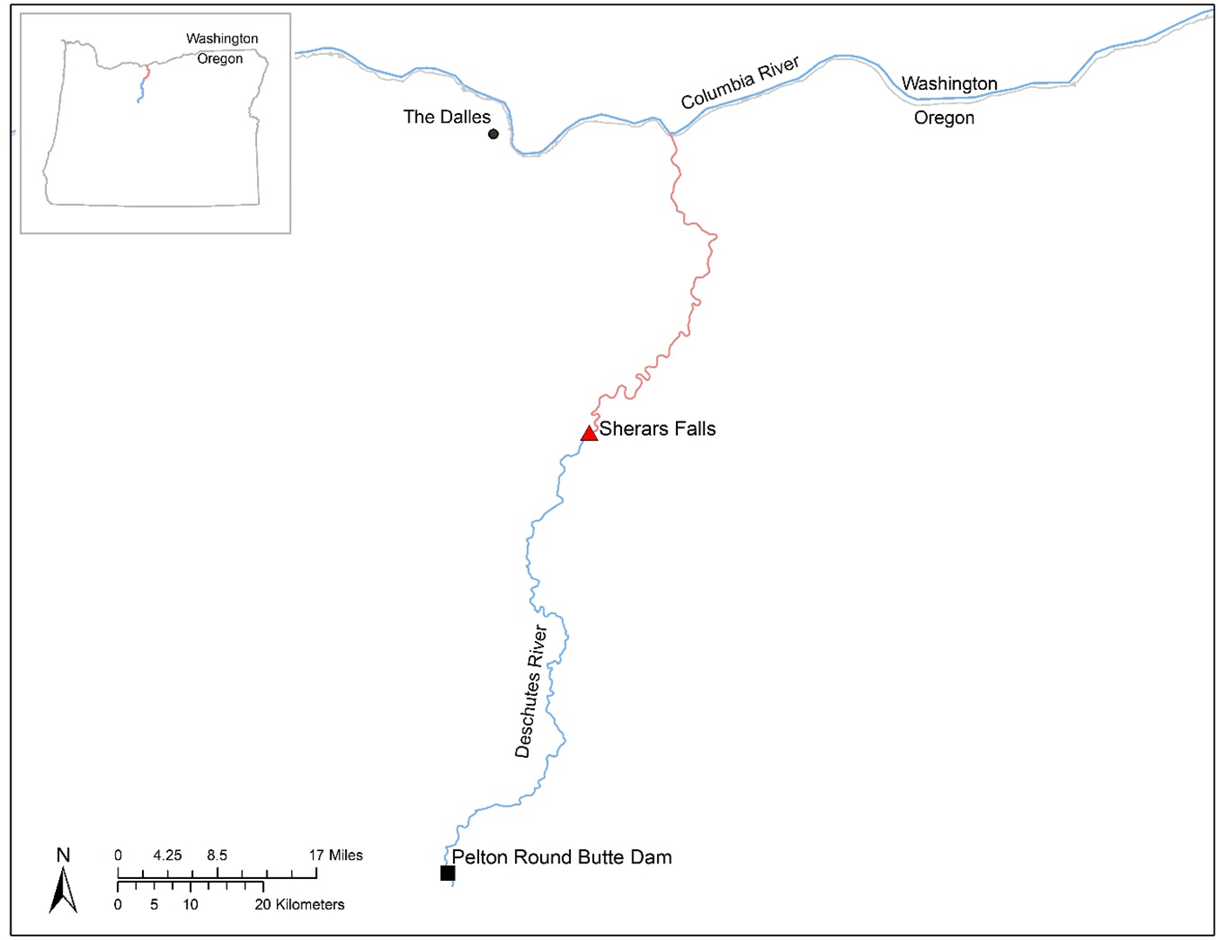
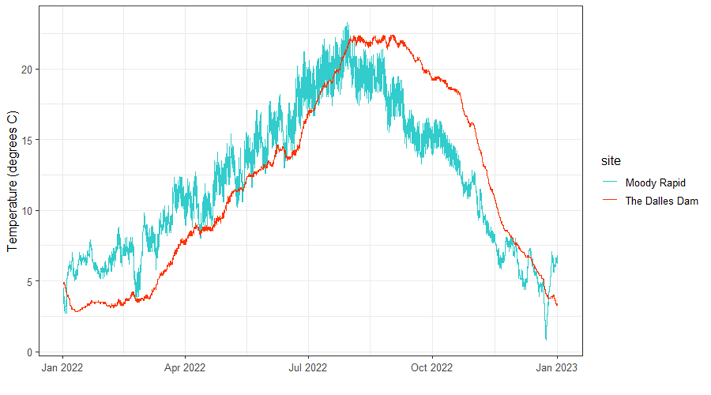
Important cold-water refugia for migrating steelhead?
Notes:
To familiarize folks with our study area, the Deschutes River is a major tributary to the Columbia River that originates on the eastern flank of the Oregon cascade mountains, and flows south to north. The Deschutes River hosts native stocks of Summer Steelhead, Spring & Fall Chinook, and a robust population of redband trout. Not only does it support native populations of salmonids, it’s historically believed be an important holdover location for a large proportion of the total migrating steelhead run passing over The Dalles Dam. But as years have passed, and the environmental drivers and management decisions have changed, is the Deschutes River still an important holdover location for migrating fish? Relative to the mainstem Columbia River, the Deschutes remains cooler during the months of August and September when the bulk of the summer steelhead run is migrating through the Columbia River, still making it an attractive option for cold water refugia, drawing them up into the river.

Slide 3
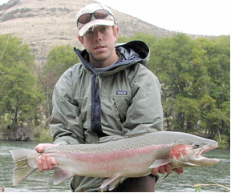
External Changes in Adult Straying Drivers
Straying to Sherars Falls 7 to 14 times more likely when transported
Straying generally not different between wild and hatchery when transported
Percent Snake R. Smolts Transported
Smolt Migration Year
Figure: NOAA Survival Memo
Upper Midwest Stray
Snake River Stray
Notes:
One key driver to adult straying has been the percentage of Snake River smolts transported downstream via barges. The percentage of hatchery origin spawners (pHOS) has been shown to be directly correlated to the percentage of barged Snake River Smolts. When the percentage of smolts transported is high, pHOS is high, and the inverse is true when the percentage of smolts transported is lower. At Sherars Falls on the Deschutes River, straying is 7-14 times more likely to occur when smolts are transported, and these stray rates are generally the same between wild and hatchery origin fish.
Looking at the figure presented here, the red arrows pointing at the 2020 and 2021 smolt migration years had the lowest percentage of transported Snake River smolts in the modern era. How would this change effect the adult fish in the 2022 return year? Do stray rates reflect the historic trend, meaning fewer snake river fish in the Deschutes River, and would that in turn result in lower human angler stray rates?

Slide 4
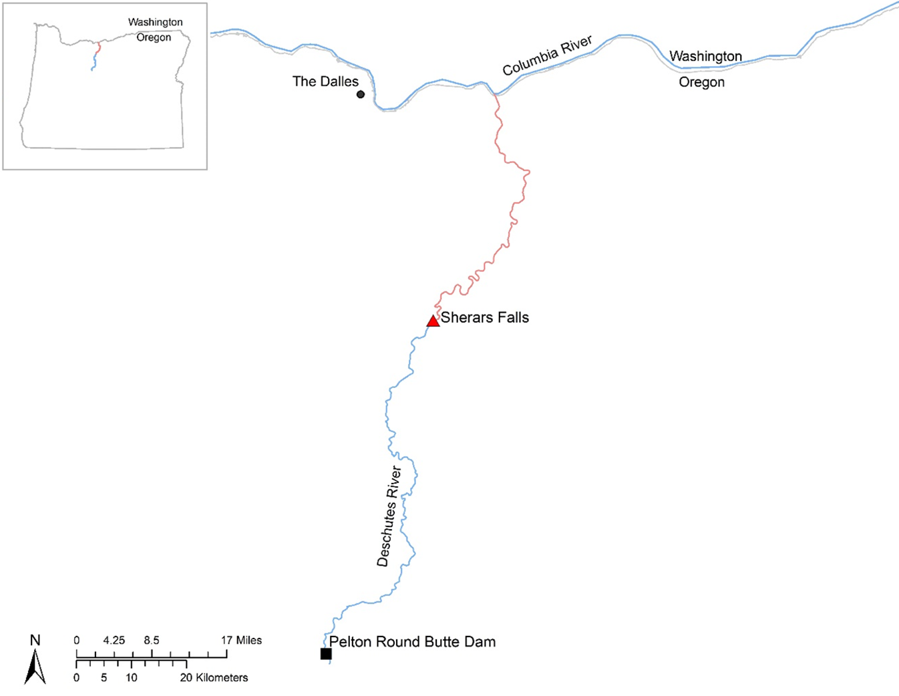
Deschutes River creel
Survey of anglers at Heritage Landing (the mouth) and Macks Canyon access road from July 1 - Nov 1
Stratified by weekday vs weekend
Expanded for days where no creel was conducted
Notes:
One method of monitoring steelhead stray rates has been through creel surveys
Historically, anglers have been creel surveyed at Heritage Landing (mouth) and Macks Canyon (~25 RM upstream) from July 1 – November 1. This effort is believed to encompass most of the recreational steelhead effort downstream of Sherars Falls, all the way to the Deschutes mouth.
It is stratified by weekday vs weekend, and it is expanded for days when no creel surveys were conducted.

Slide 5
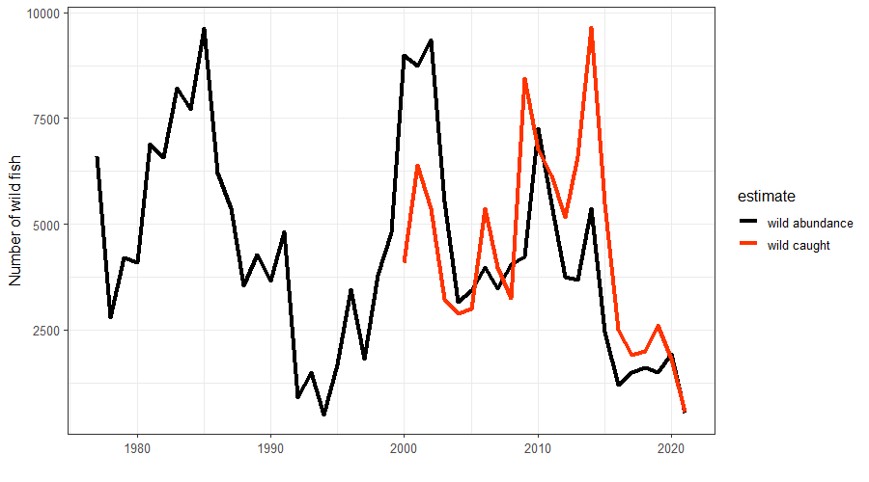
Abundance and estimated catch
Abundance of Deschutes wild steelhead and catch are somewhat correlated
Estimated catch often > abundance of wild Deschutes Spawners
Catch is a mix of Deschutes Spawners and Temporary Strays.
Temporary Strays influenced by:
Behavioral thermoregulation
Smolt transportation
Notes:
To see what some of that creel data looks like, this graph shows the abundance of wild steelhead as well as the catch of wild steelhead. Abundance is the estimate of “Deschutes River fish” or fish escaping into the Deschutes River upstream of Sherars falls (the black line), and catch is the total number of wild fish caught as estimated by creeling methods downstream of Sherars falls (the red line).
This graph shows us that the catch of wild steelhead is generally correlated to the estimated abundance of Deschutes wild steelhead, and in most years the estimated catch equals or exceeds the estimated abundance. In other words a high percentage of the total fish available are being caught. It is important to note however that anglers likely aren’t catching every Deschutes spawner, but are catching a mix of Deschutes spawners and temporary strays utilizing the river for cold water refuge during the summer months.

Slide 6
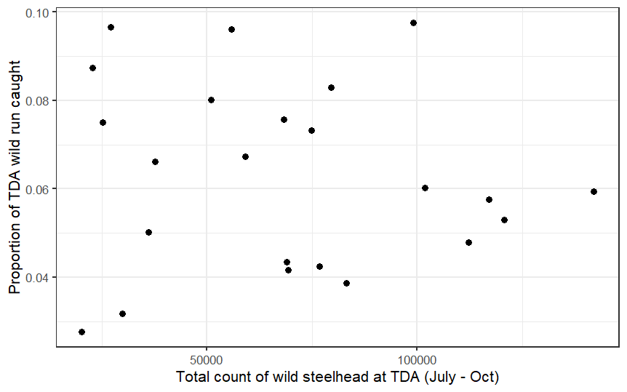
% Caught versus count at The Dalles Dam
2022
2021
Notes:
This next graph compares the catch at the Deschutes River to the total count of wild steelhead at The Dalles Dam. On the X – axis we have the counts at The Dalles Dam, and on the Y – axis we have the proportion of The Dalles Dam count caught in the Deschutes River.
The first thing to point out is 1) angling in the Deschutes River has the potential to catch a sizeable portion of the wild steelhead run migrating over The Dalles Dam, and 2) as run size gets smaller a larger proportion of the run is caught—because angler effort doesn’t scale perfectly with fish abundance or catch per unit effort; that is, anglers want to participate in this fishery whenever it’s open, even if chances of success (e.g., dam counts) are smaller.
Two exceptions to this possible trend were in 2021 when the river was closed to fishing Sep 1, and in 2022, when the river didn’t open to fishing until Aug 15.

Slide 7
Contribution of Temporary Strays to the Fishery?
3 acoustic receivers at the Deschutes Confluence (2020)
Higher barge signal in 2020 vs 2022
Deschutes Spawners vs Temporary Strays
Goal for 2022 at a spatial scale
6 receivers from confluence to Macks Canyon
Angling Sanctuary vs In River
Plume, Confluence, Moody Rapid (DS),
Gage, Rattlesnake Rapids (DS), and Macks Canyon
Moody was pulled out of water for several days
Rattlesnake had poor detection efficiency
Notes:
Switching gears to our acoustic telemetry portion, in 2020 we conducted an acoustic tagging study looking at John Day River adult overshoot. 3 acoustic receivers were deployed at the Deschutes River confluence area. From that study we saw that temporary strays heavily utilized this location, sticking around for several days – several weeks a time. We also documented several fallback fish, in other words fish that swam back downstream from locations upstream of John Day Dam, and spent their summer thermoregulating in the Deschutes River area.
The importance of the Deschutes River for migrating fish in 2020 lead us into expanding our acoustic receiver network for our 2022 acoustic tagging study, when a vast majority of returning adults would be from the two years of the lowest smolt transportion in the modern era. We wanted to see the spatial extent of adult fish comparing Deschutes spanwers to the Temporary Strays.
We refined the locations of our downstream receivers based on the boundaries of the Thermal Angling Sanctuary established in 2020. 3 receivers were deployed inside the Thermal Angling Sanctuary at the Mainstem plume, the Mouth, and downstream of Moody Rapid. Beyond the Thermal Angling Sanctuary boundary in the upstream direction, acoustic receivers were deployed at the USGS gage above Moody Rapid, Downstream of Rattlesnake Rapid, and at Macks Canyon.
Unfortunately the Moody Rapid Receiver was pulled out of the water for several days in the middle of August, likely from someone recreating in the area. And the Rattlesnake Rapid Receiver had technical problems and failed to detect fish, likely due to a faulty receiver, and a lesser extent a “noisy” acoustic environment. The Rattlesnake location would be removed from any analysis.

Slide 8
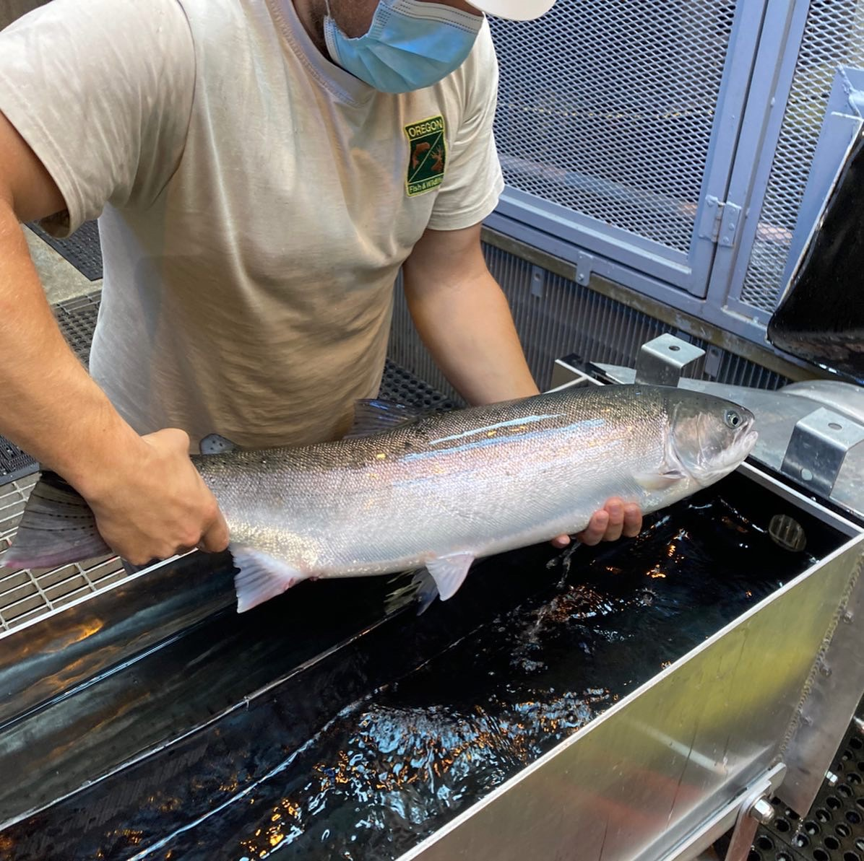
Sampling Methods
Adult Fish Facility w/ CRITFC at Bonneville Dam
A – run summer steelhead
July 13 – Sept. 18 2020
200 acoustic and PIT
July 6 – Sept. 30 2022
156 acoustic and PIT
Notes:
In order to sample fish for the acoustic telemetry portion,
we utilized the Adult Fish Facility (AFF) at Bonneville dam in 2020 & 2022
In 2020 we sampled fish from July 13th – September 18th, with these dates being centered around the peak densities of John Day steelhead returns at Bonneville dam (2005-2019). A total of 200 wild A-run summer steelhead of unknown origin were equipped with both PIT tags and acoustic tags via gastric insertion.
In 2022 we sampled fish from July 6th – September 30th. A total of 156 wild A-run summer steelhead of unknown origin were equipped with both PIT tags and acoustic tags via gastric insertion.

Slide 9
Mainstem Plume
USGS Gage
Mouth
Moody Rapid
Rattlesnake Rapid
Macks Canyon
(PIT tagging @fish trap)
Notes:
This map here helps illustrate the locations of each acoustic receiver, and as you can see, the lower portion of the river was more densely saturated with acoustic receivers, and there was a large gap in spatial scale between Rattlesnake Rapid and Macks Canyon.
It is also worth noting that the fish trap at Sherars falls captures a small portion of adults which are then PIT tagged.

Slide 10
Disposition of Tagged Wild Steelhead in The Dalles Pool
n = 27
~15% Caught in Deschutes
n = 8
Notes:
Diving into the initial results of the acoustic tagging study, this figure provides the disposition of tagged wild steelhead that entered the The Dalles Pool in 2022. The total population is subset into 4 groups, (green) fish that cross The Dalles and John Day dams without Deschutes detections, (blue) fish that enter the Deschutes River, (orange) fish that bypass the Deschutes River and proceed to the ladder at John Day Dam, (gray) no PIT or acoustic detections upstream of The Dalles Dam, and (yellow) fish that fallback over The Dalles Dam without entering the Deschutes River (all of this group thus far last detected at Lyle Falls-Klickitat River).
The biggest takeaway from this figure is that nearly 75% of steelhead entering The Dalles Pool were not detected at the Deschutes acoustic receivers, and only 21% of steelhead were detected entering the Deschutes.
951 wild steelhead were estimated as caught in the deschutes in 2022
29920 wildsteelhead crossed the dalles dam July1 – Oct 31 2022~3% of the run crossing the dalles was caught, and 15% of the fish entering the deschutes were caught.
951 wild steelhead were estimated as caught in the Deschutes in 2022
29920 wild steelhead crossed the dalles dam July 1 – Oct 31 2022 ~ 3% of the run crossing the dalles was caught, and 15% of the fish entering the deschutes were caught.

Slide 11
Spatial Stock Composition
Sherars Falls Trap PIT Tagging
Notes:
This figure builds on the pie chart of run disposition. Circles show the estimated proportion of wild steelhead present at each monitoring site in the Deschutes which were ultimately classified as “temporary strays” as opposed to those crossing and remaining upstream from Sherars Falls which were classified as “Deschutes Spawners”. Open circles are acoustic/PIT tagged steelhead, closed circles are steelhead PIT tagged only which were captured and tagged at the Sherars Falls trap. Of the total steelhead tagged at Sherars in 2022: 6% of wild and 9.7% of hatchery were later detected at John Day Dam and classified as “temporary strays”. We bring this discrete data set in here since it has 100’s of observations, as opposed to the single digit number of acoustic tagged adults that were present at the uppermost acoustic monitoring site (Macks Canyon, rivermile 24).
The dashed black line is an example of a negative exponential decay curve, or dispersal kernel curve fit for the proportion of temporary strays at each site. This decay curve should be considered theoretical in nature still since there was minimal reduction in the proportion of temporary strays among our 3 monitoring sites near the mouth of the Deschutes (less reduction than anticipated when designing sites). We will need further sampling in the RM 5 to 25 section to accurately parameterize a spatial decay function for temporary strays during low barging periods.
**I dropped the red triangles for simplicity, and did not add them into a new figure**

Slide 12
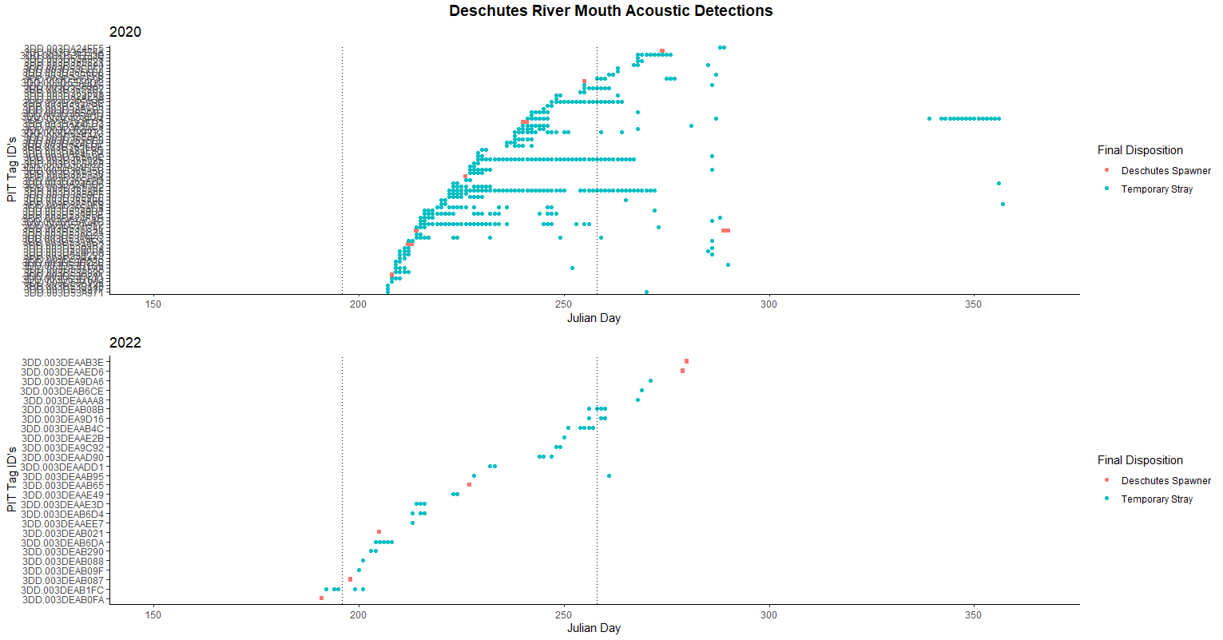

Notes:
This figure looks at the daily detections at the Deschutes River mouth acoustic receiver in both 2020 (top) and 2022 (bottom). For consistency and simplicity purposes, we excluded the mainstem plume receivers due to the difference in locations of the recovered acoustic receivers between the two years. The individual PIT tag ID’s are listed on the Y axis, and Julian day is on the X axis. It is further broken down by color, representing the final disposition of tagged fish (Deschutes Spawners = red, Temporary Strays = blue). For an added reference point, the two dotted lines represent the July 15th and September 15th angling closure dates. Important things to keep in mind here is the smaller sample size in 2022, an earlier start date in 2022, and there were numerous days in August in 2022 when we were shut down for sampling.
A majority of the detections the Deschutes River mouth occurred within the established angling closure dates, however some of the later arriving fish were detected in these areas after the September 15th closure date, most noticeably in 2020. A lot of these fish were temporary strays from the Snake River basin and other Mid-C steelhead populations. On the contrary, most of the presumed “Deschutes spawners” did not stay in the mouth area for extended periods of time, rather, they held further upstream in the Deschutes River. In 2020, we saw an overall higher proportion of tagged steelhead being detected (73/173 = 42.2%) vs 2022 (26/127 = 20.5%).
Another thing that can be seen in this figure is the number of fish in 2020 that were detected for multiple days - multiple weeks at a time. *Animation* Essentially parking the bus at this location. This migration strategy is almost nonexistent in 2022, however there was a one fish that displayed this pattern at the Plume location.
Lastly we see that in 2020 there are a number of single detections occuring in October. *Animation* Based on the timing and directionality of when these detections occurred, we inferred that these were temporary strays that spent a majority of the summer months inside the Deschutes River, being detected early in the summer as they enter the river, and again in October as they make their way out of the river. This is very different from what we saw in 2022, where there was a single fish that displayed this behavior *Animation*.

Slide 13
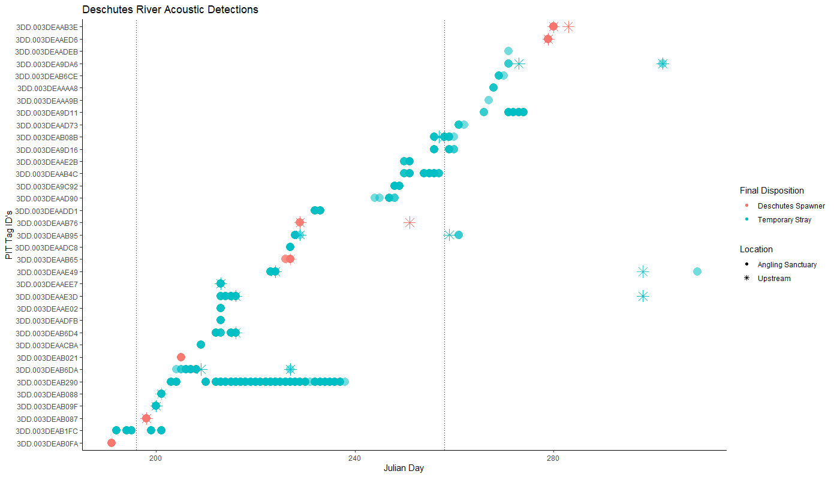
Notes:
Since the previous figure primarily was focused at the mouth location, this next figure looks at the improved spatial scale that we established in 2022.
This figure looks at the daily detections for the 35 acoustic tagged fish that were detected on the entire Deschutes River acoustic receiver network. The individual PIT tag ID’s are listed on the Y axis, and Julian day is on the X axis. It is further broken down by color, representing the final disposition (Deschutes Spawner = red, Temporary Stray = blue, all detections at or upstream of the Gauge receiver located upstream of Moody rapids are outside the current Thermal angling sanctuary boundaries), and shape representing the location of each detection in regards to the thermal sanctuary (circle = Sanctuary locations, asterisk = upstream locations). The two dotted lines represent the July 15th and September 15th angling closure dates.
One thing that can be seen in this figure is that you don’t see nearly as many detections in the upstream locations as you do in the sanctuary locations. This is likely because of several reasons, 1) a lack of resolution between the Gage and Macks Canyon sites, as well as the detection inefficiencies at the Rattlesnake rapid location, 2) fish have many more areas to hold while in the river vs the sanctuary area, and they decided not to hold near our receivers, 4) detection efficiency is lower at in-river locations due to it being a “noisy” acoustic environment.
A more representative figure of their residence times, for example, *Animation* would draw a line between these upstream detections, representing the total time spent in-river between detections. This would do better to highlight the importance of the Deschutes River as a thermal refuge.

Slide 14
Conclusions
Evidence for inter-annual variation in patterns of Temporary Straying
Reduced use of mouth/plume area in 2022 compared to 2020
Weighting of barge influence v. temperature / migration pattern effects on thermal refuge use hard to discern from these data since we don’t know the smolt migration history of tagged adults
But, lower mouth/plume use in 2022, matches dramatically lower barge history, and is consistent with prior PIT data about barging-straying.
Notes:
From this data, we have provided evidence for inter-annual variation in patterns of Temporary Straying
We also saw reduced use of the mouth/plume area in 2022 compared to 2020
Weighting of barge influence v. temperature / migration pattern effects on thermal refuge use is hard to discern from this data since we don’t know the smolt migration history of tagged adults
But, lower mouth/plume use in 2022, matches with the dramatically lower barged fish history, and is consistent with prior PIT tag data about barging-straying.

Slide 15
Conclusions
Temporary strays are using the Deschutes upstream of the Thermal Angling sanctuary boundary for extensive summer-fall holding
We can’t yet define the shape of the “Temporary Stray decay curve” in the Deschutes to refine creel monitoring / impact accounting
Capture and PIT tagging of adults throughout the lower Deschutes fishery, with re-detection at John Day Dam or Sherars Falls could be a more effective way to define a Temporary Stray decay curve
Notes:
Additionally, we saw that temporary strays are using the Deschutes upstream of the Thermal Angling sanctuary boundary for extensive summer-fall holding.
At this point in time we can’t yet define the shape of the “Temporary Stray decay curve” in the Deschutes to refine creel monitoring / impact accounting
However, the capture and PIT tagging of adults throughout the lower Deschutes fishery, with re-detection at John Day Dam or Sherars Falls could be a more effective way to define a Temporary Stray decay curve

Slide 16
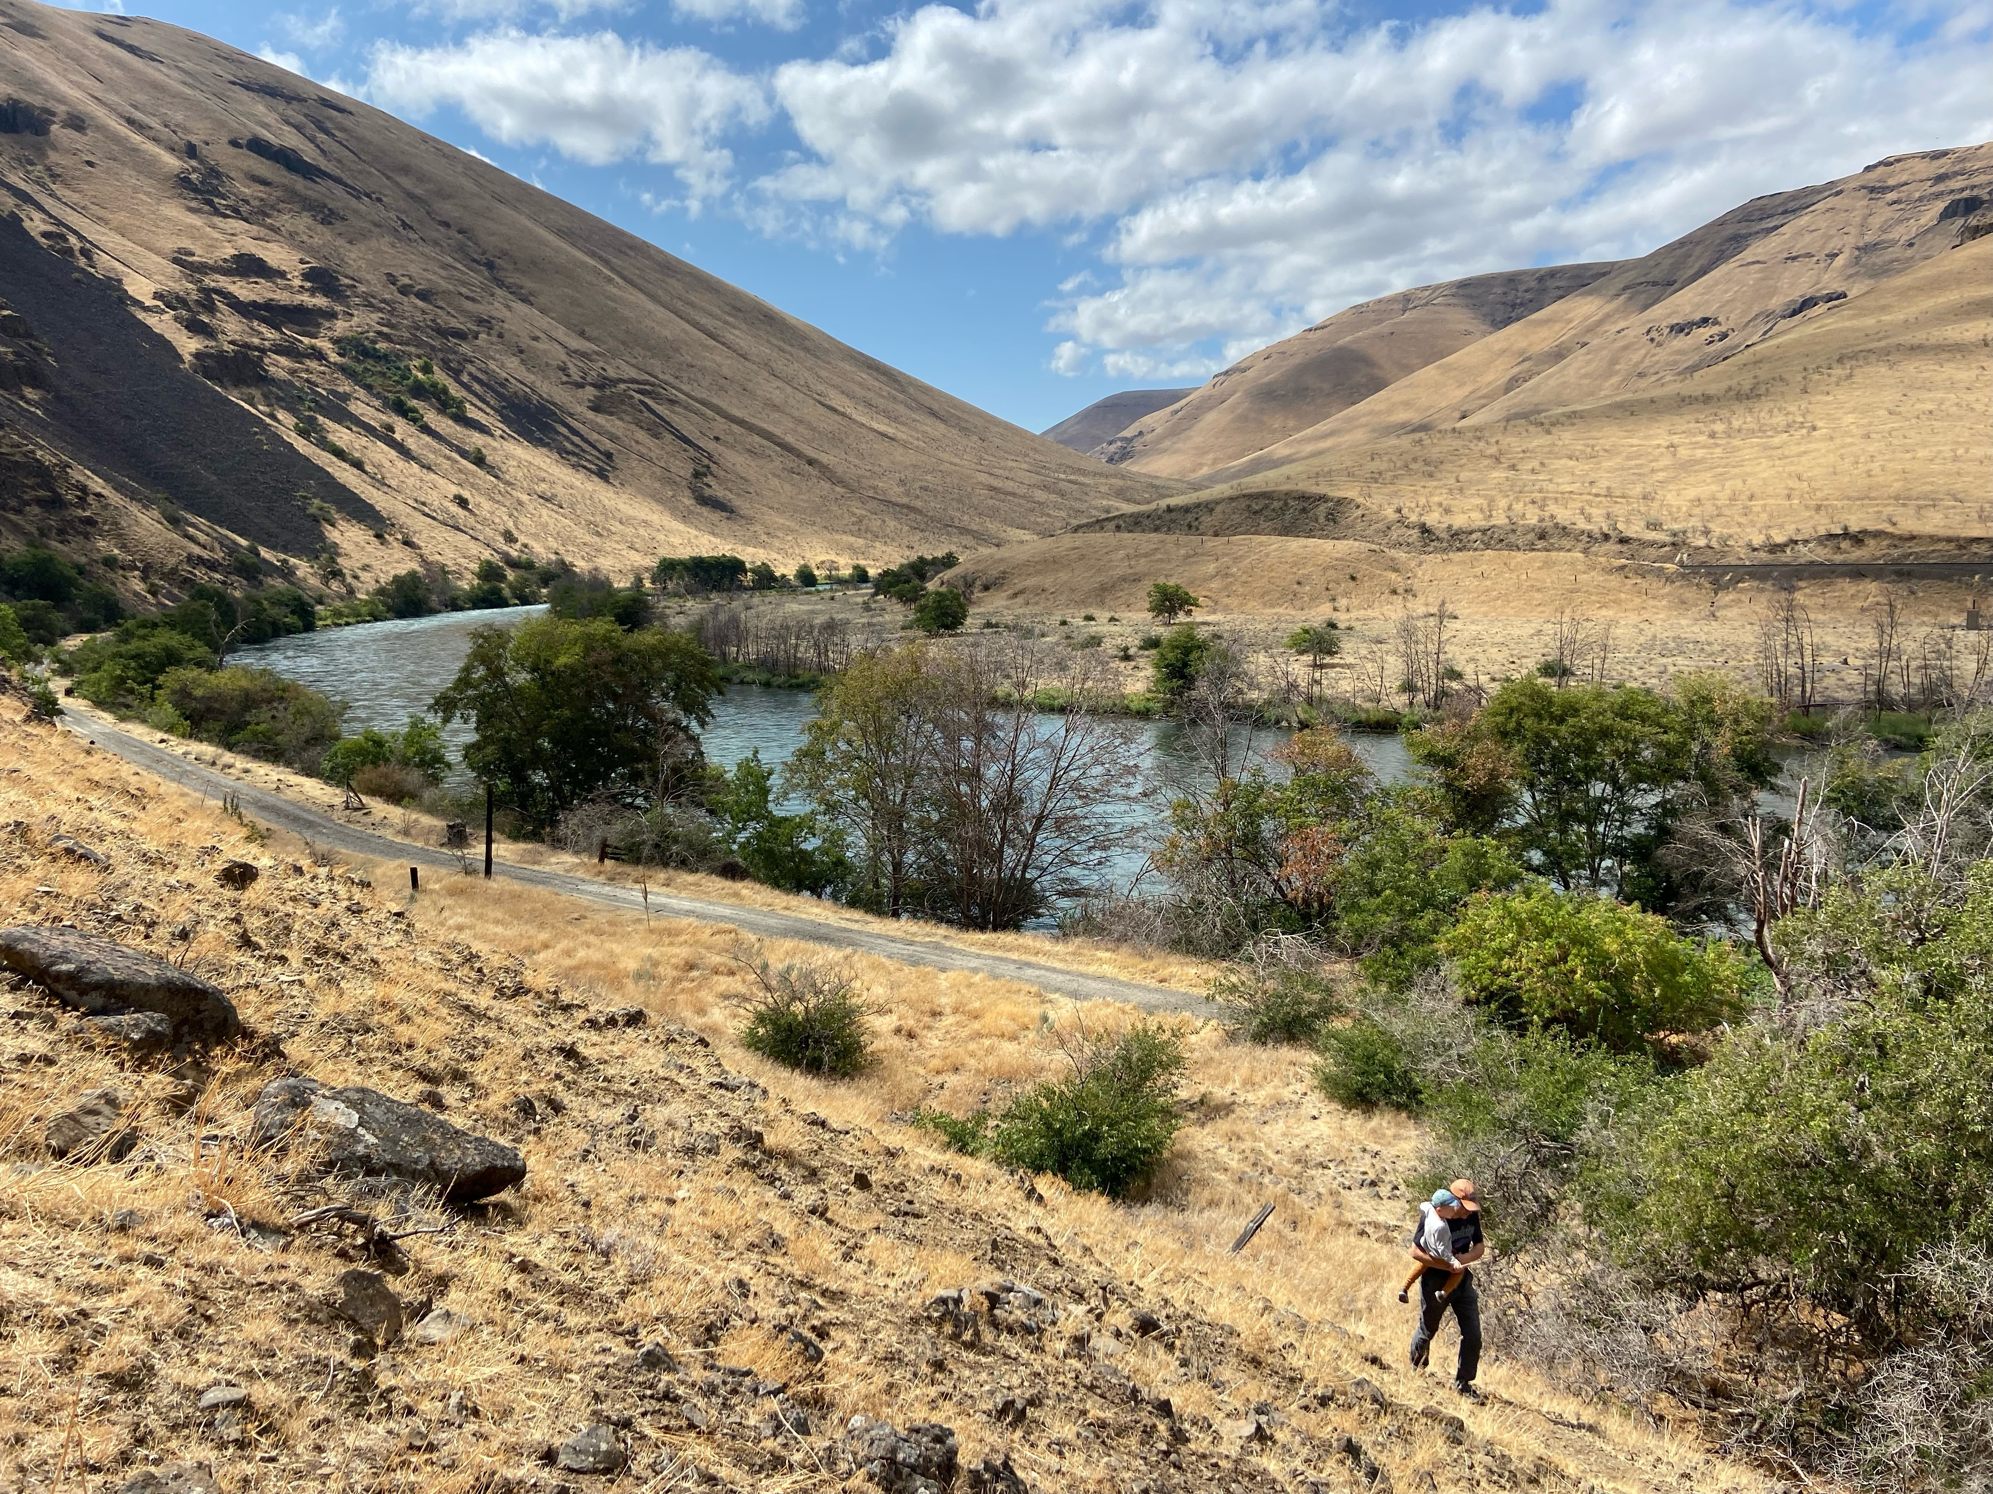
Questions?
Contact email:
Logan – logan.breshears@oregonstate.edu
Ian – Ian.A.Tattam@ODFW.oregon.gov
Jeremy – Jeremy.S.Henderson@ODFW.oregon.gov
Jason – Jason.T.Seals@ODFW.oregon.gov
Notes:
On that note I can answer any questions you might have, or field those questions over to Ian Tattam. I would also like to thank the folks over at OWEB for funding the acoustic telemetry portion of this research, Gilliam SWCD for providing us with assistance, and everyone at ODFW involved in this research.

Slide 17
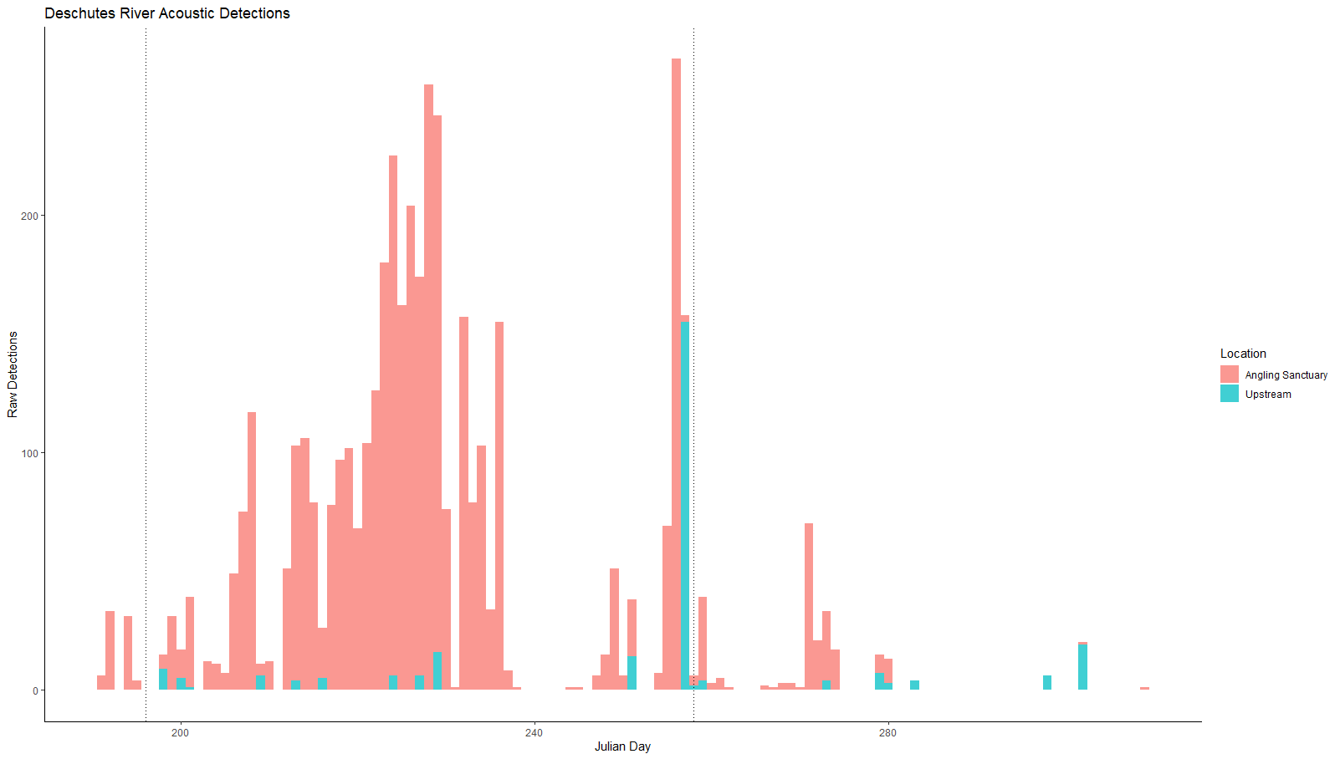
Notes:
( Backup Slide ) This figure here is a histogram comparing the total acoustic detections in the Thermal Angling Sanctuary (red) and the Upstream locations (blue). Julian day is on the X - axis and Detections are on the Y – axis. Think of this figure as the population scale. Obviously there were significantly more acoustic detections in the Thermal Angling Sanctuary compared to the Upstream locations, however this figure is washing out what is going on at the individual scale.

