Slide 1
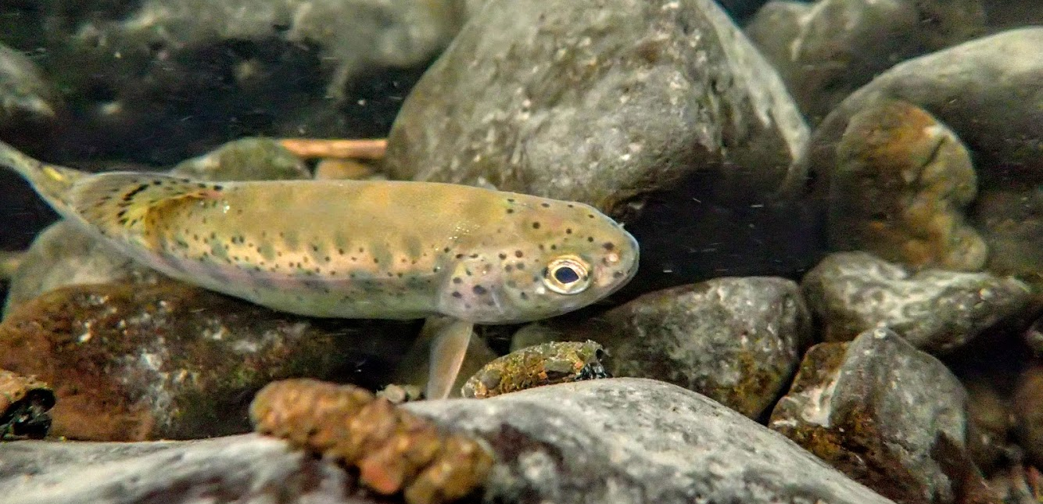

All about that bass: some trouble for rearing steelhead
Lizz Blackburn, Lindsy Ciepiela & Ian Tattam
Oregon Department of Fish and Wildlife, Eastern Oregon Fish Research
Notes:
As many of us are acutely aware the primary factor limiting mid C steelhead population viability in the John Day and really throughout much of the Columbia is rearing habitat. As such over the last decade recovery strategies for rearing steelhead have largely focused on habitat restoration.
But as implementors work diligently to improve habitat a new and emerging threat may present a substantial hurdle to ongoing and future restoration efforts.

Slide 2
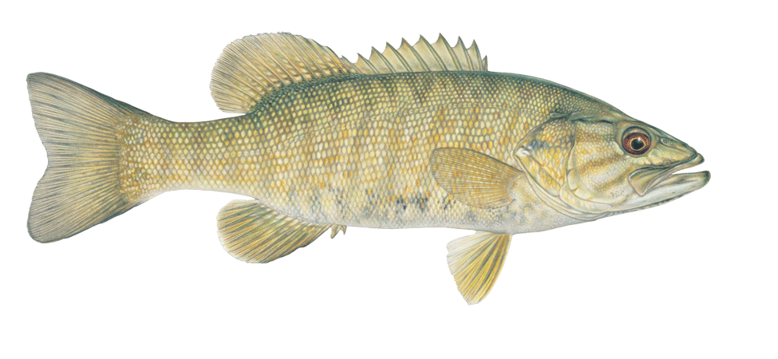
Smallmouth Bass
Notes:
And that is the notorious smallmouth bass. Smallmouth bass have without doubt established themselves throughout mainstem river in the Columbia River Basin, but climate induced stream warming is creating thermal conditions optimal for the continued upstream expansion of SMB into natal steelhead tributaries.

Slide 3
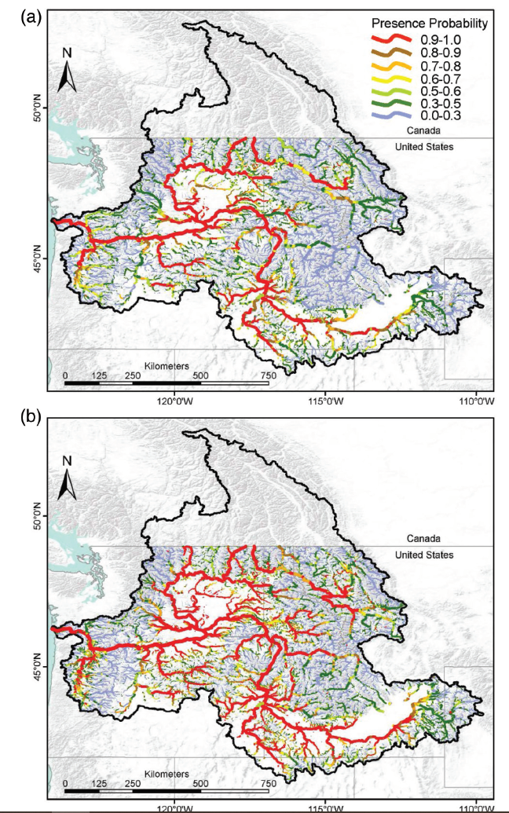
Current probability of SMB presence (~18,000 km)
+ 66%
Predicted probability of SMB presence by 2080 (~30,000 km)
Rubenson and Olden 2020
Notes:
Alarmingly, Rubenson and Olden estimate smallmouth bass currently occupy 3-62% of current salmonid habitat but are predicted to expand their range by 75% in 2080. A large portion of the their predicted range expansion is into tributary rearing habitat.
Posing an interesting juxtaposition with ongoing restoration efforts.

Slide 4
Will gains in steelhead productivity due to restoration outweigh losses due to upriver range expansion and predation of smallmouth bass?
vs.
Notes:
And there was probably no better study system for us to begin to examine this question than in thirtymile Creek.

Slide 5
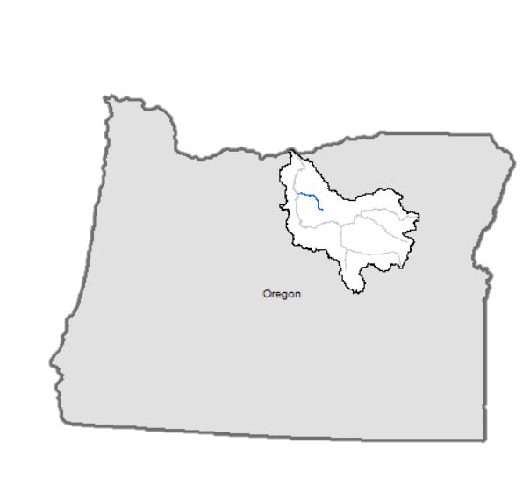
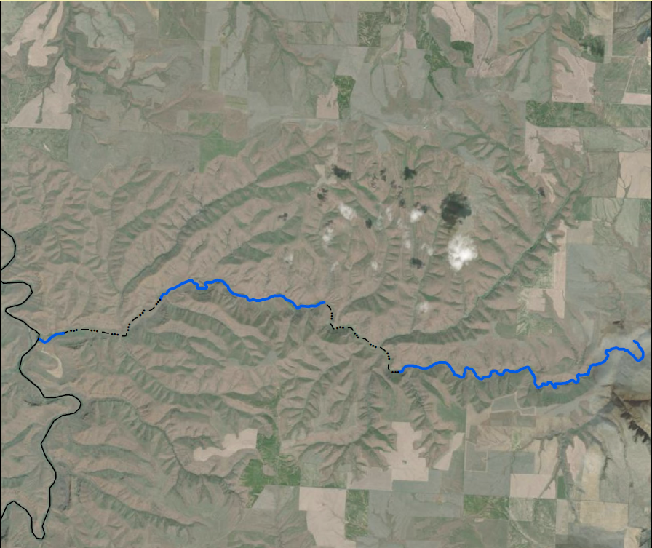
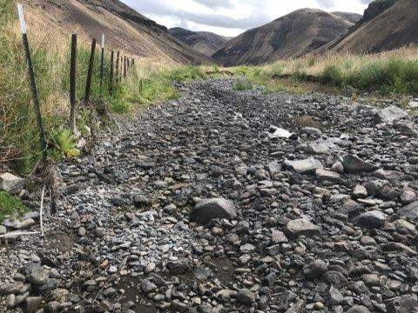
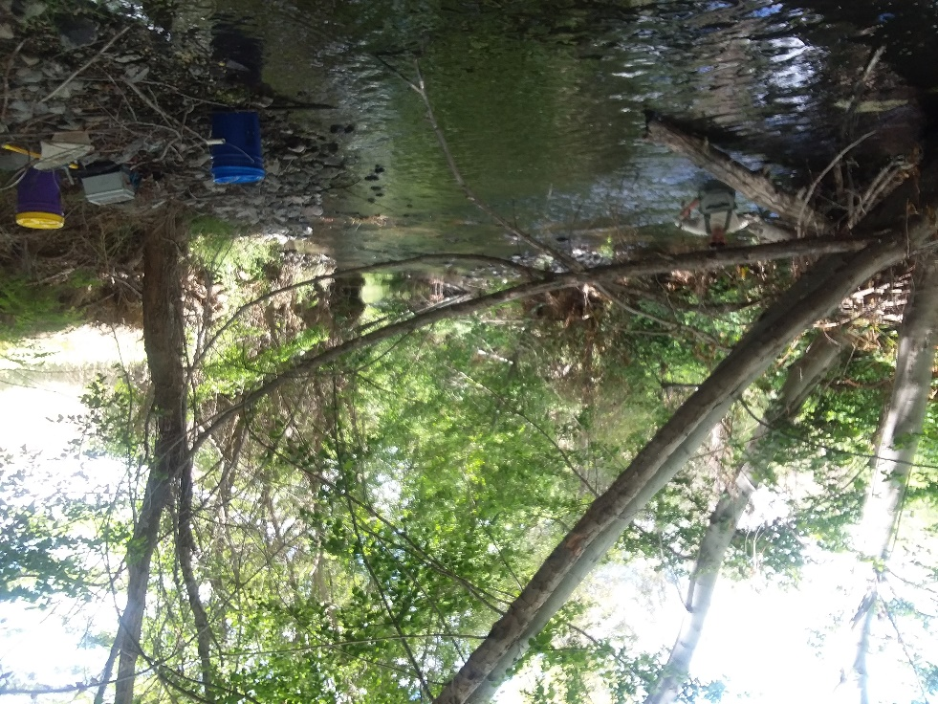
Spring sampling
Fall sampling
Thirtymile Creek
John Day River
Notes:
Thirtymile Creek, a tributary to the lower mainstem John Day is both a prime candidate for restoration and is located at the leading edge of Smallmouth Invsasion.
I’ll first speak to it’s potential for restoration.
Thirty mile creek is incredibly productive, and truly one of the more productive tributaries we have monitored in the John Day Basin we consistently see densities above 2 fish per m, the dots.
But it is only productive where there is water and that’s the crux of Thirty Mile Creek.
Currently, but not historically, the lower 20 miles in Thirty-mile is broken into three perennial sections and two ephemeral sections during summer base flow conditions. But a key point to mention is that during the spring, when steelhead are spawning there is enough surface flow that connectivity is maintained throughout 30 mile, meaning fish are able to construct redds thoughout thirtymile.
But despite connectivity during some points in the year these ephemeral and perennial reaches look very different.
Picture taken on the same day (5/14/2020) less and 2 miles apart.
The ephemeral nature of 30 mile creek is hypothesized to limit the conversion of steelhead eggs to fry and reduce the juvenile steelhead rearing capacity. So logically restoration strategies within 30 Mile Creek target extending the perennial flow in the creek as well as reestablishing riparian vegetation channel complexity.
But like I mentioned Thirtymile Creek is also at leading edge of bass expansion.

Slide 6
John Day River
Notes:
SMB enter 30 Mile Creek form the John Day during the spring when temperature in the lower perennial reach are suitable for SMB.
Unfortunately, and perhaps not coincidently their entry coincides with the emergence of steelhead.
Bass remain in 30 mile creek until late spring when migrate back to the mainstem of the john day river.
To date, we have only observed one bass upstream of the first ephemeral sections, which we believe is, at least for the time being preventing bass migration into the upper reaches of thirtymile creek.
However as you can imagine If restoration efforts are successful in creating year-round continuous surface flows, SMB may have the opportunity to expand into upstream habitats.
Bringing us back to our initial question.

Slide 7
Will gains in steelhead productivity due to restoration outweigh losses due to upriver range expansion and predation of smallmouth bass?
vs.
Objective: Quantify the effect smallmouth bass presence has on steelhead
Notes:
To begin to untangle this bass vs. restoration question we wanted to first quantify the effect smallmouth bass presence has on steelhead.

Slide 8
Objective: Quantify the effect smallmouth bass presence has on steelhead
BACI design
Steelhead density
Bass predation
Stomach content analysis
John Day River
Notes:
Specifically we were interested to know the effect that the presence of bass has on steelhead abundance, as well as if bass were directly predating on steelhead trout.
TO monitor abudance we set up a baci, or before after control impact experimental design.

Slide 9
Objective: Quantify the effect smallmouth bass presence has on steelhead
BACI design
Steelhead density
Bass predation
Stomach content analysis
Control 1
Control 2
Impact
John Day River
Notes:
Our BACI design consisted of three sites.
The mouth section, where bass are currently occupy represented our impact site and our two control sites were located upstream in the second perennial section. These two control sites were selected because of their similarity to the mouth reach.
From 2017 – 2019 we monitored the abundance of both bass and steelhead in all reaches.

Slide 10
Objective: Quantify the effect smallmouth bass presence has on steelhead
BACI design
Steelhead density
Bass predation
Stomach content analysis
May 2020
weir install
Control 1
Control 2
Impact
Below weir
John Day River
Notes:
In May of 2020 we installed a weir 380 meters upstream of the confluence. This weir was designed to block the upstream migration of bass while still allowing for the downstream passage of steelhead parr.
Because we installed the weir 380 meters upstream of the confluence we effectively created a bonus control site, which we will call below weir.
After installing our weir or first task was to determine if the weir was effective at reducing bass densities in our impact reach.

Slide 11
Objective: Quantify the effect smallmouth bass presence has on steelhead
Bass abundance
May 2020
weir install
2020 below weir – .70 bass/m (280 bass)
2020 above weir – .17 bass/m (64 bass)
76% reduction
Control 1
Control 2
Impact
Below weir
John Day River
Notes:
We found that our bass weir resulted in a 76% reduction in bass density.
Our next step was to assess if removing bass from our impact reach influenced the abundance of parr.

Slide 12
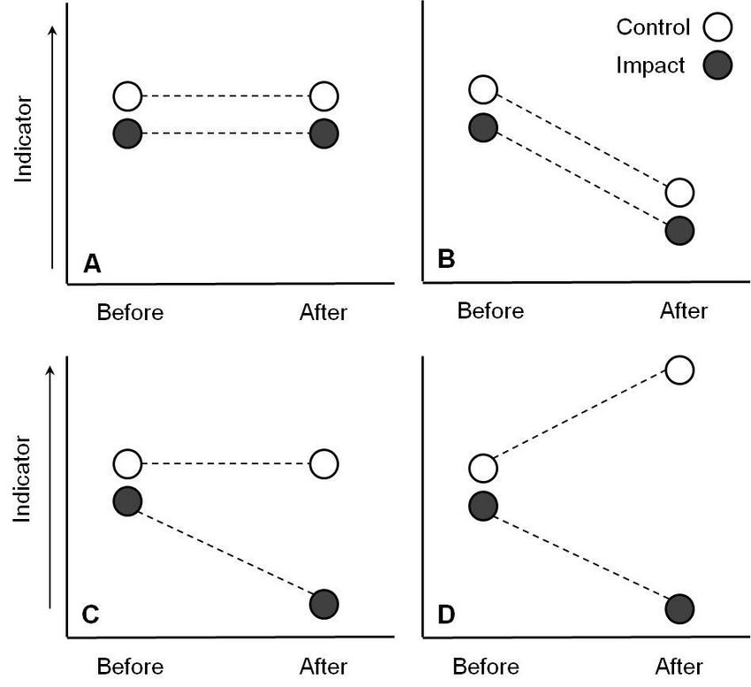
Hypothesized change in steelhead abundance
Null effect
Steelhead Density
Notes:
And before I get into the results, I want to talk a bit about what we might expect in the results given a BACI experimental design.

Slide 13
Hypothesized change in steelhead abundance
Null effect
Positive effect
Steelhead Density
Notes:
And before I get into the results, I want to talk a bit about what we might expect in the results given a BACI experimental design.

Slide 14
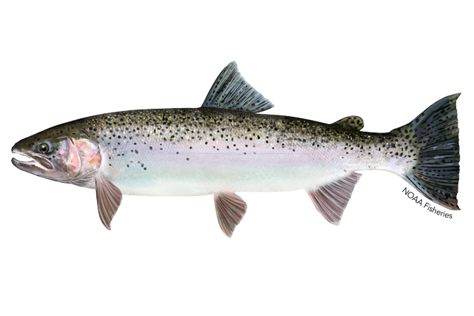
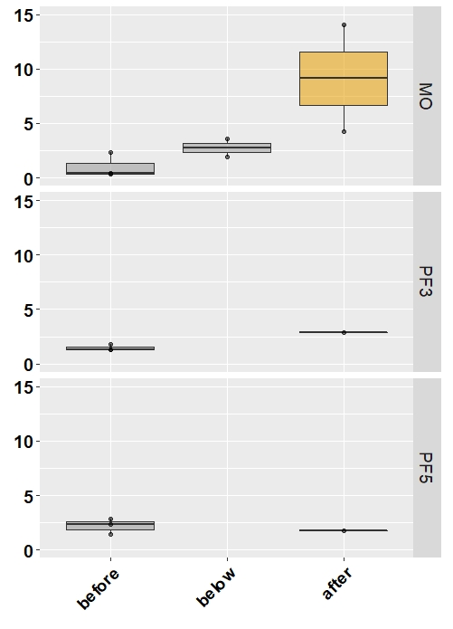
Steelhead density
Impact
Fish/m
Control 1
Control 2

Slide 15
Steelhead density
Impact
Fish/m
Control 1
Observed 4.8 times more steelhead
in the impact reach compared to control reaches
Control 2
Notes:
Along with quantifying changes in abundance we wanted look into the mechansims driving these changes.
As you might imagine direct predation was a likely cause so we went directly to the source.

Slide 16
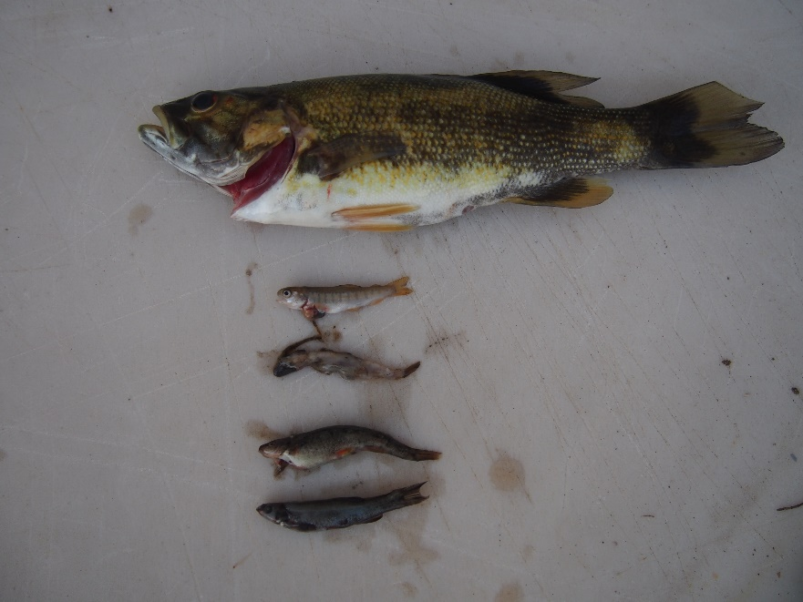
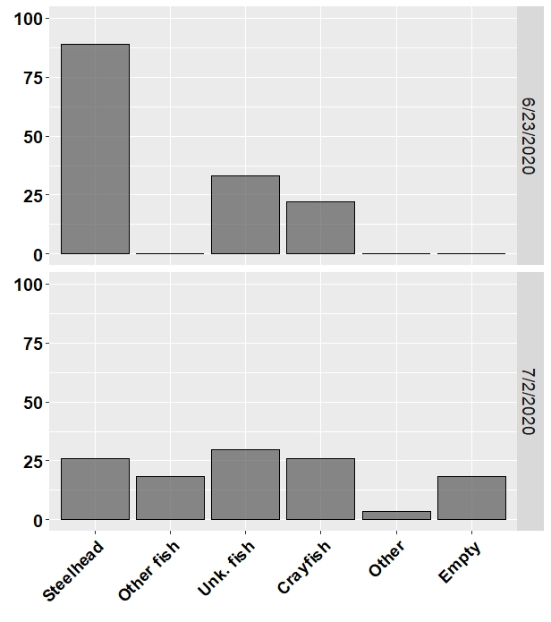
Direct predation
% of diets
n = 9
Notes:
In the spring of 2020 we examined bass diets. We found that 88% or 8 out of the nine bass that we examined had steelhead in their stomachs.

Slide 17
Direct predation
% of diets
n = 9
Notes:
But more shocking than the fact that the majority of bass had steelhead in their stomacts was that these 8 bass had 33 identifiable steelhead in their stomach.

Slide 18
Direct predation
% of diets
n = 9
Notes:
So let’s do some quick math.
This amounts to 3 and half steelhead per bass.

Slide 19
Direct predation
X 280 bass
=1,008 fry
in one day
% of diets
n = 9
Notes:
We estimate there were 280 bass below the weir…this mean bass in thirtymile have the potential to eat 1,008 fry in day! Now this is no bioenergetics but it does indicate that bass have the potential contribute to steelhead mortality.

Slide 20
Direct predation
n = 27
6°C
% of diets
n = 9
15°C
Notes:
But we recognized this is a fairly small sample size. So we went back one week later to sample more bass. And we found drastically different results. One week later sts were found in only a quarter of bass stomachs, and in total we found a total 12 sts, and 17 unknown fish.
So I think these results highlight two things.
They highlight the difficulty in detecting steelhead predation by bass and thus the difficulity in estimating the true loss of steelhead due to bass predation.
But they also highlight that predation on steelhead by bass appears a bit episodic, and seems to be in at least part, driven by temperature, the stream temperature while we were sampling in June was 15 while in July the stream temperature was six degrees.

Slide 21
Will gains in steelhead productivity due to restoration outweigh losses due to upriver range expansion and predation of smallmouth bass?
vs.
Notes:
So yes, on the surface it does appear that upriver expansion of bass will overshadow gains made through restoration. But the work that I presented today is just scratching the surface is what we need to know about bass steelhead dynamics in rearing tributaries.

Slide 22
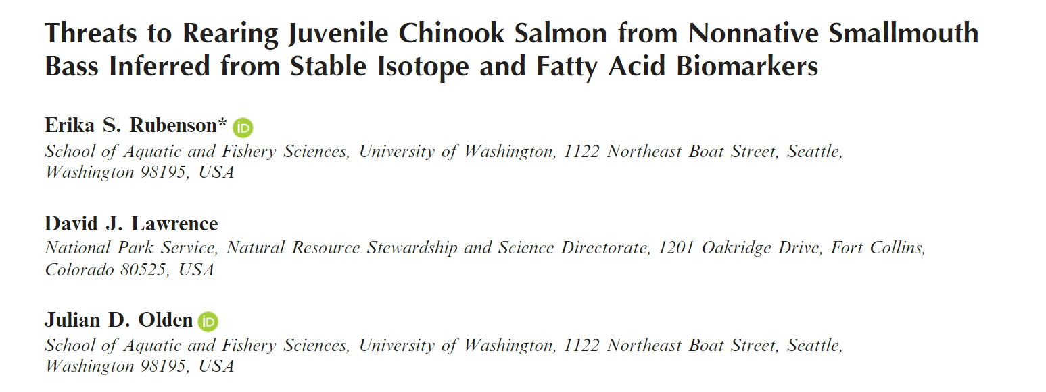
“….Neither [Northern Pikeminnow or Smallmouth Bass] appears to prey heavily on or compete with rearing juvenile Chinook Salmon in the river region where all three species only co-occur seasonally.”
”It is important to note, however, that juvenile Chinook Salmon are relatively scarce in the area of sympatry with Smallmouth Bass, given that this is the upstream leading edge of Smallmouth Bass invasion and the downstream-most occurrence of juvenile Chinook Salmon.”
Notes:
And there are other folks working to answer some these questions.
Rubenson et al. published a paper this year, where they really dug into quantifying direct predation by small mouth on, in this case Chinook. They found…read quote….
Given what we found in thirtymile these results really were quite surprising. But I think they nailed why we are seeing such different results in thirty mile than they found in North Fork.

Slide 23
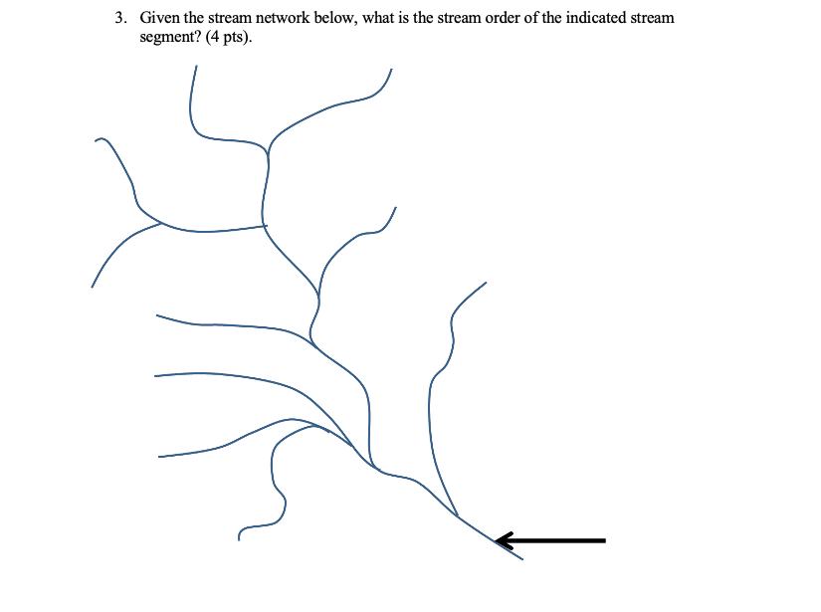
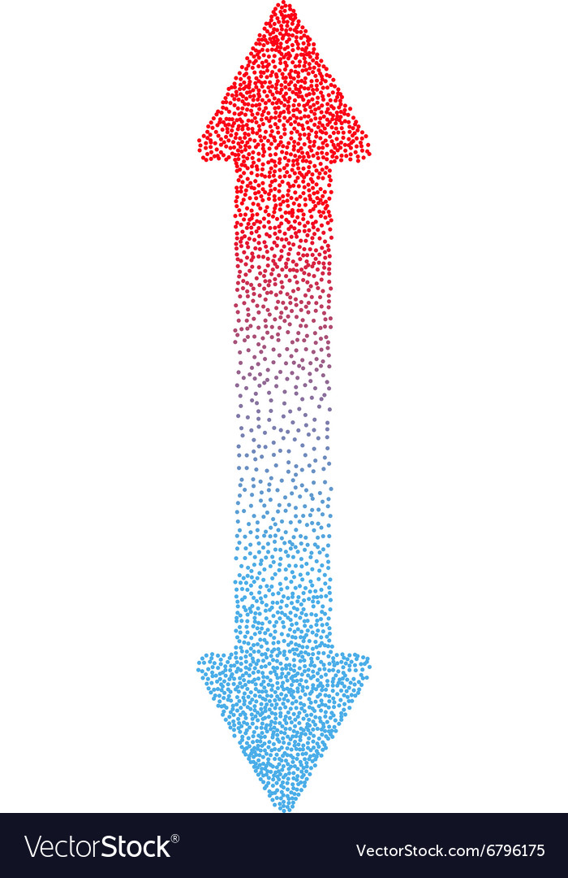
Notes:
In the north fork and throughout much of current smb bass range where streams have perennial surface flow, there is a longitudinal gradient of temperatures in the watershed, which is acting as a sorting mechanism.
Salmonids are able to rear higher in the watershed where temperatures are cooler, whereas bass, who prefer warmer waters, are sticking to lower elevation stream sections. The areas where these two species overlap are at the edge of their thermal preferences, and where both species are found in lower densities, limiting the opportunities for conflict.
This is the not the case in thirtymile creek due to the seasonally dry sections and the unique seasonal thermal profile. The warm waters in John Day river make for bass Disneyland and the spring fed cold perennial reaches in thirtymile creek make for steelhead Disneyland.
In the spring time, the lack of riparian cover in the ephemeral reaches allows the water to rapidly warm, which then warms the perennial mouth reach enough for bass to move into thirtymile during April-May, and overlap with emerging steelhead fry in their prime rearing habitat, giving bass an opportunity to feast, if even for a short duration.
The non-linear longitudinal temp gradient/profile that currently exists in Thirtymile (which is much different from the linearly increasing temp on other watersheds) creates steelhead-bass conflict through immediate spatial overlap of the two species.

Slide 24
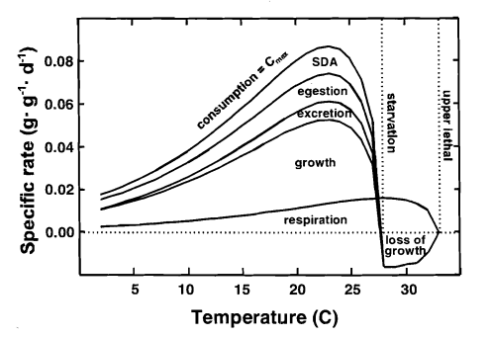
2023 – 2025 Bioenergetics Study
Figure: Fish Bioenergetics 3.0 is a product of the University of Wisconsin-Madison Center for Limnology and University of Wisconsin Sea Grant Institute.
Notes:
Upcoming research – for the next 2 years I will be studying SMB/STS interactions with a bioenergetics lens as a master's project . Through this we will hopefully be able to quantify the impacts SMB are having on STS in 30mile creek. This will look like 2 full field seasons March-July 2023 & 2024. Monitoring temperature, timing of bass entry, bass movement, fry emergence, bass and steelhead abundance and lots diet samples.

Slide 25





2023 – 2025

Slide 26


Acknowledgements
2020 ODFW field crew
Brenna Rietmann
Melody Feden
Alex Woolen
Gilliam Soil & Water Conservation District
Herb Winters
Roger Lathrop
Kristina Moore
Norie Wright
Prineville BLM office
Jeff Moss

Slide 27
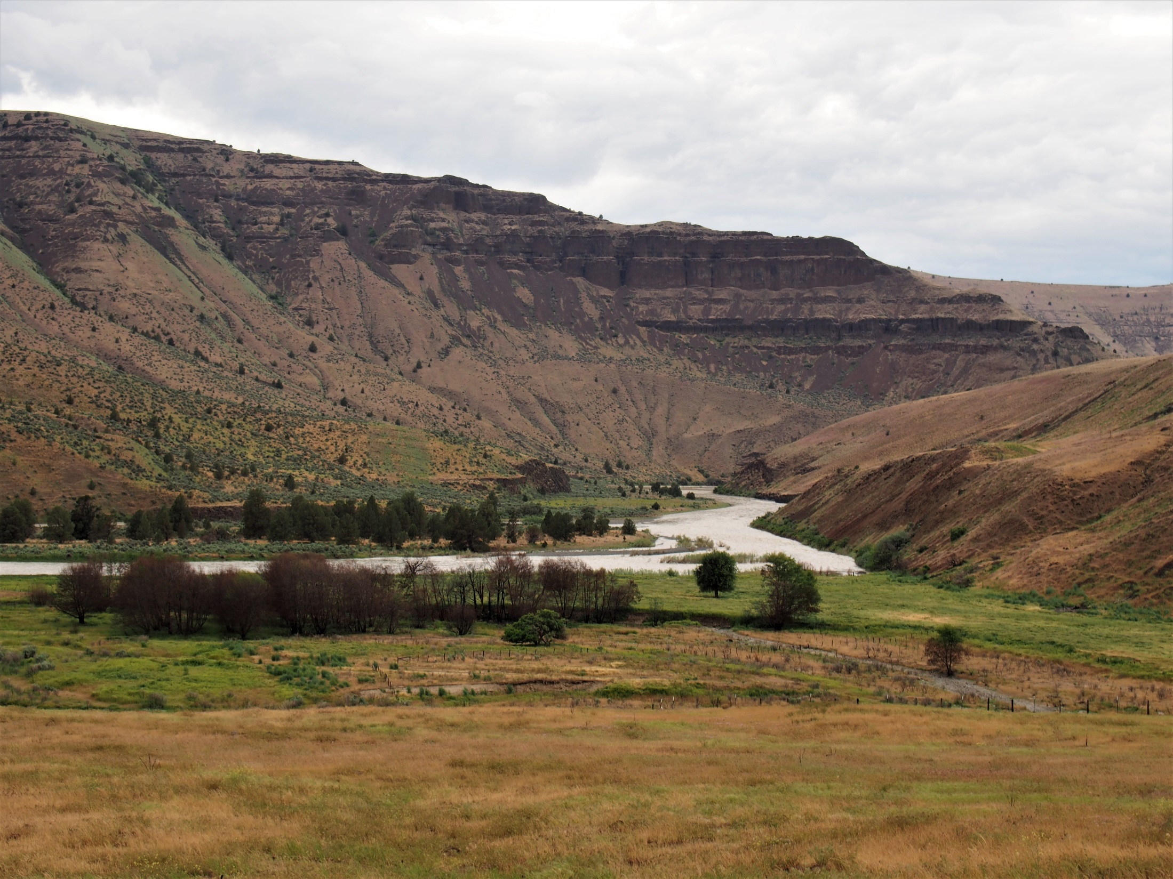
Questions?
lindsy.r.ciepiela@odfw.oregon.gov elizabeth.j.blackburn@odfw.oregon.gov
Notes:
If the data point to
Can bass exclusion be a recovery strategy.

