Slide 1
Management of Interior Fraser Steelhead
Robert Bison, Biologist
Province of British Columbia
Ministry of Forests
Pacific States Marine Fisheries Commission
Pacific Coast Steelhead Management Meeting
Newport, Oregon, March 15, 2023
Session Four (Part 2 : Case Studies)

Slide 2
Outline
Basic Information
  Interior Fraser Steelhead
  Fisheries
  Current State
Fisheries Management and Steelhead Management in British Columbia
  Statutory Obligations
  Basic Goals, Objectives & Strategies
Analytic Approach and Data Used
Current Goals and Objectives, and Implied Harvest Control Rules
  How Decisions Are Made

Slide 3
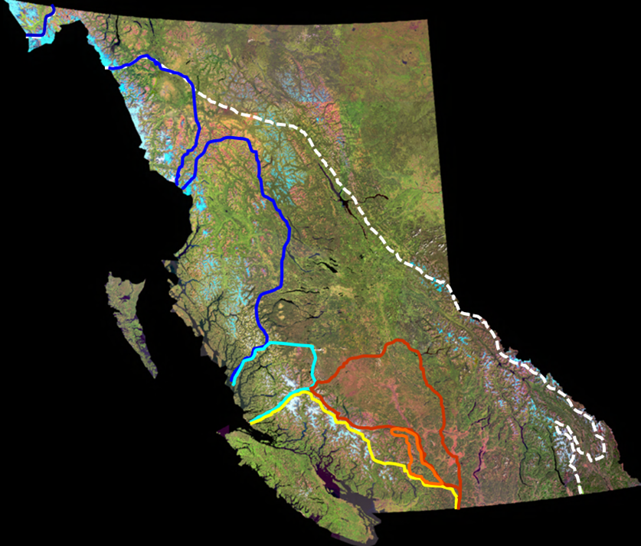
Interior Fraser Steelhead
South Interior MPG
Southern Transition

Slide 4
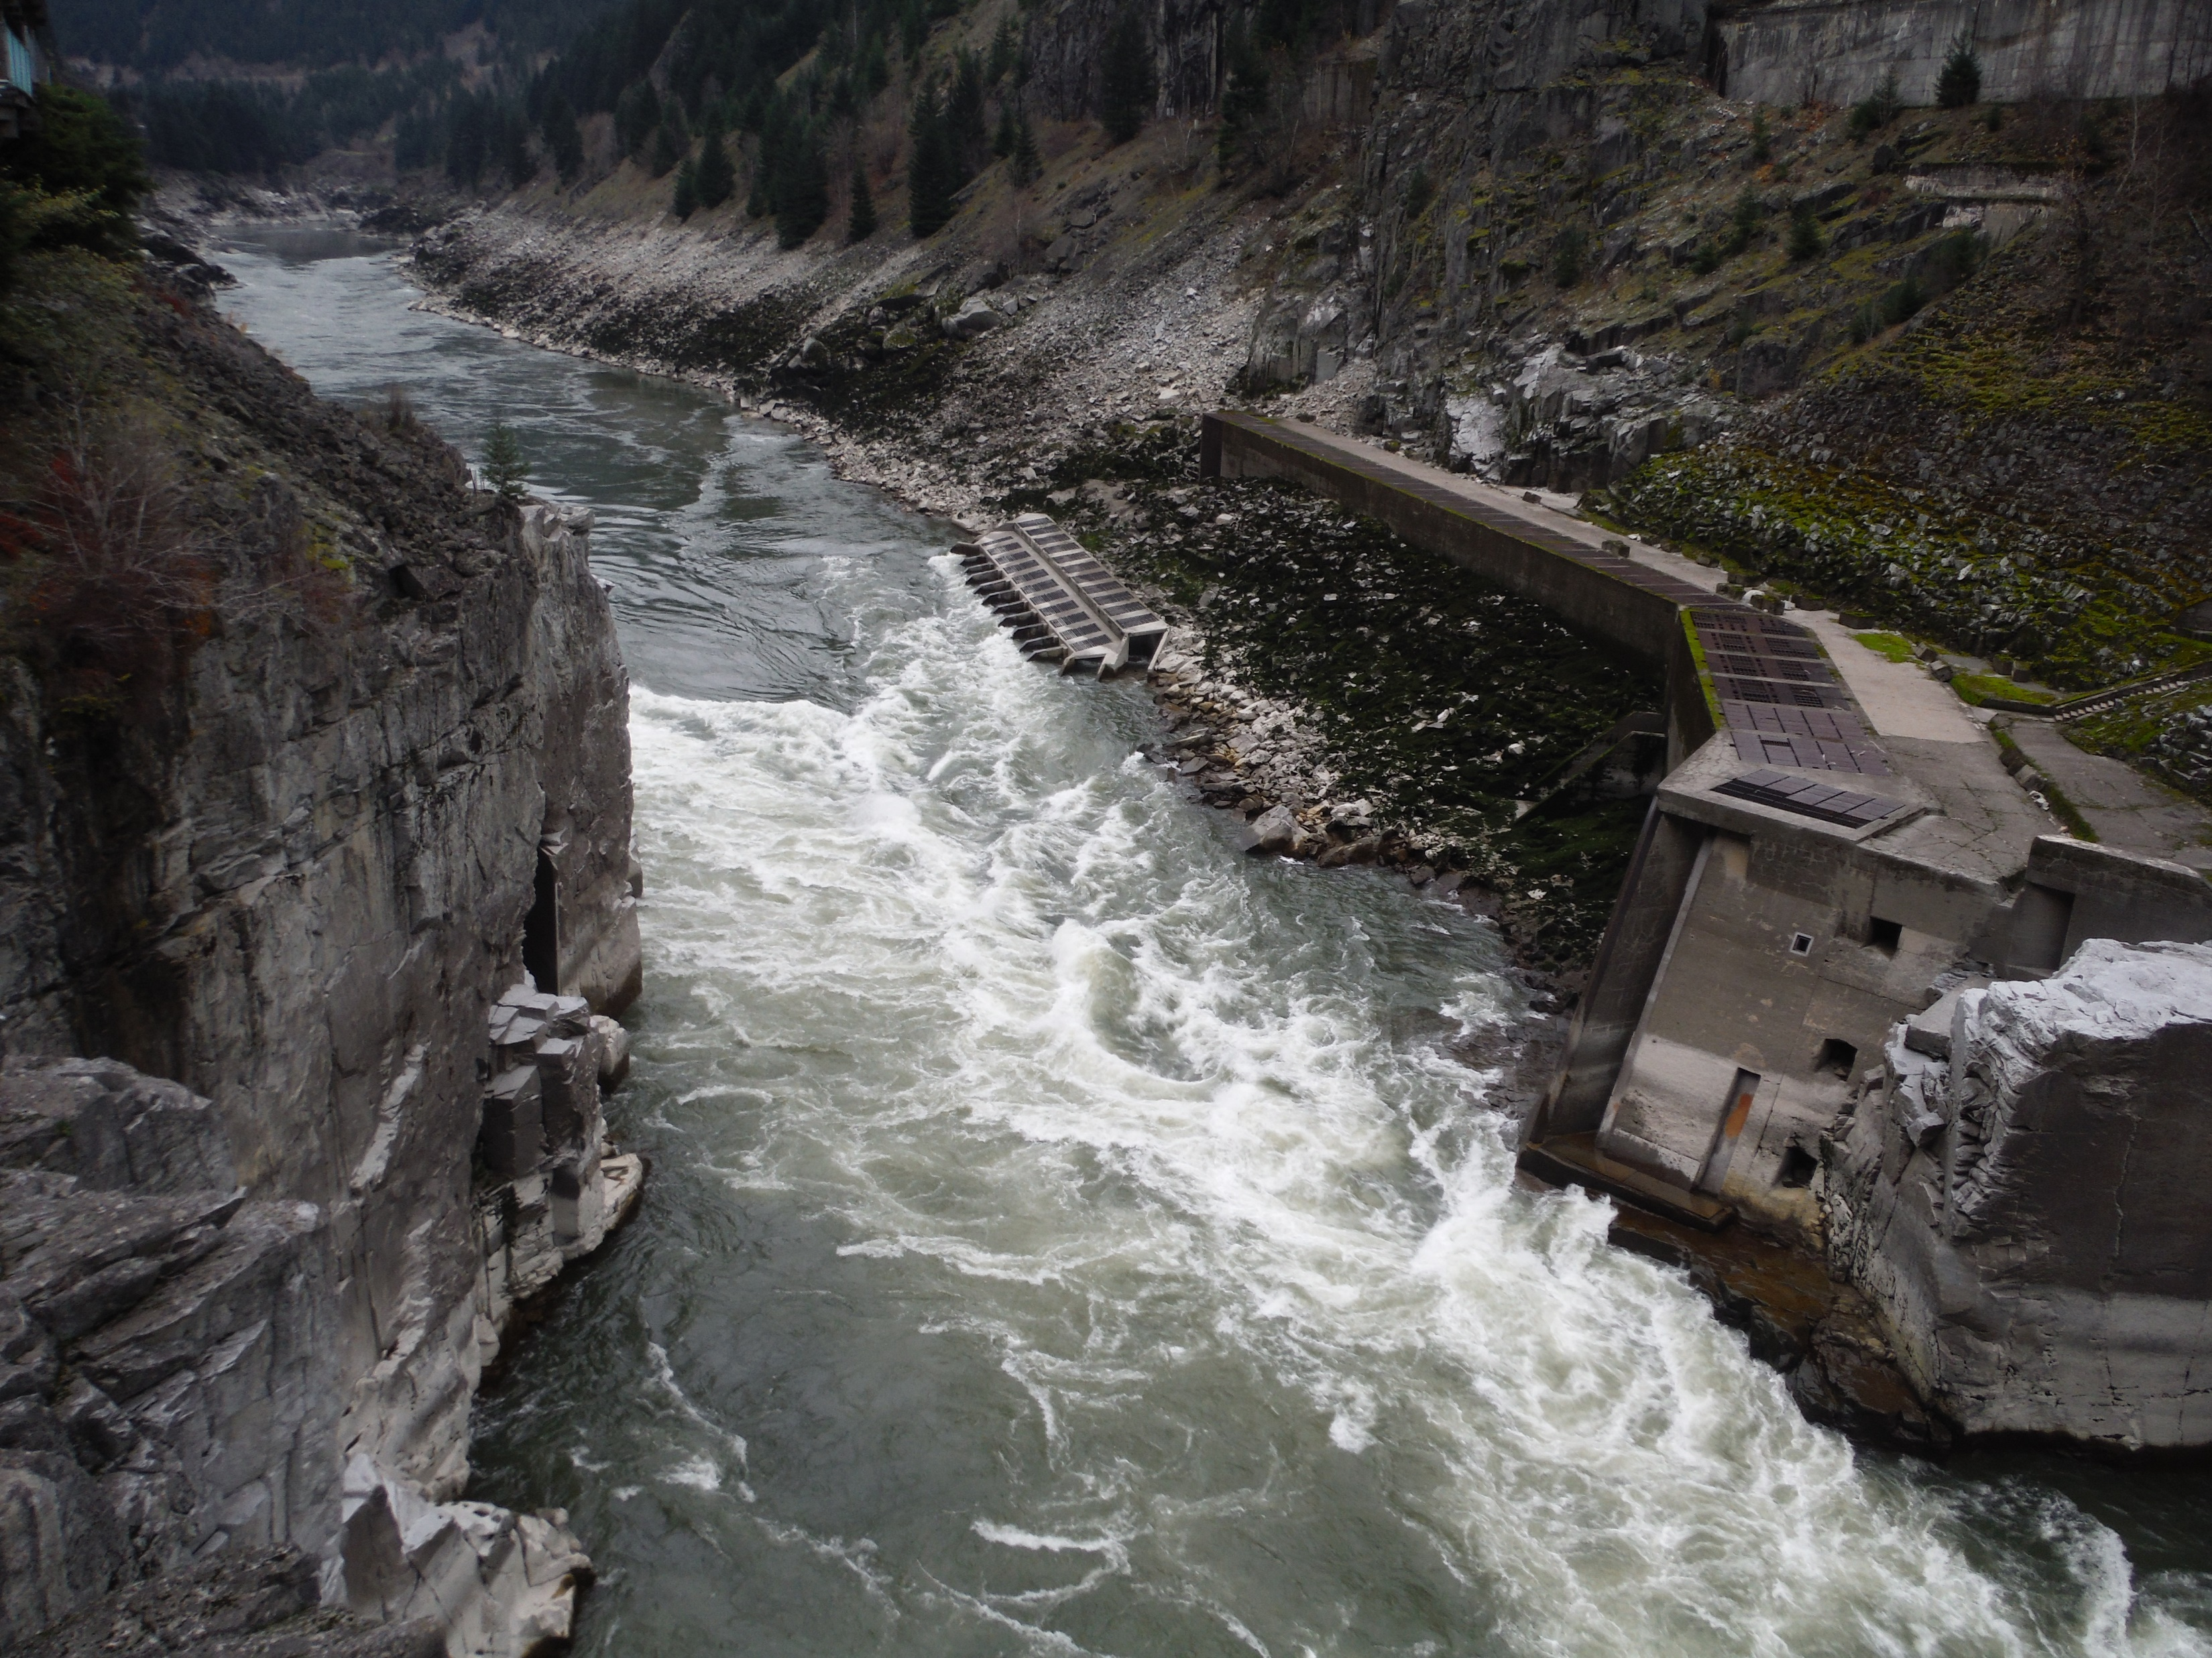
Hell’s Gate. Photo: Piotr Forysinski

Slide 5
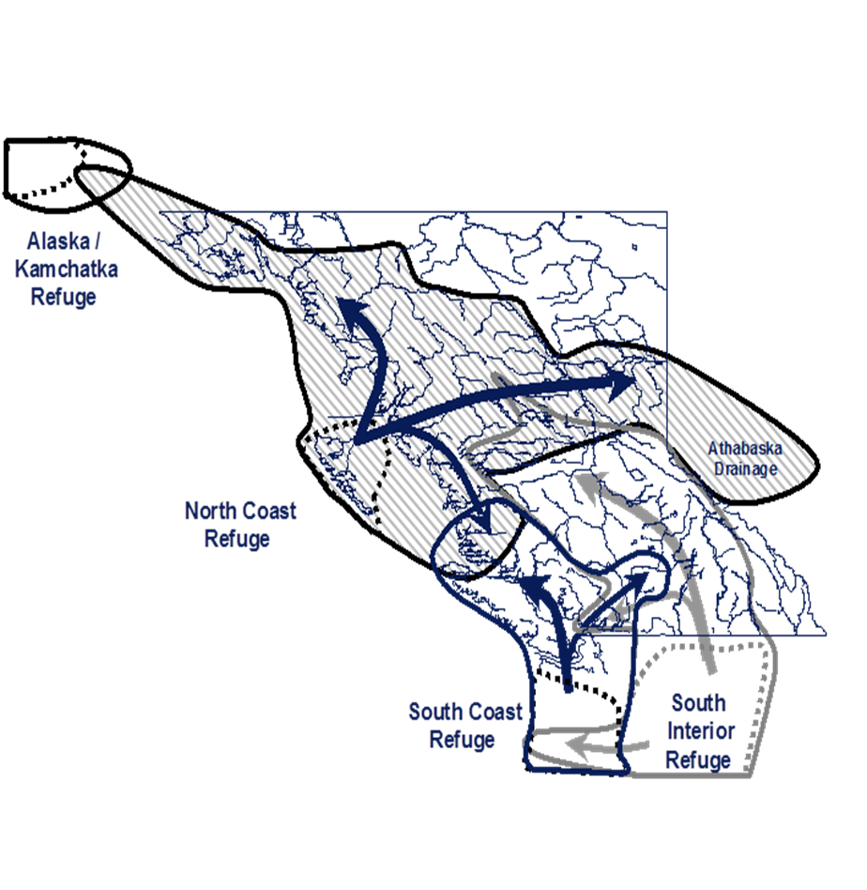
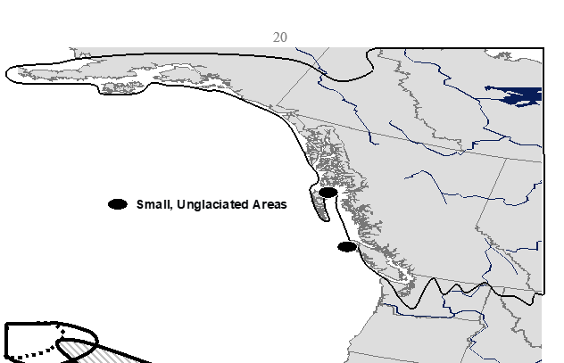
History of Interior Fraser Steelhead
Last Glaciation
60,000-15,000 YBP
Refugia and Recolonization

Slide 6
Basic Information
Mainly 2 and 3 year smolts
Mainly 2+ years in marine, subcomponent of 3+
10 spatially discrete spawning populations
Late-summer run
  early -> migrate furthest inland, fastest, smallest
  mid -> intermediate, large
  late -> migrate least furthest inland, largest
Pre-fishery abundance magnitude is 10⁴ when survival conditions are favourable. Currently 10².
Hatchery stocked at low rates from 1979 to 1995.
Material Fisheries
  Salmon Purse Seine (bycatch)
  Salmon Gillnet (bycatch)
  Salmon In-River drift and set gillnet (bycatch)
  Sport (target, closed)
  First Nation (target, closed)
Notes:
Front of the steelhead run overlaps with late-run Fraser sockeye and Fraser pink salmon which are predominantly harvested with gillnets and purse seines
The mid and back of the steelhead run overlaps with southern BC and Fraser chum salmon which are also…….

Slide 7
Recent Exploitation Rates
Thompson
Notes:
As best we could determine them.

Slide 8
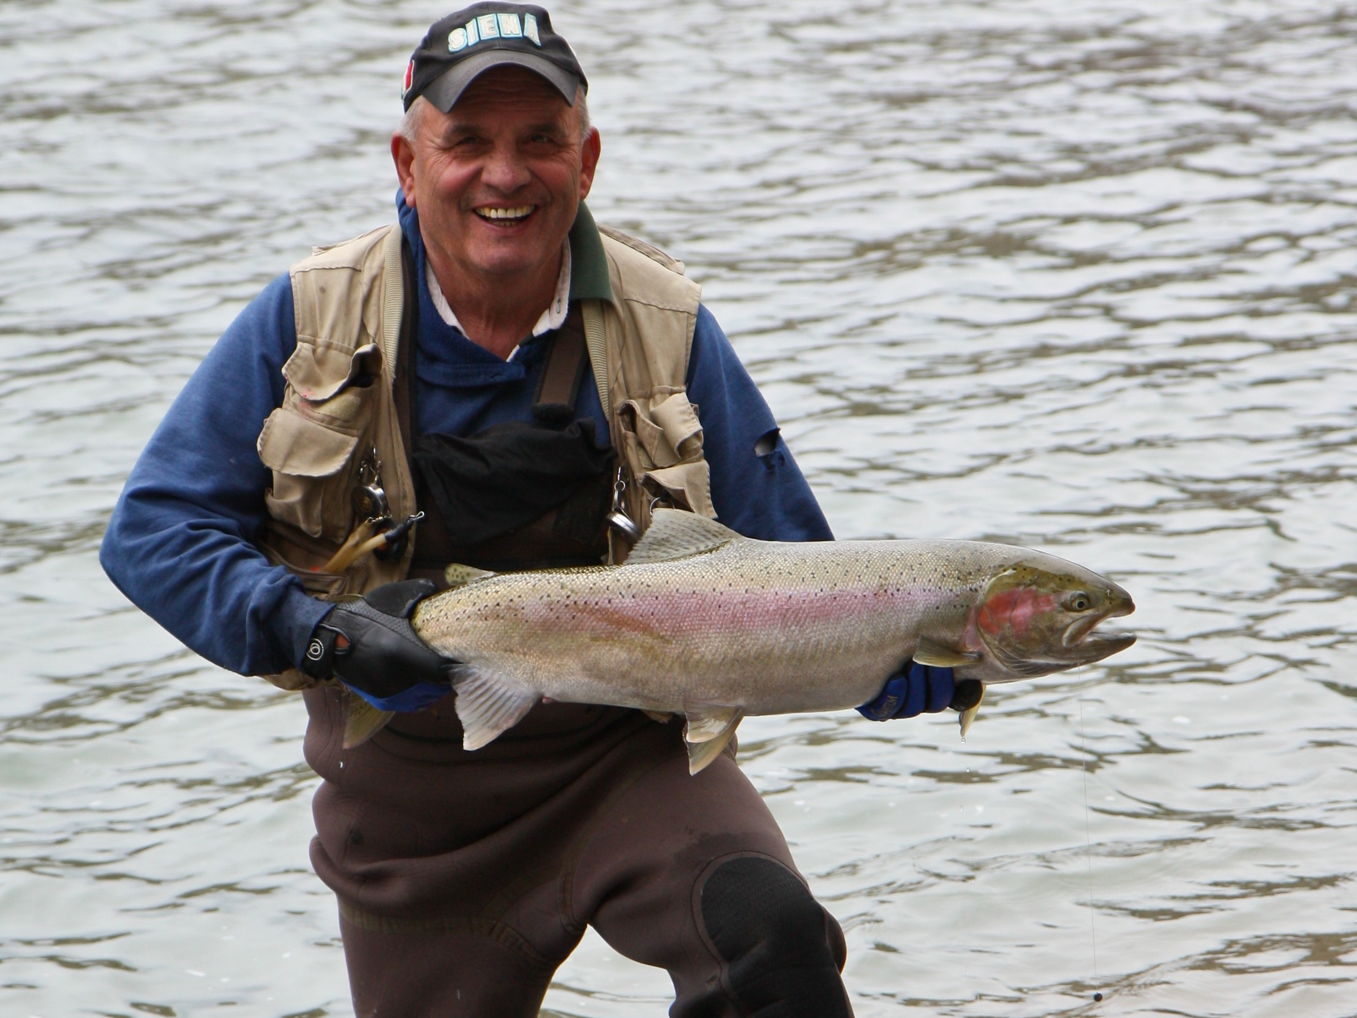
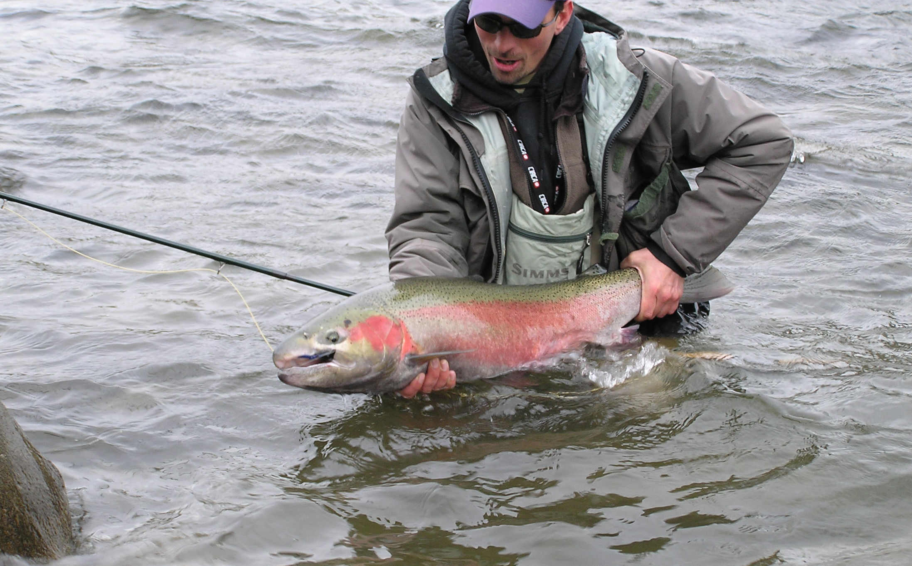
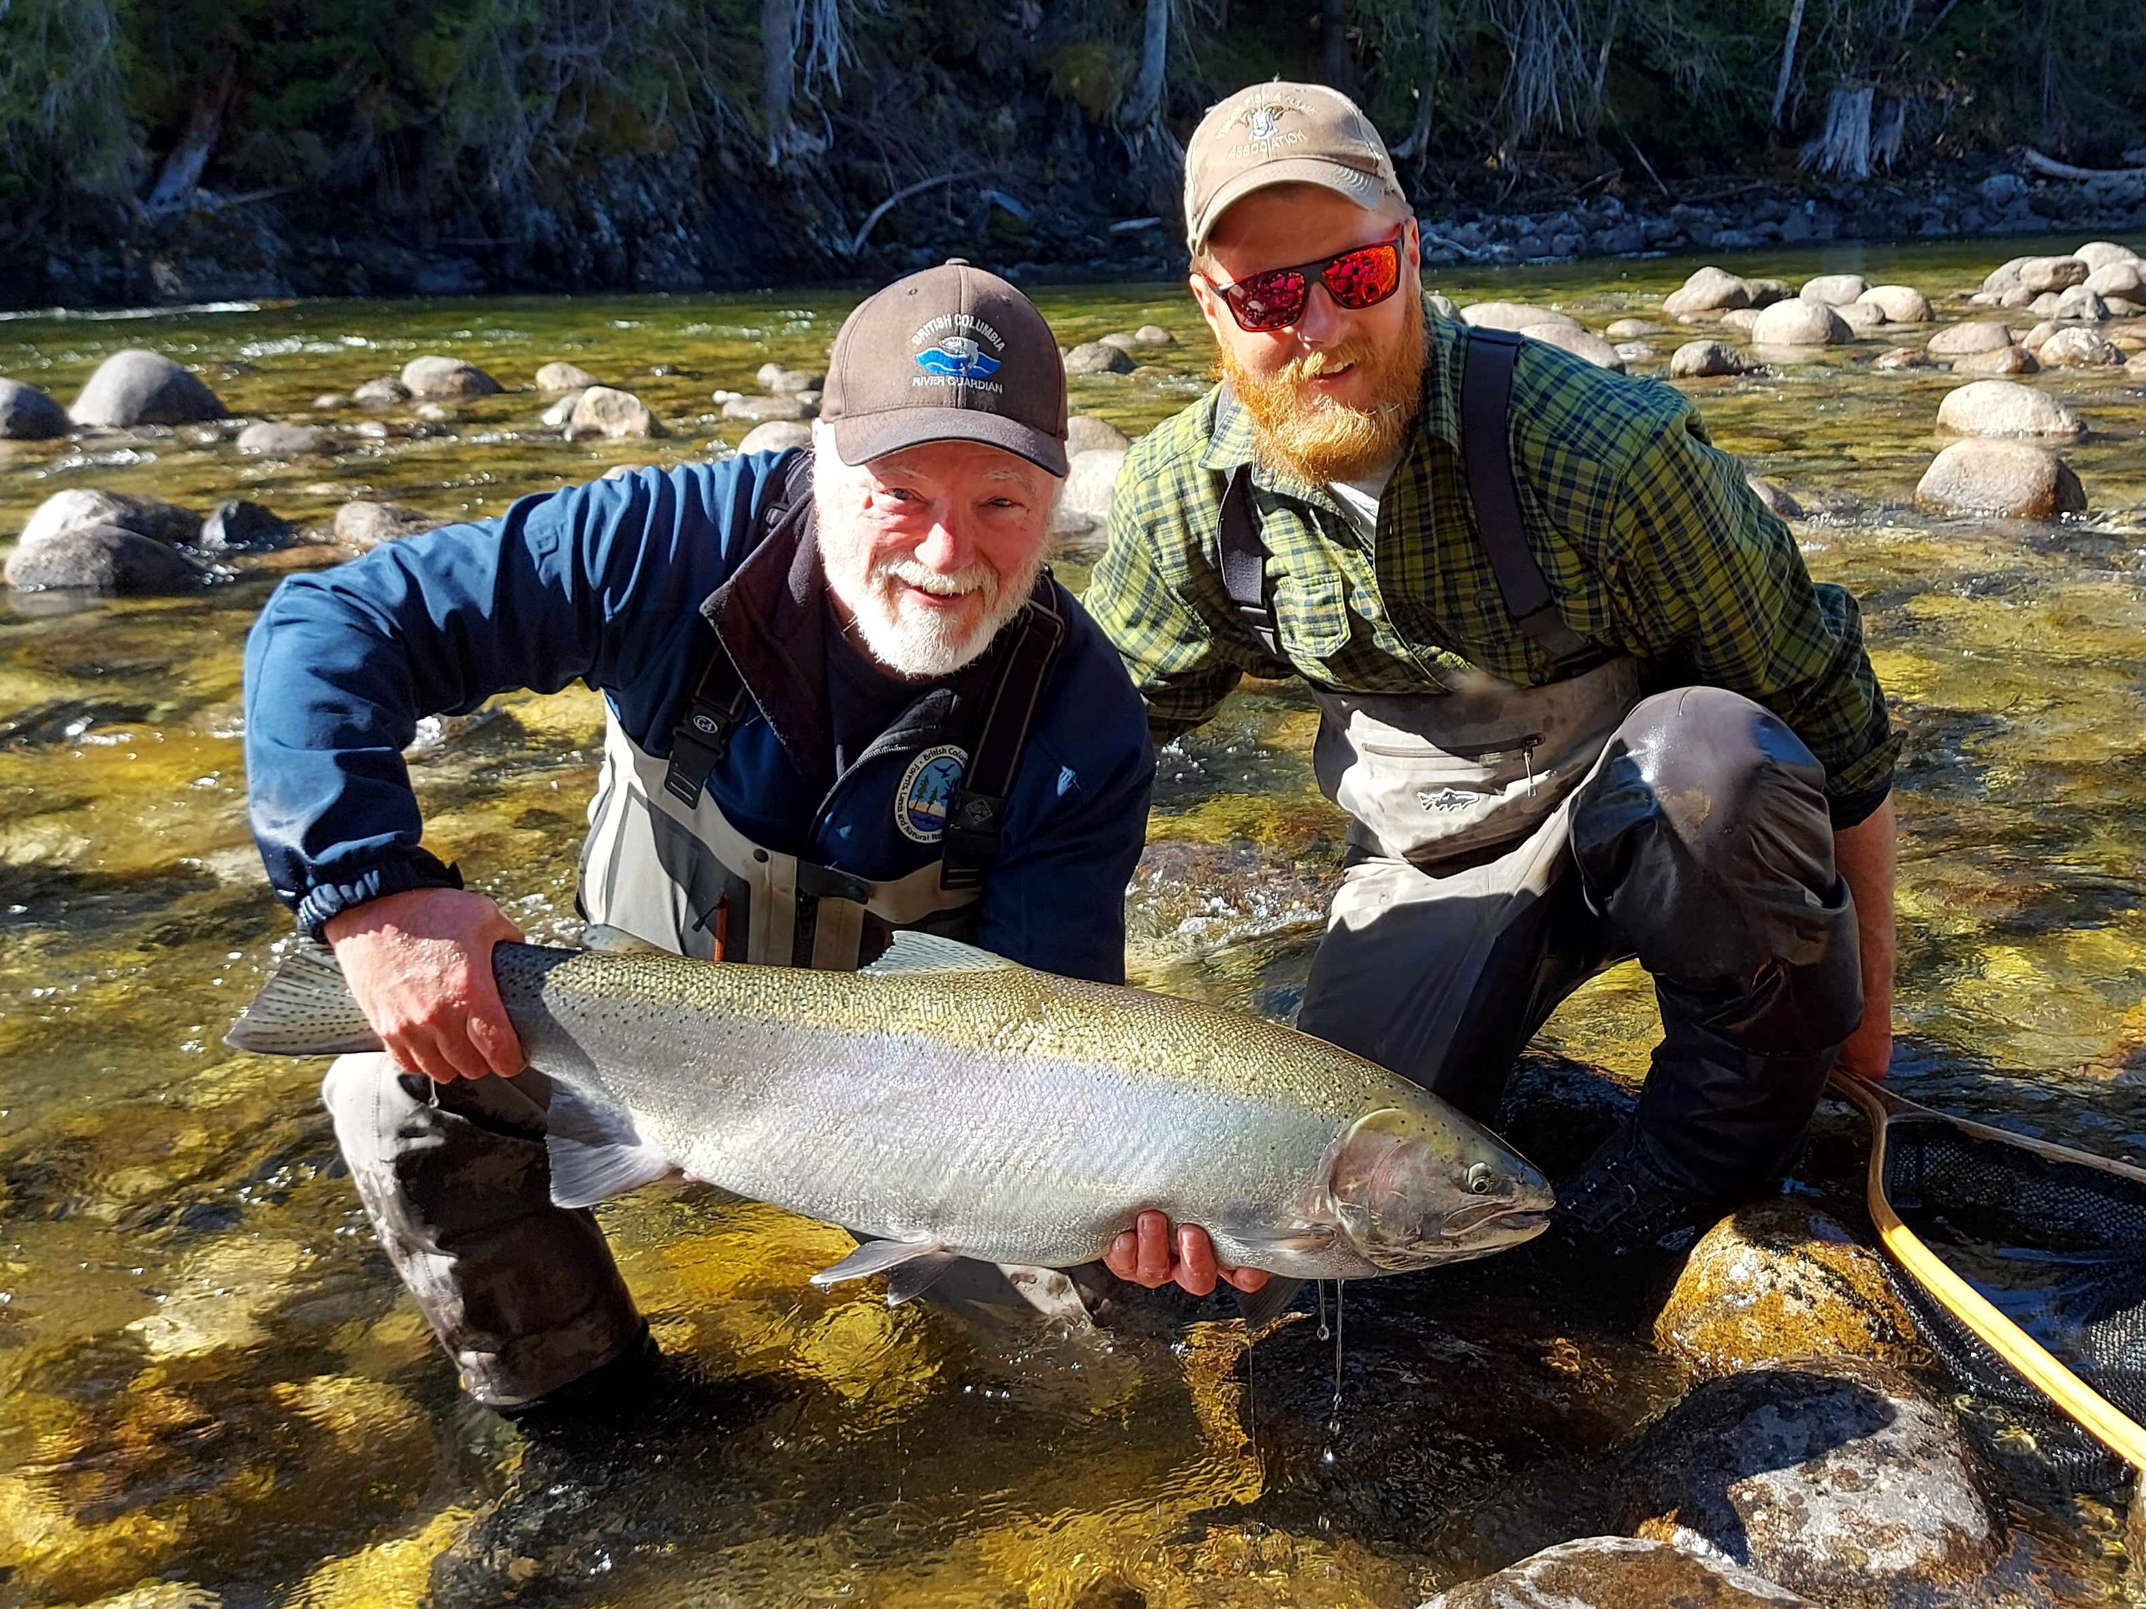
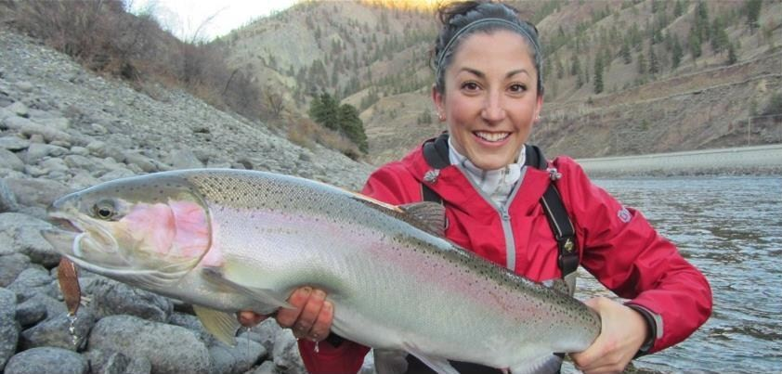

Slide 9
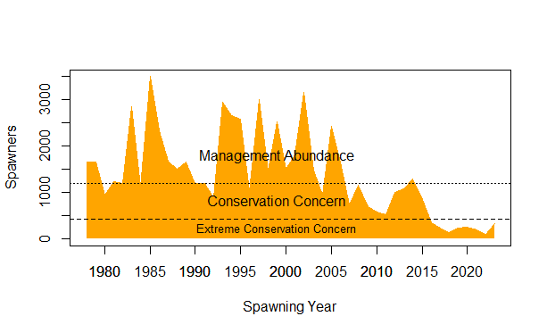
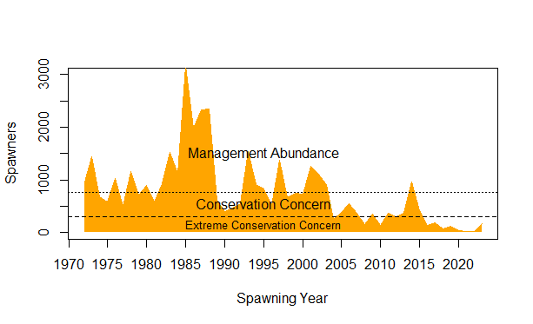
Where are we now?
Thompson DU
Chilcotin DU
Notes:
Classed as ECC.
Not listed under SARA.

Slide 10

Thompson
$$R=Se^{(a+bS+cC)}$$
Results for brood years 1978 to 2012
Model | a | b | covariate coefficient | r2 | p | Delta AICc | Support
Adult Predation | 1.66 | -0.619 | -0.71 | 0.51 | 0.000013 | 0.0 | strong
Smolt Predation | 1.43 | -0.553 | -0.65 | 0.46 | 0.000048 | 3.3 | moderate
Salmon Competition (sockeye pink and chum biomass) | 1.44 | -0.533 | -0.66 | 0.34 | 0.001146 | 7.5 | weak
Salmon Competition/Offshore Conditions (max weight) | 1.32 | -0.515 | 0.53 | 0.43 | 0.000125 | 8.9 | weak
Salmon Competition (sockeye and pink biomass) | 1.50 | -0.606 | -0.52 | 0.12 | 0.136749 | 11.2 | weak
Base | 1.14 | -0.498 | na | -0.06 | na | 12.9 | weak
Ocean Conditions (PDO) | 1.12 | -0.494 | 0.16 | 0.04 | 0.530429 | 14.6 | weak
Freshwater Conditions (Summer low flow affecting fry) | 1.13 | -0.496 | 0.13 | -0.01 | 0.484268 | 14.8 | weak
Freshwater Conditions (Summer low flow affecting parr) | 1.04 | -0.441 | 0.13 | -0.04 | na | 14.9 | weak
Freshwater Conditions (Winter high flow affecting fry). | 1.14 | -0.501 | 0.05 | -0.05 | na | 15.4 | weak

Slide 11

Chilcotin
$$R=Se^{(a+bS+cC)}$$
Results for brood years 1978 to 2011
Model | a | b | covariate coefficient | r2 | p | Delta AICc | Support
Smolt Predation | 1.53 | -1.022 | -0.89 | 0.77 | <0.00001 | 0.0 | strong
Adult Predation | 1.70 | -1.076 | -0.88 | 0.79 | <0.00001 | 0.9 | strong
Salmon Competition (sockeye pink and chum biomass) | 1.46 | -0.921 | -0.84 | 0.58 | <0.00001 | 7.0 | moderate
Salmon Competition/Offshore Conditions (max weight) | 1.01 | -0.659 | 0.48 | 0.55 | <0.00001 | 11.5 | weak
Salmon Competition (sockeye and pink biomass) | 1.15 | -0.732 | -0.56 | 0.26 | 0.009323 | 11.7 | weak
Base | 0.86 | -0.647 | na | 0.00 | 0.701099 | 13.6 | weak
Freshwater Conditions (Summer low flow affecting parr) | 0.75 | -0.523 | 0.28 | 0.19 | 0.035848 | 13.8 | weak
Ocean Conditions (PDO) | 0.82 | -0.615 | 0.21 | 0.15 | 0.086853 | 14.7 | weak
Freshwater Conditions (Summer low flow affecting fry) | 0.82 | -0.599 | 0.15 | 0.06 | 0.361684 | 15.5 | weak
Freshwater Conditions (Winter high flow affecting fry). | 0.83 | -0.624 | 0.09 | 0.05 | 0.475922 | 15.9 | weak

Slide 12
Fisheries Management in British Columbia
Statutory obligation to conserve native steelhead is Federal
  Constitution Act – jurisdiction over “Sea Coast and Inland Fisheries
  Fisheries Act – protection and sustainable use of fisheries resources and their habitat
    Wild Salmon Policy – defines CU’s
      Intended to be applicable to Steelhead and Cutthroat
      Aims to maintain CU’s, but the Minister can limit the range of conservation measures
  Species at Risk Act (SARA)
    Part of Canada’s commitment to the International Convention on Biological Diversity (1992)
    SARA “Wildlife Species” = CU’s
    Purposes
      to prevent wildlife species from being extirpated or becoming extinct,
      to provide for the recovery of wildlife species that are extirpated, endangered or threatened as a result of human activity
      to manage species of special concern to prevent them from becoming endangered or threatened.

Slide 13
Fisheries Management in British Columbia
Statutory obligation to provide angling opportunity for steelhead is delegated to a Provincial official (Director of Fish & Wildlife, Ministry of Forests)
Fisheries Act (1985)
Fishery (General) Regulations
Aboriginal Communal Fishing Licences Regulation
Marine Mammal Regulations
Variation Orders
BC Sport Fishing Regulations
Fishing in Non-Canadian Waters
Documents and Registration
ID of Fishing Vessels and Gear
General
Observers
Assisting Enforcement or Administration
Fishing for Experimental, Scientific,…
Release and Transfer of Live Fish
Authorization to Alter Habitat
Removal of Obstructions to Fsih
Penalties and Forfeitures Proceeds
Ticketable Offences
Fish Stocks
Director of
Fish & Wildlife
Ministry of Forests
Time, quota, limit Non-tidal waters
Any species other than salmon

Slide 14
Fisheries Management in British Columbia
Statutory obligation to provide salmon fishing opportunity is Federal
Fisheries Act (1985)
Fishery (General) Regulations
Aboriginal Communal Fishing Licences Regulation
Marine Mammal Regulations
Variation Orders
BC Sport Fishing Regulations
Fishing in Non-Canadian Waters
Documents and Registration
ID of Fishing Vessels and Gear
General
Observers
Assisting Enforcement or Administration
Fishing for Experimental, Scientific,…
Release and Transfer of Live Fish
Authorization to Alter Habitat
Removal of Obstructions to Fsih
Penalties and Forfeitures Proceeds
Ticketable Offences
Fish Stocks
Director of
Fish & Wildlife
Ministry of Forests
Time, quota, limit Non-tidal waters
Any species other than salmon

Slide 15
Provincial Statutes for
Fisheries Management and Conservation
Wildlife Act (2016)
Angling and Scientific Collection Regulation
Permit Regulation
Rainbow Trout Ponds
Angling Guide Licencing and Limits
Species Licencing
Angling Licencing
Collection Permits
Section 6
Designation of threatened or endangered species
Part 3 Habitat Conservation Trust
…excluding freshwater habitat protection statutes.
Notes:
Not including habitat protection statutes, which include:
Riparian Protection
Forest and Range Practices Act (BC), Riparian Management Zones
Fish Protection Act (BC), Section 12, Riparian Areas Protection Regulation (urban)
Other
Forest and Range Practices Act (BC)
Fishery Sensitive Watershed
Temperature Sensitive Stream
Wildlife Habitat Area

Slide 16
Freshwater Fisheries Management in British Columbia
Conservation takes priority
  BC Freshwater Fisheries Program Plan (2007)
    Aim - A naturally rich and sustainable freshwater fish resource supporting diverse uses for all British Columbians.
    Goals
      Establish governance approaches that are strategic, effective and efficient
      Conserve wild fish and their habitats
      Optimize recreational opportunities based on the fishery resource

Slide 17
Provincial Framework for Steelhead Management in British Columbia (2016)
Goal
  To ensure the abundance of wild steelhead populations at levels that will produce societal benefits now and for future generations of British Columbians.
Objectives
  Maintain sustainable recreational angling opportunity
  Maintain, protect, and restore the productive capacity of steelhead stocks

Slide 18
Provincial Framework for Steelhead Management in British Columbia (2016)
Strategies
  Abundance based management (ECC, CC, RM)
  Precautionary small stock policy
  Catch & release of wild steelhead
  Administer wild stock sport fisheries in a careful and responsible manner
  Support bycatch mortality reduction
  Hatcheries where stock conservation risks are low and expected societal benefits high (Steelhead Stream Classification Policy, 2005)
  Manage angler use when and where it is beneficial to do so.
  Precautionary approach to address environmental uncertainty
  Support environmental regulation to conserve productive capacity
Notes:
On strategy 9,

Slide 19
Analytic Approach and Data Used

Slide 20
Approach and Tools for Managing Exploitation of Interior Fraser Steelhead
Data (time series) and Estimates | How/Tools | Who
Spawners | Resistivity counter data interpretation Arrival departure models Peak count extrapolation | F&W F&W F&W and FN
Mortalities in FN | Field surveys Self report NA | F&W FN F&W
Mortalities in Sport | Field surveys | F&W
Exploitation Rate in bycatch fisheries | Box-car model Field surveys | F&W and DFO and PSC
Pre-fishery Abundance |  | F&W
Age Composition | Scale analysis | F&W
Recruits | Adult Parr | F&W F&W
Stock Recruitment Analysis | Time invariant parameters -> reference points Time varying parameters Covariates (causal hypotheses) | F&W F&W F&W and DFO
Conservation N Reference Points and N Status | Simulation modeling Peer review Reference point estimation N status in-season N status post-season and status monitoring | F&W (UBC) F&W and DFO F&W F&W F&W
Analytic Approach
Management Action | Sport fishery management (application of BC Framework) | F&W
Management Influence | Salmon fishery management FN fisheries targeting steelhead | Province -> DFO F&W -> FN

Slide 21
Noteworthy Overall Challenges
Data (time series) and Estimates | How/Tools | Who
Spawners | Resistivity counter data interpretation Arrival departure models Peak count extrapolation | F&W F&W F&W and FN
Mortalities in FN | Field surveys Self report NA | F&W FN F&W
Mortalities in Sport | Field surveys | F&W
Exploitation Rate in bycatch fisheries | Box-car model Field surveys | F&W and DFO and PSC
Pre-fishery Abundance |  | F&W
Age Composition | Scale analysis | F&W
Recruits | Adult Parr | F&W F&W
Stock Recruitment Analysis | Time invariant parameters -> reference points Time varying parameters Covariates (causal hypotheses) | F&W F&W F&W and DFO
Conservation N Reference Points and N Status | Simulation modeling Peer review Reference point estimation N status in-season N status post-season and status monitoring | F&W (UBC) F&W and DFO F&W F&W F&W
Analytic Approach
Management Action | Sport fishery management (application of BC Framework) | F&W
Management Influence | Salmon fishery management FN fisheries targeting steelhead | Province -> DFO F&W -> FN

Slide 22
Recent or Emerging Challenges
Data (time series) and Estimates | How/Tools | Who
Spawners | Resistivity counter data interpretation Arrival departure models Peak count extrapolation | F&W F&W F&W and FN
Mortalities in FN | Field surveys Self report NA | F&W FN F&W
Mortalities in Sport | Field surveys | F&W
Exploitation Rate in bycatch fisheries | Box-car model Field Surveys | F&W and DFO and PSC
Pre-fishery Abundance |  | F&W
Age Composition | Scale analysis | F&W
Recruits | Adult Parr | F&W F&W
Stock Recruitment Analysis | Time invariant parameters -> reference points Time varying parameters Covariates (causal hypotheses) | F&W F&W F&W and DFO
Conservation N Reference Points and N Status | Simulation modeling Peer review Reference point estimation N status in-season N status post-season and status monitoring | F&W (UBC) F&W and DFO F&W F&W F&W
Analytic Approach
Management Action | Sport fishery management (application of BC Framework) | F&W
Management Influence | Salmon fishery management FN fisheries targeting steelhead | Province -> DFO F&W -> FN

Slide 23
Current Goals and Objectives
International - Pacific Salmon Treaty (2022) Article IX: Steelhead
  In fulfilling their functions, the Panels and Commission shall take into account the conservation of steelhead
Federal - Draft IFMP, Salmon, Southern BC (2023)
  DFO will protect IFR Steelhead from incidental fishing mortality occurring in salmon fisheries using the window closure approach implemented since 2019, with additional restrictions applied to set gill net fisheries in the Fraser River.
  The closure window for commercial gill net and seine fisheries (including purse seine, beach seine, and shallow seine gear) is 42 days, while commercial troll fisheries will be closed for 27 days.
  First Nations’ Food, Social, and Ceremonial (FSC) salmon fisheries occurring within the Fraser River mainstem downstream of Thompson and Chilcotin River Steelhead spawning areas are closed for a 27-day moving window.
Provincial Framework for Steelhead Management in BC (2016)
  1. Maintain a diversity of sustainable recreational angling opportunities for steelhead in British Columbia.
    Chilcotin Sport Fishery closed since 2008
    Thompson and remaining Interior Fraser sport fisheries closed since 2018.
  2. Maintain, protect and restore the productive capacity of the freshwater environment to produce steelhead
Notes:
PST – Not applicable
Federal – Harvest Control Rule is a maximum fixed exploitation rate objective (percent unprotected)
Implemented by DFO unilaterally.
Provincial – Harvest Control Rule is a fixed exploitation rate objective of C&R only, unless the stock is classed as ECC, then C&R is closed.
FN Target Fisheries – Declared closed.

Slide 24
Example of a Protection Window
Fraser River, Port Mann to Mission
First Nations Food, Social,
and Ceremonial
Commercial gill net and
seine fisheries
52% Unprotected
32% Unprotected
Notes:
Evaluation possible with simulation of exposure of run to fishing schedules, but an exposure reference point is not available.
Estimation of exploitation rate in salmon fisheries remains a challenge.
A recovery assessment recommendation (2019) was to reduce exploitation as much as possible (near zero) in order to maximize chances of stemming further downward abundance decline, which implies large windows of protection (+- 2SD) from salmon fisheries using gillnet and purse seine, driftnet and set net fisheries.

Slide 25
How Decisions Are Made
Federal
  Opportunity to fish outside of window closures is subject to in-season status of the target salmon species.
Provincial – C&R Sport Fishery
  Based on inseason N status (test fishery based spawner forecasts)
    Closed-until-open and open-until-closed.
  Chilcotin closed since 2008
  Thompson and other IFS fisheries closed since 2018
  Very limited experience opening C&R to date.
Interior First Nations
  By local councils.

Slide 26
End

