Slide 1
Steelhead Stock Status British Columbia
Robert Bison, Biologist
Province of British Columbia
Ministry of Forests
Pacific States Marine Fisheries Commission
Pacific Coast Steelhead Management Meeting
Newport, Oregon, March 14, 2023

Slide 2
Outline
Zoogeographical Orientation
Southern BC
Sport fishery statistics
Fishery independent abundance monitoring
Northern BC
Sport fishery statistics
Fishery independent monitoring
Update on SARA (ESA) Listings
Summary of Abundance Status

Slide 3
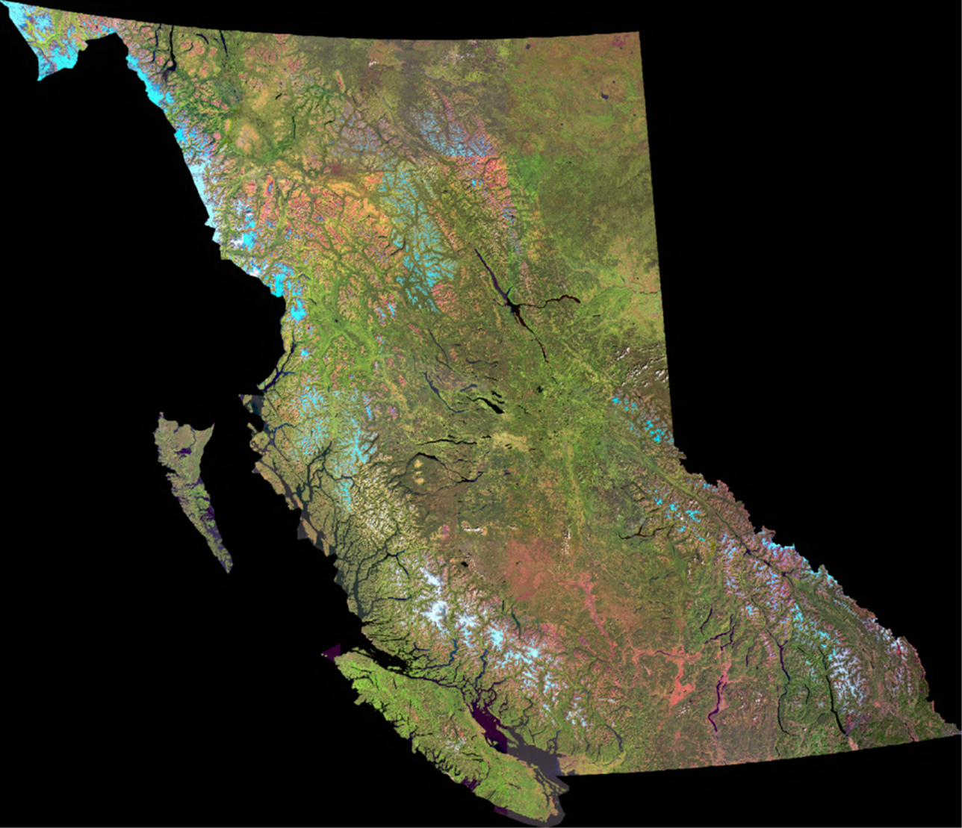
Native Range of O. mykiss in British Columbia
Notes:
The stocks can be grouped according to their ancestral lineages as evidence by molecular genetic studies. Generally these groups reflect the most recent glacial refugia, specifically, the southern coastal refuge (South Coast major phylogenetic group or South Coast MPG), the Columbia refuge (South Interior MPG), and the Queen Charlotte Island refuge (North Coast MPG). Among these three groups there are two “transition” groups that reflect post glacial genetic mixing between the MPG’s (Parkinson 2005, McCusker 2000).
Note that molecular genetic studies indicate that Alsek stock may have been colonized from the Berring Refuge as is evidenced for steelhead and rainbow stocks from Alaska and Kamchatka (McCusker et al. 2000).
Dividing these 5 phylogenetic groups into run timing groups results in 9 groups.
Dividing these further into major drainages results in 27 CU’s.

Slide 4
North Coast MPG
South Interior MPG
Major phyologenetic groups of Steelhead
Northern Transition
South Coast MPG
Southern Transition
Notes:
The stocks can be grouped according to their ancestral lineages as evidence by molecular genetic studies. Generally these groups reflect the most recent glacial refugia, specifically, the southern coastal refuge (South Coast major phylogenetic group or South Coast MPG), the Columbia refuge (South Interior MPG), and the Queen Charlotte Island refuge (North Coast MPG). Among these three groups there are two “transition” groups that reflect post glacial genetic mixing between the MPG’s (Parkinson 2005, McCusker 2000).
Note that molecular genetic studies indicate that Alsek stock may have been colonized from the Berring Refuge as is evidenced for steelhead and rainbow stocks from Alaska and Kamchatka (McCusker et al. 2000).
Dividing these 5 phylogenetic groups into run timing groups results in 9 groups.
Dividing these further into major drainages results in 27 CU’s.

Slide 5
North Coast MPG
South Interior MPG
Northern Transition
South Coast MPG
Southern Transition
Notes:
The stocks can be grouped according to their ancestral lineages as evidence by molecular genetic studies. Generally these groups reflect the most recent glacial refugia, specifically, the southern coastal refuge (South Coast major phylogenetic group or South Coast MPG), the Columbia refuge (South Interior MPG), and the Queen Charlotte Island refuge (North Coast MPG). Among these three groups there are two “transition” groups that reflect post glacial genetic mixing between the MPG’s (Parkinson 2005, McCusker 2000).
Note that molecular genetic studies indicate that Alsek stock may have been colonized from the Berring Refuge as is evidenced for steelhead and rainbow stocks from Alaska and Kamchatka (McCusker et al. 2000).
Dividing these 5 phylogenetic groups into run timing groups results in 9 groups.
Dividing these further into major drainages results in 27 CU’s.

Slide 6
Southern British Columbia

Slide 7
Southern British Columbia
Note: Southern BC has about 220 Steelhead streams.

Slide 8
Southern British Columbia
Note: Southern BC has about 220 Steelhead streams.

Slide 9
Southern British Columbia

Slide 10
Southern British Columbia (224 populations)
Coastal Summers (41)
Interior Summers (10)
Winter Runs (173)
Pristine freshwater habitat

Slide 11
Southern British Columbia Stock & Recruitment

Slide 12
Southern British Columbia Stock & Recruitment

Slide 13
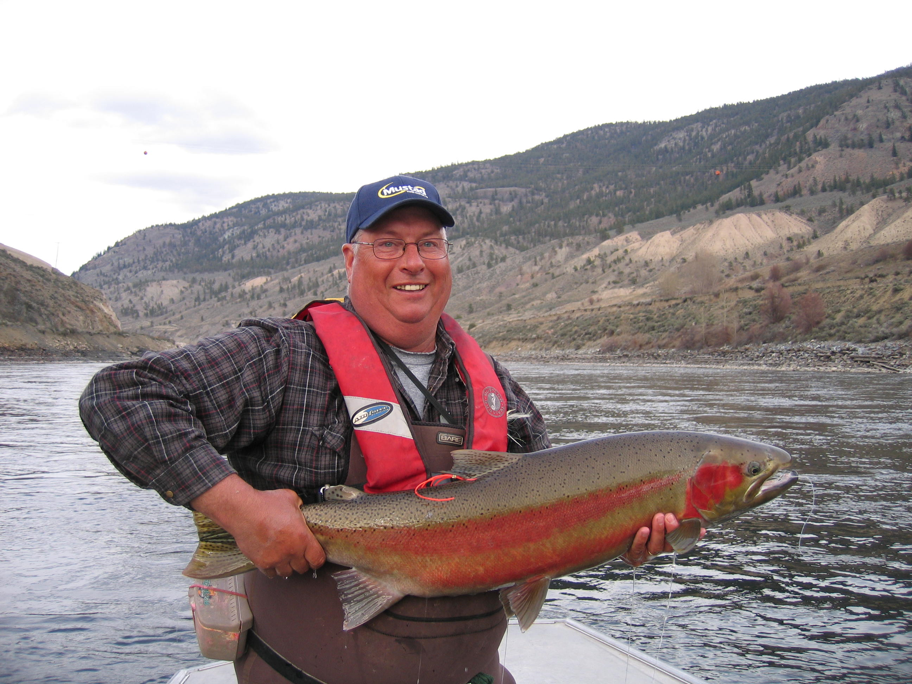
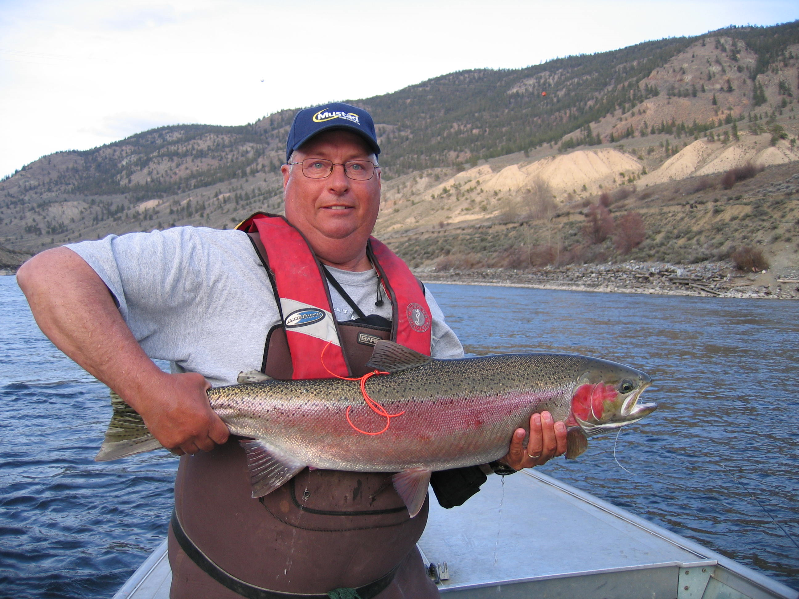
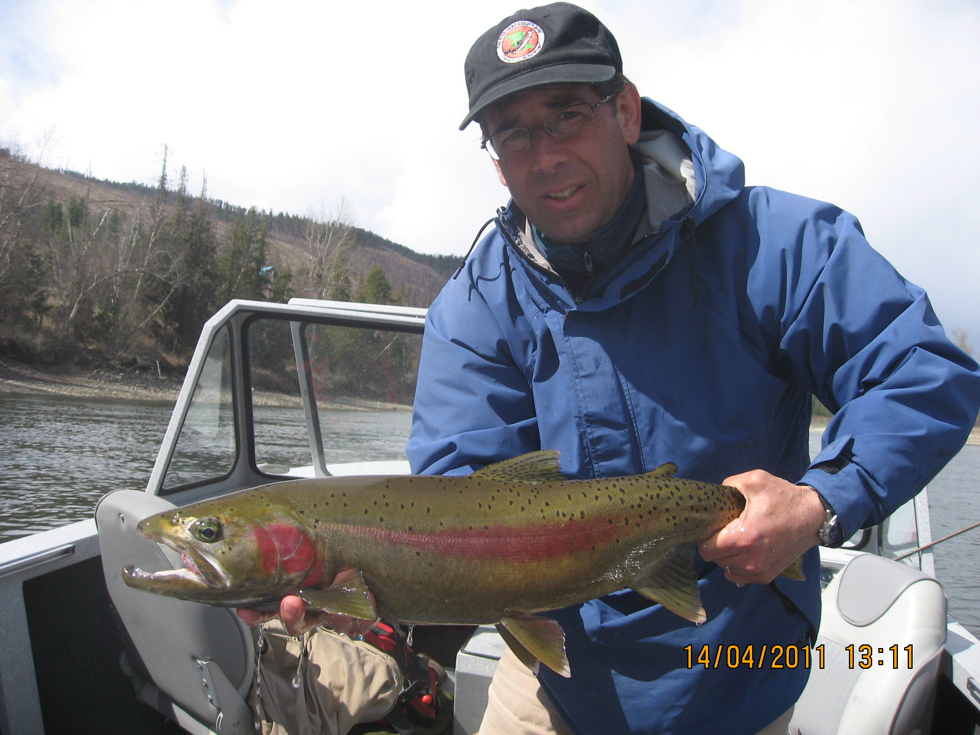
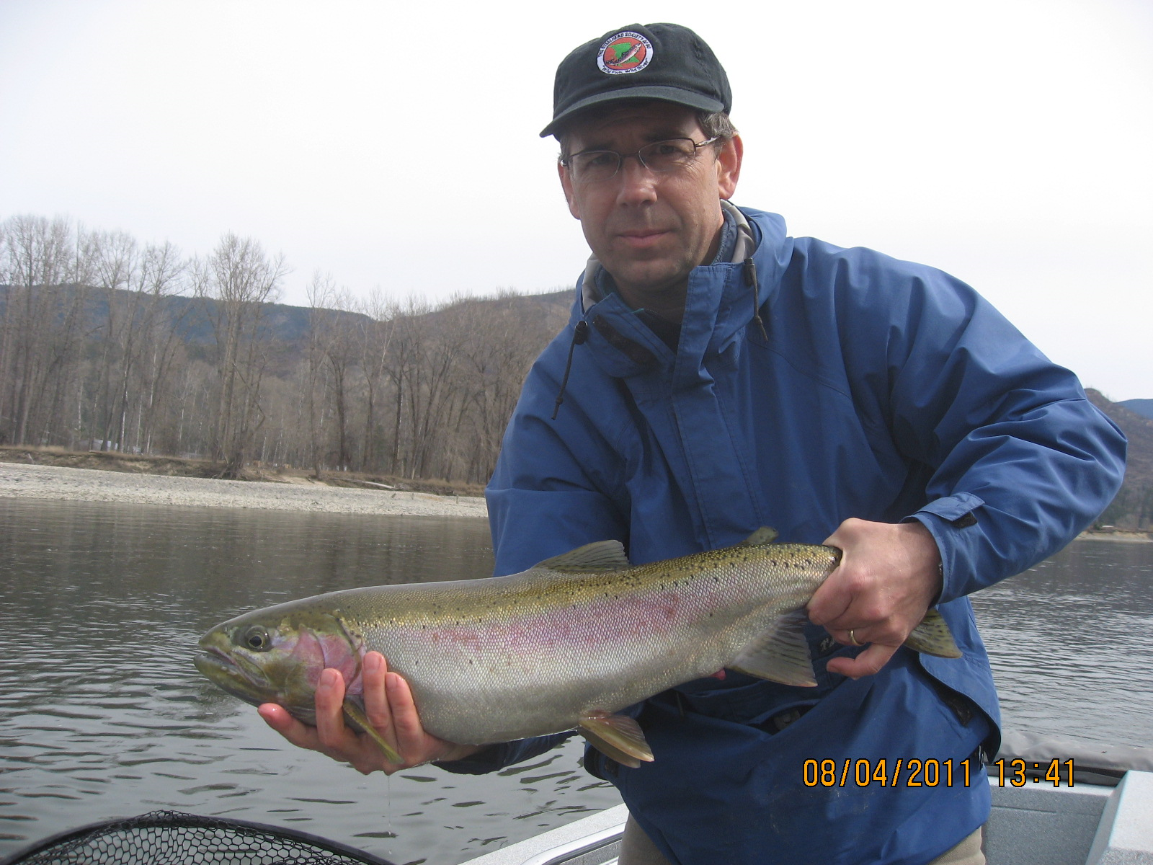
Thompson River Steelhead
Kamloops Lake Rainbow Trout

Slide 14
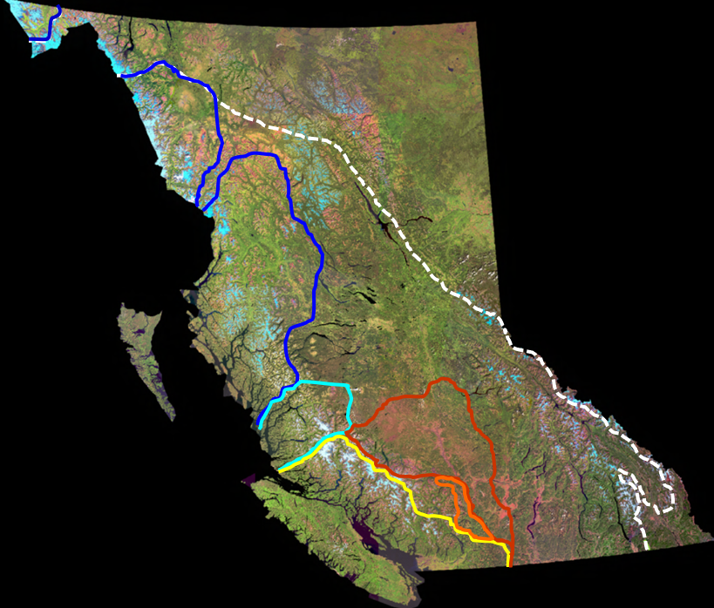
South Coast and South Interior Non-Anadromous wild O. mykiss
Population or Fishery | Status
Thompson River | Stable
Kamloops Lake | Stable
Shuswap Lake | Stable
Clearwater River/Lake | Stable
Chilko River | Stable
Blackwater River | Stable
Quesnel Lake | Stable
Okanagan Lake | Stable
Kettle/Granby Rivers | Stable
Kootenay Lake (Gerrard) | Increase decrease near historic minimum, parr stable

Slide 15
Northern British Columbia

Slide 16
Northern British Columbia
Northern BC has about 190 Steelhead streams.
Note: Northern BC has about 160 Steelhead streams.

Slide 17
Northern British Columbia
Northern BC has about 190 Steelhead streams.

Slide 18
Northern British Columbia

Slide 19
Northern British Columbia (195 populations)
Coastal Summers (6)
Interior Summers (45)
Winter Runs (144)

Slide 20
Skeena Summer Run

Slide 21
SARA (ESA) Listings
Two DU’s formally identified to date, Thompson DU and Chilcotin DU.
Both classified as Endangered (twice)
Neither listed to date.

Slide 22
Abundance Status Summary
Major Phylogenetic Group or Transition Group | Generalized Abundance Classification in 2022/23
North Coast MPG | Conservation Concern
Northern Transition | Conservation Concern or Routine Management
South Interior MPG | Extreme Conservation Concern
Southern Transition | Extreme Conservation Concern
South Coast MPG | Extreme Conservation Concern

Slide 23




Acknowledgements
Province of BC
Kenji Miyazaki
Joe De Gisi
Russell Bobrowski
Lee Williston
Michael McCulloch
Trevor Davies
Ron Ptolemy
Greg Andrusak

